Slide 1
A Causal Analysis of Organic Farming
on Ground Water Nitrate Levels
Alexander D. J. Sommer & Sophia N. K. Marangou | Applied Environmental Economics Seminar | 16.July 2026
Notes:
thanks for tuning in,
we are Alexander Sommer who is in the room with you, and I, Sophia Marangou, who has got the flu,
and we will share to you the current status of our project on the CAUSEL ANALYSIS….. OF …. NITRATE LEVELS

Slide 2
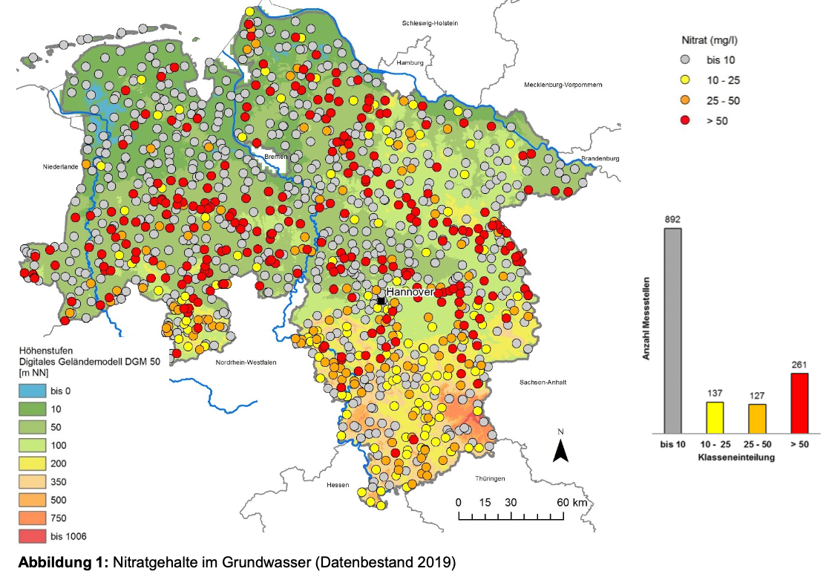
Introduction
Lower Saxony exhibits some of the highest groundwater nitrate concentrations in Germany
Many monitoring stations exceed the EU threshold of 50 mg/L
The region is characterized by intensive agricultural activity
Around 90% of nitrate pollution originates from agricultural fertilizer application
Quelle: NLWKN (2020), Grundwasserbericht Niedersachsen – Parameterblatt Nitrat.
Notes:
So according to the NLKWN Landesbetrieb für Wasserwirtschaft, Küsten- und Naturschutz, lower saxony exhibits

Slide 3
Introduction
Lower Saxony exhibits some of the highest groundwater nitrate concentrations in Germany
Many monitoring stations exceed the EU threshold of 50 mg/L
The region is characterized by intensive agricultural activity
Around 90% of nitrate pollution originates from agricultural fertilizer application
Quelle: NLWKN (2020), Grundwasserbericht Niedersachsen – Parameterblatt Nitrat.
Notes:
2. ….

Slide 4
Introduction
Lower Saxony exhibits some of the highest groundwater nitrate concentrations in Germany
Many monitoring stations exceed the EU threshold of 50 mg/L
The region is characterized by intensive agricultural activity
Around 90% of nitrate pollution originates from agricultural fertilizer application
Quelle: NLWKN (2020), Grundwasserbericht Niedersachsen – Parameterblatt Nitrat.
Notes:
3. … as we also saw on the ALKIS dataset cartographable visualization last time…

Slide 5
Introduction
Lower Saxony exhibits some of the highest groundwater nitrate concentrations in Germany
Many monitoring stations exceed the EU threshold of 50 mg/L
The region is characterized by intensive agricultural activity
Around 90% of nitrate pollution originates from agricultural fertilizer application
Quelle: NLWKN (2020), Grundwasserbericht Niedersachsen – Parameterblatt Nitrat.
Notes:
4. and still the matter of fact, also studied beyond this here, ….

Slide 6
Research Question
“Does organic farming affect
groundwater nitrate pollution
in Lower Saxony?”
Notes:
so our research question remains -------------------
which we will approach with the following raw backbone data as ingredients

Slide 7
Data Sources
 | Variables | Limitations
UBA Groundwater Report (2024) | Annual nitrate concentration at groundwater monitoring stations (2012–2022) | Unbalanced panel (missing station-years); limited to 2012–2022
Google Dynamic World | Annual land-cover classes (cropland, trees, built-up, water, grass, etc.); 10 m resolution | Available only from 2016 onward
CORINE Land Cover | European land-cover classes (agriculture, forest, urban, water, etc.); 100 m resolution | Snapshot years only (2006, 2012, 2018)
Regionalstatistik (Agricultural Census) | Organic farming area/share, agricultural area, farm counts, livestock variables | Snapshot years only (2010, 2016, 2020); district-level only; livestock variables only available for 2020
BKG VG250 Administrative Boundaries | District (Landkreis) boundaries | Historical boundary changes require harmonization
Notes:
first, data from THE UBA GROUNDWATER REPORT

Slide 8
Data Sources
 | Variables | Limitations
UBA Groundwater Report (2024) | Annual nitrate concentration at groundwater monitoring stations (2012–2022) | Unbalanced panel (missing station-years); limited to 2012–2022
Google Dynamic World | Annual land-cover classes (cropland, trees, built-up, water, grass, etc.); 10 m resolution | Available only from 2016 onward
CORINE Land Cover | European land-cover classes (agriculture, forest, urban, water, etc.); 100 m resolution | Snapshot years only (2006, 2012, 2018)
Regionalstatistik (Agricultural Census) | Organic farming area/share, agricultural area, farm counts, livestock variables | Snapshot years only (2010, 2016, 2020); district-level only; livestock variables only available for 2020
BKG VG250 Administrative Boundaries | District (Landkreis) boundaries | Historical boundary changes require harmonization
Notes:
it provides:
groundwater monitoring stations data, and their coordinates,
nitrate measurements,
AND THAT yearly-

Slide 9
Data Sources
 | Variables | Limitations
UBA Groundwater Report (2024) | Annual nitrate concentration at groundwater monitoring stations (2012–2022) | Unbalanced panel (missing station-years); limited to 2012–2022
Google Dynamic World | Annual land-cover classes (cropland, trees, built-up, water, grass, etc.); 10 m resolution | Available only from 2016 onward
CORINE Land Cover | European land-cover classes (agriculture, forest, urban, water, etc.); 100 m resolution | Snapshot years only (2006, 2012, 2018)
Regionalstatistik (Agricultural Census) | Organic farming area/share, agricultural area, farm counts, livestock variables | Snapshot years only (2010, 2016, 2020); district-level only; livestock variables only available for 2020
BKG VG250 Administrative Boundaries | District (Landkreis) boundaries | Historical boundary changes require harmonization
Notes:
we will deal with the missing stations and missing years,
but teaser for you: this is kind of the master data set we use, indexed/keyed by (station,year) pairs to merge it with following data

Slide 10
Data Sources
 | Variables | Limitations
UBA Groundwater Report (2024) | Annual nitrate concentration at groundwater monitoring stations (2012–2022) | Unbalanced panel (missing station-years); limited to 2012–2022
Google Dynamic World | Annual land-cover classes (cropland, trees, built-up, water, grass, etc.); 10 m resolution | Available only from 2016 onward
CORINE Land Cover | European land-cover classes (agriculture, forest, urban, water, etc.); 100 m resolution | Snapshot years only (2006, 2012, 2018)
Regionalstatistik (Agricultural Census) | Organic farming area/share, agricultural area, farm counts, livestock variables | Snapshot years only (2010, 2016, 2020); district-level only; livestock variables only available for 2020
BKG VG250 Administrative Boundaries | District (Landkreis) boundaries | Historical boundary changes require harmonization
Notes:
data from pictures from Google Dynamic World

Slide 11
Data Sources
 | Variables | Limitations
UBA Groundwater Report (2024) | Annual nitrate concentration at groundwater monitoring stations (2012–2022) | Unbalanced panel (missing station-years); limited to 2012–2022
Google Dynamic World | Annual land-cover classes (cropland, trees, built-up, water, grass, etc.); 10 m resolution | Available only from 2016 onward
CORINE Land Cover | European land-cover classes (agriculture, forest, urban, water, etc.); 100 m resolution | Snapshot years only (2006, 2012, 2018)
Regionalstatistik (Agricultural Census) | Organic farming area/share, agricultural area, farm counts, livestock variables | Snapshot years only (2010, 2016, 2020); district-level only; livestock variables only available for 2020
BKG VG250 Administrative Boundaries | District (Landkreis) boundaries | Historical boundary changes require harmonization
Notes:
this works on remote sensing queries: so
Land-cover characteristics around a given point, point for us being: each water monitoring station and characteristics being:
crops vs. trees vs. grass
buildings vs. settlements

Slide 12
Data Sources
 | Variables | Limitations
UBA Groundwater Report (2024) | Annual nitrate concentration at groundwater monitoring stations (2012–2022) | Unbalanced panel (missing station-years); limited to 2012–2022
Google Dynamic World | Annual land-cover classes (cropland, trees, built-up, water, grass, etc.); 10 m resolution | Available only from 2016 onward
CORINE Land Cover | European land-cover classes (agriculture, forest, urban, water, etc.); 100 m resolution | Snapshot years only (2006, 2012, 2018)
Regionalstatistik (Agricultural Census) | Organic farming area/share, agricultural area, farm counts, livestock variables | Snapshot years only (2010, 2016, 2020); district-level only; livestock variables only available for 2020
BKG VG250 Administrative Boundaries | District (Landkreis) boundaries | Historical boundary changes require harmonization
Notes:
where we queried every year from 2016 (where the collection was started) to 2022

Slide 13
Data Sources
 | Variables | Limitations
UBA Groundwater Report (2024) | Annual nitrate concentration at groundwater monitoring stations (2012–2022) | Unbalanced panel (missing station-years); limited to 2012–2022
Google Dynamic World | Annual land-cover classes (cropland, trees, built-up, water, grass, etc.); 10 m resolution | Available only from 2016 onward
CORINE Land Cover | European land-cover classes (agriculture, forest, urban, water, etc.); 100 m resolution | Snapshot years only (2006, 2012, 2018)
Regionalstatistik (Agricultural Census) | Organic farming area/share, agricultural area, farm counts, livestock variables | Snapshot years only (2010, 2016, 2020); district-level only; livestock variables only available for 2020
BKG VG250 Administrative Boundaries | District (Landkreis) boundaries | Historical boundary changes require harmonization
Notes:
then, including data from CORINE
essentially the same,
so remote-sensing data,
but less fine that Google’s collection,
limited to snapshots on three years, so we have to interpolate for coverage of the rest

Slide 14
Data Sources
 | Variables | Limitations
UBA Groundwater Report (2024) | Annual nitrate concentration at groundwater monitoring stations (2012–2022) | Unbalanced panel (missing station-years); limited to 2012–2022
Google Dynamic World | Annual land-cover classes (cropland, trees, built-up, water, grass, etc.); 10 m resolution | Available only from 2016 onward
CORINE Land Cover | European land-cover classes (agriculture, forest, urban, water, etc.); 100 m resolution | Snapshot years only (2006, 2012, 2018)
Regionalstatistik (Agricultural Census) | Organic farming area/share, agricultural area, farm counts, livestock variables | Snapshot years only (2010, 2016, 2020); district-level only; livestock variables only available for 2020
BKG VG250 Administrative Boundaries | District (Landkreis) boundaries | Historical boundary changes require harmonization
Notes:
and of course incorporating the key ingredient for our causal design:
some socio-economic data of the district, the district where water station lies

Slide 15
Data Sources
 | Variables | Limitations
UBA Groundwater Report (2024) | Annual nitrate concentration at groundwater monitoring stations (2012–2022) | Unbalanced panel (missing station-years); limited to 2012–2022
Google Dynamic World | Annual land-cover classes (cropland, trees, built-up, water, grass, etc.); 10 m resolution | Available only from 2016 onward
CORINE Land Cover | European land-cover classes (agriculture, forest, urban, water, etc.); 100 m resolution | Snapshot years only (2006, 2012, 2018)
Regionalstatistik (Agricultural Census) | Organic farming area/share, agricultural area, farm counts, livestock variables | Snapshot years only (2010, 2016, 2020); district-level only; livestock variables only available for 2020
BKG VG250 Administrative Boundaries | District (Landkreis) boundaries | Historical boundary changes require harmonization
Notes:
namely for :
- organic farms presence and count,
- it being an agricultural area (vs populated area),

Slide 16
Data Sources
 | Variables | Limitations
UBA Groundwater Report (2024) | Annual nitrate concentration at groundwater monitoring stations (2012–2022) | Unbalanced panel (missing station-years); limited to 2012–2022
Google Dynamic World | Annual land-cover classes (cropland, trees, built-up, water, grass, etc.); 10 m resolution | Available only from 2016 onward
CORINE Land Cover | European land-cover classes (agriculture, forest, urban, water, etc.); 100 m resolution | Snapshot years only (2006, 2012, 2018)
Regionalstatistik (Agricultural Census) | Organic farming area/share, agricultural area, farm counts, livestock variables | Snapshot years only (2010, 2016, 2020); district-level only; livestock variables only available for 2020
BKG VG250 Administrative Boundaries | District (Landkreis) boundaries | Historical boundary changes require harmonization
Notes:
… so this is a big clean&merge to be done,
with again some missing lines in need of augmentation or continuation

Slide 17
Data Sources
 | Variables | Limitations
UBA Groundwater Report (2024) | Annual nitrate concentration at groundwater monitoring stations (2012–2022) | Unbalanced panel (missing station-years); limited to 2012–2022
Google Dynamic World | Annual land-cover classes (cropland, trees, built-up, water, grass, etc.); 10 m resolution | Available only from 2016 onward
CORINE Land Cover | European land-cover classes (agriculture, forest, urban, water, etc.); 100 m resolution | Snapshot years only (2006, 2012, 2018)
Regionalstatistik (Agricultural Census) | Organic farming area/share, agricultural area, farm counts, livestock variables | Snapshot years only (2010, 2016, 2020); district-level only; livestock variables only available for 2020
BKG VG250 Administrative Boundaries | District (Landkreis) boundaries | Historical boundary changes require harmonization
Notes:
… before also consulting the Bundesamt für Kartographie und Geodäsie
not only gain back some cartographic visuals
but also to be able to assign temporal causal impact to local boundaries / so classifications on the ground,

Slide 18
Data Sources
 | Variables | Limitations
UBA Groundwater Report (2024) | Annual nitrate concentration at groundwater monitoring stations (2012–2022) | Unbalanced panel (missing station-years); limited to 2012–2022
Google Dynamic World | Annual land-cover classes (cropland, trees, built-up, water, grass, etc.); 10 m resolution | Available only from 2016 onward
CORINE Land Cover | European land-cover classes (agriculture, forest, urban, water, etc.); 100 m resolution | Snapshot years only (2006, 2012, 2018)
Regionalstatistik (Agricultural Census) | Organic farming area/share, agricultural area, farm counts, livestock variables | Snapshot years only (2010, 2016, 2020); district-level only; livestock variables only available for 2020
BKG VG250 Administrative Boundaries | District (Landkreis) boundaries | Historical boundary changes require harmonization
Notes:
cause those change over the years,
and if we key/index our data on (station + year),
we need to take into account that those districts, a station belongs to, might change over time (german regulations)

Slide 19
Data Sources
 | Variables | Limitations
UBA Groundwater Report (2024) | Annual nitrate concentration at groundwater monitoring stations (2012–2022) | Unbalanced panel (missing station-years); limited to 2012–2022
Google Dynamic World | Annual land-cover classes (cropland, trees, built-up, water, grass, etc.); 10 m resolution | Available only from 2016 onward
CORINE Land Cover | European land-cover classes (agriculture, forest, urban, water, etc.); 100 m resolution | Snapshot years only (2006, 2012, 2018)
Regionalstatistik (Agricultural Census) | Organic farming area/share, agricultural area, farm counts, livestock variables | Snapshot years only (2010, 2016, 2020); district-level only; livestock variables only available for 2020
BKG VG250 Administrative Boundaries | District (Landkreis) boundaries | Historical boundary changes require harmonization
Notes:
So this is the raw data we used,
and we can further explain the pipeline to create the panel and variables
from this raw data, in the discussion,
So you, can later just enjoy reading the econometric analysis / causal design and results in the final report

Slide 20
Data Sources
 | Variables | Limitations
UBA Groundwater Report (2024) | Annual nitrate concentration at groundwater monitoring stations (2012–2022) | Unbalanced panel (missing station-years); limited to 2012–2022
Google Dynamic World | Annual land-cover classes (cropland, trees, built-up, water, grass, etc.); 10 m resolution | Available only from 2016 onward
CORINE Land Cover | European land-cover classes (agriculture, forest, urban, water, etc.); 100 m resolution | Snapshot years only (2006, 2012, 2018)
Regionalstatistik (Agricultural Census) | Organic farming area/share, agricultural area, farm counts, livestock variables | Snapshot years only (2010, 2016, 2020); district-level only; livestock variables only available for 2020
BKG VG250 Administrative Boundaries | District (Landkreis) boundaries | Historical boundary changes require harmonization
Notes:
and to maybe get ahead of maybe some of your flashbacks,
YES we ended up discarding some of the initial raw data sources,
let us know if youre curious as of why,
again in the discussion…

Slide 21
Data Sources
Chosen Source | Alternative | Assessment / Criteria
UBA Groundwater Report (2024) | NUMIS (Geodaten des Niedersächsisches Umweltportals) | too short: UBA has longer panel wit more complete metadata, too unofficial: UBA is harmonized & reported by national guidelines.
Google Dynamic World + CORINE Land Cover | ALKIS (Amtliches Liegenschaftskataster-Informationssystem) BORIS (Bodenrichtwerte) | too fine: cadastral / parcel-level -> aggregation steps, too inconsistent: wrt. historical snapshot maintenance, too unstandardized: tricky abbreviations and licensing. ( • out of scope: valuation of land wrt. property tax and ownership )
Regionalstatistik (Agricultural Census) | ( kept ) | -
BKG VG250 Administrative Boundaries | ( new )
Notes:
but more importantly we now want to show you the final panel, so I omit that irritation here,
please ask in the end if you want to know what happened
But first, to maybe get ahead of maybe some of your flashbacks,
here is why we ended up discarding some of the initial raw data sources

Slide 22
Data Sources
Chosen Source | Alternative | Assessment / Criteria
UBA Groundwater Report (2024) | NUMIS (Geodaten des Niedersächsisches Umweltportals) | too short: UBA has longer panel wit more complete metadata, too unofficial: UBA is harmonized & reported by national guidelines.
Google Dynamic World + CORINE Land Cover | ALKIS (Amtliches Liegenschaftskataster-Informationssystem) BORIS (Bodenrichtwerte) | too fine: cadastral / parcel-level -> aggregation steps, too inconsistent: wrt. historical snapshot maintenance, too unstandardized: tricky abbreviations and licensing. ( • out of scope: valuation of land wrt. property tax and ownership )
Regionalstatistik (Agricultural Census) | ( kept ) | -
BKG VG250 Administrative Boundaries | ( new )
Notes:
instead of the UBA dataset, we once viewed geodata from NUMIS

Slide 23
Data Sources
Chosen Source | Alternative | Assessment / Criteria
UBA Groundwater Report (2024) | NUMIS (Geodaten des Niedersächsisches Umweltportals) | too short: UBA has longer panel wit more complete metadata, too unofficial: UBA is harmonized & reported by national guidelines.
Google Dynamic World + CORINE Land Cover | ALKIS (Amtliches Liegenschaftskataster-Informationssystem) BORIS (Bodenrichtwerte) | too fine: cadastral / parcel-level -> aggregation steps, too inconsistent: wrt. historical snapshot maintenance, too unstandardized: tricky abbreviations and licensing. ( • out of scope: valuation of land wrt. property tax and ownership )
Regionalstatistik (Agricultural Census) | ( kept ) | -
BKG VG250 Administrative Boundaries | ( new )
Notes:
but this was : ….

Slide 24
Data Sources
Chosen Source | Alternative | Assessment / Criteria
UBA Groundwater Report (2024) | NUMIS (Geodaten des Niedersächsisches Umweltportals) | too short: UBA has longer panel wit more complete metadata, too unofficial: UBA is harmonized & reported by national guidelines.
Google Dynamic World + CORINE Land Cover | ALKIS (Amtliches Liegenschaftskataster-Informationssystem) BORIS (Bodenrichtwerte) | too fine: cadastral / parcel-level -> aggregation steps, too inconsistent: wrt. historical snapshot maintenance, too unstandardized: tricky abbreviations and licensing. ( • out of scope: valuation of land wrt. property tax and ownership )
Regionalstatistik (Agricultural Census) | ( kept ) | -
BKG VG250 Administrative Boundaries | ( new )
Notes:
we also used the ALKIS (---), mainly to identify Lower Saxony as a good place to focus our research question on,
and initially also thought to use the land-use/land-value data from there, but

Slide 25
Data Sources
Chosen Source | Alternative | Assessment / Criteria
UBA Groundwater Report (2024) | NUMIS (Geodaten des Niedersächsisches Umweltportals) | too short: UBA has longer panel wit more complete metadata, too unofficial: UBA is harmonized & reported by national guidelines.
Google Dynamic World + CORINE Land Cover | ALKIS (Amtliches Liegenschaftskataster-Informationssystem) BORIS (Bodenrichtwerte) | too fine: cadastral / parcel-level -> aggregation steps, too inconsistent: wrt. historical snapshot maintenance, too unstandardized: tricky abbreviations and licensing. ( • out of scope: valuation of land wrt. property tax and ownership )
Regionalstatistik (Agricultural Census) | ( kept ) | -
BKG VG250 Administrative Boundaries | ( new )
Notes:
but it was…..

Slide 26
Data Sources
Chosen Source | Alternative | Assessment / Criteria
UBA Groundwater Report (2024) | NUMIS (Geodaten des Niedersächsisches Umweltportals) | too short: UBA has longer panel wit more complete metadata, too unofficial: UBA is harmonized & reported by national guidelines.
Google Dynamic World + CORINE Land Cover | ALKIS (Amtliches Liegenschaftskataster-Informationssystem) BORIS (Bodenrichtwerte) | too fine: cadastral / parcel-level -> aggregation steps, too inconsistent: wrt. historical snapshot maintenance, too unstandardized: tricky abbreviations and licensing. ( • out of scope: valuation of land wrt. property tax and ownership )
Regionalstatistik (Agricultural Census) | ( kept ) | -
BKG VG250 Administrative Boundaries | ( new ) | -
Notes:
and BORIS could be tossed entirely because it logs “land value” in a different sense namely valuation

Slide 27
Data Sources
Chosen Source | Alternative | Assessment / Criteria
UBA Groundwater Report (2024) | NUMIS (Geodaten des Niedersächsisches Umweltportals) | too short: UBA has longer panel wit more complete metadata, too unofficial: UBA is harmonized & reported by national guidelines.
Google Dynamic World + CORINE Land Cover | ALKIS (Amtliches Liegenschaftskataster-Informationssystem) BORIS (Bodenrichtwerte) | too fine: cadastral / parcel-level -> aggregation steps, too inconsistent: wrt. historical snapshot maintenance, too unstandardized: tricky abbreviations and licensing. ( • out of scope: valuation of land wrt. property tax and ownership )
Regionalstatistik (Agricultural Census) | ( kept ) | -
BKG VG250 Administrative Boundaries | ( new )
Notes:
The census dataset is one we kept, the other one is new to gain spatial data back

Slide 28
Data Pipeline and Code Workflow
UBA groundwater stations & nitrate measurements
master table: station-year based panel
┌───────────────────────────┼───────────────────────────▼ ▼ ▼
Dynamic World CORINE buffers Regionalstatistik
Annual land cover 500/1000 m shares Agricultural structure
│
▼
full panel dataset│
▼
Fixed Effects • Event Study • DiD • ML Models
Notes:
So far, this is our workflow on how the pre-processed full panel dataset we will use got created
and the code’s pipeline is also structured like this

Slide 29
Data Pipeline and Code Workflow
UBA groundwater stations & nitrate measurements
master table: station-year based panel
┌───────────────────────────┼───────────────────────────▼ ▼ ▼
Dynamic World CORINE buffers Regionalstatistik
Annual land cover 500/1000 m shares Agricultural structure
│
▼
full panel dataset│
▼
Fixed Effects • Event Study • DiD • ML Models
MODULE_A | MODULE_B | MODULE_C | MODULE_D | MODULE_E | MODULE_F | ...
𝄜 | 𝄜 | 𝄜 | 𝄜 | ☰ | 𝄜 | ...
Notes:
and the panel dataset is a huge long table, with columns-MODULES after processing all data

Slide 30
Data Pipeline and Code Workflow
UBA groundwater stations & nitrate measurements
master table: station-year based panel
┌───────────────────────────┼───────────────────────────▼ ▼ ▼
Dynamic World CORINE buffers Regionalstatistik
Annual land cover 500/1000 m shares Agricultural structure
│
▼
full panel dataset│
▼
Fixed Effects • Event Study • DiD • ML Models
station_id | year | n_measurements | nitrate_mg_l | ...
1 1 | 2012 2013 | 1 2 | 48.7 mg/L 62 mg/L | ...
2 | 2012 | 1 | ... | ...
MODULE_A | MODULE_B | MODULE_C | MODULE_D | MODULE_E | MODULE_F | ...
𝄜 | 𝄜 | 𝄜 | 𝄜 | ☰ | 𝄜 | ...
Notes:
just for you to get an idea, one module deals with nitrate measurements
per station per year

Slide 31
Data Pipeline and Code Workflow
UBA groundwater stations & nitrate measurements
master table: station-year based panel
┌───────────────────────────┼───────────────────────────▼ ▼ ▼
Dynamic World CORINE buffers Regionalstatistik
Annual land cover 500/1000 m shares Agricultural structure
│
▼
full panel dataset│
▼
Fixed Effects • Event Study • DiD • ML Models
st_id year | station_name | water_body_id | water_body_name | sampling_depth_m | lon | lat
 | Emmen I | DEGB_DENI_4_2103 | Ise Lockergestein re | 9.3 | 106228076 | 527052441
... | ... | ... | ... | ... | ... | ...
MODULE_A | MODULE_B | MODULE_C | MODULE_D | MODULE_E | MODULE_F | ...
𝄜 | 𝄜 | 𝄜 | 𝄜 | ☰ | 𝄜 | ...
Notes:
another module with data for the water station data
its name, id, coordinates, water parcel

Slide 32
Data Pipeline and Code Workflow
UBA groundwater stations & nitrate measurements
master table: station-year based panel
┌───────────────────────────┼───────────────────────────▼ ▼ ▼
Dynamic World CORINE buffers Regionalstatistik
Annual land cover 500/1000 m shares Agricultural structure
│
▼
full panel dataset│
▼
Fixed Effects • Event Study • DiD • ML Models
st_id year | dw_crops_share_500m | dw_trees_share_500m | dw_crops_share_1000m | dw_trees_share_1000m
 | 0.9858760148435586 | 0.00856644125052586 | 0.9701641039035896 | 0.010202338932703019
MODULE_A | MODULE_B | MODULE_C | MODULE_D | MODULE_E | MODULE_F | ...
𝄜 | 𝄜 | 𝄜 | 𝄜 | ☰ | 𝄜 | ...
Notes:
another module for having created buffers around a point/water station
and collecting the shares of land use
once for a ringbuffer of 500m once of 100m

Slide 33
Data Pipeline and Code Workflow
UBA groundwater stations & nitrate measurements
master table: station-year based panel
┌───────────────────────────┼───────────────────────────▼ ▼ ▼
Dynamic World CORINE buffers Regionalstatistik
Annual land cover 500/1000 m shares Agricultural structure
│
▼
full panel dataset│
▼
Fixed Effects • Event Study • DiD • ML Models
Notes:
and so on..
but before we come to some ideas for the causal design, I now hand over to Alex for some EDA

Slide 34
Notes:
but for now let’s hand over to Alex for some importand EDA
before we finish up with causal analysis ideas, and DID methodolgy

Slide 35
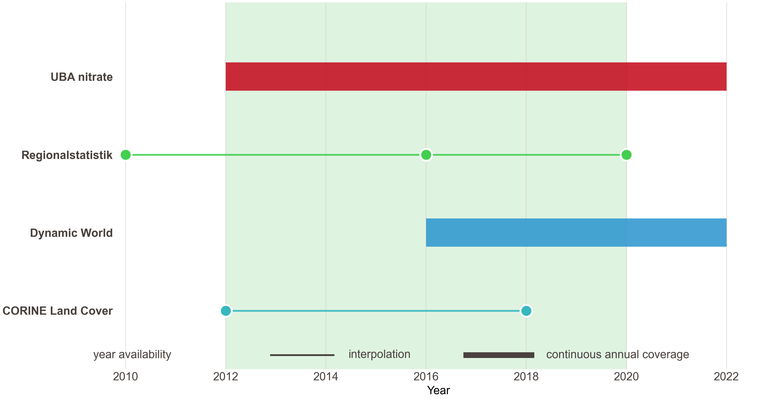
Data Availability
Main study window

Slide 36
Panel Data Set
Groundwater stations nitrate measurements
+ Regionalstatistik data
(esp. Organic Farming Share)
+ Land Cover Data
baseline: station-year
Station-District level mapping
500m buffer around stations

Slide 37
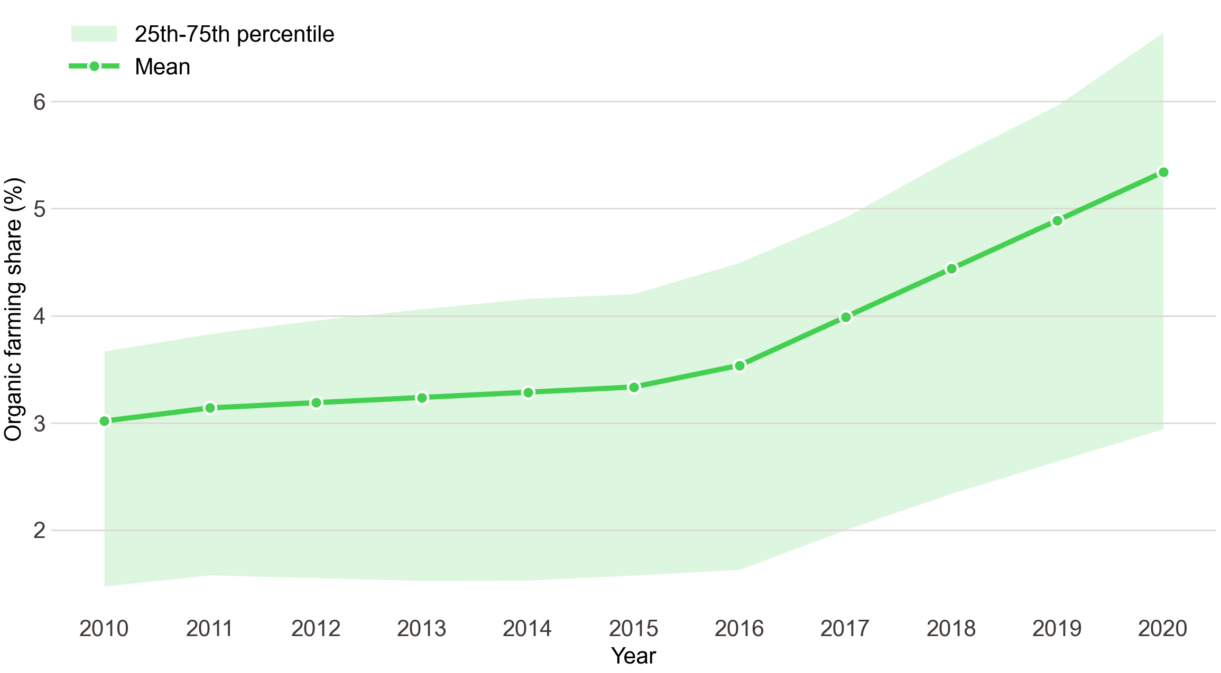
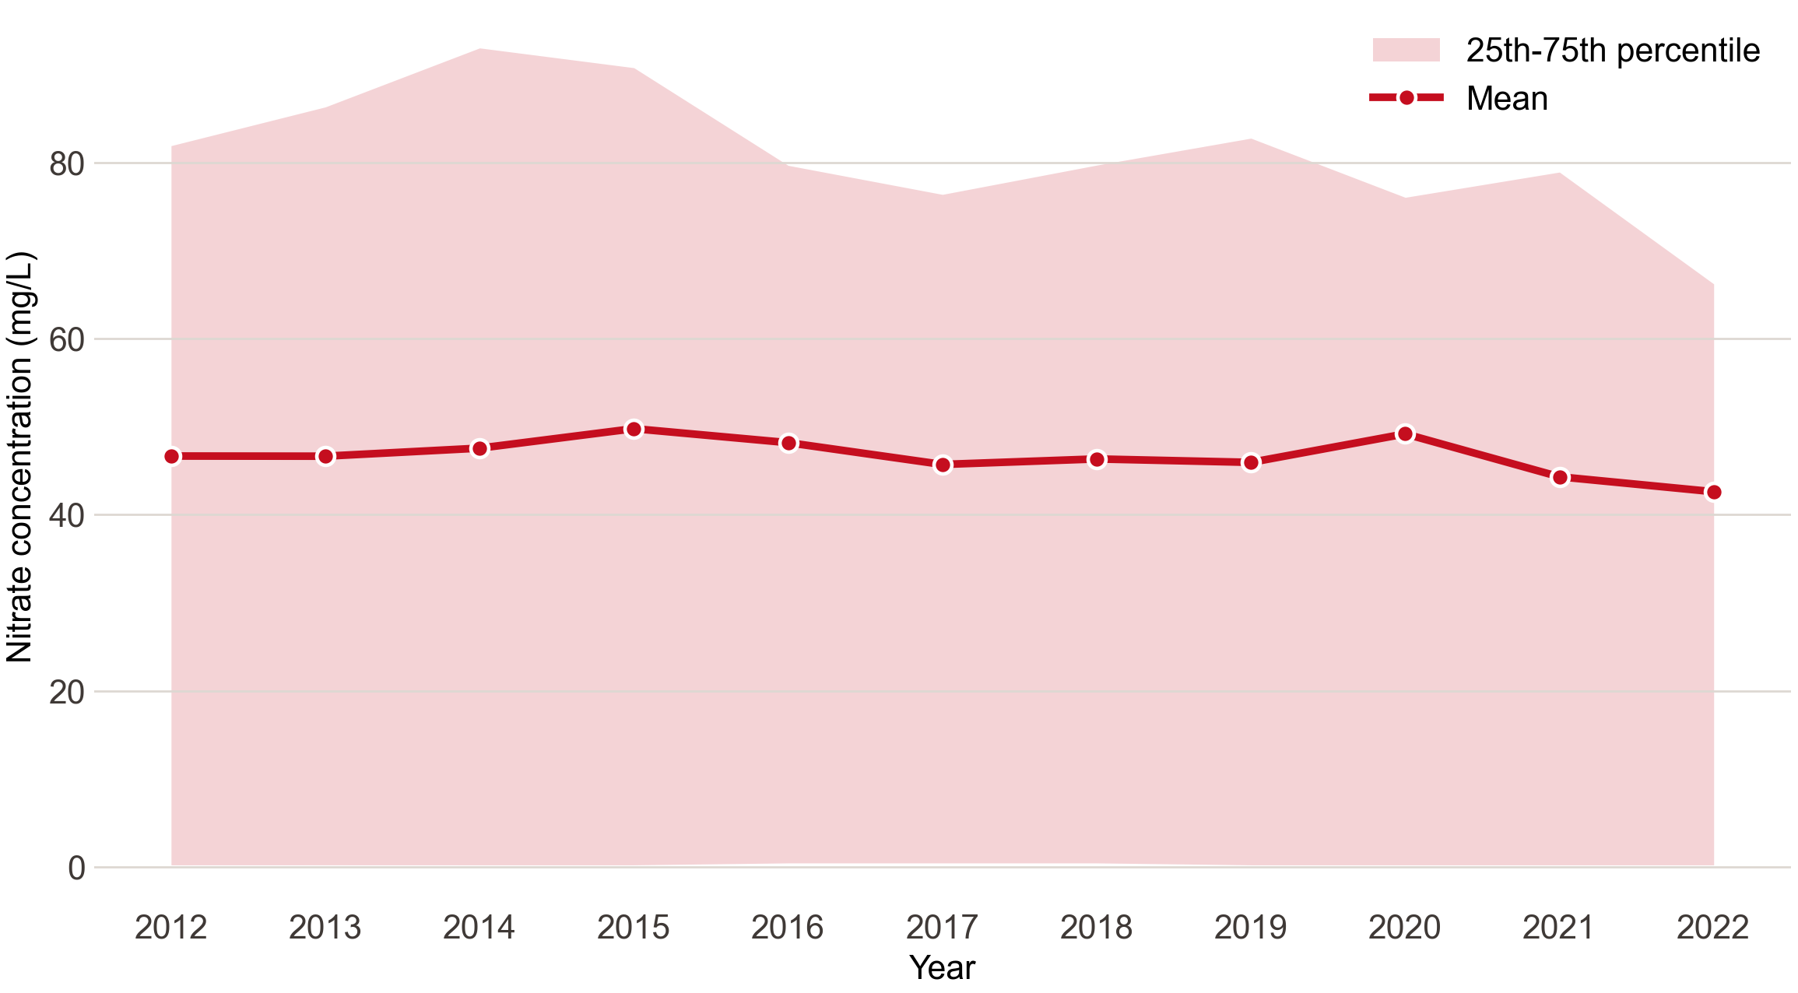
Exploratory Data Analysis
Trend of organic farming share
Trend of nitrate concentration

Slide 38
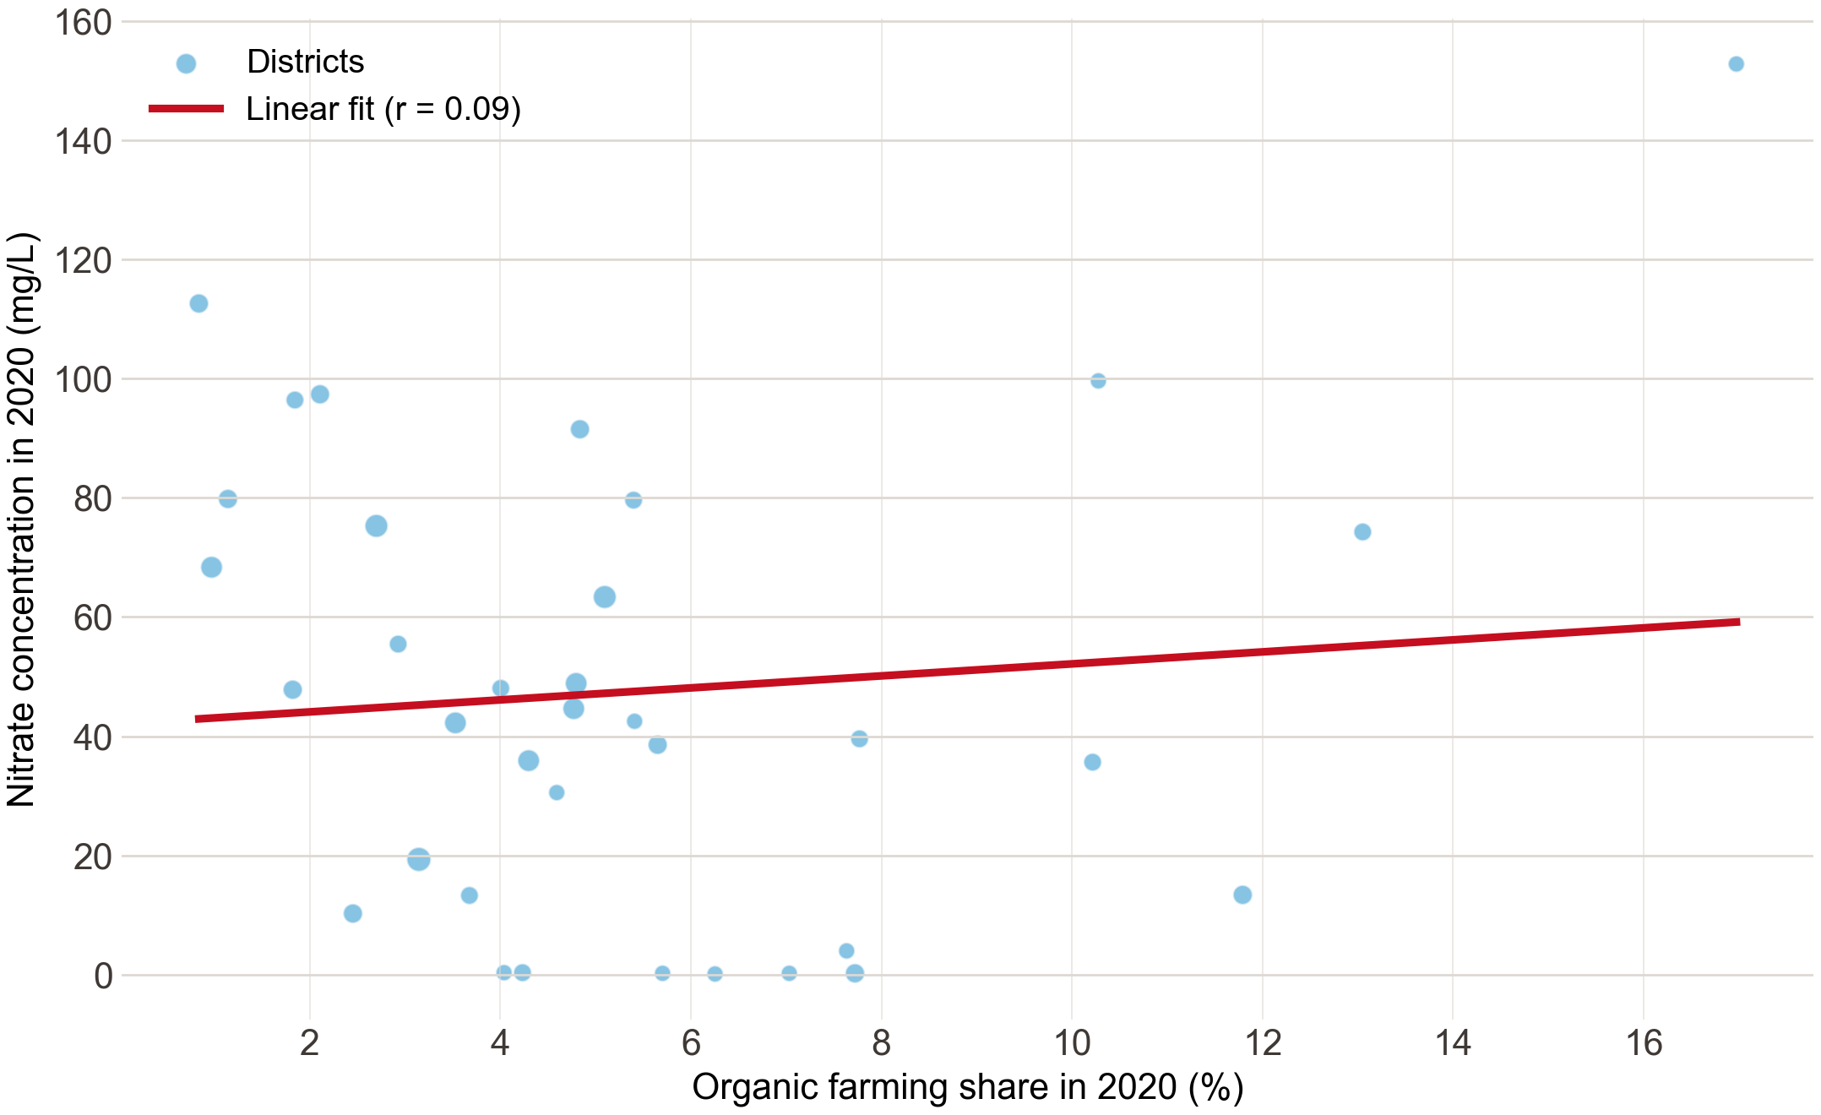
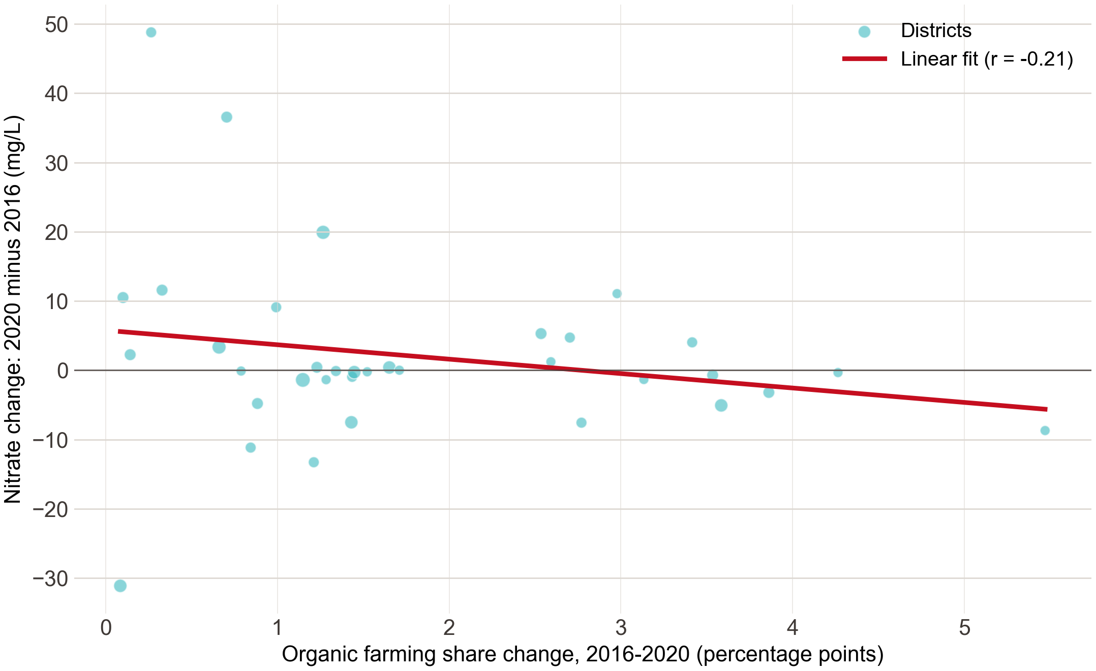
Exploratory Data Analysis
Organic share level vs nitrate level (2020)
Organic growth vs nitrate change (2016 – 2020)

Slide 39
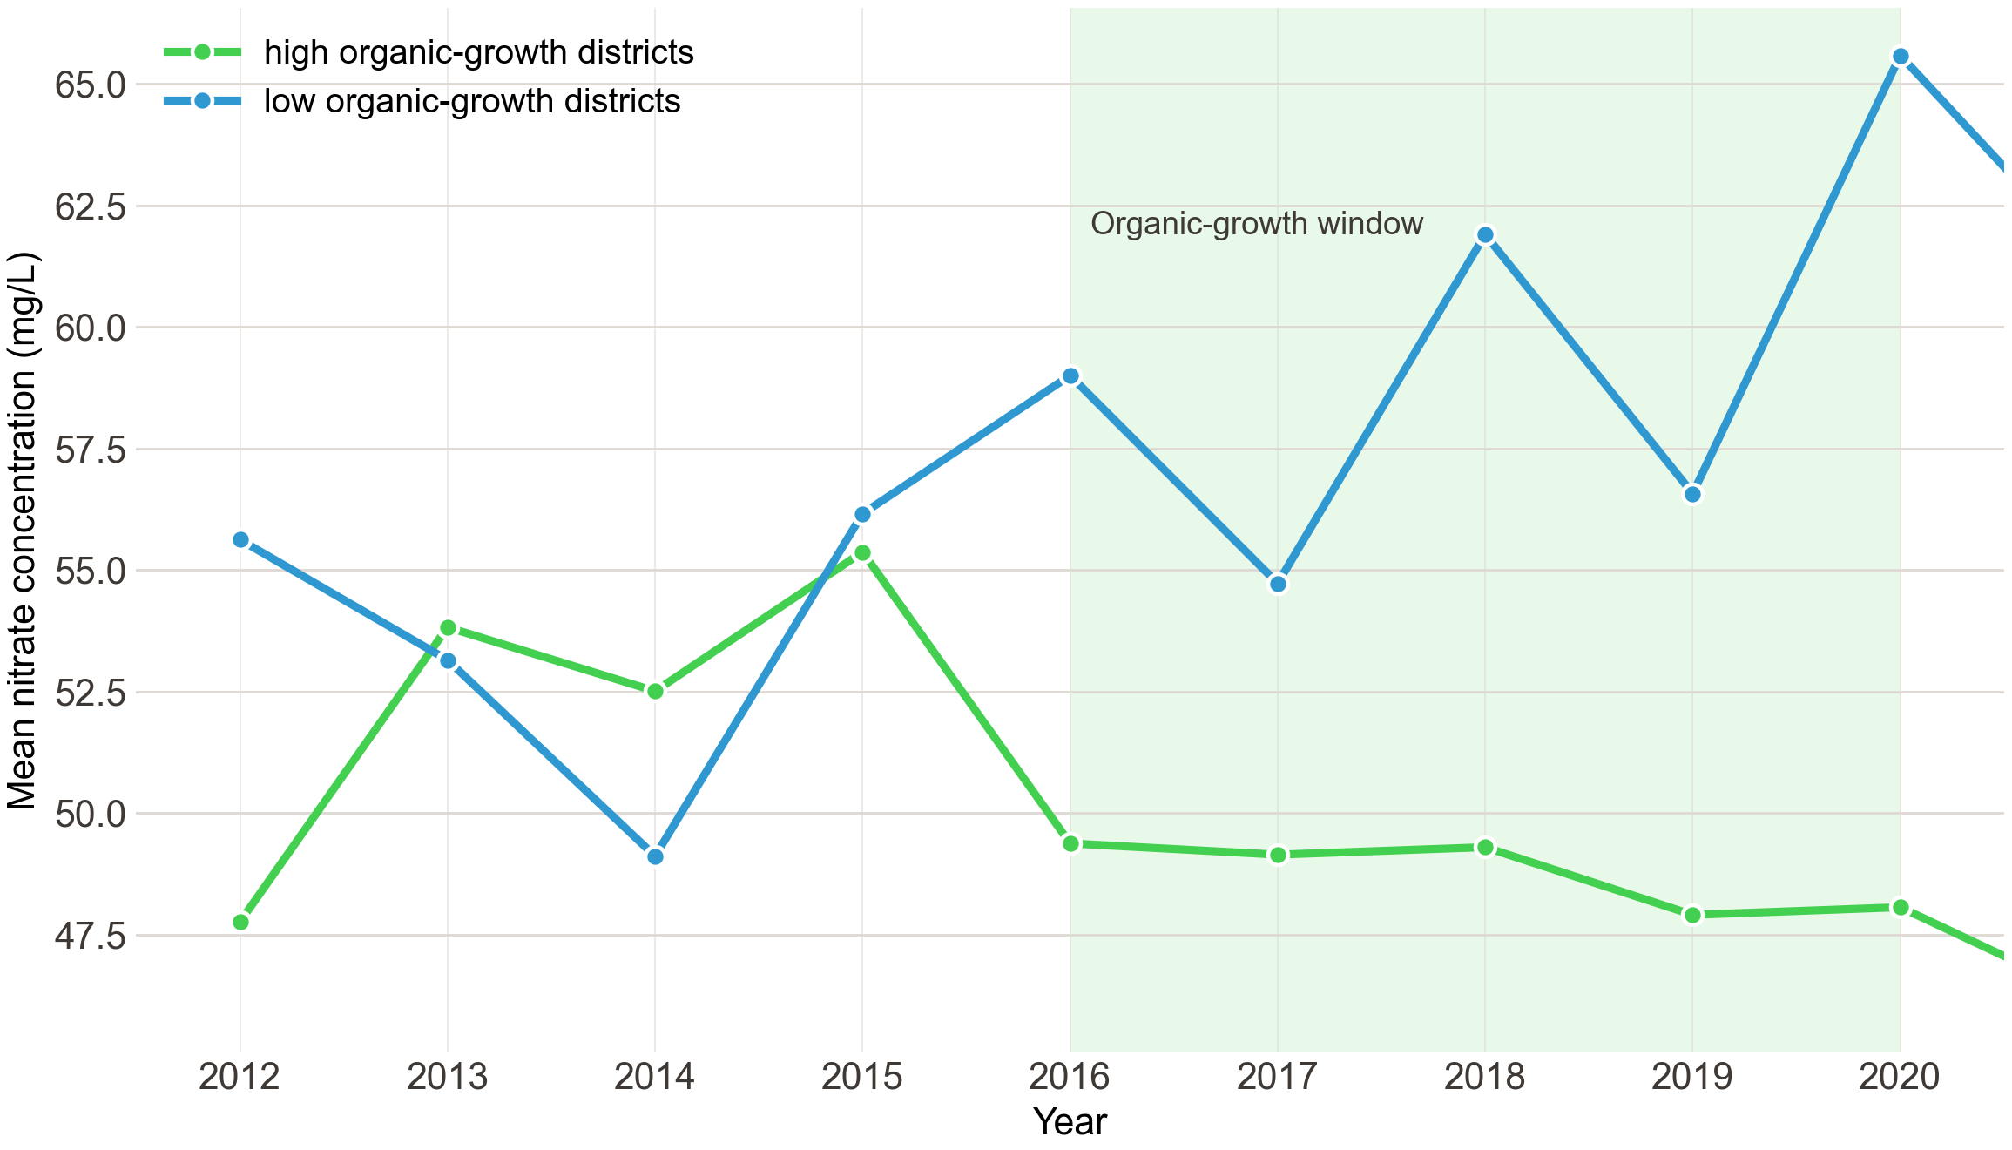
Exploratory Data Analysis
Organic growth in 2020:
Low-growth districts = bottom 25% of districts by organic farming share increase
High-growth districts = top 25% of districts by organic farming share increase
Parallel trends are not clean

Slide 41
Current status of our project:
Exploring and Testing Econometric and DiD Setups
Notes:
great, coming to methods for causal analysis of this research question,
whose exploration is the current status of our project. we would like to test

Slide 42
Current status of our project:
Exploring and Testing Econometric and DiD Setups
Fixed-effects panel regression,
Notes:
fixed effects regression,
as they come really natural to our panels’ key, station FE and year FE

Slide 43
Current status of our project:
Exploring and Testing Econometric and DiD Setups
Fixed-effects panel regression,
Event study,
Notes:
we would like to test an Event study:
NOT with the treatment being “farm converted”
but with the treatment being “district experienced a large increase in organic share”, eg +5-10% within four years

Slide 44
Current status of our project:
Exploring and Testing Econometric and DiD Setups
Fixed-effects panel regression,
Event study,
Notes:
this is, because as Alex already mentioned, a classic binary (treatment/untreated variable) DiD is not set up anymore,
cause our panel logs gradual changes

Slide 45
Current status of our project:
Exploring and Testing Econometric and DiD Setups
Fixed-effects panel regression,
Event study,
Staggered Adoption,
Notes:
but we may still be able to construct a treatment group in the sense of: “district where organic area increased by 30%” vs group of “everything else”
which is called Staggered Adoption DiD, which is what we are currently reading into

Slide 46
Current status of our project:
Exploring and Testing Econometric and DiD Setups
Fixed-effects panel regression,
Event study
Staggered Adoption
Advanced DiD methods: - CSDID, - DRDID, - Distributed-Lag DID,
Notes:
but our panel data set might actually also really well suited for some fancy DiD mods
- Callaway & Sant'Anna Difference-in-Differences (CSDID)
Doubly Robust Difference-in-Differences (DRDID)

Slide 47
Current status of our project:
Exploring and Testing Econometric and DiD Setups
Fixed-effects panel regression,
Event study
Staggered Adoption
Advanced DiD methods: - CSDID, - DRDID, - Distributed-Lag DID,
Notes:
..which are some packeges we found for STATA so maybe they also exist for python or R,
and we would just throw them on our panel

Slide 48
Current status of our project:
Exploring and Testing Econometric and DiD Setups
Fixed-effects panel regression,
Event study
Staggered Adoption
Advanced DiD methods: - CSDID, - DRDID, - Distributed-Lag DID
Notes:
also Distributed Lag DID which works on some sort of moving averages sliding window technique

Slide 49
Current status of our project:
Exploring and Testing Econometric and DiD Setups
Fixed-effects panel regression,
Event study
Staggered Adoption
Advanced DiD methods: - CSDID, - DRDID, - Distributed-Lag DID
Notes:
so if anyone already spots the right method, let us now,
elsewise this goes to testing phase

Slide 50
Next Steps
Identify Econometric Setup, preferably and if possible: a DiD-Setup
If enough time: add cofounders (soil type, industrial activity, traffic)
Potential extension to whole of Germany
Notes:
that’s about it, so the next steps are -------------

Slide 51
Next Steps
Identify Econometric Setup, preferably and if possible: a DiD-Setup
If enough time: add cofounders (soil type, industrial activity, traffic)
Potential extension to whole of Germany
Future Research Beyond Seminar
Notes:
and since we actually have the data and only filtered for lower saxony ------- extending the causal design to the entire nation

Slide 52
Thank you for listening!

Slide 53
Bibliography
NLWKN (2020), Grundwasserbericht Niedersachsen – Parameterblatt Nitrat.
Umweltbundesamt (2024), Daten der Auswertungen des Nitratberichts 2024.
Statistische Ämter des Bundes und der Länder (2010/2016/2020), Regionalstatistik Tabelle 41141-04-02-4: Landwirtschaftliche Betriebe insgesamt sowie mit ökologischem Landbau und deren landwirtschaftlich genutzte Fläche (LF) und Viehbestand.
Google, World Resources Institute und National Geographic Society (2022), Dynamic World V1: Near real-time global 10 m land use/land cover mapping.
European Environment Agency / Copernicus (2012/2018), CORINE Land Cover.
GeoBasis-DE / Bundesamt für Kartographie und Geodäsie (2026), Verwaltungsgebiete 1:250 000 (VG250), Kreisgrenzen Niedersachsen.
Notes:
for completion sake, here are our sources

Slide 54
Any Questions?

Slide 56
Data Sources
Chosen Source | Alternative | Assessment / Criteria
UBA Groundwater Report (2024) | NUMIS (Geodaten des Niedersächsisches Umweltportals) | too short: UBA has longer panel wit more complete metadata, too unofficial: UBA is harmonized & reported by national guidelines.
Google Dynamic World + CORINE Land Cover | ALKIS (Amtliches Liegenschaftskataster-Informationssystem) BORIS (Bodenrichtwerte) | too fine: cadastral / parcel-level -> aggregation steps, too inconsistent: wrt. historical snapshot maintenance, too unstandardized: tricky abbreviations and licensing. ( • out of scope: valuation of land wrt. property tax and ownership )
Regionalstatistik (Agricultural Census) | ( kept ) | -
BKG VG250 Administrative Boundaries | ( new )
Notes:
here is why we ended up discarding some of the initial raw data sources

Slide 57
Data Sources
Chosen Source | Alternative | Assessment / Criteria
UBA Groundwater Report (2024) | NUMIS (Geodaten des Niedersächsisches Umweltportals) | too short: UBA has longer panel wit more complete metadata, too unofficial: UBA is harmonized & reported by national guidelines.
Google Dynamic World + CORINE Land Cover | ALKIS (Amtliches Liegenschaftskataster-Informationssystem) BORIS (Bodenrichtwerte) | too fine: cadastral / parcel-level -> aggregation steps, too inconsistent: wrt. historical snapshot maintenance, too unstandardized: tricky abbreviations and licensing. ( • out of scope: valuation of land wrt. property tax and ownership )
Regionalstatistik (Agricultural Census) | ( kept ) | -
BKG VG250 Administrative Boundaries | ( new )
Notes:
instead of the UBA dataset, we once viewed geodata from NUMIS

Slide 58
Data Sources
Chosen Source | Alternative | Assessment / Criteria
UBA Groundwater Report (2024) | NUMIS (Geodaten des Niedersächsisches Umweltportals) | too short: UBA has longer panel wit more complete metadata, too unofficial: UBA is harmonized & reported by national guidelines.
Google Dynamic World + CORINE Land Cover | ALKIS (Amtliches Liegenschaftskataster-Informationssystem) BORIS (Bodenrichtwerte) | too fine: cadastral / parcel-level -> aggregation steps, too inconsistent: wrt. historical snapshot maintenance, too unstandardized: tricky abbreviations and licensing. ( • out of scope: valuation of land wrt. property tax and ownership )
Regionalstatistik (Agricultural Census) | ( kept ) | -
BKG VG250 Administrative Boundaries | ( new )
Notes:
but this was : ….

Slide 59
Data Sources
Chosen Source | Alternative | Assessment / Criteria
UBA Groundwater Report (2024) | NUMIS (Geodaten des Niedersächsisches Umweltportals) | too short: UBA has longer panel wit more complete metadata, too unofficial: UBA is harmonized & reported by national guidelines.
Google Dynamic World + CORINE Land Cover | ALKIS (Amtliches Liegenschaftskataster-Informationssystem) BORIS (Bodenrichtwerte) | too fine: cadastral / parcel-level -> aggregation steps, too inconsistent: wrt. historical snapshot maintenance, too unstandardized: tricky abbreviations and licensing. ( • out of scope: valuation of land wrt. property tax and ownership )
Regionalstatistik (Agricultural Census) | ( kept ) | -
BKG VG250 Administrative Boundaries | ( new )
Notes:
we also used the ALKIS (---), mainly to identify Lower Saxony as a good place to focus our research question on,
and initially also thought to use the land-use/land-value data from there, but

Slide 60
Data Sources
Chosen Source | Alternative | Assessment / Criteria
UBA Groundwater Report (2024) | NUMIS (Geodaten des Niedersächsisches Umweltportals) | too short: UBA has longer panel wit more complete metadata, too unofficial: UBA is harmonized & reported by national guidelines.
Google Dynamic World + CORINE Land Cover | ALKIS (Amtliches Liegenschaftskataster-Informationssystem) BORIS (Bodenrichtwerte) | too fine: cadastral / parcel-level -> aggregation steps, too inconsistent: wrt. historical snapshot maintenance, too unstandardized: tricky abbreviations and licensing. ( • out of scope: valuation of land wrt. property tax and ownership )
Regionalstatistik (Agricultural Census) | ( kept ) | -
BKG VG250 Administrative Boundaries | ( new )
Notes:
but it was…..

Slide 61
Data Sources
Chosen Source | Alternative | Assessment / Criteria
UBA Groundwater Report (2024) | NUMIS (Geodaten des Niedersächsisches Umweltportals) | too short: UBA has longer panel wit more complete metadata, too unofficial: UBA is harmonized & reported by national guidelines.
Google Dynamic World + CORINE Land Cover | ALKIS (Amtliches Liegenschaftskataster-Informationssystem) BORIS (Bodenrichtwerte) | too fine: cadastral / parcel-level -> aggregation steps, too inconsistent: wrt. historical snapshot maintenance, too unstandardized: tricky abbreviations and licensing. ( • out of scope: valuation of land wrt. property tax and ownership )
Regionalstatistik (Agricultural Census) | ( kept ) | -
BKG VG250 Administrative Boundaries | ( new ) | -
Notes:
and BORIS could be tossed entirely because it logs “land value” in a different sense namely valuation

Slide 62
Data Sources
Chosen Source | Alternative | Assessment / Criteria
UBA Groundwater Report (2024) | NUMIS (Geodaten des Niedersächsisches Umweltportals) | too short: UBA has longer panel wit more complete metadata, too unofficial: UBA is harmonized & reported by national guidelines.
Google Dynamic World + CORINE Land Cover | ALKIS (Amtliches Liegenschaftskataster-Informationssystem) BORIS (Bodenrichtwerte) | too fine: cadastral / parcel-level -> aggregation steps, too inconsistent: wrt. historical snapshot maintenance, too unstandardized: tricky abbreviations and licensing. ( • out of scope: valuation of land wrt. property tax and ownership )
Regionalstatistik (Agricultural Census) | ( kept ) | -
BKG VG250 Administrative Boundaries | ( new )
Notes:
The census dataset is one we kept, the other one is new to gain spatial data back

Slide 64
Data Pipeline and Code Workflow
UBA groundwater stations & nitrate measurements
master table: station-year based panel
┌───────────────────────────┼───────────────────────────▼ ▼ ▼
Dynamic World CORINE buffers Regionalstatistik
Annual land cover 500/1000 m shares Agricultural structure
│
▼
full panel dataset│
▼
Fixed Effects • Event Study • DiD • ML Models
Notes:
from raw data to panel
So far, this is our workflow on how the pre-processed full panel dataset we will use got created
and the code’s pipeline is also structured like this

Slide 65
Data Pipeline and Code Workflow
UBA groundwater stations & nitrate measurements
master table: station-year based panel
┌───────────────────────────┼───────────────────────────▼ ▼ ▼
Dynamic World CORINE buffers Regionalstatistik
Annual land cover 500/1000 m shares Agricultural structure
│
▼
full panel dataset│
▼
Fixed Effects • Event Study • DiD • ML Models
MODULE_A | MODULE_B | MODULE_C | MODULE_D | MODULE_E | MODULE_F | ...
𝄜 | 𝄜 | 𝄜 | 𝄜 | ☰ | 𝄜 | ...
Notes:
and the panel dataset is a huge long table, with columns-MODULES after processing all data

Slide 66
Data Pipeline and Code Workflow
UBA groundwater stations & nitrate measurements
master table: station-year based panel
┌───────────────────────────┼───────────────────────────▼ ▼ ▼
Dynamic World CORINE buffers Regionalstatistik
Annual land cover 500/1000 m shares Agricultural structure
│
▼
full panel dataset│
▼
Fixed Effects • Event Study • DiD • ML Models
station_id | year | n_measurements | nitrate_mg_l | ...
1 1 | 2012 2013 | 1 2 | 48.7 mg/L 62 mg/L | ...
2 | 2012 | 1 | ... | ...
MODULE_A | MODULE_B | MODULE_C | MODULE_D | MODULE_E | MODULE_F | ...
𝄜 | 𝄜 | 𝄜 | 𝄜 | ☰ | 𝄜 | ...
Notes:
just for you to get an idea, one module deals with nitrate measurements
per station per year

Slide 67
Data Pipeline and Code Workflow
UBA groundwater stations & nitrate measurements
master table: station-year based panel
┌───────────────────────────┼───────────────────────────▼ ▼ ▼
Dynamic World CORINE buffers Regionalstatistik
Annual land cover 500/1000 m shares Agricultural structure
│
▼
full panel dataset│
▼
Fixed Effects • Event Study • DiD • ML Models
st_id year | station_name | water_body_id | water_body_name | sampling_depth_m | lon | lat
 | Emmen I | DEGB_DENI_4_2103 | Ise Lockergestein re | 9.3 | 106228076 | 527052441
... | ... | ... | ... | ... | ... | ...
MODULE_A | MODULE_B | MODULE_C | MODULE_D | MODULE_E | MODULE_F | ...
𝄜 | 𝄜 | 𝄜 | 𝄜 | ☰ | 𝄜 | ...
Notes:
another module with data for the water station data
its name, id, coordinates, water parcel

Slide 68
Data Pipeline and Code Workflow
UBA groundwater stations & nitrate measurements
master table: station-year based panel
┌───────────────────────────┼───────────────────────────▼ ▼ ▼
Dynamic World CORINE buffers Regionalstatistik
Annual land cover 500/1000 m shares Agricultural structure
│
▼
full panel dataset│
▼
Fixed Effects • Event Study • DiD • ML Models
st_id year | dw_crops_share_500m | dw_trees_share_500m | dw_crops_share_1000m | dw_trees_share_1000m
 | 0.9858760148435586 | 0.00856644125052586 | 0.9701641039035896 | 0.010202338932703019
MODULE_A | MODULE_B | MODULE_C | MODULE_D | MODULE_E | MODULE_F | ...
𝄜 | 𝄜 | 𝄜 | 𝄜 | ☰ | 𝄜 | ...
Notes:
another module for having created buffers around a point/water station
and collecting the shares of land use
once for a ringbuffer of 500m once of 100m

Slide 69
Data Pipeline and Code Workflow
UBA groundwater stations & nitrate measurements
master table: station-year based panel
┌───────────────────────────┼───────────────────────────▼ ▼ ▼
Dynamic World CORINE buffers Regionalstatistik
Annual land cover 500/1000 m shares Agricultural structure
│
▼
full panel dataset│
▼
Fixed Effects • Event Study • DiD • ML Models
Notes:
and so on..
only once we had this panel, we could start with the work, and that panel took a while

