Slide 1
SpaceX Falcon 9
First Stage Landing Prediction
Data Science Capstone Project
90+
4
83%
$103M
Launch Records
ML Models
Best Accuracy
Cost Savings
IBM Data Science Professional Certificate · 2024
GitHub: https://github.com/codemewithc/Python-projects

Slide 2
Executive Summary
Key findings and business impact at a glance
Business Problem
83%
SpaceX lists Falcon 9 launches at $62M vs $165M+ for competitors — largely because they reuse the first stage booster.
Predicting whether the first stage will successfully land determines actual launch cost. This capability gives competing bidders a strategic pricing advantage.
Best Model Accuracy
(Decision Tree)
KSC
Methodology
Top Launch Site
(Most Successes)
Data collected via SpaceX REST API & Wikipedia web scraping
SQL-based EDA on launch records; interactive Folium maps
Plotly Dash dashboard for real-time visual analytics
4 ML classifiers trained with GridSearchCV; Decision Tree achieved best test accuracy
2,000–4,000 kg
Highest Success
Payload Range
FT
Best Booster Version
by Success Rate
SpaceX Capstone Project | IBM Data Science | https://github.com/codemewithc/Python-projects
2

Slide 3
Introduction
Background, problem definition & project goals
Background
Problem Statement
SpaceX has disrupted the launch industry through reusable rocket technology. The Falcon 9 rocket's first stage booster can be recovered, refurbished, and reflown, cutting per-launch costs by up to 60%.
A successful booster landing directly translates to savings of $100M+. Predicting landing success before launch enables:
Given historical Falcon 9 launch data (payload mass, orbit, launch site, booster version), predict whether the first stage booster will successfully land — enabling pre-launch cost estimation.
Accurate cost estimation for competing launch providers
Risk assessment and insurance pricing
Strategic bidding against SpaceX tenders
Launch Cost Comparison ($ Millions)
SpaceX
(Reused)
$62M
Competitors
(Avg)
$165M
SpaceX Capstone Project | IBM Data Science | https://github.com/codemewithc/Python-projects
3

Slide 4
Data Collection — SpaceX API
Methodology · GitHub: https://github.com/codemewithc/Python-projects
Data Retrieval Workflow
SpaceX REST API
v4/launches
Fetch Rocket
& Payload IDs
Enrich with
launchpad & crew
Construct
DataFrame
Export
spacex_data.csv
→
→
→
→
Key Features Extracted
Dataset Summary
FlightNumber
Launch date
Total Launches
90
BoosterVersion
PayloadMass (kg)
Date Range
2010 – 2020
Orbit
LaunchSite
Launch Sites
4
Outcome
Longitude/Latitude
Booster Versions
6+
LandingPad
Block / GridFins
Success Rate
~67%
SpaceX Capstone Project | IBM Data Science | https://github.com/codemewithc/Python-projects
4

Slide 5
Data Collection — Web Scraping
Wikipedia scraping with BeautifulSoup · GitHub: https://github.com/codemewithc/Python-projects
Scraped: Wikipedia — List of Falcon 9 and Falcon Heavy Launches
1
Request HTML
2
Parse with BS4
Used requests library to fetch Wikipedia launch table HTML
BeautifulSoup parsed <table> tags; extracted Falcon 9 rows
3
Extract Columns
4
Clean & Export
Flight No., Date/Time, Version, Payload, Orbit, Outcome, Turnaround
Handled missing values; exported to CSV for downstream use
Additional Data Captured via Scraping
Booster reuse count · Landing outcome (Success/Failure/Drone Ship/Ground Pad) · Turnaround time between launches · Customer/mission type · Payload classification
SpaceX Capstone Project | IBM Data Science | https://github.com/codemewithc/Python-projects
5

Slide 6
Data Wrangling
Data cleaning, feature engineering & label creation · GitHub: https://github.com/codemewithc/Python-projects
1
Handle Missing Values
Landing Outcome Distribution
PayloadMass: filled with column mean. LandingPad: filled 'None' for non-pad landings.
Outcome Code | Description | Count
True Ocean | Failure (ocean) | 5
False ASDS | Failure (ship) | 10
True RTLS | Success (ground) | 14
True ASDS | Success (ship) | 41
None None | No attempt | 21
2
Filter Falcon 9 Only
Removed Falcon Heavy and experimental flights; kept only operational Falcon 9 launches.
3
Create Training Label
"class" column: 1 = successful first-stage landing, 0 = unsuccessful. Derived from Outcome field.
Class Balance
4
Feature Engineering
Success (Class=1): ~67% Failure (Class=0): ~33%
Slightly imbalanced — handled via stratified train/test split (80/20).
One-hot encoding for categorical variables (Orbit, LaunchSite, LandingPad, Serial). Standardized numeric features.
SpaceX Capstone Project | IBM Data Science | https://github.com/codemewithc/Python-projects
6

Slide 7
EDA — Visualization Results
Key patterns from scatter plots, bar charts & trend analysis
↑ SSO & VLEO orbits show 88–92% success — lighter payloads improve landing odds
📈 Year-over-year success rate climbed from near-zero in 2010 to 90%+ by 2020
⚖️ Payload 2,000–4,000 kg sweet spot: high enough payload, low enough mass for fuel-efficient landing
🚀 GTO missions have lowest success rate (~55%) due to high fuel consumption leaving booster
SpaceX Capstone Project | IBM Data Science | https://github.com/codemewithc/Python-projects
7

Slide 8
EDA — SQL Analysis Results
SQL queries on SPACEXTABLE (SQLite) · GitHub: https://github.com/codemewithc/Python-projects
Selected SQL Query Results
Unique Launch Sites
CCAFS LC-40, VAFB SLC-4E, KSC LC-39A, CCAFS SLC-40
Total NASA CRS Payload (kg)
45,596 kg across all CRS missions
Avg Payload — F9 v1.1
2,534 kg average payload mass
First Successful Ground Landing
2015-12-22 (CCAFS LC-40)
Drone Ship Success — 4–6k kg
B1039, B1060 (4,230 & 5,683 kg)
Top Ranked Landing Outcome
Success (ground pad): 27 landings
SpaceX Capstone Project | IBM Data Science | https://github.com/codemewithc/Python-projects
8

Slide 9
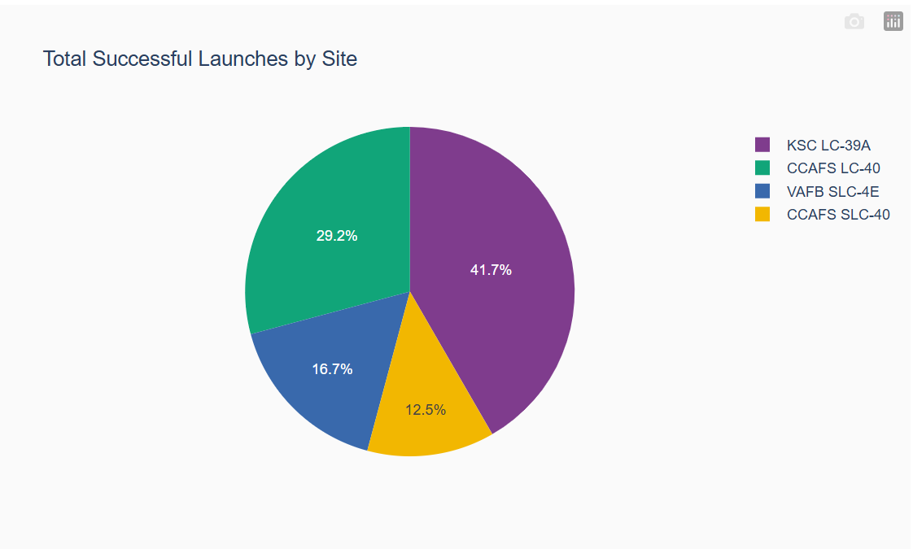

Slide 10
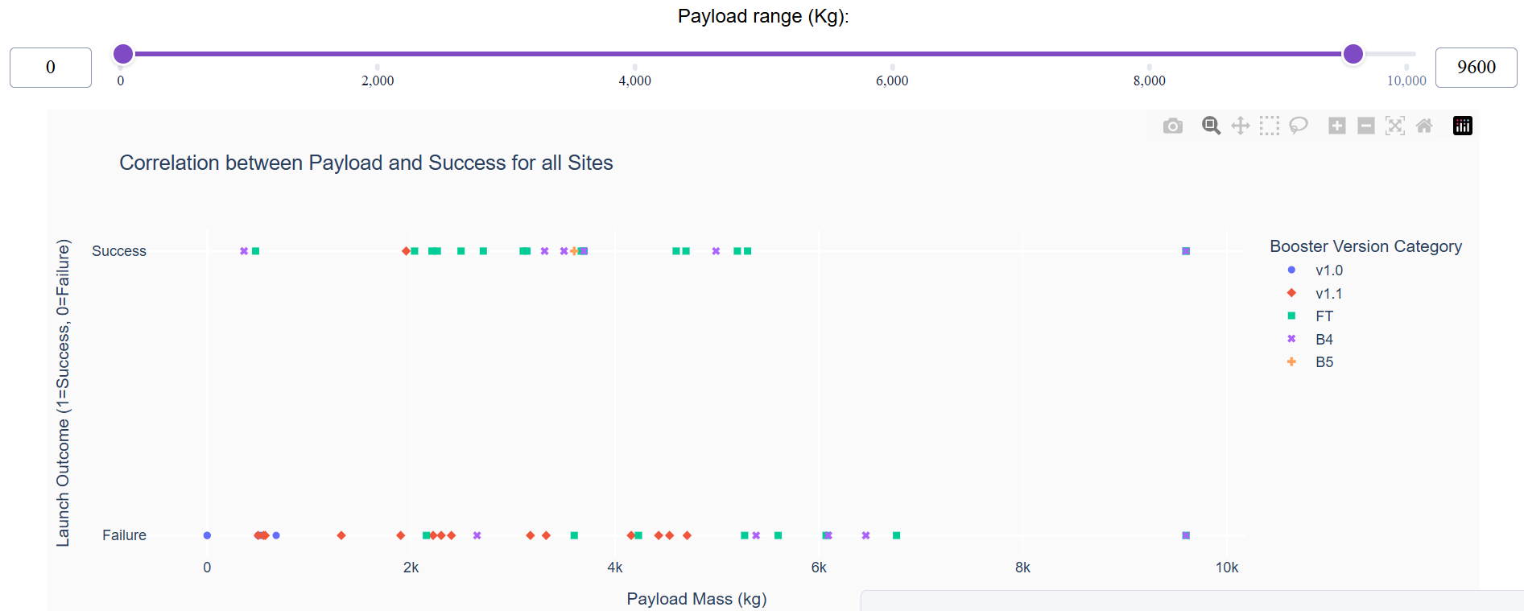

Slide 11
Interactive Visual Analytics — Folium Maps
Launch site mapping & proximity analysis · GitHub: https://github.com/codemewithc/Python-projects
Launch Sites Mapped
Folium Map Features
Site | State | Launches | Success%
KSC LC-39A | Florida | 27 | 77%
CCAFS LC-40 | Florida | 26 | 65%
CCAFS SLC-40 | Florida | 22 | 59%
VAFB SLC-4E | California | 13 | 62%
🟢 Green markers = successful landings
🔴 Red markers = failed landings
⭕ Circle markers = launch sites with pop-up details
Proximity Analysis Findings
📏 Distance lines — coastline, city, railways
All sites located within 20 km of coastline (ocean proximity for safety)
Sites 50–100 km from populated cities (safety buffers maintained)
KSC closest to railway infrastructure — logistics advantage
VAFB optimized for polar/SSO orbits (Pacific launch corridor)
🗺️ Cluster view for dense launch areas
Filterable by mission outcome for pattern analysis
View live map: https://github.com/codemewithc/Python-projects/blob/main/lab_jupyter_launch_site_location.ipynb
SpaceX Capstone Project | IBM Data Science | https://github.com/codemewithc/Python-projects
9

Slide 12
Interactive Visual Analytics — Plotly Dash Dashboard
Real-time analytics app · GitHub: https://github.com/codemewithc/Python-projects
Dashboard Components
Launch Site Dropdown
Payload Range Slider
Select a specific site or 'All Sites' to filter the entire dashboard in real-time.
Filter launches by payload mass (0–10,000 kg) to explore mass vs. outcome correlations.
Success Pie Chart
Payload Scatter Plot
Dynamic pie chart showing success/failure ratio for selected site(s) — updates on dropdown change.
X: Payload Mass, Y: Launch Outcome. Color-coded by Booster Version (v1.0, v1.1, FT, B4, B5).
Dashboard Insights
KSC LC-39A has the highest total successful launches (27). CCAFS SLC-40 has highest overall launch count. Payload 2,000–4,000 kg shows the highest success rate across all sites. FT booster version consistently outperforms older versions in success rate.
SpaceX Capstone Project | IBM Data Science | https://github.com/codemewithc/Python-projects
10

Slide 13
Predictive Analysis — Methodology
Machine learning pipeline & model selection
ML Pipeline
Standardize
Features
Train/Test
Split 80/20
GridSearchCV
cv=10
Best Model
Selection
Test Set
Evaluation
▶
▶
▶
▶
Models Trained & Hyperparameters (GridSearchCV)
Model | Key Hyperparameters Searched | CV Score | Test Accuracy
Logistic Regression | C: [0.01, 0.1, 1, 10, 100], solver: lbfgs | 83.3% | 83.3%
Support Vector Machine | C: [0.01-100], gamma: [auto, scale], kernel: linear/rbf | 83.3% | 83.3%
Decision Tree | max_depth: [2–15], criterion: gini/entropy, max_features | 87.2% | 83.3%
K-Nearest Neighbors | n_neighbors: [1–10], algorithm, p: [1,2] | 80.0% | 83.3%
SpaceX Capstone Project | IBM Data Science | https://github.com/codemewithc/Python-projects
11

Slide 14
Predictive Analysis — Results & Evaluation
Model comparison, confusion matrix & best model
Decision Tree — Confusion Matrix
(on 18 test samples)
Predicted: 0
Predicted: 1
Actual: 0
TP=3
(True 0)
FP=3
(False 1)
Actual: 1
FN=0
(False 0)
TN=12
(True 1)
Key Findings
All 4 models achieved identical 83.3% test accuracy on 18 test samples. Decision Tree was selected as best model due to highest CV score (87.2%) and interpretability. The main error type is False Positives (predicting landing when it fails), which is safer for business use — overestimating costs rather than underestimating them.
SpaceX Capstone Project | IBM Data Science | https://github.com/codemewithc/Python-projects
12

Slide 15
Conclusion & Insights
SpaceX Falcon 9 First Stage Landing Prediction — Capstone Summary
Technical Findings
Business Insights
Future Work
Decision Tree (best CV 87.2%) selected as final model
83.3% test accuracy — strong baseline for 90-sample dataset
No false negatives: zero missed actual successes
Key predictors: orbit type, payload mass, launch site
KSC LC-39A = highest success count & efficiency
FT booster version = highest reliability across sites
2,000–4,000 kg payloads achieve best landing odds
SSO & VLEO missions most likely to recover booster
Expand dataset to post-2020 launches (Starship era)
Add weather data, reuse count, turnaround time features
Try XGBoost/Random Forest for ensemble improvements
Deploy model as real-time pricing API for bid calculation
GitHub Repository: https://github.com/codemewithc/Python-projects · IBM Data Science Professional Certificate · 2024

