Slide 1
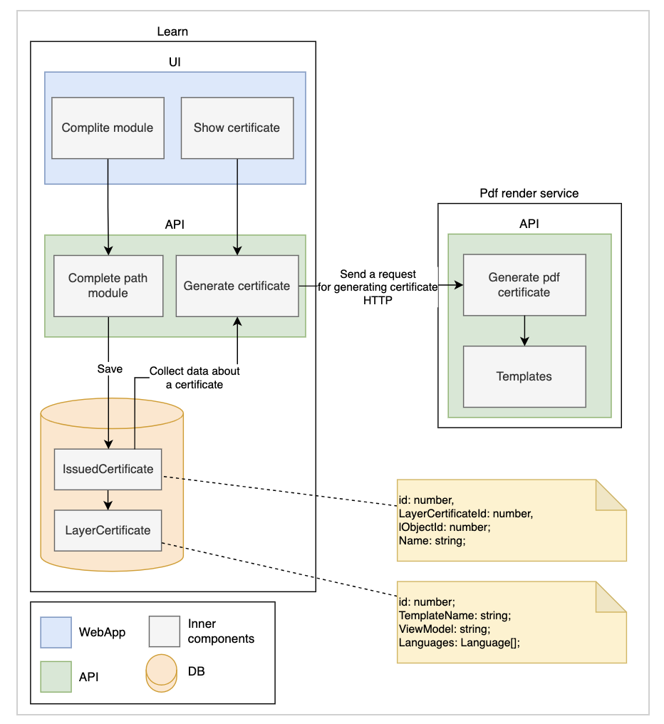
Header1 | Header2 | Header3 | Header4 | Header5
Value1 | Value2 | Value3 | Value1 | Value5
Value6 | Value7 | Value8 | Value9 | Value10
Value11 | Value12 | Value13 | Value14 | Value15
Some Text
Non-Functional Requirements:
Performance:
Fast response times ( <3s ) and high availability ( 9.99 ).
Scalability to handle increasing user load.
Security:
Preventing actions without access
Secure authentication and authorization mechanisms.
Usability:
User-friendly interface and intuitive navigation.
Accessibility for users with disabilities.
Reliability:
Fault tolerance and disaster recovery mechanisms.
Regular backups and data redundancy.
Notes:
Some note here
One more note
Some Note again

