Slide 1
Moving TFS 2010 from a Single-Server to a Dual-Server Deployment
When Team Foundation Server is moved from an installation on a single server to an installation across two or more servers - this is a specific type of restore-based move.

Slide 2
Context
SERVER-ONE represents a TFS Deployment of a “Single-Server-Installation” mode
AppTier
Reporting Services
Analysis Services
Integration Services
Time Sheet
SharePoint Services 3.0
SERVER-ONE
-----------------------
App Tier
+
Data Tier

Slide 3
Reasons To Split
Improve performance for SCM & Work Items
Improve performance for Reporting
Support more project ( branching, etc )
Free resources ( RAM, HDD, CPU )

Slide 4
What will happen
SERVER-ONE
-----------------------
App Tier
SERVER-ONE
-----------------------
App Tier
+
Data Tier
SERVER-TWO
-----------------------
Data Tier
Move all (TFS, SharePoint, Reporting) databases to the new server
Convert the original server to application-tier server only
Create (install & config SQL Server related products) on the new data-tier server
Redirect SharePoint to the new data-tier server
Redirect TFS to the new data-tier server
Redirect Reporting in TFS to use new data-tier server

Slide 5



The How – Part 1 (SERVER-ONE)
StopServices()
cd “c:\Program Files\Microsoft Team Foundation Server 2010\Tools”
« TFSServiceControl quiesce » will stop this service also
Then stop anything that can use the databases (except the sql engine needed to do the backups)

Slide 6

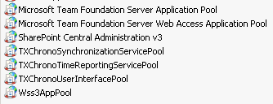
The How – Part 2 (SERVER-ONE)
StopSites()
StopAppPools()

Slide 7
The How – Part 3 (SERVER-ONE)
BackupTfsDatabases()
Tfs_R_D
Tfs_DefaultCollection
Tfs_SetupSignatureHiddenProjects
Tfs_Warehouse
Tfs_Configuration (you must make sure to back up this database last and restore first)
BackupReportingDatabases()
ReportServer
ReportServerTempDB
BackupTimeSheetDatabases()
TimeTrack
BackupSharePointDatabases()
WSS_AdminContent
WSS_Config
WSS_Content
WSS_Search_SERVAPPS2010

Slide 8
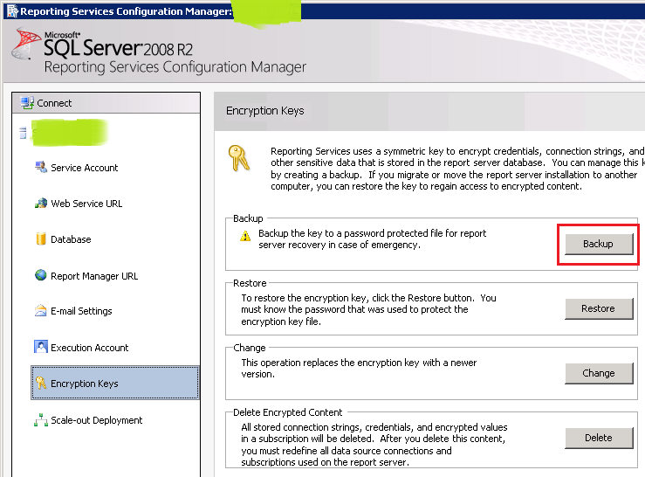
The How – Part 4 (SERVER-ONE)
BackupReportingServicesEncryptionKey()

Slide 9
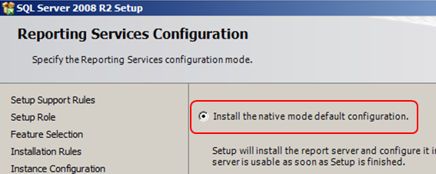
The How – Part 5 (SERVER-TWO)
InstallSqlAndReportingInNativeMode()
ActivateIISRole()

Slide 10
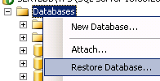
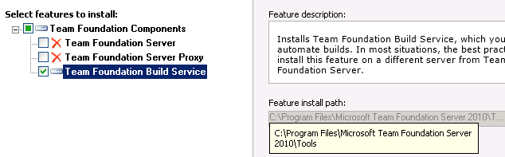
The How – Part 6 (SERVER-TWO)
RestoreDatabases()
Restore all the DB
INFO: some BIG DBs the compressed backup of which has about 65GB might take more than an hour to restore
WARNING: “Tfs_Configuration” database - you must make sure to back up this database last and restore first)
InstallBuildServices()
INFO: in order to prepare the SQL Server to host TFS databases we need to make use of “TFSConfig” that is available only if we install TFS app-tier only. By installing “BuildServices” we get the needed tools.

Slide 11
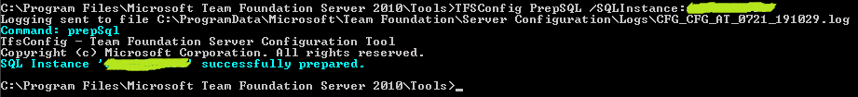
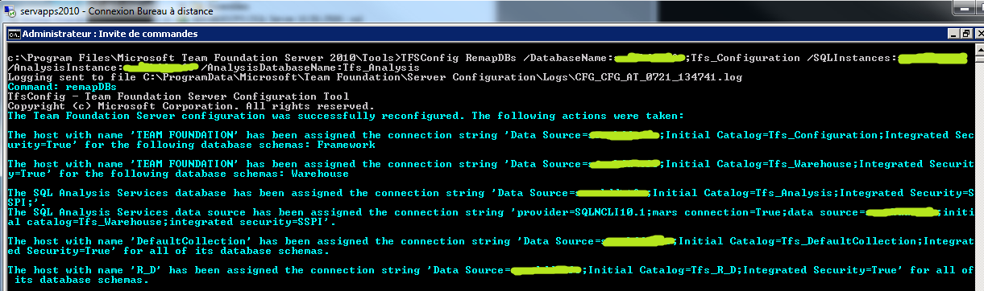
The How – Part 7 (SERVER-TWO)
PrepareSqlForHostingTfs()
TFSConfig PrepSQL /SQLInstance:ServerName
RedirectTfsToNewDataTier()
TFSConfig RemapDBs /DatabaseName:server-two\sqlinstqnce;Tfs_Configuration /SQLInstances:server-two\sqlinstqnce /AnalysisInstance:server-two\sqlinstqnce /AnalysisDatabaseName:Tfs_Analysis

Slide 12
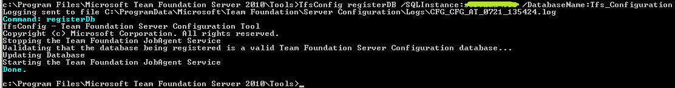
The How – Part 8 (SERVER-ONE)
RegisterLocationOfMovedDatabases()

Slide 13
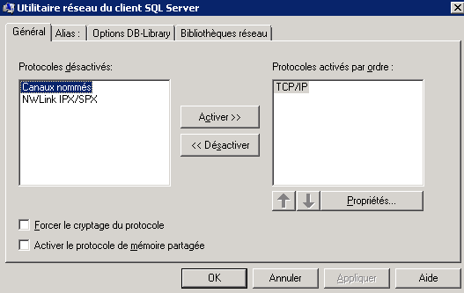
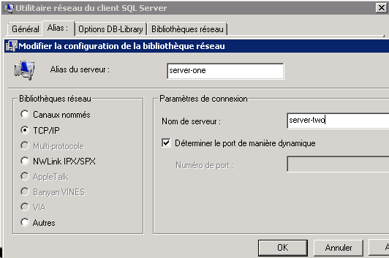
The How – Part 9 (SERVER-TWO)
RedirectSharePointServicesToNewDataTier()
%SYSTEM%\cliconfg.exe

Slide 14
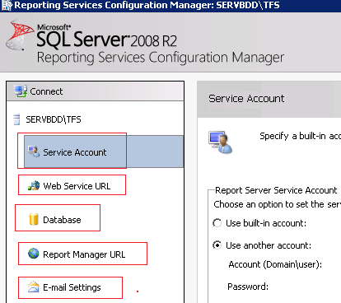
The How – Part 10 (SERVER-TWO)
ConfigureReporting()

Slide 15
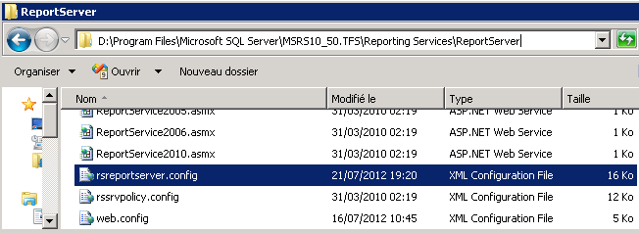

The How – Part 12 (SERVER-TWO)
MakeSureTheAuthenticationIsOk()

Slide 16
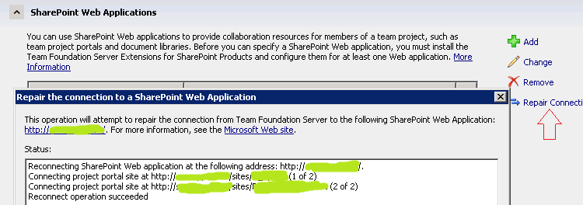
The How – Part 13 (SERVER-ONE)
StartAllThatWasStopped()
Change TimeSheet Config files to use the new DataBase Server
AppPools
Sites
Services (Except Sql Services because we don’t need them any ways)
TFSServiceControl unquiesce
RepairSharePoint Web ApplicationsConnections()

Slide 17
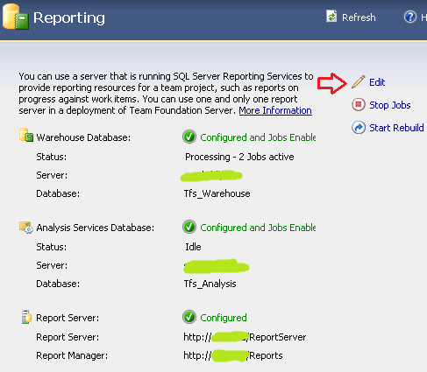
The How – Part 14 (SERVER-TWO)
ConfigureReportingAndAnalysisServices()

Slide 18

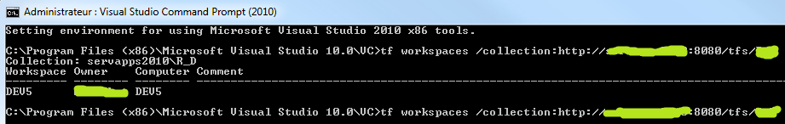
The How – Part 15 (Developer PC)
RefreshCacheOnClientComputers()
tf workspaces /collection:http://server-one:8080/tfs/collection_name

Slide 19
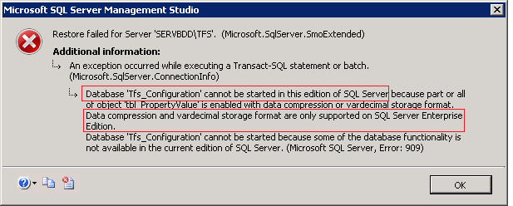
Errors that may (or not) occur
To solve this go here http://social.msdn.microsoft.com/Forums/eu/tfsadmin/thread/9365b0da-f5e9-4219-b8b2-498df11d921b and apply the first post marked as answer
BUT it is strongly advised to have the same type (enterprise, standard) of SQL server as the one where you’re moving from.

Slide 20
Resources
http://msdn.microsoft.com/en-us/library/ms404860.aspx
http://msdn.microsoft.com/en-us/library/ms404869.aspx
http://msdn.microsoft.com/en-us/library/ms404854.aspx
http://msdn.microsoft.com/en-us/library/cc716728.aspx
http://msdn.microsoft.com/en-us/library/ms400729.aspx
http://msdn.microsoft.com/en-us/library/ms253070.aspx
http://technet.microsoft.com/en-us/library/cc512723(office.12).aspx

