Slide 1
Migrate TFS 2010 to TFS2012
TFS2010 is a Dual-Server Deployment

Slide 2
Existing Config
SERVBDD (TFSDatabaseServer)
Win2008 R2 Enterprise SP1 64bit, SQL2008 R2, 12GB RAM, Xeon 2.13Ghz 4 Cores
SERVAPPS2010 (TFS2010 App Tier + WSS 3.0 for Devs)
Win2008 Standard SP2 32bit, TFS2010, 4GB RAM, AMD 2.27Ghz 4Cores
SERVAPPS (TFS2010 Build Controller + TFS Build Agents + WSS 3.0+SQL/PMs)
Win2003 R2 Standard SP2 32bit, TFS2010, 4GB RAM, Xeon 2Ghz 4Cores
Vista-Dev (TFS2010 Build Agents)
WinVista Pro SP2 32bit, 4GB RAM, Core 2 Duo 3GHz
Dev10-7 (TFS2010 Build Agents)
Win7 Ultimate SP1 32bit, 4GB RAM, Core 2 Duo 3GHz

Slide 3
New Config
SERVBDD (TFSDatabaseServer)
Win2008 R2 Enterprise SP1 64bit, SQL2008 R2, 12GB RAM, Xeon 2.13Ghz 4 Cores
SERVTFS (TFSServer)
Win2008 R2 Standard SP1 64bit, TFS2012, SPF2013, 4GB RAM, Xeon 2.27Ghz 8 Cores
TFSBuildController
Win2008 R2 Standard SP1 64bit, TFS2012 Build, TFS2010 Build, 4GB RAM, Xeon 2Ghz 4Cores
TFSBuildAgent1
Win7 Pro SP1 64bit, TFS2012 Build, TFS2010 Build, 4GB RAM, Core 2 Duo 3GHz
TFSBuildAgent2
Win7 Pro SP1 64bit, TFS2012 Build, TFS2010 Build, 4GB RAM, Core 2 Duo 3GHz

Slide 4
Requirements for TFS 2012
http://msdn.microsoft.com/en-us/library/vstudio/dd578592.aspx
http://technet.microsoft.com/en-us/library/cc262485.aspx

Slide 5
Upgrade Scenarios
http://technet.microsoft.com/en-us/library/cc303309(v=office.14)
http://msdn.microsoft.com/en-us/library/dd936138(v=vs.100).aspx
http://technet.microsoft.com/en-us/library/cc303311(v=office.14)
http://technet.microsoft.com/en-us/library/jj219571.aspx

Slide 6
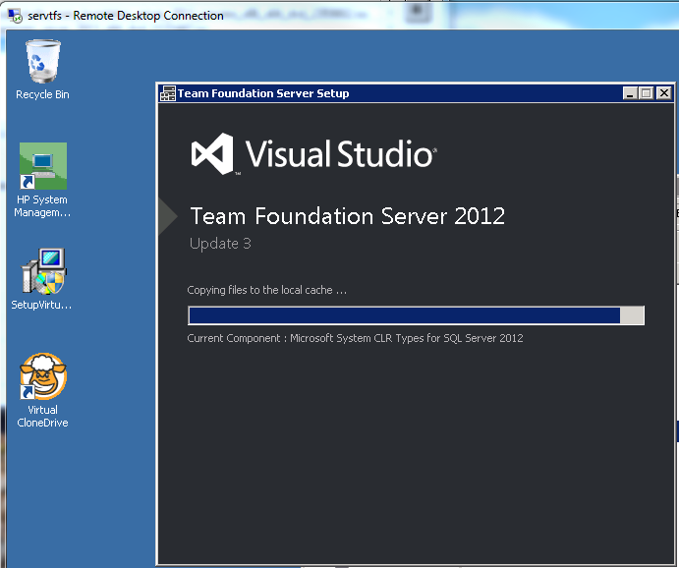

Slide 7
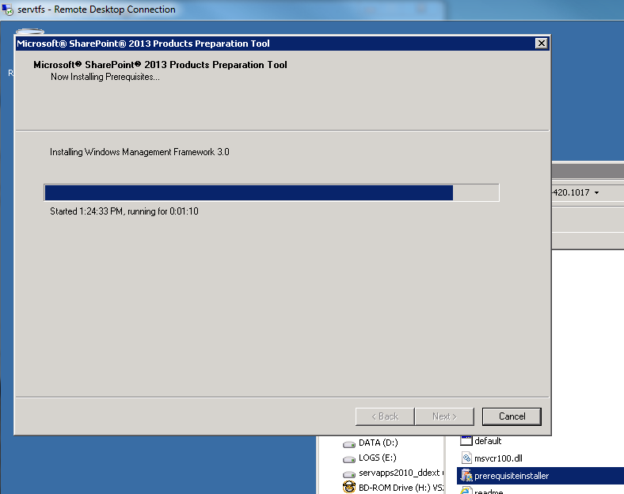

Slide 8
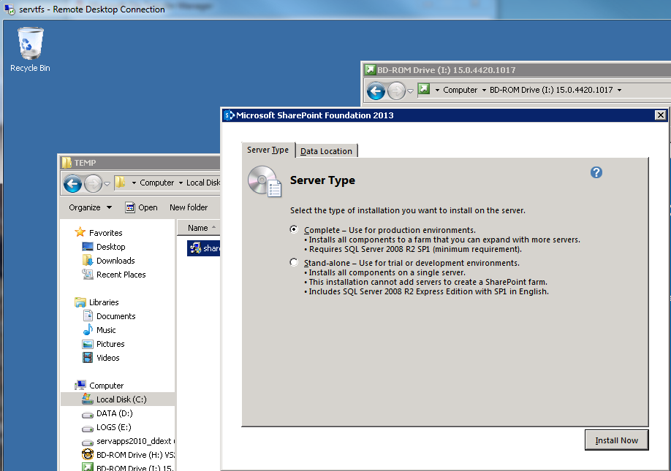

Slide 9
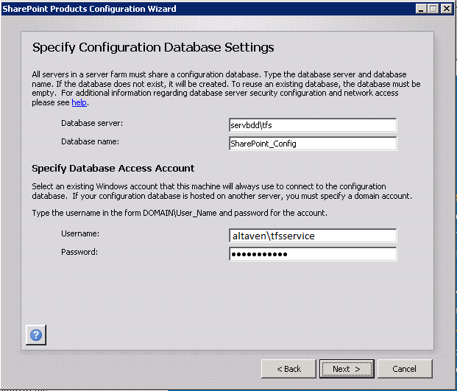

Slide 10
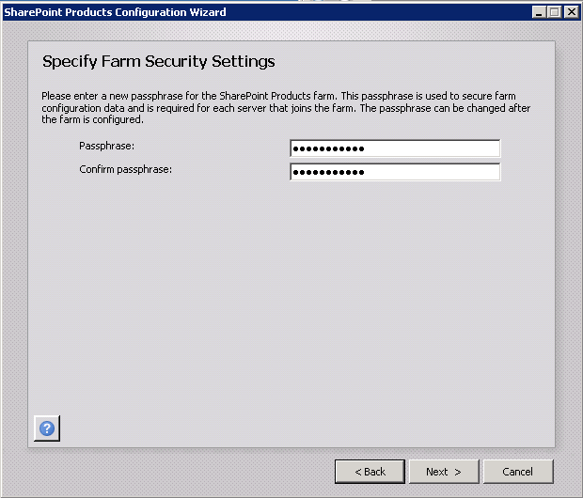
altaven123!

Slide 11
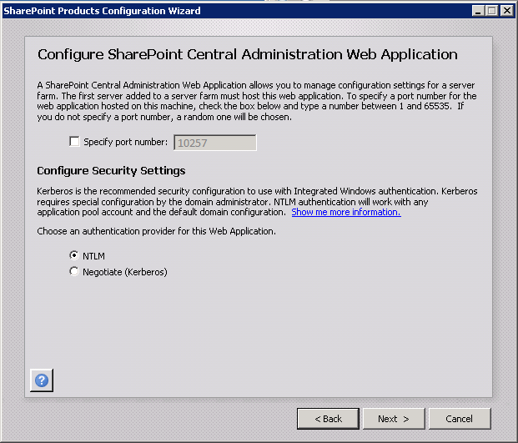

Slide 12
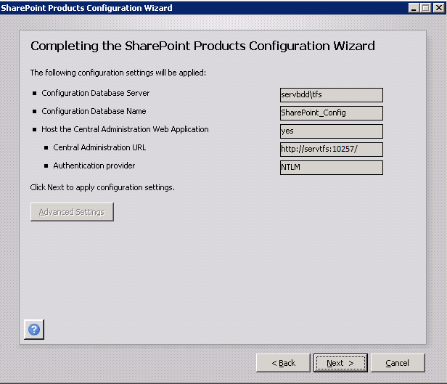

Slide 13
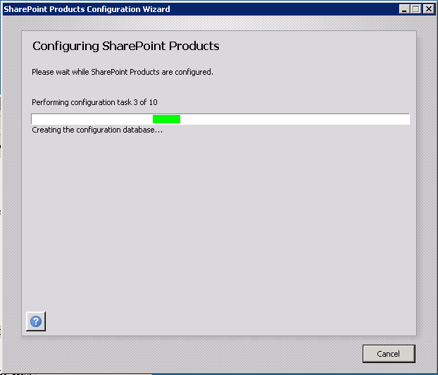

Slide 14
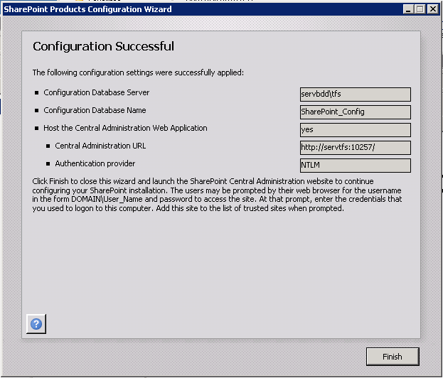

Slide 15
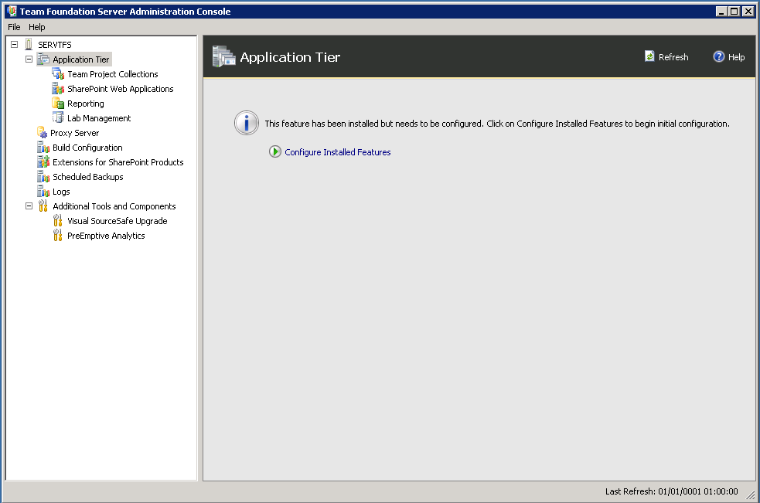

Slide 16
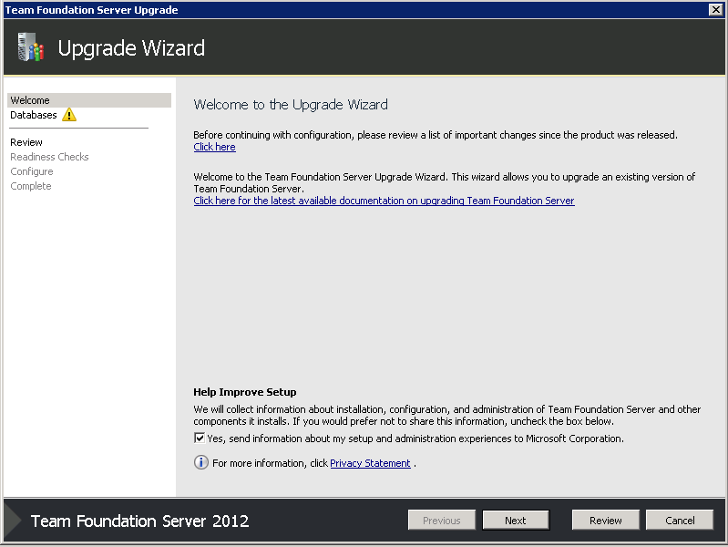

Slide 17
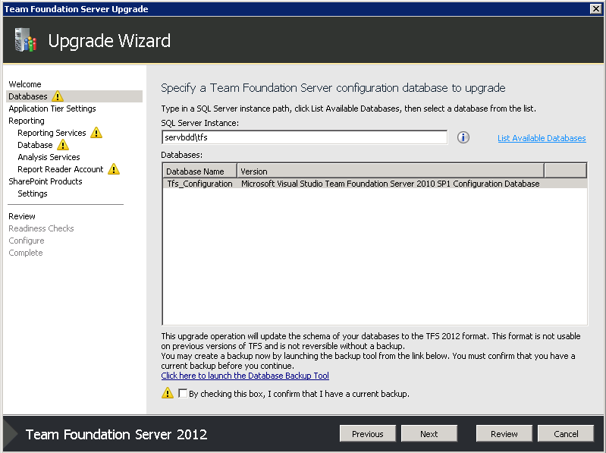

Slide 18
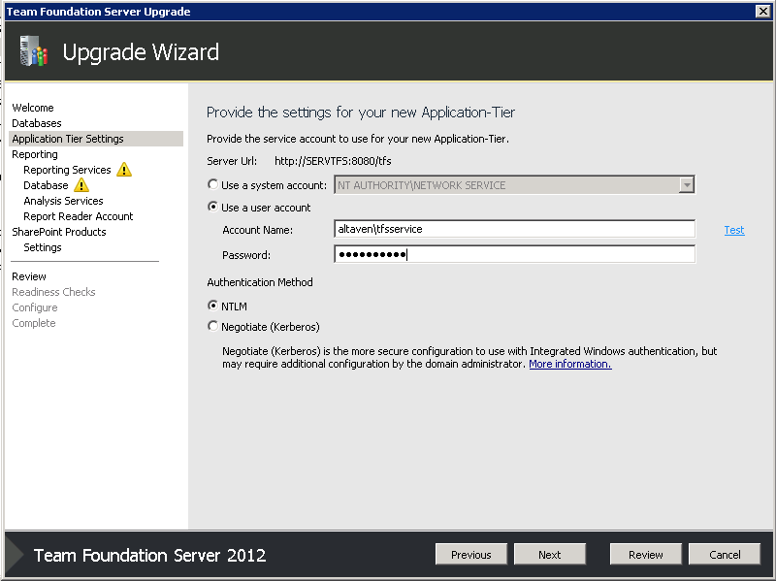

Slide 19
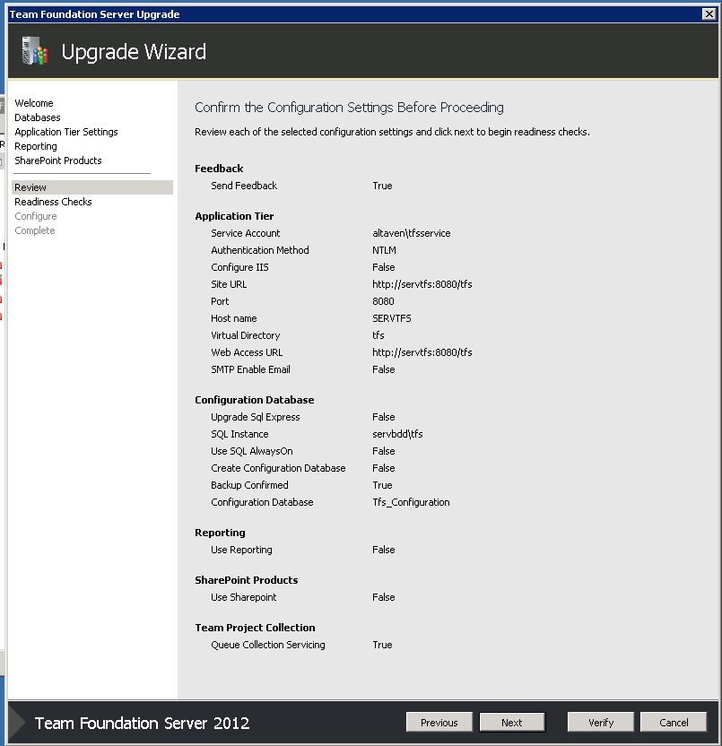

Slide 20
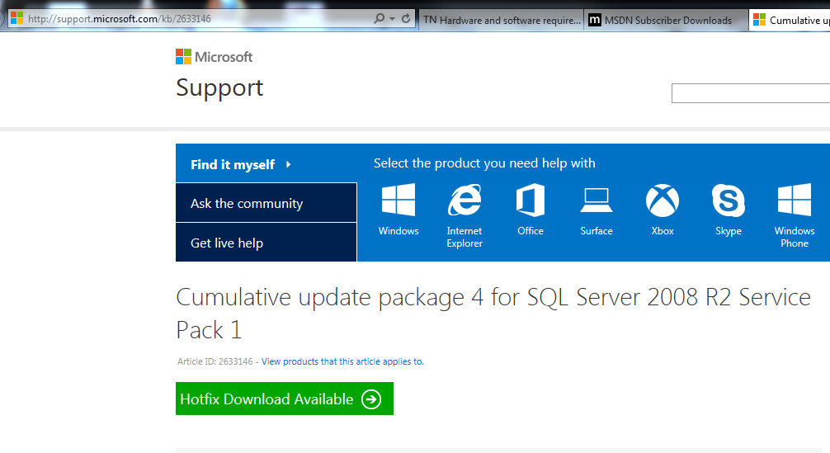
http://support.microsoft.com/kb/2633146

Slide 21
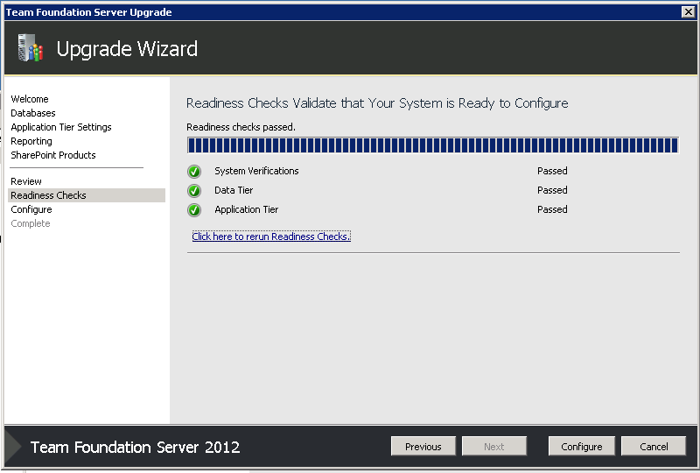

Slide 22
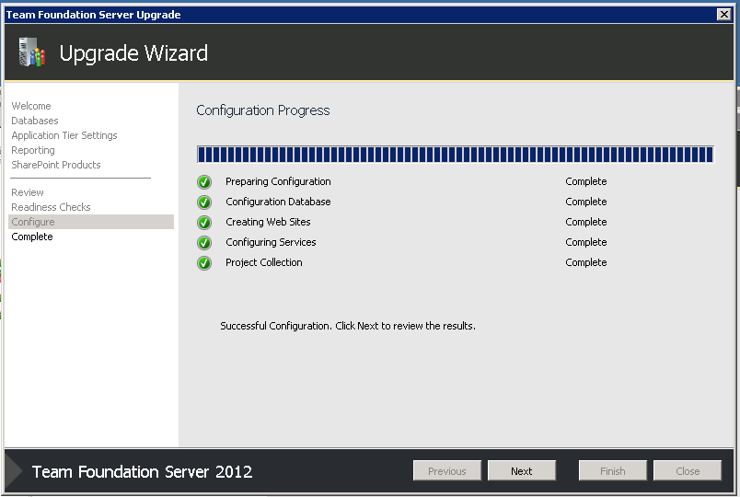

Slide 23
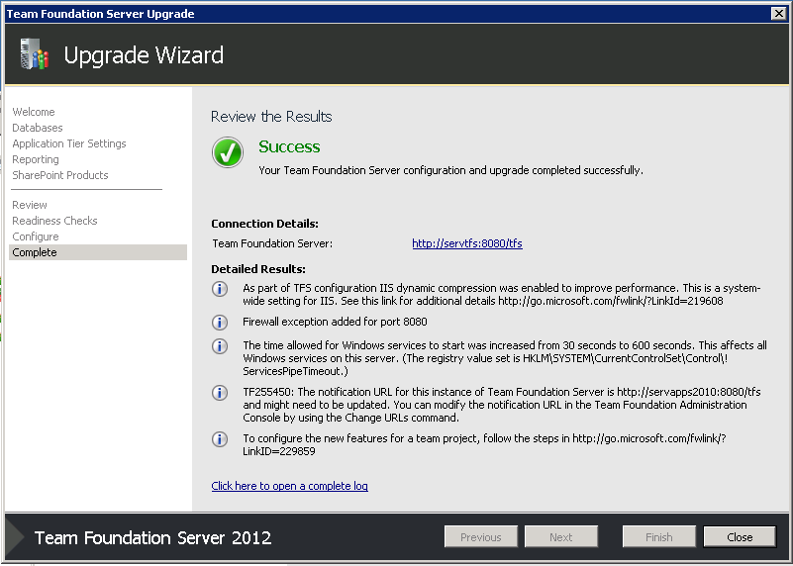

Slide 24
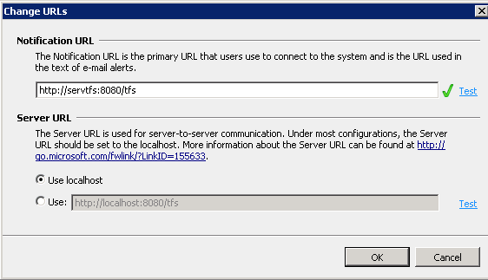

Slide 25
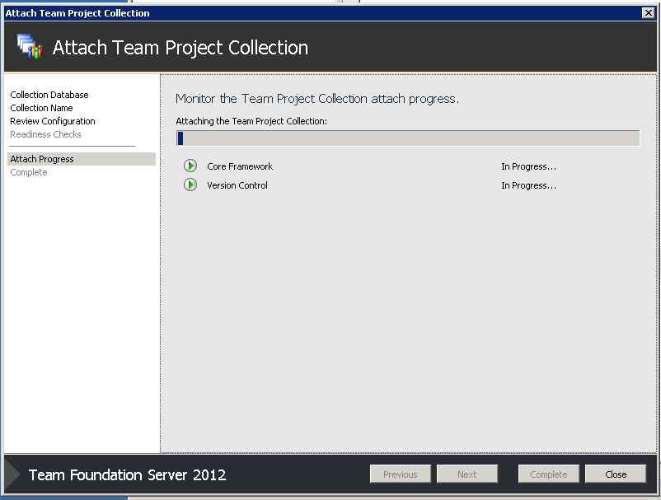

Slide 26
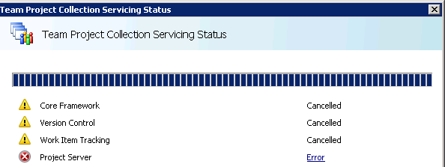
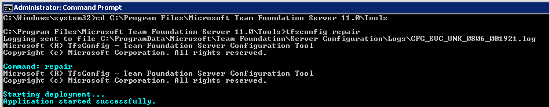
In case of errors like these
http://social.msdn.microsoft.com/Forums/vstudio/en-US/85d7c8a6-e947-4bb9-afb5-965f7d710ead/migrate-tfs-2010-to-tfs2012-error-when-attaching-project-collections#befeeebc-8731-471e-8791-11d42f210ed2
Solution
Info from http://msdn.microsoft.com/en-us/library/ee349268.aspx
TFSConfig Repair attempts to repair connections to or problems with the databases in your deployment. During this
all services are stopped,
TFS is taken offline,
repair operation is run on the configuration database
repair operations are queued for the collection databases
TFS is returned to an online state

Slide 27
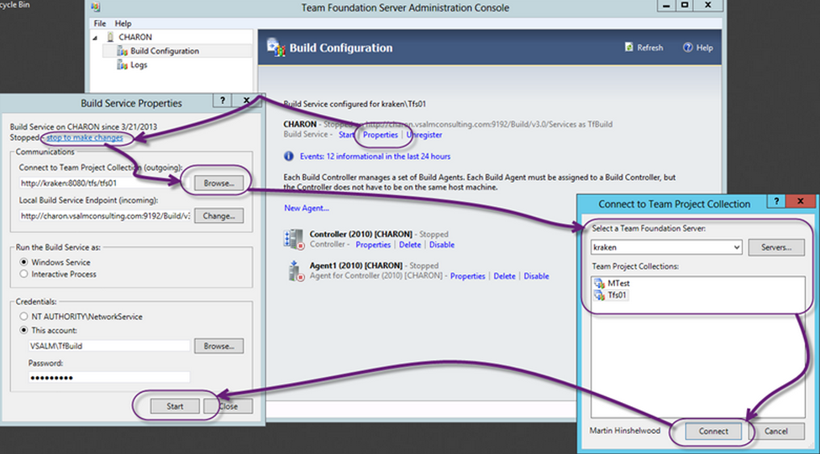
Redirect existing build agents to the new TFS

Slide 28
Upgrade WSS 3.0 to SharePoint 2013
http://technet.microsoft.com/en-us/library/ee947141.aspx
http://community.bamboosolutions.com/blogs/sharepoint-2010/archive/2010/11/02/sharepoint-2010-cookbook-migrate-a-sharepoint-2007-site-to-sharepoint-2010.aspx
Hint: Update WSS3 to 2010 then 2010 to 2013. This is needed because of radical changes in the DB structure, a direct DB detach/attach is not supported.
The hotfixes for SP2010 are here
http://blogs.msdn.com/b/opal/archive/2009/10/25/sharepoint-2010-pre-requisites-download-links.aspx

Slide 29
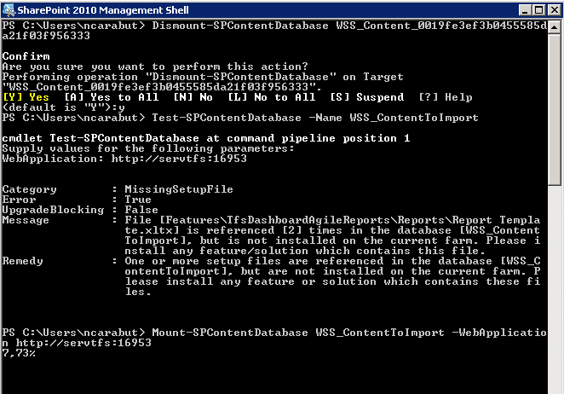
Upgrade WSS 3.0 to SharePoint 2013
Check logs => %COMMONPROGRAMFILES%\Microsoft Shared\web server extensions\14\LOGS
Change rights if needed => http://technet.microsoft.com/en-us/library/gg251985.aspx

Slide 30
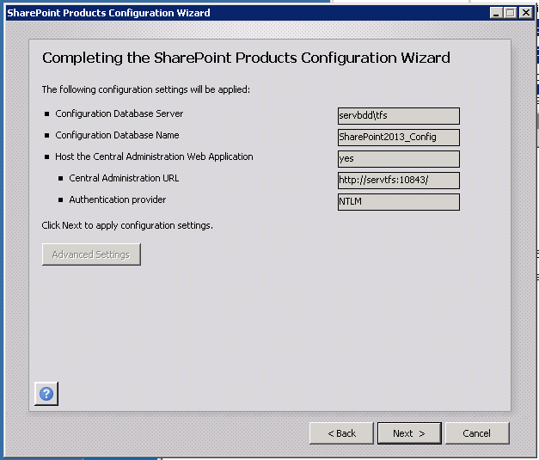
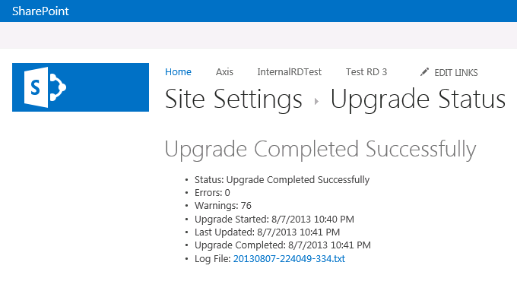
Upgrade WSS 3.0 to SharePoint 2013

Slide 31
Errors (The less fun part)
Access could not be granted for the server running SharePoint Products. The following error occurred: Microsoft.TeamFoundation.TeamFoundationServerException: TF250017: The following error occurred: An update conflict has occurred, and you must re-try this action. The object SPAdminFeature Name=Feature/31871cb4-cc0e-478d-872a-97bd52119991/d28825da-cb13-4810-a31e-08b6e5e9b7f8 Parent=SPWebApplication Name=Default Web Site is being updated by ALTAVEN\Ncarabut, in the w3wp process, on machine SERVAPPS2010.
http://support.microsoft.com/kb/939308

Slide 32
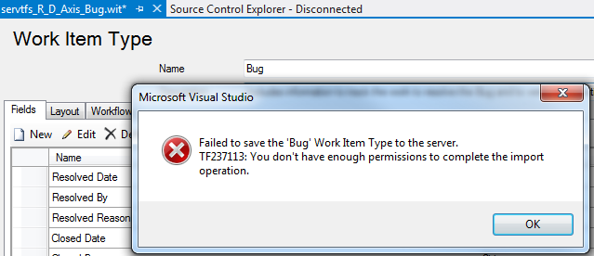

Slide 33
SharePoint 2013 DataBases
SharePoint_Config
StateService_1860a583207c44ef8d7c51b2e181ea9c
WSS_Content_a0e2e7096ad1468faa6107f9f7d9e7fb
SharePoint_AdminContent_fe9098a9-34eb-4c77-8d6e-6bc88bb16cf6
Secure_Store_Service_DB_b934538d6c6641efa1d50a4fc1c6c5fb
AppMng_Service_DB_87d52c8c8cb343ffb745a21dc9cf0b21
Bdc_Service_DB_5d7c27b1854f4039a68cf6b440b1e1c6
Search_Service_Application_DB_b968e54a54f24a46ad166a13437e887d
Search_Service_Application_CrawlStoreDB_32954dd681284b99bf9b2760c45c58d8
Search_Service_Application_LinksStoreDB_07524489bf3e49499e40bceb84949cb1
Search_Service_Application_AnalyticsReportingStoreDB_6612d6da20a0450aa74a73e1294b484d
WSS 3.0 DataBases
WSS_AdminContent
WSS_Config
WSS_Content
WSS_Logging
WSS_Search_SERVAPPS2010
TFS 2010 DataBases
AltavenReporting
ReportServer
ReportServerTempDB
Tfs_Configuration
Tfs_DefaultCollection
Tfs_R_D
Tfs_SetupSignatureHiddenProjects
Tfs_Warehouse
TfsTimesheet
TimeTrack

Slide 34
Project Management
http://blogs.msdn.com/b/bharry/archive/2012/05/16/formal-requirements-with-tfs-and-integreat.aspx

