Slide 1


Bootstrap.js - Chart.js - Math.js
Brian Holaday

Slide 2
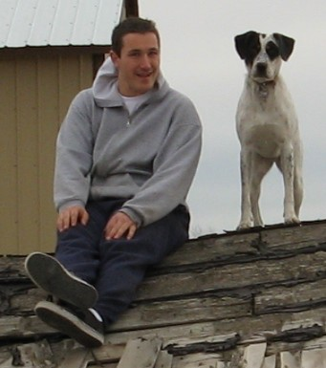
AAS in Digital Forensics (CWI)
AAS in Network Administration (CWI)
AAS in Electronics Technology (BSU)
BAS in Information Technology (BSU)

Slide 3
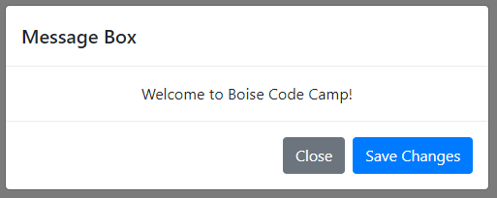
Bootstrap - DropDown & Modal

Slide 4
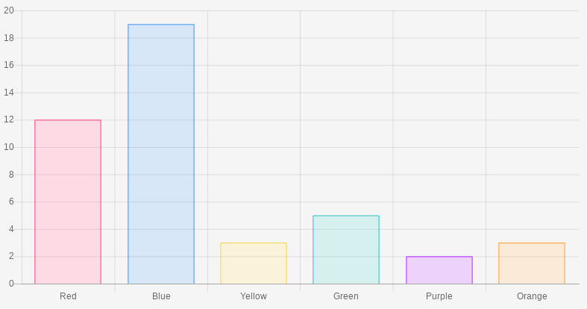
Chart #1 - Horizontal Chart

Slide 5
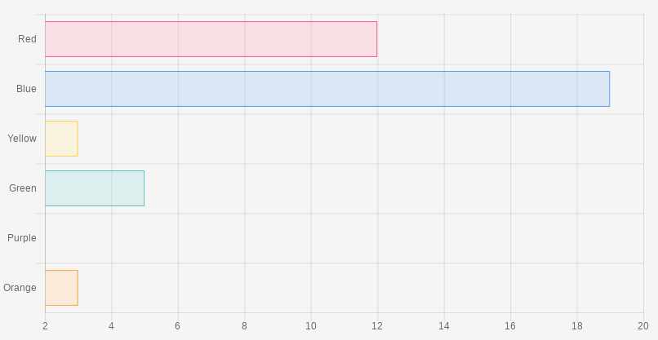
Chart #2 - Vertical Chart

Slide 6
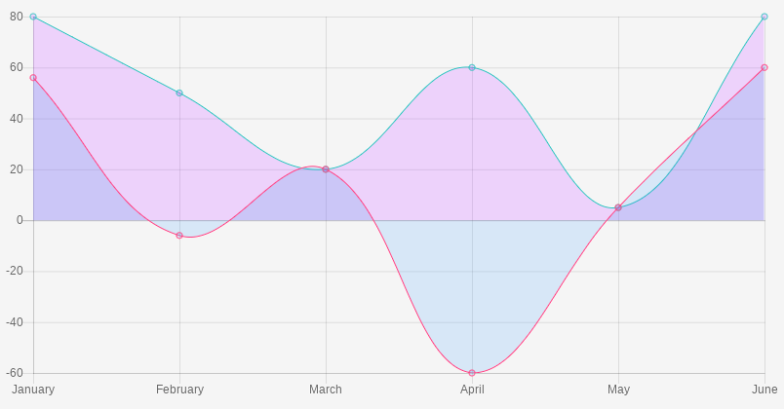
Chart #3 - Line Chart

Slide 7
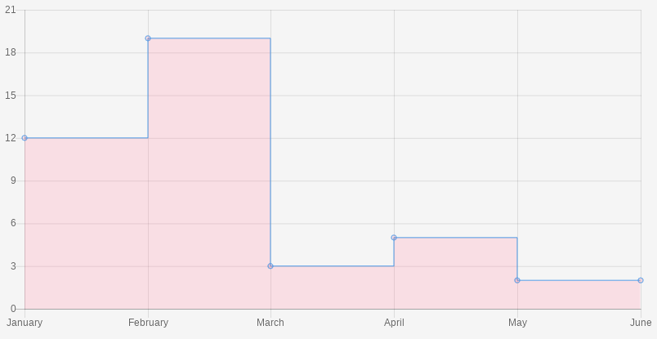
Chart #4 - Step Chart

Slide 8
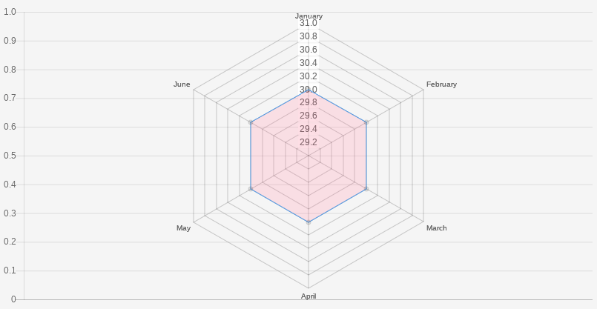
Chart #5 - Radar Chart

Slide 9
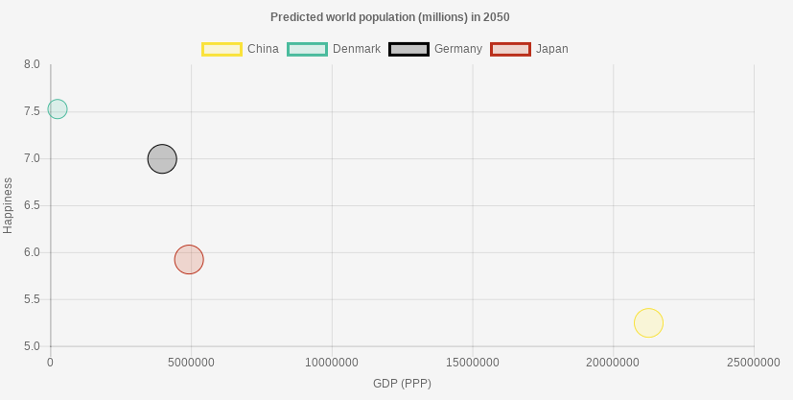
Chart #6 - Scatter Plot

Slide 10
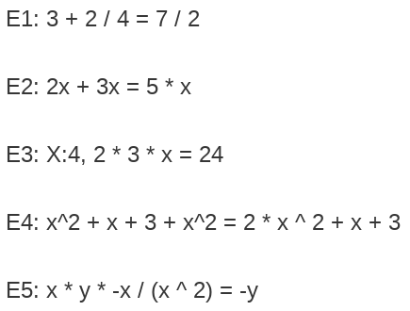
Math - Add/Subtract/Mult/Divide

Slide 11
Questions

