Slide 1


Personal Qualities
and People Skills
Brian Holaday

Slide 2
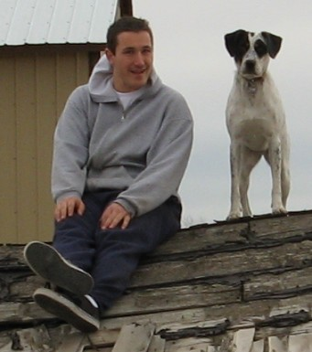
AAS in Digital Forensics (CWI)
AAS in Network Administration (CWI)
AAS in Electronics Technology (BSU)
BAS in Information Technology (BSU)

Slide 3
What is Workplace Readiness?
Being able to work in a mixed environment
Overcome self problematic skills
Building long term goals of achievement
Understanding of speech language
Respect others regardless of Your Opinion
Think before responding to issues
Work to improve process control

Slide 4
Who Needs Workplace Readiness?
High School Student
College Student
Current Workforce Worker

Slide 5
Skill #1 : Positive Work Ethic
“Demonstrate a positive work ethic by coming to work every day on time, a willingness to take direction, and motivation to accomplish the task at hand” (Idaho Workplace)
Exhibiting motivation to accomplish a task
Taking directions carefully

Slide 6
Skill #2 : Integrity
“Demonstrate integrity by abiding by workplace policies and laws and demonstrating honesty and reliability” (Idaho Workplace)
Identify how my actions and behavior can have far-reaching
effects on others
Identify workplace policies as a guide : work to not be literal

Slide 7
Skill #3 : Teamwork
“Demonstrate teamwork skills by contributing to the success of the team, assisting others, and requesting help when needed”
(Idaho Workplace)
Work to assist others
Look to seek help from others. Don’t make assumptions

Slide 8
Skill #4 : Self Representation
“Demonstrate positive self-representation skills by dressing appropriately and using language and manners suitable for the workplace” (Idaho Workplace)
Work to address body language
Work to address overall appearance

Slide 9
Skill #5 : Diversity Awareness
“Demonstrate diversity awareness by working with all customers and co-workers” (Idaho Workplace)
Learn to accept that we all have freedom of choice
Learn to work with others

Slide 10
Skill #6 : Conflict Resolution
“Demonstrate conflict-resolution skills by negotiating diplomatic solutions to interpersonal and workplace issues” (Idaho Workplace)
Work to resolve disagreements on said projects
Work to let go performance issues (leading)

Slide 11
Skill #7: Creativity and Resourcefulness
“Demonstrate creativity and resourcefulness by contributing
new ideas and working with initiative” (Idaho Workplace)
Following directions
Dealing promptly to new situations

Slide 12
WR Analysis #1
Rather than trying to focus on “qualities” ask yourself:
Do I interrupt others : is this a problem?
Are you easily distracted?
Can you change work based on demand?
What can you change about yourself?

Slide 13
WR Analysis #2
Rather than trying to focus on “problems” ask yourself:
What did I do right? Why?
What did I do wrong? Why?
Can you accept or decline the right or wrong?
What can you change about yourself?

Slide 14
Workplace Readiness: Key Findings
Learn to listen instead of leading.
Think about my actions before applying them on others.
Work to assist others instead of leading.
Work to offer respect to management.
Work to let others voice their opinion freely.
Think about my problem before reacting when upset.
Learn to let go : work to be useful.

Slide 15
References
Idaho Workplace Skills - https://bit.ly/2wAc8ic
Virginia Readiness Skills - https://bit.ly/2Jvax1c

Slide 16
Questions

