Slide 1


Dancing with Arduino
Brian Holaday

Slide 2
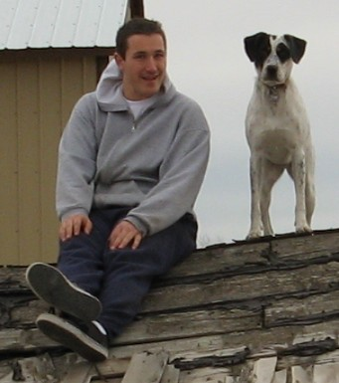
AAS in Digital Forensics (CWI)
AAS in Network Administration (CWI)
AAS in Electronics Technology (BSU)
BAS in Information Technology (BSU)

Slide 3
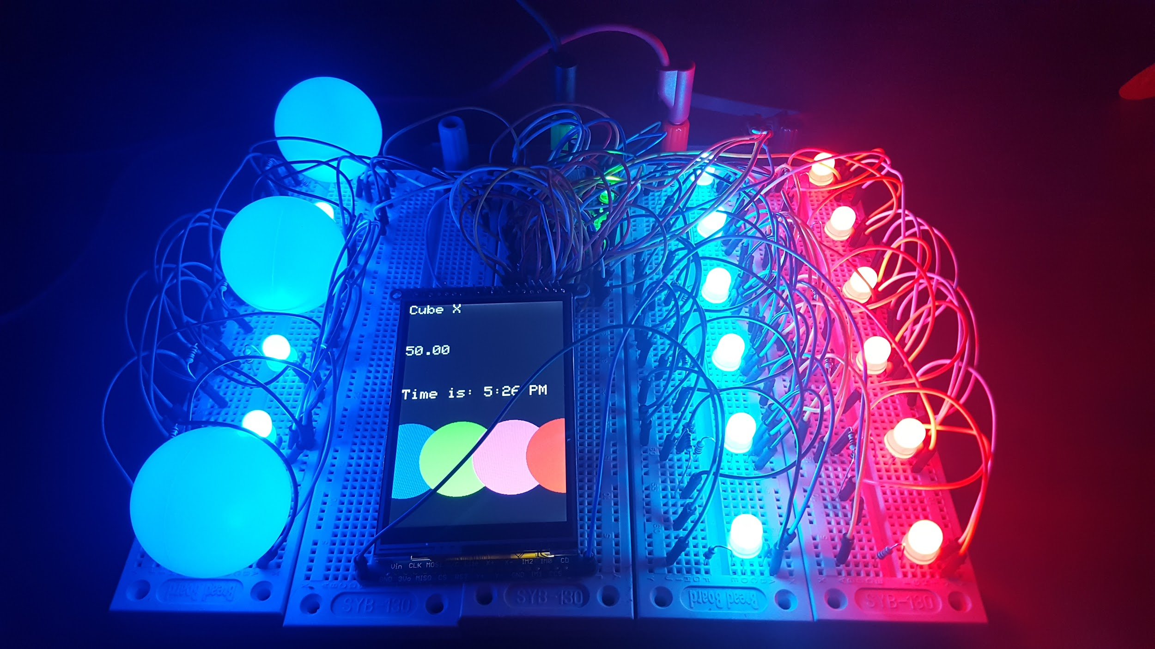
Demo

Slide 4
Questions

