Slide 1
Led CUBE Project
By: Brian Holaday

Slide 2
Past PROJECTS

Slide 3
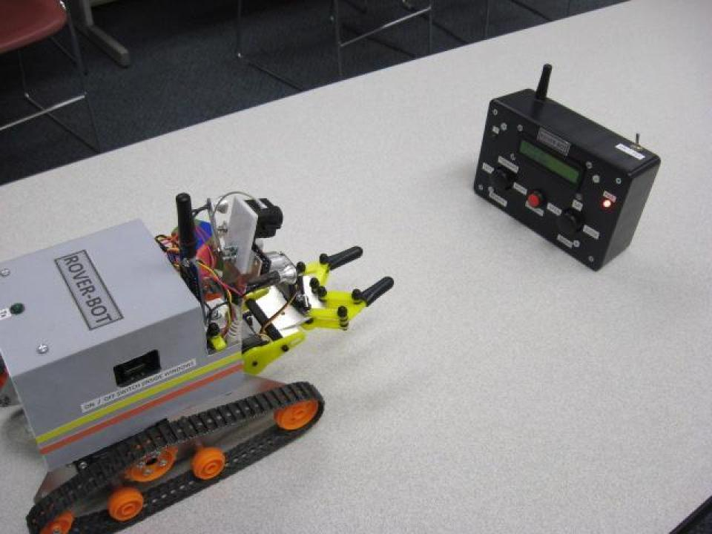

Slide 4
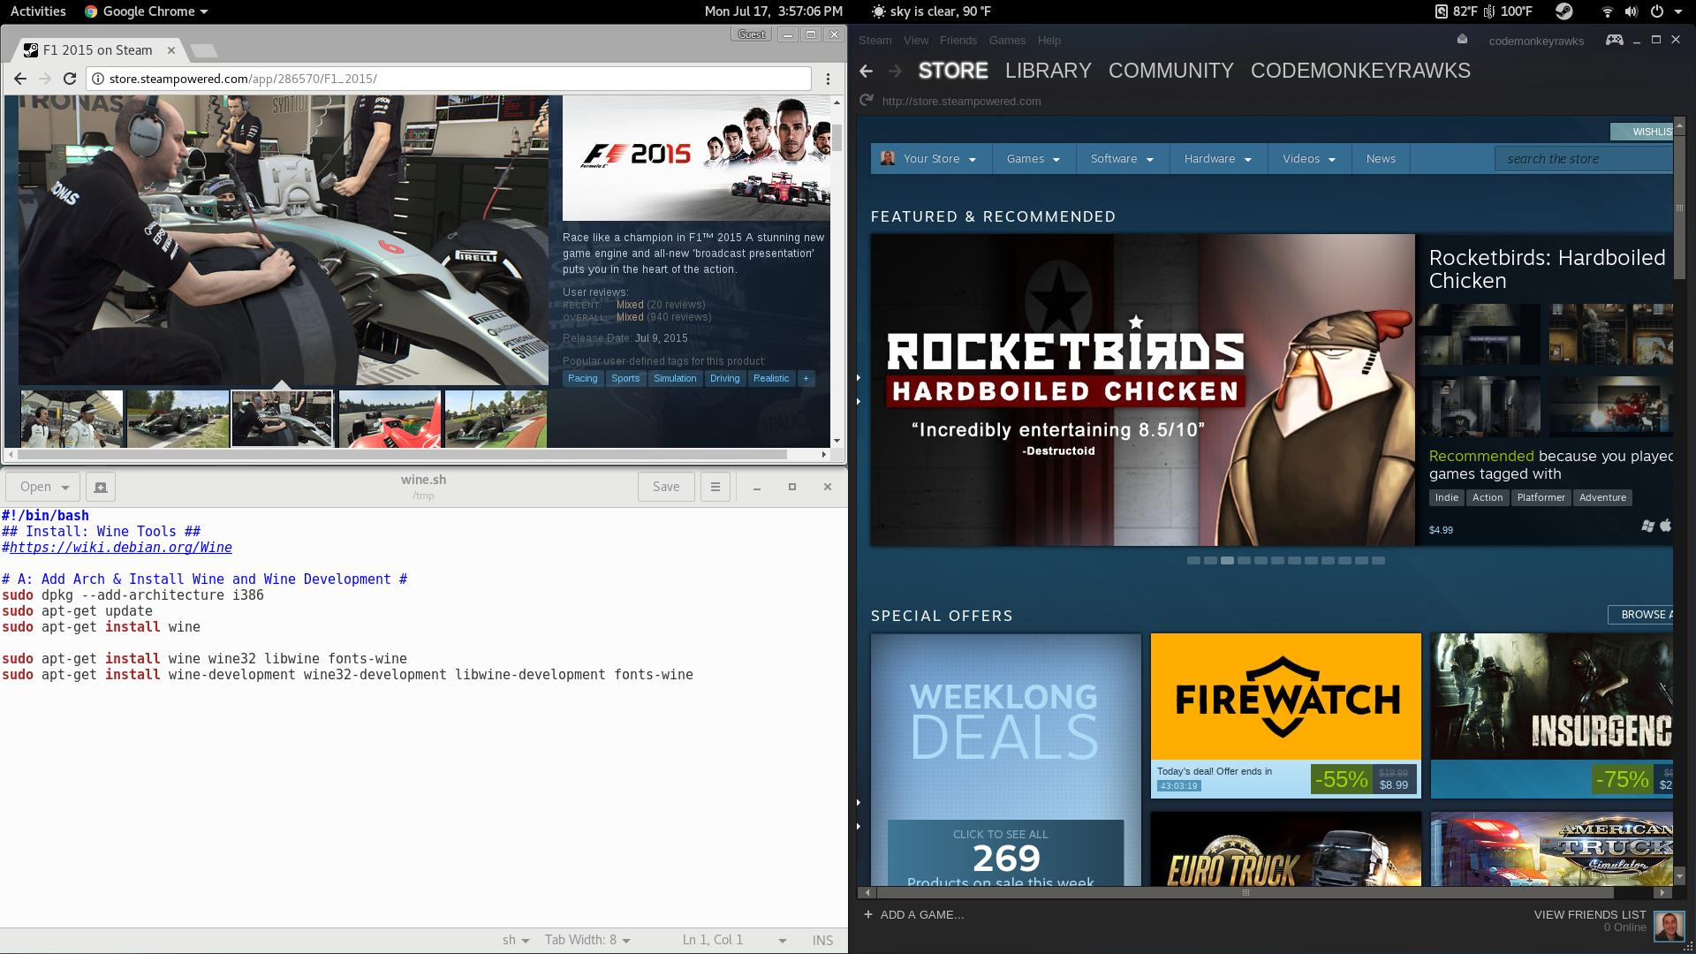
Notes:
https://www.youtube.com/watch?v=Otk6VTVJKBU&list=PL-xZsBalytNA71DNhKQv3fKPJpMA8v7VH&t=0s&index=8 1:34

