Slide 1
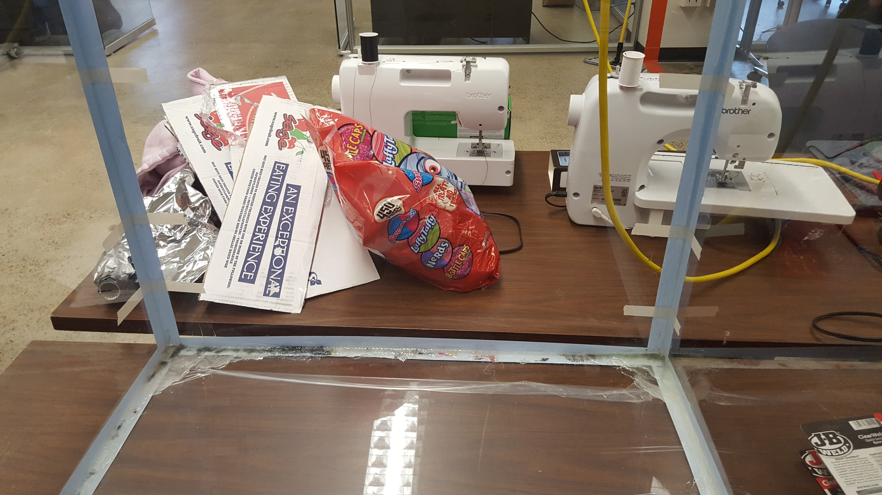
Led Cube
Description:
Build a 8x8x8 Box with Ping Pong Balls
Brian Holaday

Slide 2
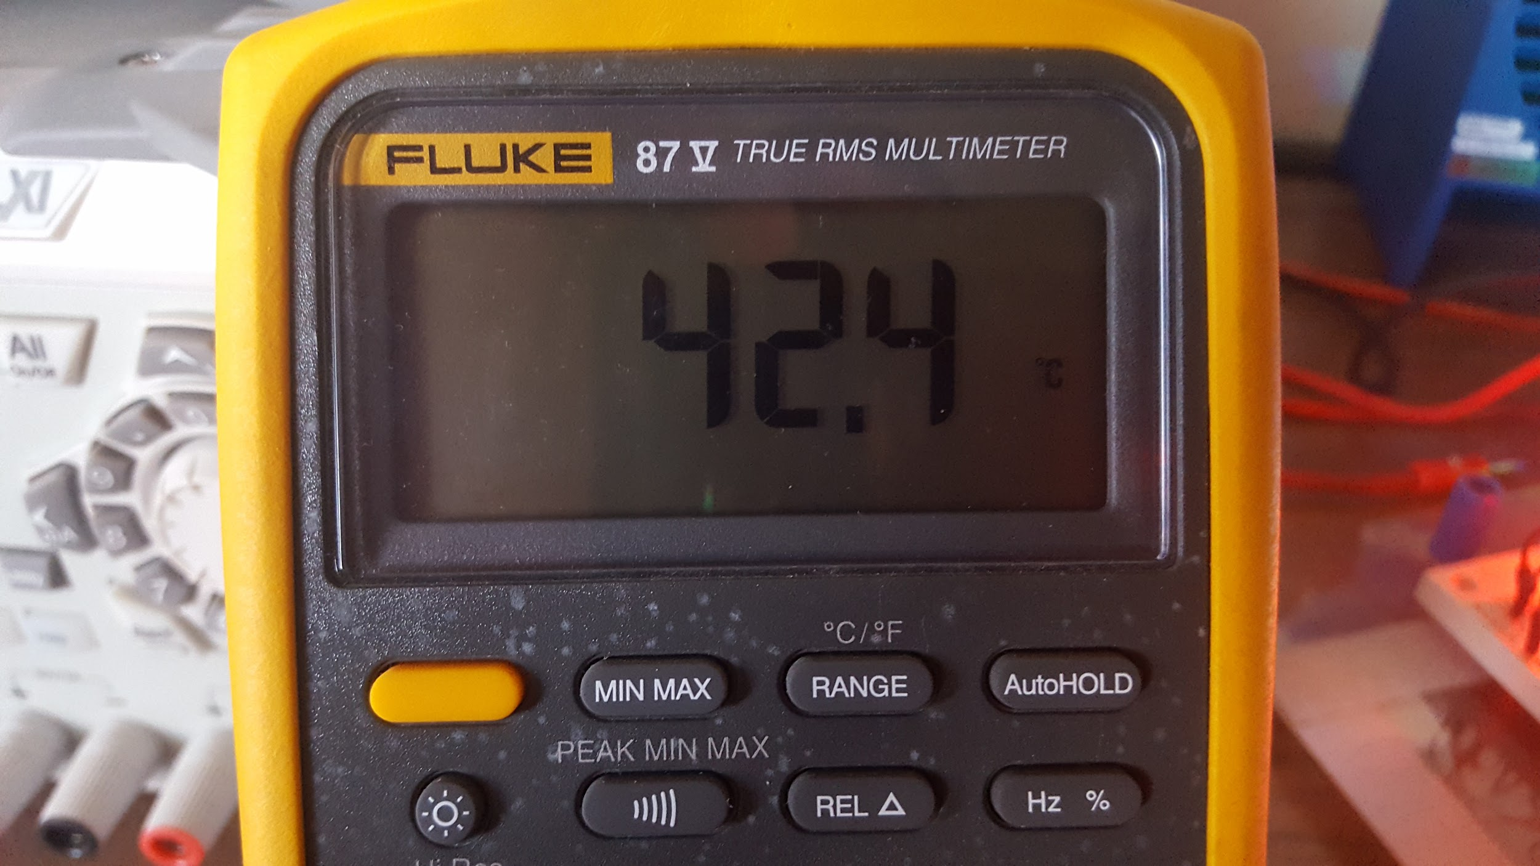
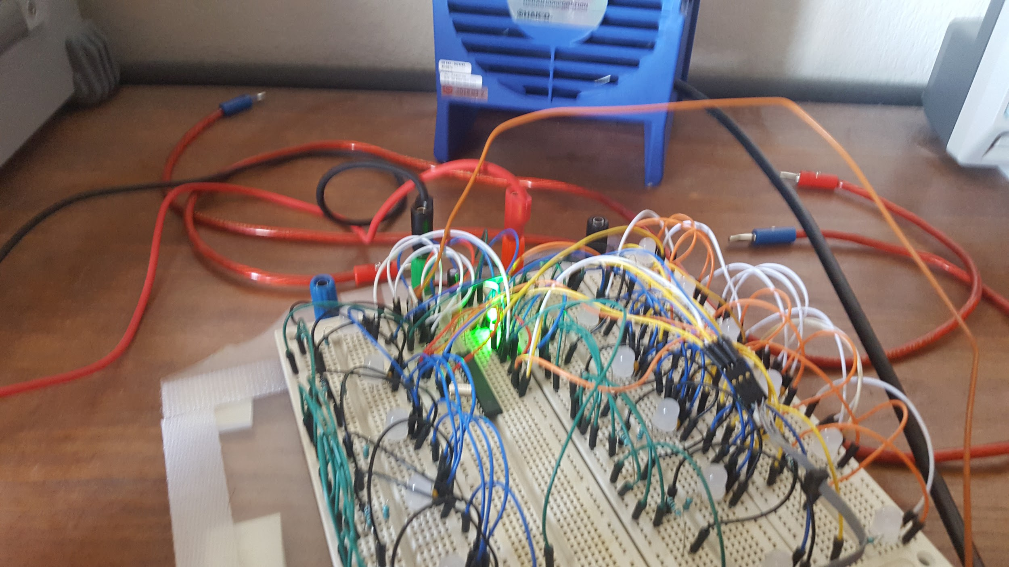
Led Cube - Problem #1
Problem: Overload on Temperature due to Current
Solution: 6 Volts x 20mA = 120mW (24° C)
Brian Holaday

Slide 3
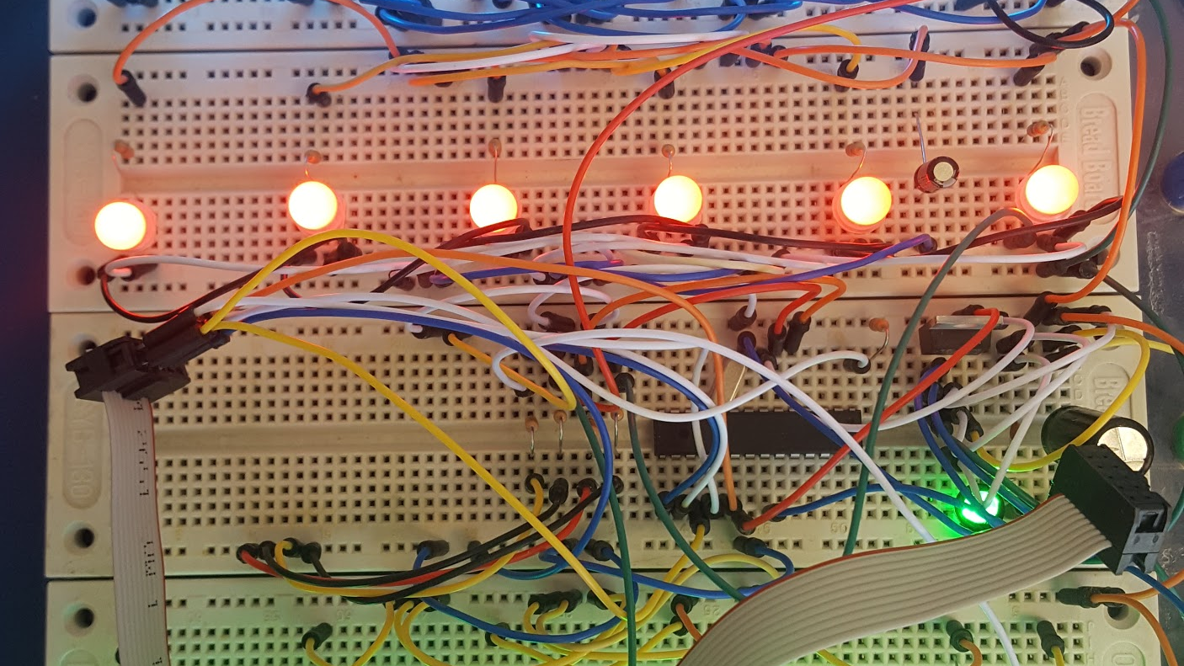
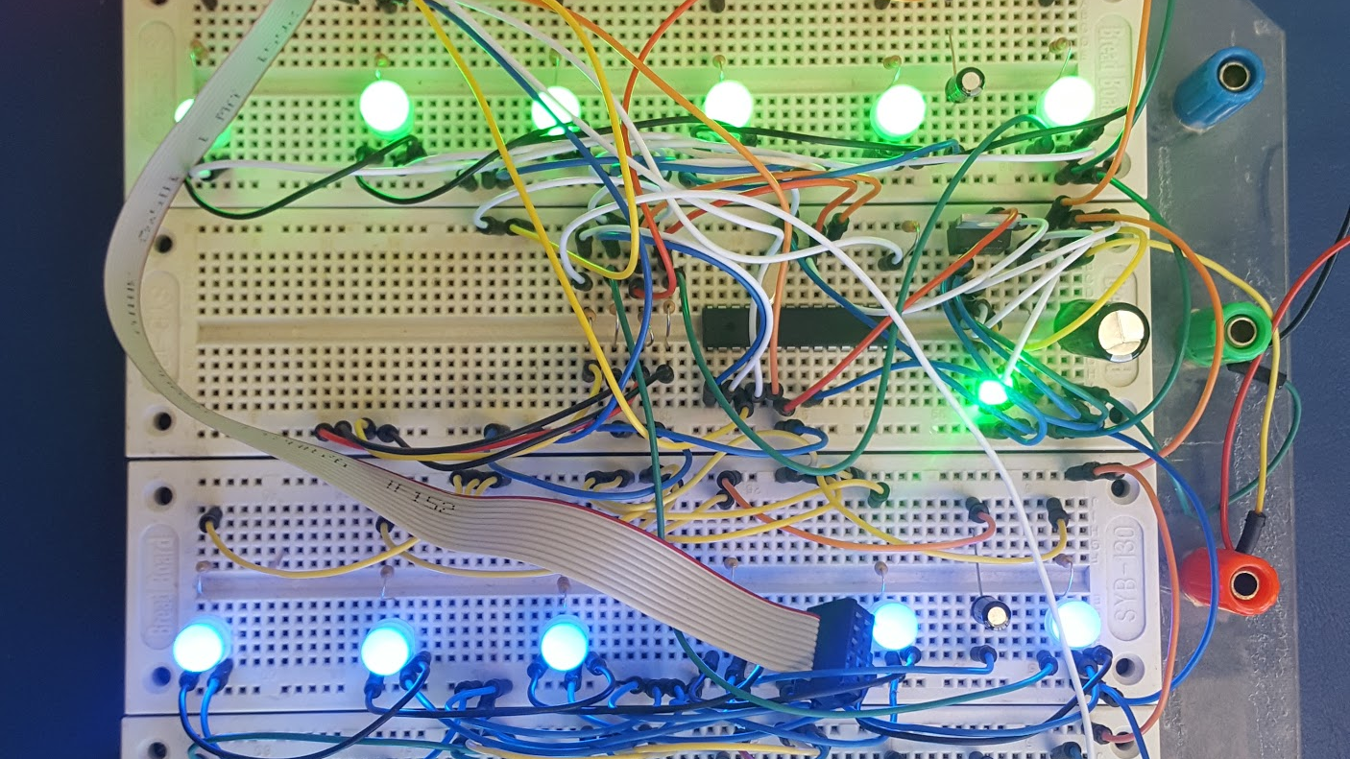
Led Cube - Problem #2
Problem: Timing is Key with Shift Registers
Solution: Added: RC Filter and R Overload
Brian Holaday

Slide 4
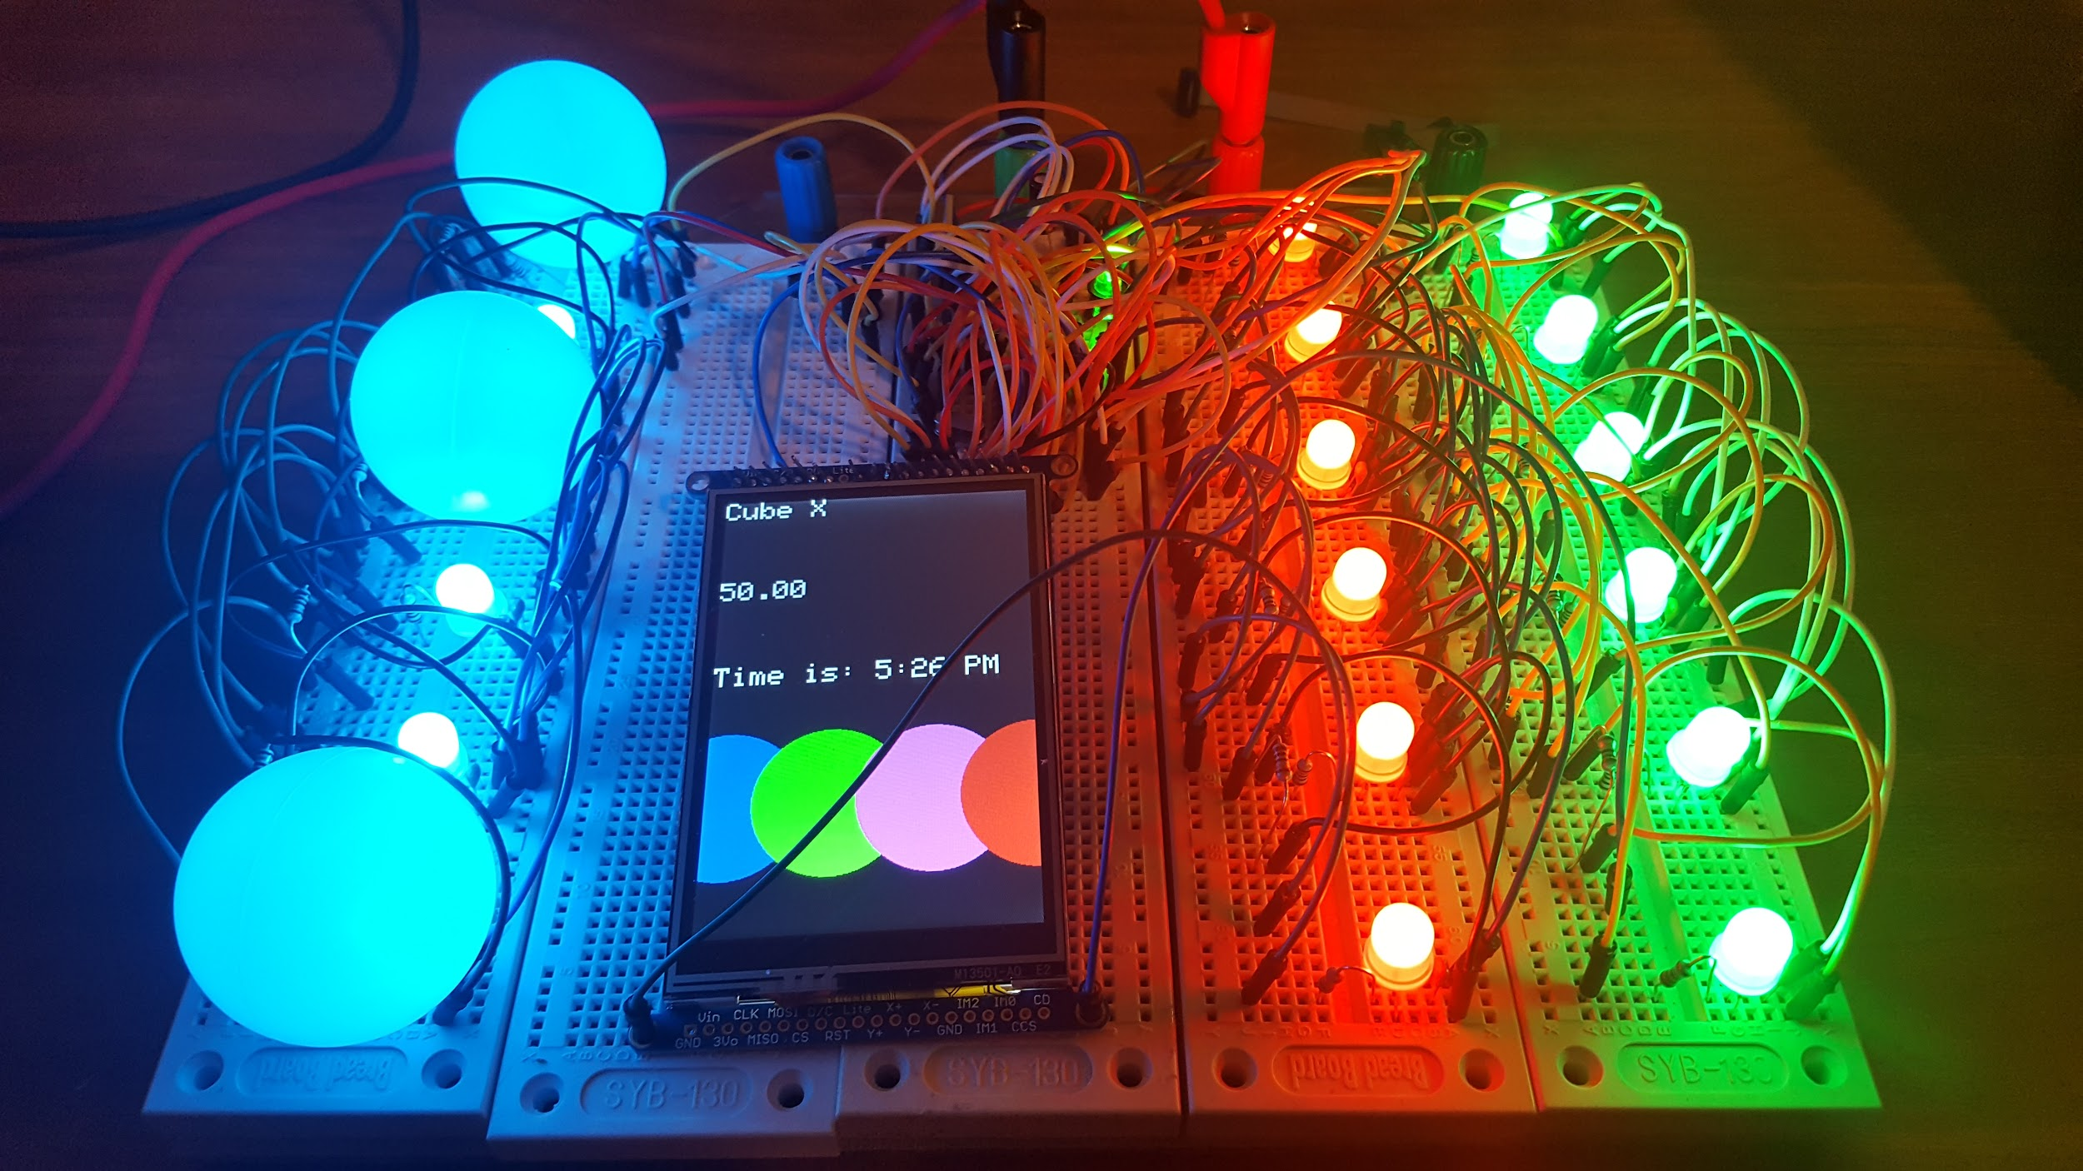
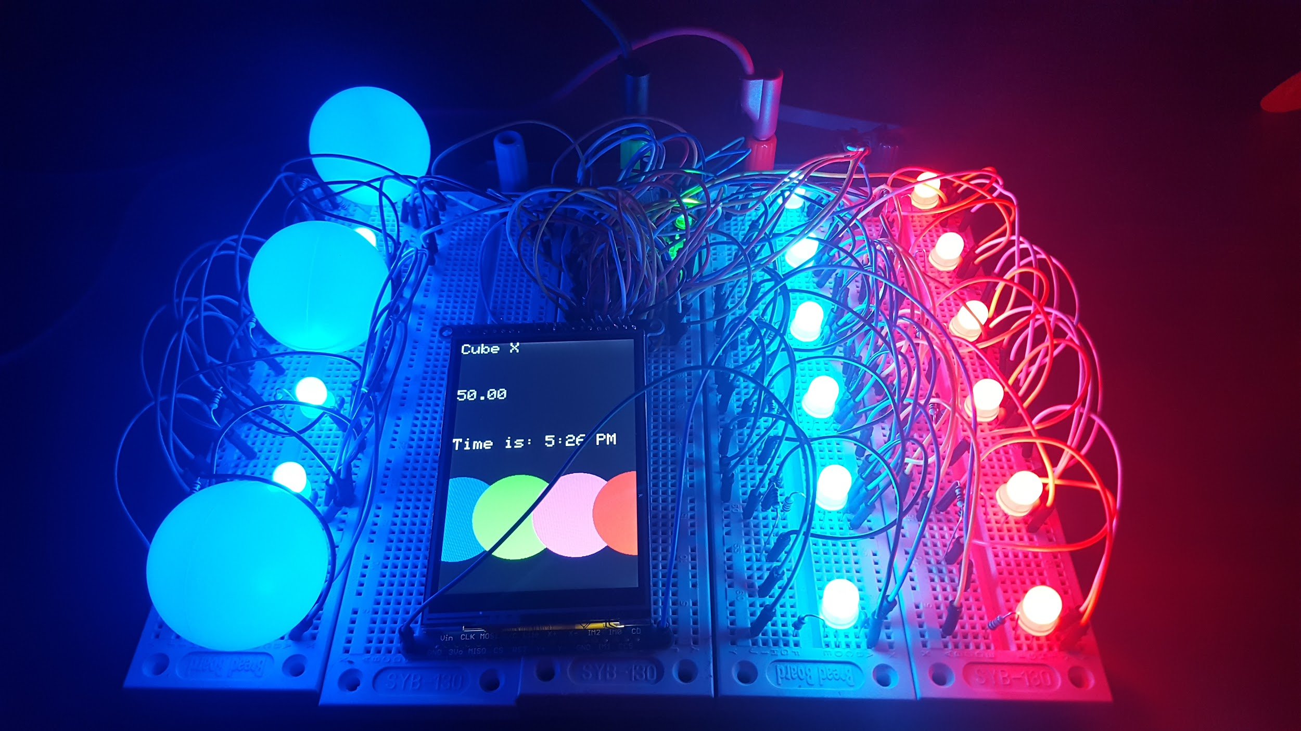
Led Cube - Problem #3
Problem: Brightness Adjustment using PWM
Solution: Tweaked R Value on LED’s for Max Bright
Brian Holaday

