Slide 1
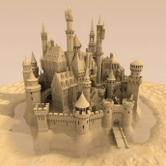
Sandcastle
Documentation Compilers For Managed Class Libraries
Enabling managed class library developers throughout the world to easily create accurate, informative documentation with a default (common) look and feel.

Slide 2
Agenda
Problem Statement
Target Audience – Jane and Joe
User Scenarios
Documentation process using Sandcastle
Sandcastle highlights
Appendix
Notes:
1.
2. So it’s useful even for undocumented code.
3. Even COBOL.NET, right Imran?? ☺
4. Because we use unmanaged reflection.
5. Simple compiler interface for build script automation or VS add-in for convenience.
6. The Tablet PC SDK docs you just saw were compiled end-to-end in just under 3 minutes.
7. Fully supports localization.

Slide 3
The Problem
Since releasing v1 of the .NET Framework, Microsoft has been encouraging C# developers to document their code using XML documentation comments.
In Whidbey, the VB compiler has the same feature.
But… once you’ve compiled your XML documentation comments, you’re left with a big XML file, not good documentation.
Developers need good documentation.
Notes:
This isn’t a bad thing. ☺
This isn’t a bad thing either. ☺
We leave the customer hanging here. Sure, the file is useful to deploy with the corresponding assembly so customers can enjoy IntelliDoc. But it’s not useful documentation for the end user yet. Customers want and need good end-user documentation. Today, they’re left with weak XSL transforms (no reflection), mediocre 3rd party solutions, or rolling out their own solutions.
In today’s society, documentation is generally ignored. You buy a camera, a dish washer, a VCR, or a lawn mower, and the first thing you do is throw away the documentation or file it away never to be seen again. Either way, you never look at it again… unless something goes wrong in which case you agonize of the documentation for a while and then file it away again for several years.
The exception to the rule is Software Developers. Documentation is critical to developers at all levels and is continually used as a reference throughout their careers.
Right now our statement is, please create lots of useful documentation. Now you have nothing to do with it.

Slide 4
Target Audience
Anybody writing managed code.
Two personas
  Jane in London
  Joe in Iowa
Notes:
This is a broad audience, so we group it into two personas: Joe in Iowa and Jane in New York.
The core difference is Joe is a developer in a small company or organization and has to write his products’ documentation himself. Jane is an IT manager for a larger company or organization and can afford to hire a UE staff including technical writers and editors or at least outsource the work. Microsoft itself would be an example of Jane in Iowa.

Slide 5

Jane in London
“We’re a large company specializing in advanced imaging components for .NET. We have our own team of technical writers who author using an in-house XML-based system. We found it very easy to integrate our existing authoring system with Sandcastle using XSL transforms. It’s now an essential part of our daily build process and has saved our writers hours of work while reducing human errors and increasing the accuracy of our documentation.”
Jane in London
Notes:
Jane is better organized. She can delegate the development work to developers. She can delegate the documentation work to technical writers and editors.

Slide 6

Joe in Iowa
“I’m one of four developers on our team creating reusable web controls. We write our own documentation inline using C# XML documentation comments. It’s really convenient and we can see our real documentation in seconds using the Sandcastle Add-in in Visual Studio. Our customers really love the MSDN-like documentation.”
Joe in Iowa
Notes:
Joe is a Jack of all trades. He is a developer. He writes his own documentation. He services the copy machine. (Not necessarily successfully.) We need to make it as easy and convenient for him to produce quality documentation for his customers as is possible.

Slide 7
Real Joe in Iowa
From: Ryosuke Matsuuchi
Sent: Thursday, May 06, 2006 1:23 AM
To: Sandcastle User Help
Subject:
Hi there,
I am contributing to a small managed-code library (developed by ~4 SDETs and used by ~30 STEs) and was looking for handy documentation tool, and came across Sandcastle. Tried with a couple of CLR 2.0-based assemblies and fell in love with this tool - it's so handy and works very nicely.
Notes:
Or perhaps I should say Ryosuke in Redmond.

Slide 8
The Solution
Enter Sandcastle.
  Introducing two new documentation compilers…
  Introducing one new Visual Studio Add-in…
Sandcastle produces accurate, familiar, comprehensive documentation by:
  reflecting over the source assemblies
  optionally integrating XML Documentation Comments.
Notes:
1. Sandcastle solves this problem by introducing two new documentation compilers as well as a Visual Studio Add-in.
2. These documentation compilers reflect over the source assemblies and XML documentation files to produce full-featured end-user documentation much like MSDN.

Slide 9
Documentation Process using Sandcastle
assemblies
MrefBuilder
+
xslTransform
C# or VB
source files
csc /doc
Reflection.xml
+
Manifest
XML
files
HTML
topics
BuildAssembler
Help Viewer
HTML Help
Compiler
project
file
TOC
file
indexes
Sandcastle Libraries
External Tools
Source Files

Slide 10
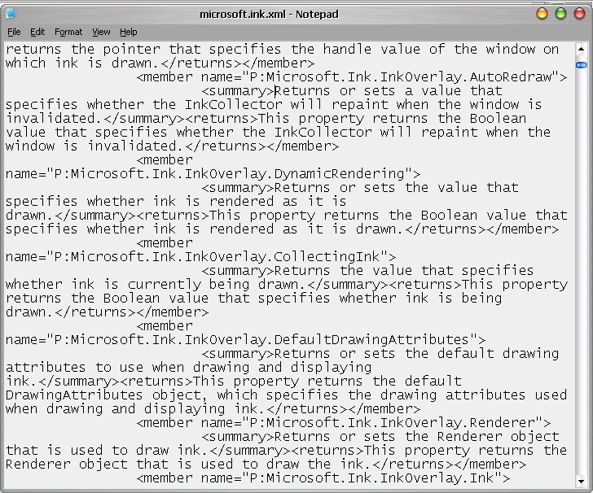
Previous (Without mref doc compiler)
Notes:
Big ugly XML file… got this from the Tablet PC SDK.

Slide 11
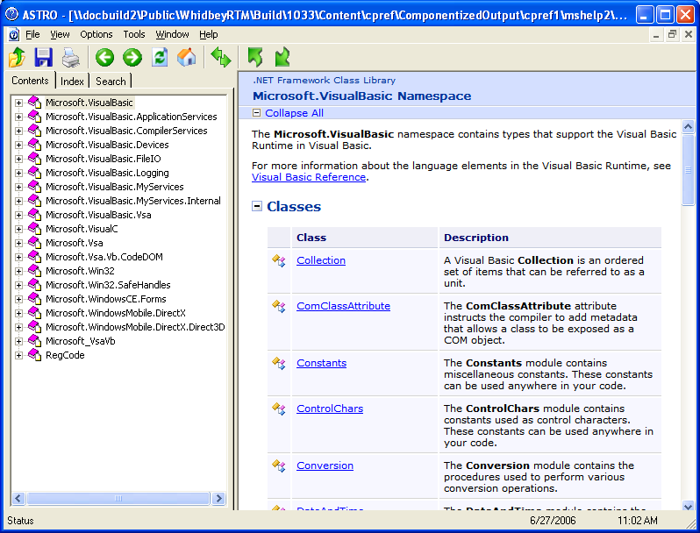
With Sandcastle
Notes:
I created this from the TabletPC SDK. They don’t even know they’re using Sandcastle!! That’s how easy it is.

Slide 12
Sandcastle Highlights
Produces quality, comprehensive, familiar MSDN-like documentation.
Works with or without authored comments.
Supports all .NET languages.
Supports Generics and .NET Framework 2.0.
Supports .NET Compact Framework projects.
Simple compiler interface or Visual Studio add-in.
Very fast performance.
Supports localization.
Notes:
1.
2. So it’s useful even for undocumented code.
3. Even COBOL.NET, right Imran?? ☺
4. Because we use unmanaged reflection.
5. Simple compiler interface for build script automation or VS add-in for convenience.
6. The Tablet PC SDK docs you just saw were compiled end-to-end in just under 3 minutes.
7. Fully supports localization.

Slide 13


Appendix

Slide 14
Packaging
MRefBuilder.exe
Sandcastle consists of private assemblies MRefBuilder.exe, xslTransform.exe and BuildAssembler.exe.
HTML Help 1.x compiler (hhc.exe) or Microsoft Help 2.0 compiler (hxcomp.exe) required to produce .chm or .hxs.
Help Viewer
xslTransform.exe
BuildAssembler.exe
mcd.dll
(optional add-in for VS)
HTML Help 1.0
Workshop
Microsoft Help 2.0
VSIP Package
Help Viewer

Slide 15
MrefBuilder’s and xslTransfrom’s Purpose
MrefBuilder uses CCI to reflect against the assemblies and generates an output file.
xslTranform transforms the output file into a Reflection.xml “documentation” file.
Reflection.xml contains all of the documentation data and none of the presentation.
xslTranform also generates the manifest for the topics.
Notes:
Using reflection against the rich metadata stored in .NET assemblies promotes consistency, increases accuracy, and frees technical writers from tedious work.
Use of Metadata Unmanaged API allows documentation of projects dependent on different runtime versions (such as the .NET Compact Framework).
High-end customers such as some Jane in New York’s may choose to develop their own presentation system by skipping pDoc and having their own tools consume cDocML directly.
The cDoc interface is modeled after traditional language compilers.
cDoc interacts with the user using command-line arguments and the standard output pipe.
cDoc supports .NET compiler enhancements such as response files.
cDoc errors and warnings use the “CDnnnn” range of compiler error codes.

Slide 16
BuildAssembler’s Purpose
BuildAssembler “presents” the “documentation” from the Reflection.xml file and authored comments as logically-grouped HTML topics.
The output of BuildAssembler is ready to be consumed by existing Microsoft HTML Help Compilers (1.x or 2.x).
Notes:
We currently have about 23 kinds of topics.
pDoc also generates indexes and a TOC ready to be consumed by the HTML Help compilers.

Slide 17
Presentation Features
MSDN-like layout and look & feel.
Auto-generated index entries, TOC entries, topic chunking, and page layout promote consistency and familiarity.
Auto-generated syntax declaration sections.
Auto-generated inheritance tables.
Code colorization.
Multiple styles and language selection give end user the ability to select their favorite preferences.
Notes:
1. Sandcastle documentation uses the same

Slide 18
For More Information…
http://sandcastle

Slide 19


© 2005 Microsoft Corporation. All rights reserved.
This presentation is for informational purposes only. Microsoft makes no warranties, express or implied, in this summary.

