Slide 1
FURNACES
By Vivek Kumar and Sweety Kumari

Slide 2
KOKUSAI Electric

Slide 3
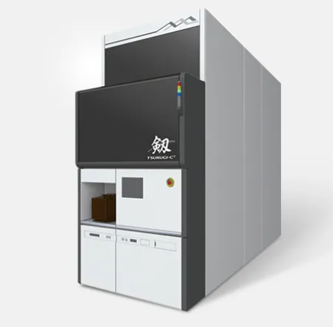
TSURUGI-C²
Process Applications
Thin film deposition
Features
High performance wafer reactor ーNew Innovative reactor design provides thickness uniformity improvement with the least loading effect ーShortens total deposition time dramatically with improved reaction gas purging efficiency
Low particle & high speed wafer transfer automation
High productivity, small footprint

Slide 4
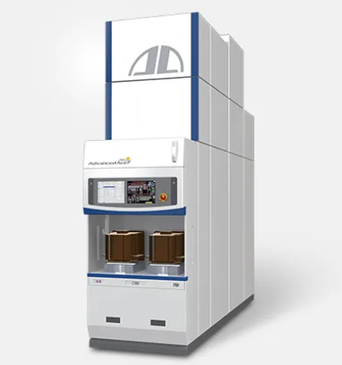
AdvancedAce -300
Process Applications
LP CVD
Oxidation
Annealing (low/high temp.)
Diffusion
Features
Achieved high productivity: Improved 1.5times(*) larger lot processing in a time (* Compared with previous model)
Capable of conformal films into deep trench
Realized high accurate, high quality film deposition in low temperature
Health check function (Option)

Slide 5
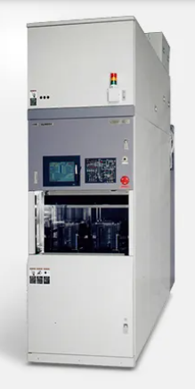
VERTRON® Revolution
Process Applications
LP CVD
Oxidation
Annealing (low/high temp.)
Diffusion
Features
Compatible with processes of other models in the proven VERTRON® series
Incorporates the latest 300-mm technology for increased processing speed
High productivity (175 wafers) and low ceiling height (100 wafers) options are also available
Optional atmosphere control to accommodate processes sensitive to oxygen concentration and humidity
Controller architecture has been revamped to improve processing performance and eliminate risk of production stoppage

Slide 6
ASML -Advanced Semiconductor Materials Lithography

Slide 7
A lithography system is essentially a projection system. Light is projected through a blueprint of the pattern that will be printed (known as a ‘mask’ or ‘reticle’). The blueprint is four times larger than the intended pattern on the chip. With the pattern encoded in the light, the system’s optics shrink and focus the pattern onto a photosensitive silicon wafer. After the pattern is printed, the system moves the wafer slightly and makes another copy on the wafer.

