Slide 1
BWUNETIC

Slide 2

Submitted by
Akash Debnath
Mousumi Biswas
Debjoyti Debnath
Arideep Nandi

Slide 3
PURPOSE OF “BWUNETIC’’
The purpose of this project is to develop an in-house social media outlet that can be used by the students and the staff as well of the university to get connected each other.
BWUNETIC mission is to give students the power to build community and bring the University closer together. Student use BWUNETIC to stay connected with friends and teachers, and to share and express what matters to them.

Slide 4
TECHNOLOGY USED IN THIS PROJECT
FRONTEND TECHNOLOGIES:
ReactJs
HTML and CSS
BACKEND TECHNOLOGIES:
NodeJs
ExpressJs Framework

Slide 5
TECHNOLOGY USED IN THIS PROJECT
DATABASE:
Mongo DB

Slide 6

What is ReactJS used for?
React is a JavaScript library for building modern applications. React is used for handling the view layer and can be used for development of both web and mobile applications

Slide 7

What are HTML and CSS used for?
HTML (the Hypertext Markup Language) and CSS (Cascading Style Sheets) are two of the core technologies for building Web pages. HTML provides the structure of the page, CSS the (visual and aural) layout, for a variety of devices.

Slide 8

What Mongo DB is used for?
Mongo DB is an open source NoSQL database management program. NoSQL is used as an alternative to traditional relational databases. NoSQL databases are quite useful for working with large sets of distributed data. Mongo DB is a tool that can manage document-oriented information, store or retrieve information.

Slide 9
FEATURES OF THIS PROJECT
Outer Interface
Home Page
Chat Features
Notification
Profile
Logout
Internal Interface
Create post
Edit post
Show all post
Comment on post
Like post
Personal chat
Audio call
Video call

Slide 11
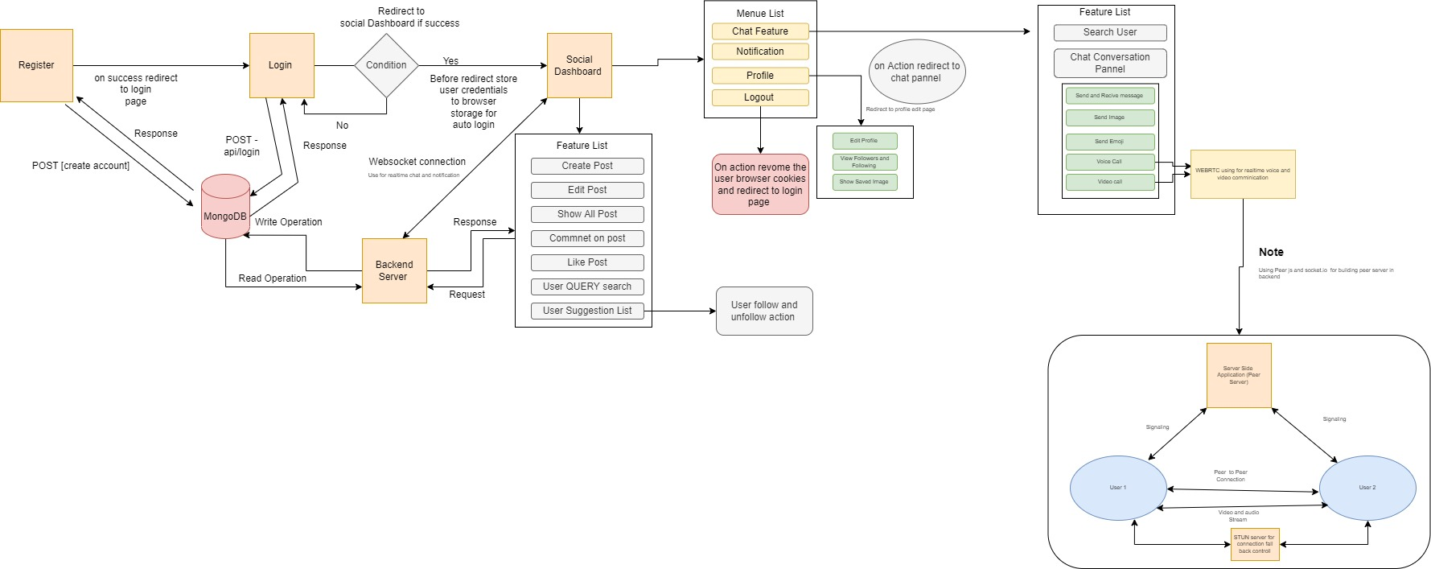
DATA FLOW DIAGRAM

Slide 12
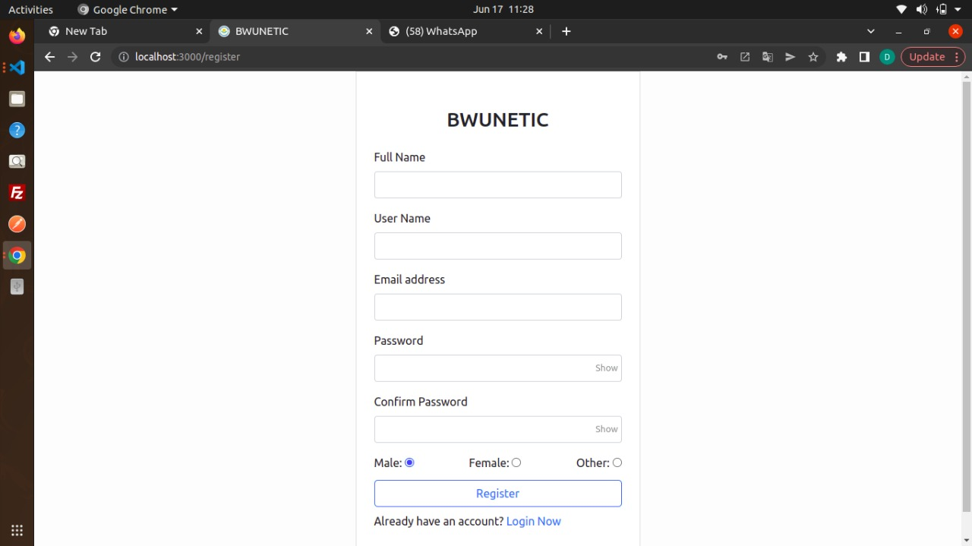
REGISTRATION FORM

Slide 13
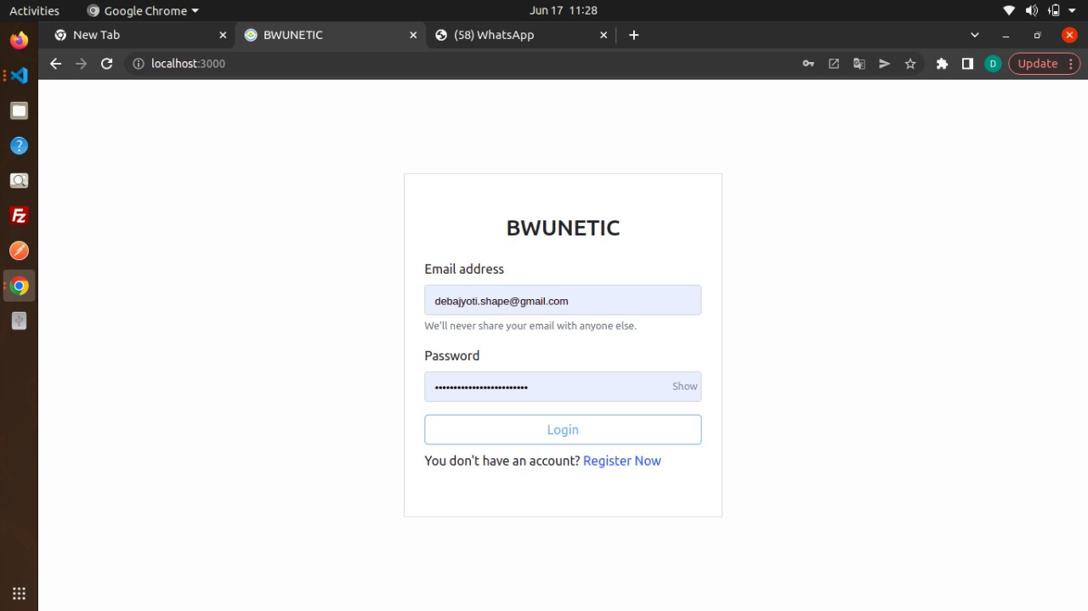
LOGIN FORM

Slide 14
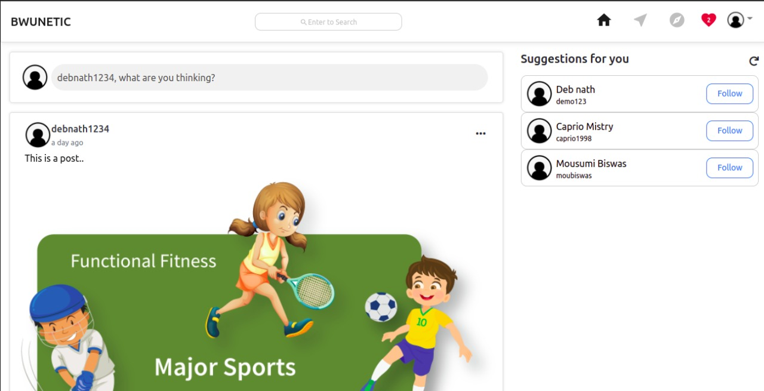
HOME PAGE
This page contains your Feed, a continually updated collection of postings from your friends, groups you're a member of, Pages you follow, and more. Find out how to: You have complete control over what you see in Feed. Look for individuals and subjects that are important to you.

Slide 15
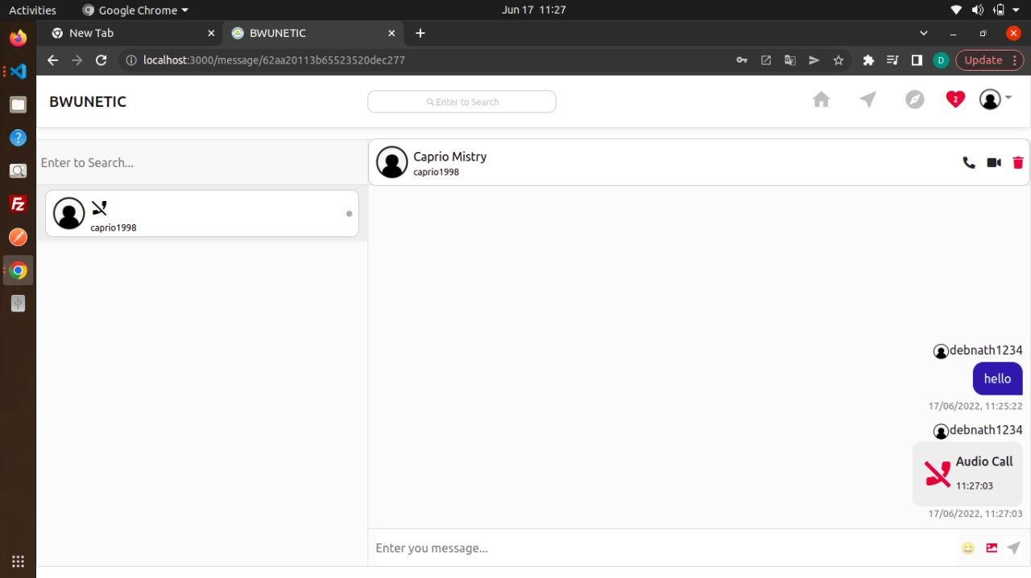
CHAT FEATURES
From the chat feature on BWUNETIC, you may reach out to individuals you care about right now.

Slide 16
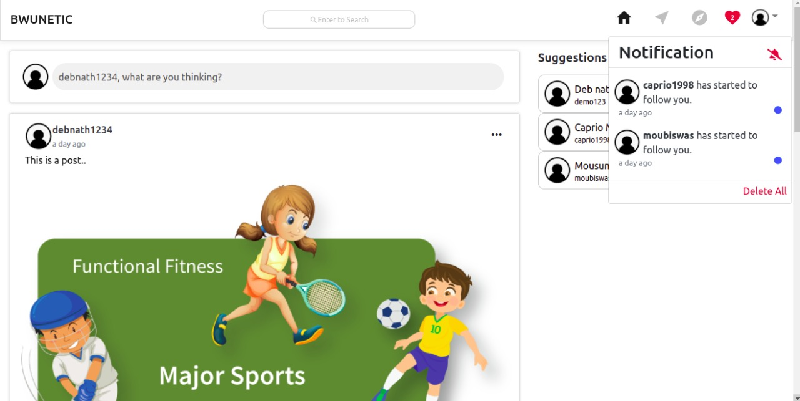
NOTIFICATION
Notifications are notifications regarding what's going on at BWUNETIC. You may alter what you're alerted about and how you're notified by going to your notifications settings. Depending on the platform you're using, you may receive different sorts of alerts.

Slide 17
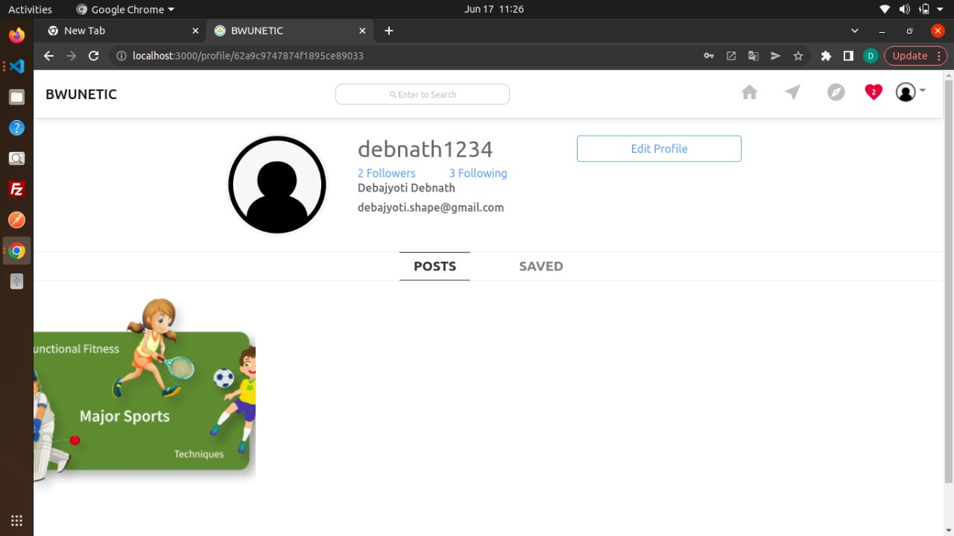
PROFILE
A profile on BWUNETIC is a place where you may post information about yourself, such as your hobbies, images, videos, current city, and hometown. Click or press your name or profile photo at the top of BWUNETIC to see your profile

Slide 18
INTERNAL INTERFACE
We can notice there are various sections to see after successfully logging into the BWUNETIC. We've highlighted a few of the features here.

Slide 19
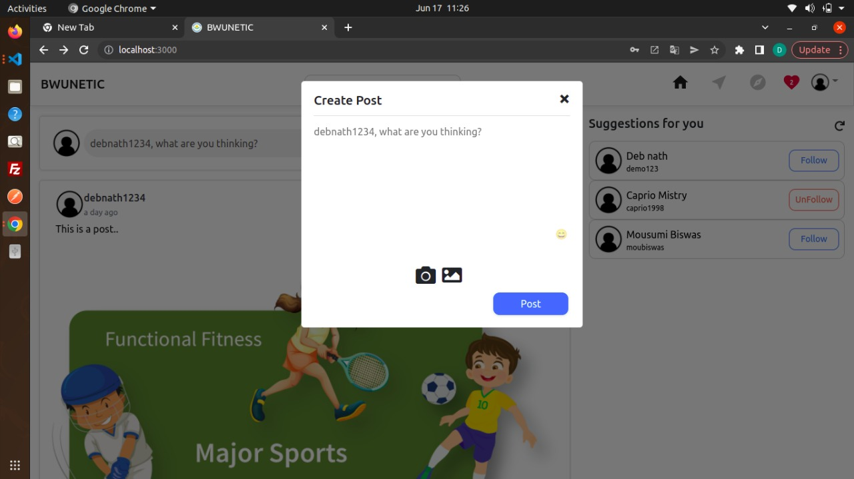
CREATE POST & PERSONAL CHAT

Slide 20
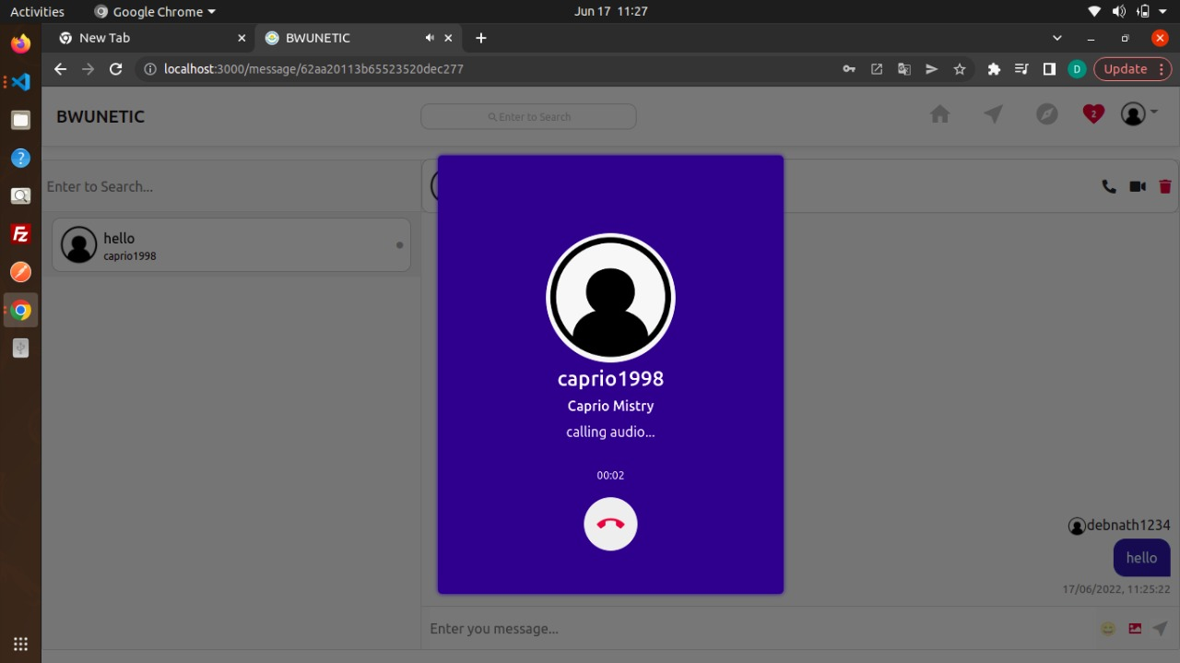
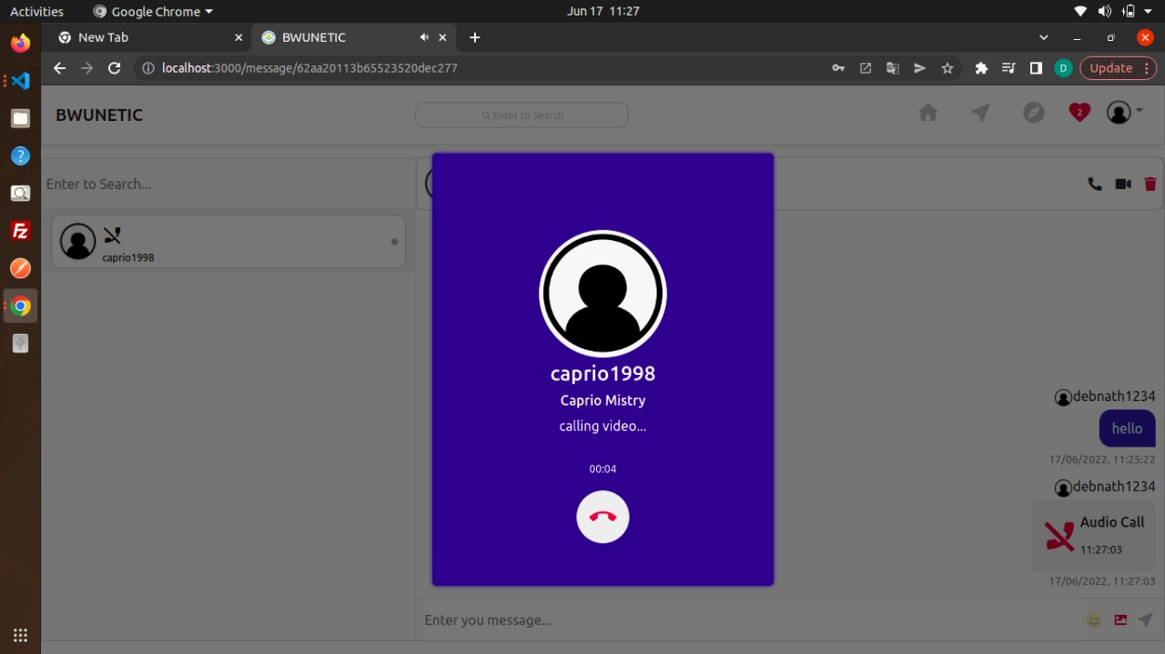
AUDIO CALL & VIDEO CALL

Slide 21
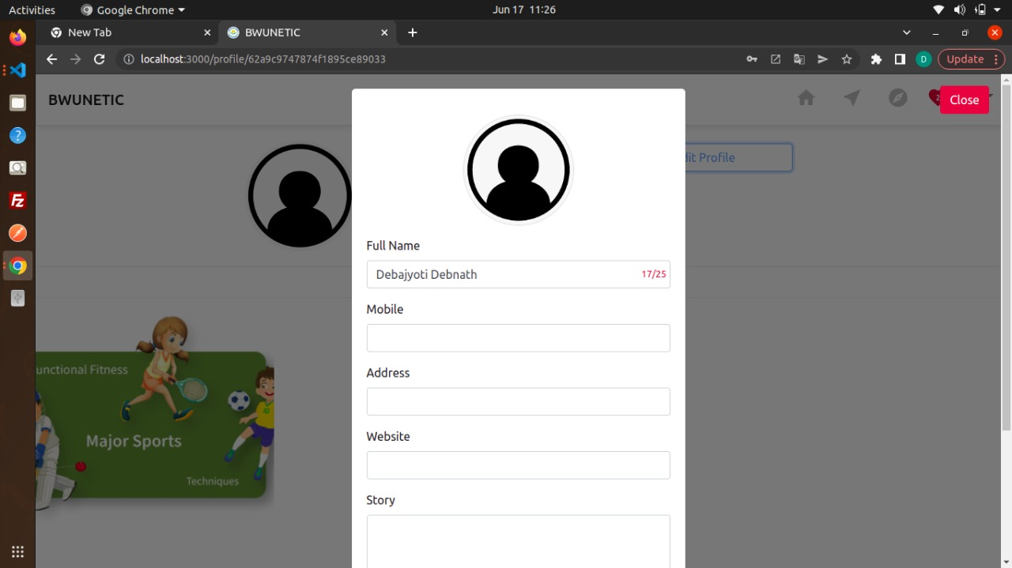
EDIT PROFILE

Slide 22
CONCLUSION
This idea is Centered on an in house social media outlet that students and university personnel may use to connected each other or it aids in the connection of all of our university’s students.

Slide 23
THANK YOU

