Slide 1
Good Morning! Thank you for joining us…
Thursday January 10, 2008 General Membership Meeting

Slide 2
PLEASE TURN OFF YOUR CELL PHONE…
If your cell phone rings prepare to give us $10.00, if you ANSWER it prepare to give us $20.00 toward Operation Uplink…we will happily purchase phone cards for our soldiers.

Slide 3
Words of inspiration…
Kathleen Buys

Slide 4

Please join us in the flag salute…

Slide 5
Congratulations
REALTOR® Bill Yates

Slide 6
Meet
Shelley Fowler
From
REALTOR.COM

Slide 7
Announcements

Slide 8
Meet your fellow REALTORS®

Slide 9
Have you thanked your Affiliate today?

Slide 10
Welcome to the CDAR Virtual Showcase
Caravan for January 10, 2008

Slide 11
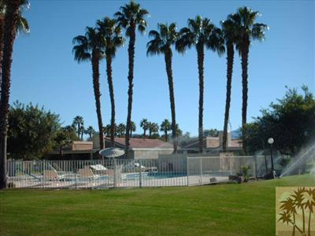
72295 Beverly Way , Rancho Mirage 92270
Agent: Claudine Messika Phone Number: 760-799-5308
List Price | $367,000
Bedrooms | 3
Baths | 3
Sq Ft. | 1922
Lot Size | 3920
Year Built | 1979
Photo Placeholder
Office: Prudential California Realty Phone Number: 760-324-9100

Slide 12
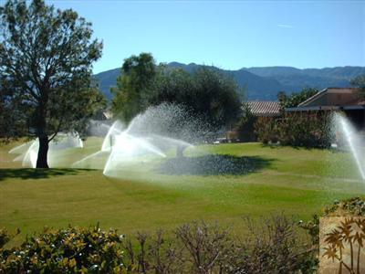
72295 Beverly Way , Rancho Mirage 92270
Agent: Claudine Messika Phone Number: 760-799-5308
List Price | $367,000
Bedrooms | 3
Baths | 3
Sq Ft. | 1922
Lot Size | 3920
Year Built | 1979
Photo Placeholder
Office: Prudential California Realty Phone Number: 760-324-9100

Slide 13
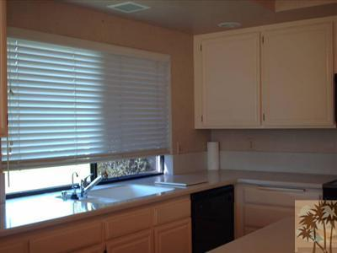
72295 Beverly Way , Rancho Mirage 92270
Agent: Claudine Messika Phone Number: 760-799-5308
List Price | $367,000
Bedrooms | 3
Baths | 3
Sq Ft. | 1922
Lot Size | 3920
Year Built | 1979
Photo Placeholder
Office: Prudential California Realty Phone Number: 760-324-9100

Slide 14
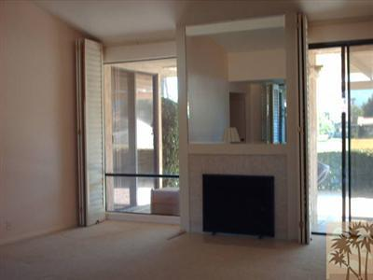
72295 Beverly Way , Rancho Mirage 92270
Agent: Claudine Messika Phone Number: 760-799-5308
List Price | $367,000
Bedrooms | 3
Baths | 3
Sq Ft. | 1922
Lot Size | 3920
Year Built | 1979
Photo Placeholder
Office: Prudential California Realty Phone Number: 760-324-9100

Slide 15
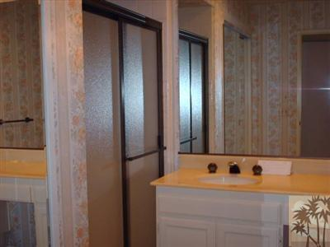
72295 Beverly Way , Rancho Mirage 92270
Agent: Claudine Messika Phone Number: 760-799-5308
List Price | $367,000
Bedrooms | 3
Baths | 3
Sq Ft. | 1922
Lot Size | 3920
Year Built | 1979
Photo Placeholder
Office: Prudential California Realty Phone Number: 760-324-9100

Slide 16
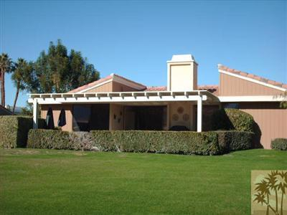
72295 Beverly Way , Rancho Mirage 92270
Agent: Claudine Messika Phone Number: 760-799-5308
List Price | $367,000
Bedrooms | 3
Baths | 3
Sq Ft. | 1922
Lot Size | 3920
Year Built | 1979
Photo Placeholder
Office: Prudential California Realty Phone Number: 760-324-9100

Slide 17


tina.bates@equitytitle.com
Tina Bates
72-608 El Paseo, Suite 3
Palm Desert, CA 92260
760-861-4960

Slide 18
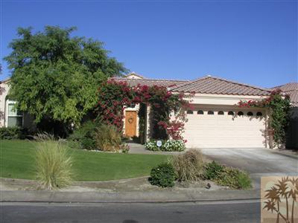
41 Calle Del Norte, Rancho Mirage 92270
Agent: Peter Schmidt Phone Number: 760-808-0095
List Price | $1,095,000
Bedrooms | 3
Baths | 3.5
Sq Ft. | 3422
Lot Size | 11326
Year Built | 2003
Photo Placeholder
Office: Windermere Real Estate Phone Number: 760-770-6801

Slide 19
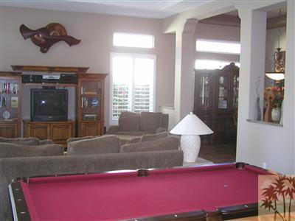
41 Calle Del Norte, Rancho Mirage 92270
Agent: Peter Schmidt Phone Number: 760-808-0095
List Price | $1,095,000
Bedrooms | 3
Baths | 3.5
Sq Ft. | 3422
Lot Size | 11326
Year Built | 2003
Photo Placeholder
Office: Windermere Real Estate Phone Number: 760-770-6801

Slide 20
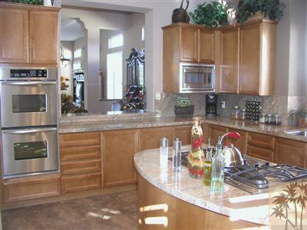
41 Calle Del Norte, Rancho Mirage 92270
Agent: Peter Schmidt Phone Number: 760-808-0095
List Price | $1,095,000
Bedrooms | 3
Baths | 3.5
Sq Ft. | 3422
Lot Size | 11326
Year Built | 2003
Photo Placeholder
Office: Windermere Real Estate Phone Number: 760-770-6801

Slide 21
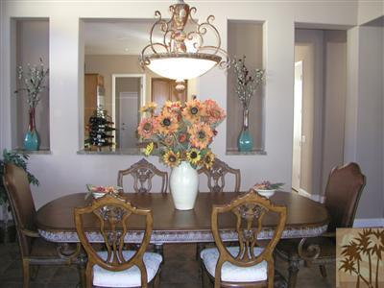
41 Calle Del Norte, Rancho Mirage 92270
Agent: Peter Schmidt Phone Number: 760-808-0095
List Price | $1,095,000
Bedrooms | 3
Baths | 3.5
Sq Ft. | 3422
Lot Size | 11326
Year Built | 2003
Photo Placeholder
Office: Windermere Real Estate Phone Number: 760-770-6801

Slide 22
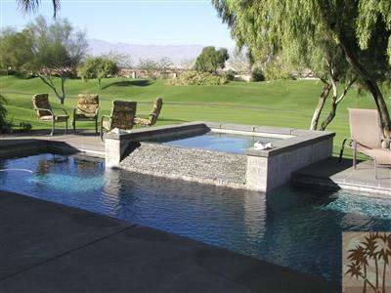
41 Calle Del Norte, Rancho Mirage 92270
Agent: Peter Schmidt Phone Number: 760-808-0095
List Price | $1,095,000
Bedrooms | 3
Baths | 3.5
Sq Ft. | 3422
Lot Size | 11326
Year Built | 2003
Photo Placeholder
Office: Windermere Real Estate Phone Number: 760-770-6801

Slide 23
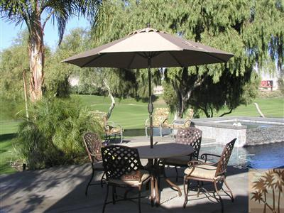
41 Calle Del Norte, Rancho Mirage 92270
Agent: Peter Schmidt Phone Number: 760-808-0095
List Price | $1,095,000
Bedrooms | 3
Baths | 3.5
Sq Ft. | 3422
Lot Size | 11326
Year Built | 2003
Photo Placeholder
Office: Windermere Real Estate Phone Number: 760-770-6801

Slide 24


Cindy Lundquist
44-901 Village Court, Suite A
Palm Desert, CA 92260
760-835-2060
clundquist@firstam.com

Slide 25
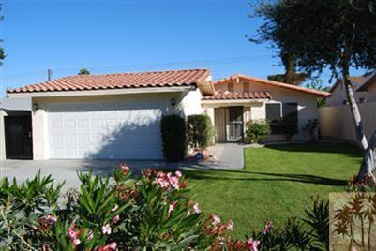
52180 Avenida Carranza, La Quinta 92253
Agent: Beverly J. Fitzgerald Phone Number: 760-574-5891
List Price | $275,000
Bedrooms | 3
Baths | 2
Sq Ft. | 1230
Lot Size | 4792
Year Built | 1978
Photo Placeholder
Office: Tarbell REALTORS® Phone Number: 760-777-7570

Slide 26
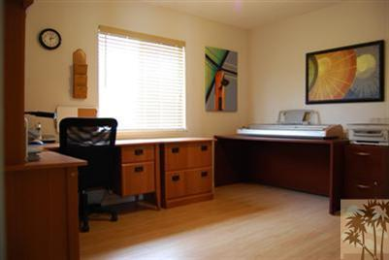
52180 Avenida Carranza, La Quinta 92253
Agent: Beverly J. Fitzgerald Phone Number: 760-574-5891
List Price | $275,000
Bedrooms | 3
Baths | 2
Sq Ft. | 1230
Lot Size | 4792
Year Built | 1978
Photo Placeholder
Office: Tarbell REALTORS® Phone Number: 760-777-7570

Slide 27
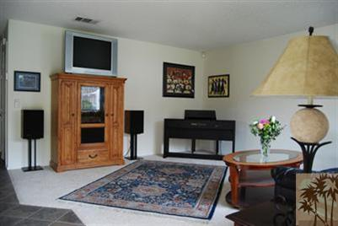
52180 Avenida Carranza, La Quinta 92253
Agent: Beverly J. Fitzgerald Phone Number: 760-574-5891
List Price | $275,000
Bedrooms | 3
Baths | 2
Sq Ft. | 1230
Lot Size | 4792
Year Built | 1978
Photo Placeholder
Office: Tarbell REALTORS® Phone Number: 760-777-7570

Slide 28
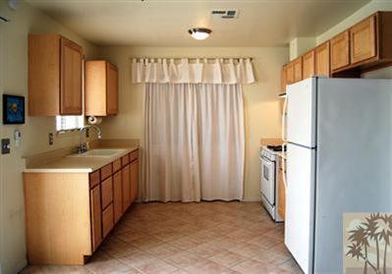
52180 Avenida Carranza, La Quinta 92253
Agent: Beverly J. Fitzgerald Phone Number: 760-574-5891
List Price | $275,000
Bedrooms | 3
Baths | 2
Sq Ft. | 1230
Lot Size | 4792
Year Built | 1978
Photo Placeholder
Office: Tarbell REALTORS® Phone Number: 760-777-7570

Slide 29
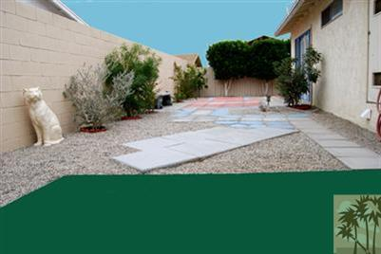
52180 Avenida Carranza, La Quinta 92253
Agent: Beverly J. Fitzgerald Phone Number: 760-574-5891
List Price | $275,000
Bedrooms | 3
Baths | 2
Sq Ft. | 1230
Lot Size | 4792
Year Built | 1978
Photo Placeholder
Office: Tarbell REALTORS® Phone Number: 760-777-7570

Slide 30
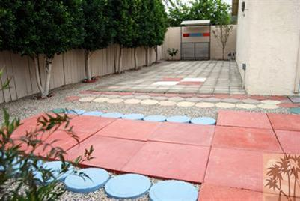
52180 Avenida Carranza, La Quinta 92253
Agent: Beverly J. Fitzgerald Phone Number: 760-574-5891
List Price | $275,000
Bedrooms | 3
Baths | 2
Sq Ft. | 1230
Lot Size | 4792
Year Built | 1978
Photo Placeholder
Office: Tarbell REALTORS® Phone Number: 760-777-7570

Slide 31


Shelly O’Donnell
42335 Washington Street Ste.F342
Palm Desert CA, 92211
760-200-9600
rereports@aol.com

Slide 32


Ellen Kardashian
44751 Village Court Dr. · Suite 300
Indian Wells, CA 92210
760-837-1110
EKardashian@heritageescrow.com

Slide 33
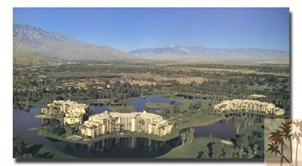
910 Island Dr #308, Rancho Mirage 92270
Agent: Debra Manning Phone Number: 760-673-6155
List Price | $559,000
Bedrooms | 2
Baths | 1.75
Sq Ft. | 2159
Lot Size | 2614
Year Built | 1980
Photo Placeholder
Office: Desert Island On-Site Resale Phone Number: 760-673-6155

Slide 34
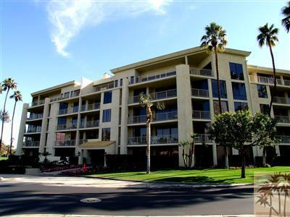
910 Island Dr #308, Rancho Mirage 92270
Agent: Debra Manning Phone Number: 760-673-6155
List Price | $559,000
Bedrooms | 2
Baths | 1.75
Sq Ft. | 2159
Lot Size | 2614
Year Built | 1980
Photo Placeholder
Office: Desert Island On-Site Resale Phone Number: 760-673-6155

Slide 35
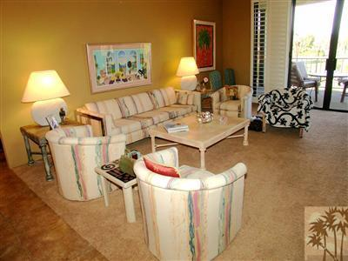
910 Island Dr #308, Rancho Mirage 92270
Agent: Debra Manning Phone Number: 760-673-6155
List Price | $559,000
Bedrooms | 2
Baths | 1.75
Sq Ft. | 2159
Lot Size | 2614
Year Built | 1980
Photo Placeholder
Office: Desert Island On-Site Resale Phone Number: 760-673-6155

Slide 36
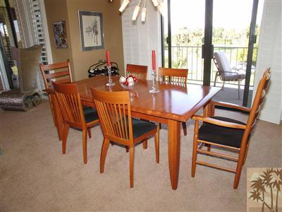
910 Island Dr #308, Rancho Mirage 92270
Agent: Debra Manning Phone Number: 760-673-6155
List Price | $559,000
Bedrooms | 2
Baths | 1.75
Sq Ft. | 2159
Lot Size | 2614
Year Built | 1980
Photo Placeholder
Office: Desert Island On-Site Resale Phone Number: 760-673-6155

Slide 37
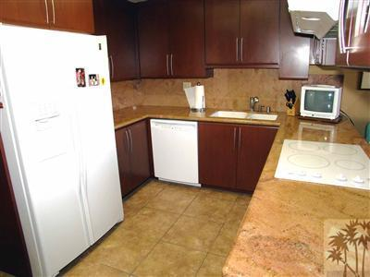
910 Island Dr #308, Rancho Mirage 92270
Agent: Debra Manning Phone Number: 760-673-6155
List Price | $559,000
Bedrooms | 2
Baths | 1.75
Sq Ft. | 2159
Lot Size | 2614
Year Built | 1980
Photo Placeholder
Office: Desert Island On-Site Resale Phone Number: 760-673-6155

Slide 38
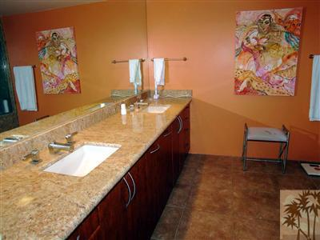
910 Island Dr #308, Rancho Mirage 92270
Agent: Debra Manning Phone Number: 760-673-6155
List Price | $559,000
Bedrooms | 2
Baths | 1.75
Sq Ft. | 2159
Lot Size | 2614
Year Built | 1980
Photo Placeholder
Office: Desert Island On-Site Resale Phone Number: 760-673-6155

Slide 39


Kristine Eastling
41865 Boardwalk #202
Palm Desert, CA 92211
760-773-0166
keastling@stewart.com

Slide 40


Jeff Vandermate
82-240 Avenida La Vista, Ste. C
Cathedral City, CA 92234
760-778-6009

Slide 41
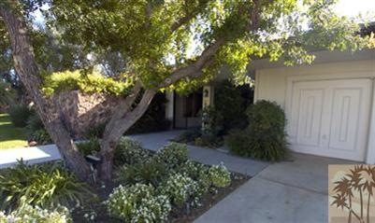
44 Mount Holyoke, Rancho Mirage 92270
Agent: Rebecca Pikus Phone Number: 760-534-5888
List Price | $875,000
Bedrooms | 3
Baths | 3
Sq Ft. | 2730
Lot Size | 5227
Year Built | 1983
Photo Placeholder
Office: Tarbell REALTORS® Phone Number: 760-341-6180

Slide 42
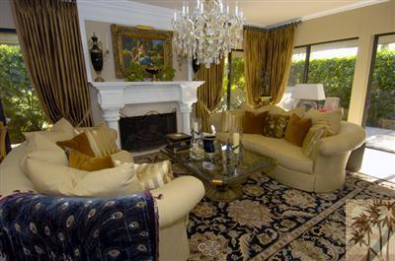
44 Mount Holyoke, Rancho Mirage 92270
Agent: Rebecca Pikus Phone Number: 760-534-5888
List Price | $875,000
Bedrooms | 3
Baths | 3
Sq Ft. | 2730
Lot Size | 5227
Year Built | 1983
Photo Placeholder
Office: Tarbell REALTORS® Phone Number: 760-341-6180

Slide 43
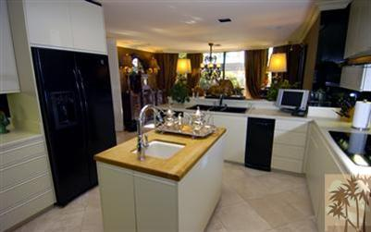
44 Mount Holyoke, Rancho Mirage 92270
Agent: Rebecca Pikus Phone Number: 760-534-5888
List Price | $875,000
Bedrooms | 3
Baths | 3
Sq Ft. | 2730
Lot Size | 5227
Year Built | 1983
Photo Placeholder
Office: Tarbell REALTORS® Phone Number: 760-341-6180

Slide 44
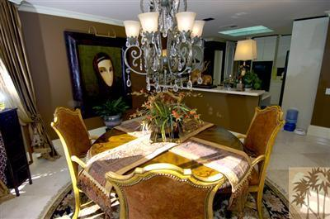
44 Mount Holyoke, Rancho Mirage 92270
Agent: Rebecca Pikus Phone Number: 760-534-5888
List Price | $875,000
Bedrooms | 3
Baths | 3
Sq Ft. | 2730
Lot Size | 5227
Year Built | 1983
Photo Placeholder
Office: Tarbell REALTORS® Phone Number: 760-341-6180

Slide 45
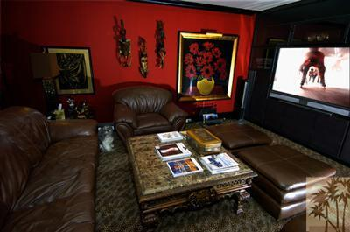
44 Mount Holyoke, Rancho Mirage 92270
Agent: Rebecca Pikus Phone Number: 760-534-5888
List Price | $875,000
Bedrooms | 3
Baths | 3
Sq Ft. | 2730
Lot Size | 5227
Year Built | 1983
Photo Placeholder
Office: Tarbell REALTORS® Phone Number: 760-341-6180

Slide 46
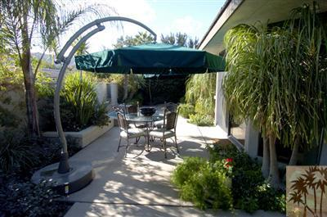
44 Mount Holyoke, Rancho Mirage 92270
Agent: Rebecca Pikus Phone Number: 760-534-5888
List Price | $875,000
Bedrooms | 3
Baths | 3
Sq Ft. | 2730
Lot Size | 5227
Year Built | 1983
Photo Placeholder
Office: Tarbell REALTORS® Phone Number: 760-341-6180

Slide 47

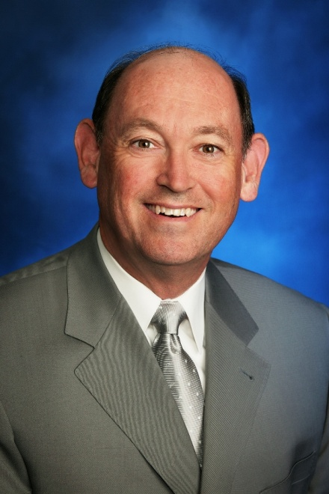
Ken Agee
72605 Highway 111, Ste. A-1
Palm Desert CA, 92260
760-862-4830
kenneth.agee@wamu.net

Slide 48

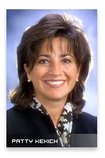
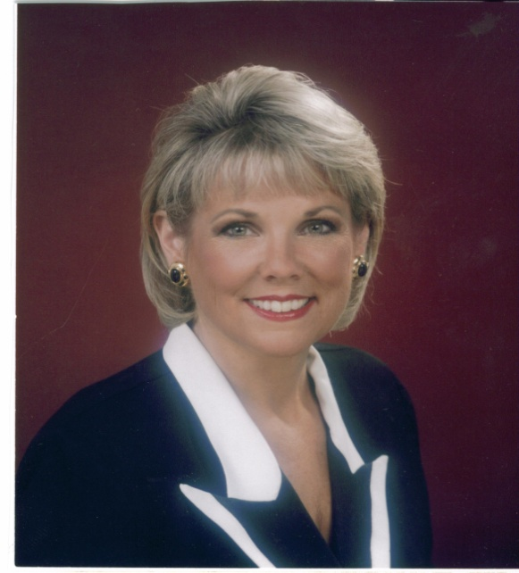
Patty Kekich
pattyfortitle@aol.com
47110 Washington St. Ste. 220
La Quinta, CA 92253
760-564-7454
Kathleen Buys
Kathleen.Buys@TicorTitle.com

Slide 49
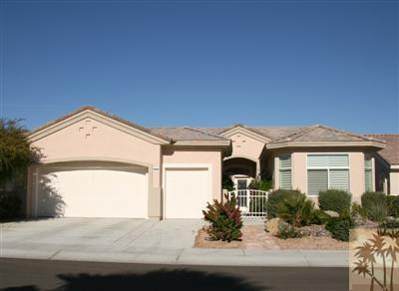
78094 Elenbrook Ct, Palm Desert 92211
Agent: Marilynn M. Rebhun Phone Number: 760-218-1036
List Price | $579,000
Bedrooms | 2
Baths | 2.5
Sq Ft. | 2318
Lot Size | 6534
Year Built | 2002
Photo Placeholder
Office: Tarbell REALTORS® Phone Number: 760-777-7570

Slide 50
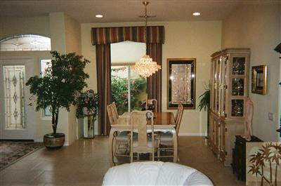
78094 Elenbrook Ct, Palm Desert 92211
Agent: Marilynn M. Rebhun Phone Number: 760-218-1036
List Price | $579,000
Bedrooms | 2
Baths | 2.5
Sq Ft. | 2318
Lot Size | 6534
Year Built | 2002
Photo Placeholder
Office: Tarbell REALTORS® Phone Number: 760-777-7570

Slide 51
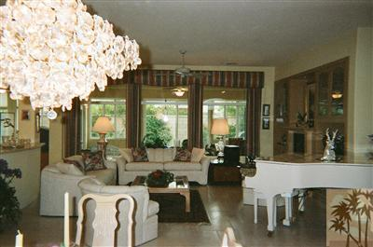
78094 Elenbrook Ct, Palm Desert 92211
Agent: Marilynn M. Rebhun Phone Number: 760-218-1036
List Price | $579,000
Bedrooms | 2
Baths | 2.5
Sq Ft. | 2318
Lot Size | 6534
Year Built | 2002
Photo Placeholder
Office: Tarbell REALTORS® Phone Number: 760-777-7570

Slide 52
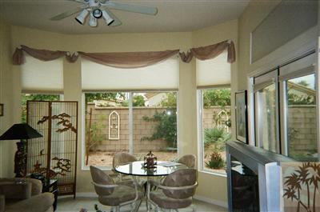
78094 Elenbrook Ct, Palm Desert 92211
Agent: Marilynn M. Rebhun Phone Number: 760-218-1036
List Price | $579,000
Bedrooms | 2
Baths | 2.5
Sq Ft. | 2318
Lot Size | 6534
Year Built | 2002
Photo Placeholder
Office: Tarbell REALTORS® Phone Number: 760-777-7570

Slide 53
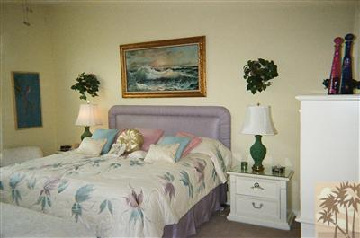
78094 Elenbrook Ct, Palm Desert 92211
Agent: Marilynn M. Rebhun Phone Number: 760-218-1036
List Price | $579,000
Bedrooms | 2
Baths | 2.5
Sq Ft. | 2318
Lot Size | 6534
Year Built | 2002
Photo Placeholder
Office: Tarbell REALTORS® Phone Number: 760-777-7570

Slide 54
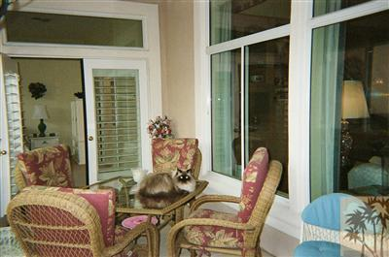
78094 Elenbrook Ct, Palm Desert 92211
Agent: Marilynn M. Rebhun Phone Number: 760-218-1036
List Price | $579,000
Bedrooms | 2
Baths | 2.5
Sq Ft. | 2318
Lot Size | 6534
Year Built | 2002
Photo Placeholder
Office: Tarbell REALTORS® Phone Number: 760-777-7570

Slide 55


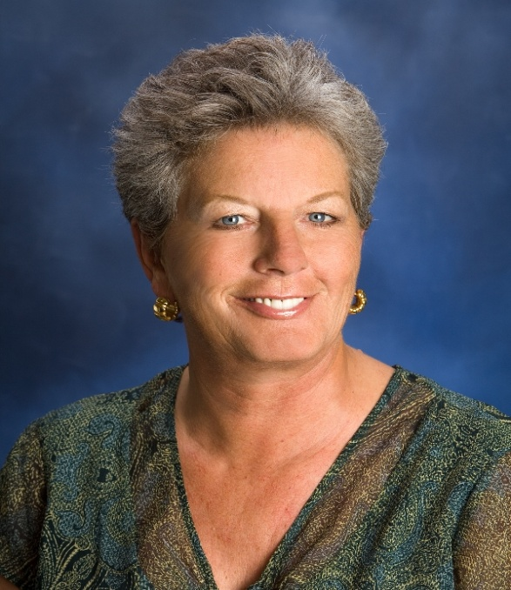
Ann Papanek
78900 Avenue 47, Ste 202
La Quinta CA, 92253
760-393-3100
ann.papanek@wellsfargo.com

Slide 56

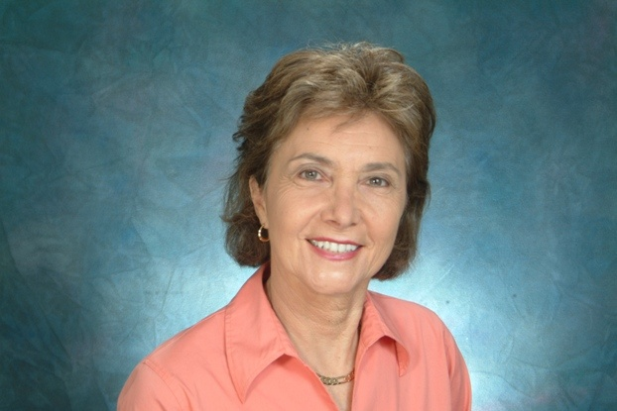
Judy Gaudiano
73280 El Paseo, Suite 6
Palm Desert CA, 92260
760-779-9669
actionappraisalservices@verizon.net

Slide 57
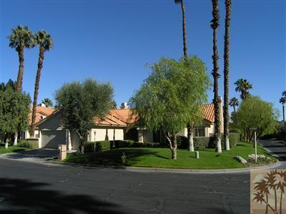
402 Oakmont Dr, Palm Desert 92211
Agent: Francesca Vacatello Phone Number: 760-413-9153
List Price | $685,000
Bedrooms | 4
Baths | 3.5
Sq Ft. | 2552
Lot Size | 11761
Year Built | 1989
Photo Placeholder
Office: Coldwell Banker Residential Brokerage Phone Number: 760-771-5454

Slide 58
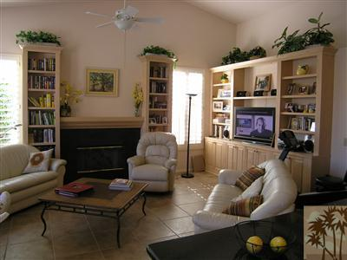
402 Oakmont Dr, Palm Desert 92211
Agent: Francesca Vacatello Phone Number: 760-413-9153
List Price | $685,000
Bedrooms | 4
Baths | 3.5
Sq Ft. | 2552
Lot Size | 11761
Year Built | 1989
Photo Placeholder
Office: Coldwell Banker Residential Brokerage Phone Number: 760-771-5454

Slide 59
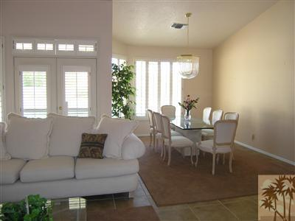
402 Oakmont Dr, Palm Desert 92211
Agent: Francesca Vacatello Phone Number: 760-413-9153
List Price | $685,000
Bedrooms | 4
Baths | 3.5
Sq Ft. | 2552
Lot Size | 11761
Year Built | 1989
Photo Placeholder
Office: Coldwell Banker Residential Brokerage Phone Number: 760-771-5454

Slide 60
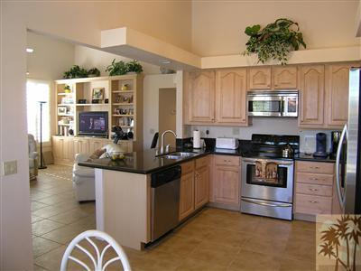
402 Oakmont Dr, Palm Desert 92211
Agent: Francesca Vacatello Phone Number: 760-413-9153
List Price | $685,000
Bedrooms | 4
Baths | 3.5
Sq Ft. | 2552
Lot Size | 11761
Year Built | 1989
Photo Placeholder
Office: Coldwell Banker Residential Brokerage Phone Number: 760-771-5454

Slide 61
402 Oakmont Dr, Palm Desert 92211
Agent: Francesca Vacatello Phone Number: 760-413-9153
List Price | $685,000
Bedrooms | 4
Baths | 3.5
Sq Ft. | 2552
Lot Size | 11761
Year Built | 1989
Photo Placeholder
Office: Coldwell Banker Residential Brokerage Phone Number: 760-771-5454

Slide 62
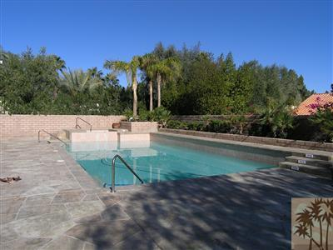
402 Oakmont Dr, Palm Desert 92211
Agent: Francesca Vacatello Phone Number: 760-413-9153
List Price | $685,000
Bedrooms | 4
Baths | 3.5
Sq Ft. | 2552
Lot Size | 11761
Year Built | 1989
Photo Placeholder
Office: Coldwell Banker Residential Brokerage Phone Number: 760-771-5454

Slide 63

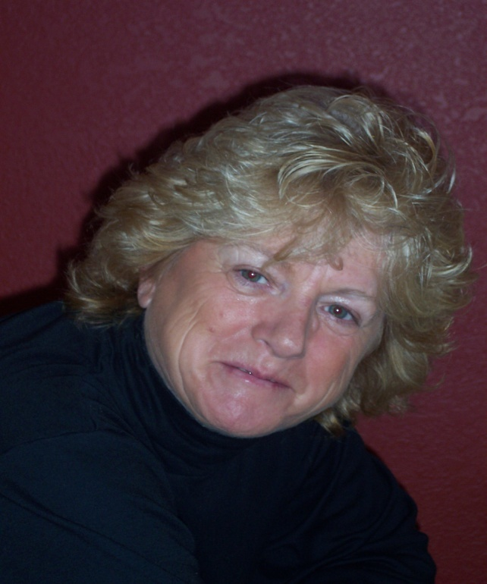
Melinda Tremaglio
1182 Tiffany Circle N.
Palm Springs, CA 92262
760-327-8708
caravandispath@dc.rr.com

Slide 64

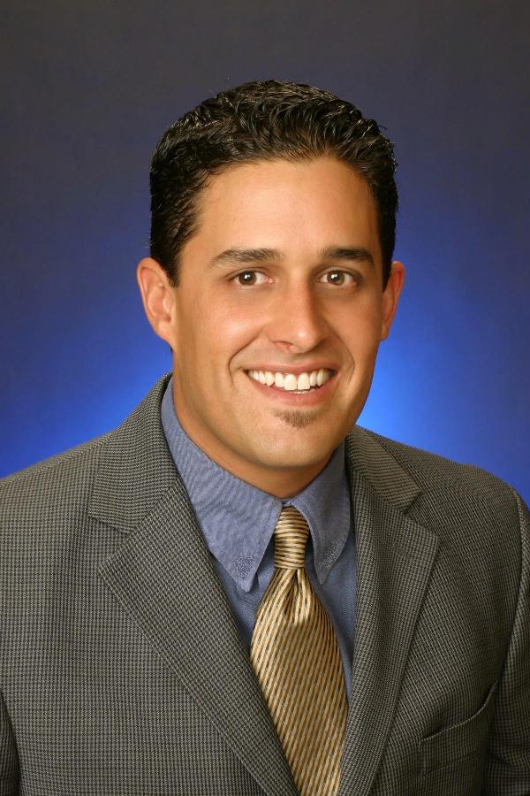
Jerod Pannell
74040 Highway 111, Ste.D
Palm Desert, CA 92260
760-346-6139
jerod.pannell@capitolbancorp.cm

Slide 65
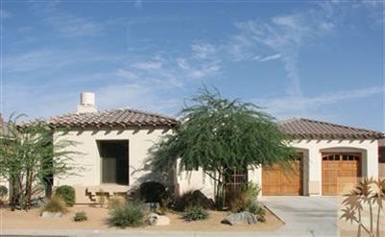
41612 Via Aregio, Palm Desert 92260
Agent: Cathi Walter Phone Number: 760-218-5752
List Price | $810,000
Bedrooms | 3
Baths | 3.5
Sq Ft. | 2774
Lot Size | 9148
Year Built | 2005
Photo Placeholder
Office: Coldwell Banker Residential Brokerage Phone Number: 760-202-3434

Slide 66
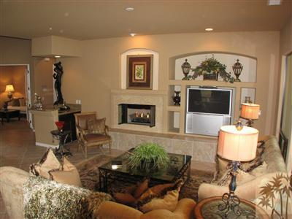
41612 Via Aregio, Palm Desert 92260
Agent: Cathi Walter Phone Number: 760-218-5752
List Price | $810,000
Bedrooms | 3
Baths | 3.5
Sq Ft. | 2774
Lot Size | 9148
Year Built | 2005
Photo Placeholder
Office: Coldwell Banker Residential Brokerage Phone Number: 760-202-3434

Slide 67

41612 Via Aregio, Palm Desert 92260
Agent: Cathi Walter Phone Number: 760-218-5752
List Price | $810,000
Bedrooms | 3
Baths | 3.5
Sq Ft. | 2774
Lot Size | 9148
Year Built | 2005
Photo Placeholder
Office: Coldwell Banker Residential Brokerage Phone Number: 760-202-3434

Slide 68

41612 Via Aregio, Palm Desert 92260
Agent: Cathi Walter Phone Number: 760-218-5752
List Price | $810,000
Bedrooms | 3
Baths | 3.5
Sq Ft. | 2774
Lot Size | 9148
Year Built | 2005
Photo Placeholder
Office: Coldwell Banker Residential Brokerage Phone Number: 760-202-3434

Slide 69

41612 Via Aregio, Palm Desert 92260
Agent: Cathi Walter Phone Number: 760-218-5752
List Price | $810,000
Bedrooms | 3
Baths | 3.5
Sq Ft. | 2774
Lot Size | 9148
Year Built | 2005
Photo Placeholder
Office: Coldwell Banker Residential Brokerage Phone Number: 760-202-3434

Slide 70

41612 Via Aregio, Palm Desert 92260
Agent: Cathi Walter Phone Number: 760-218-5752
List Price | $810,000
Bedrooms | 3
Baths | 3.5
Sq Ft. | 2774
Lot Size | 9148
Year Built | 2005
Photo Placeholder
Office: Coldwell Banker Residential Brokerage Phone Number: 760-202-3434

Slide 71




The
California Desert Association of REALTORS
Virtual Showcase
is brought to you by the
CDAR Affiliate Committee

Slide 72
The
California Desert Association of REALTORS
Virtual Showcase
is brought to you by the
CDAR Affiliate Committee

Slide 73

You can see the
California Desert Association of REALTORS
Virtual Showcase
at any time on its website:
http://www.caldesertrealtors.com

Slide 74
Opportunity is now…
Pitch your listing.

Slide 75
50/50
Drawing

Slide 76
Please take a moment and thank…
Greg, Stacey, Paul, Juan, Joy, Patrick, Barbara, Sue, and Alex

Slide 77
The End!
Make it a GREAT
DAY!

Slide 78
Address
Agent: Name Phone Number: 555-555-5555
List Price | $
Bedrooms | 0
Baths | 0
Sq Ft. | 0
Lot Size | 0
Year Built | 0
Photo Placeholder
Office: Name Phone Number: 555-555-5555

