Slide 1
Memory-Based Detection of Golden Ticket and SID History Abuse in Active Directory
Name: P Rahul SRN: R23MTC09 | Date: 17/08/2026
M.Tech
Cybersecurity
Capstone Project Presentation

Slide 2
01 Introduction
Background | Current status | Why this study
07 Software Design
High Level | Low Level Design Diagrams
02 Literature Review
Seminal works | Summary | Research Gap
08 Implementation
Demo | Application | Use cases
03 Problem Statement
Technical | Functional Problem
09 Testing and Validation
Test Results | Learnings
Agenda
04 Project Objectives
Primary & Secondary Objectives | Expected Outcome
10 Analysis and Results
Key Findings | Insights
05 Project Methodology
Conceptual Framework | Research Design
11 Suggestions and Conclusions
Insights | Next Step | Future Scope
06 Resource Specification
Software | Hardware
12 Annexure
References | Publications | Plagiarism Score

Slide 3
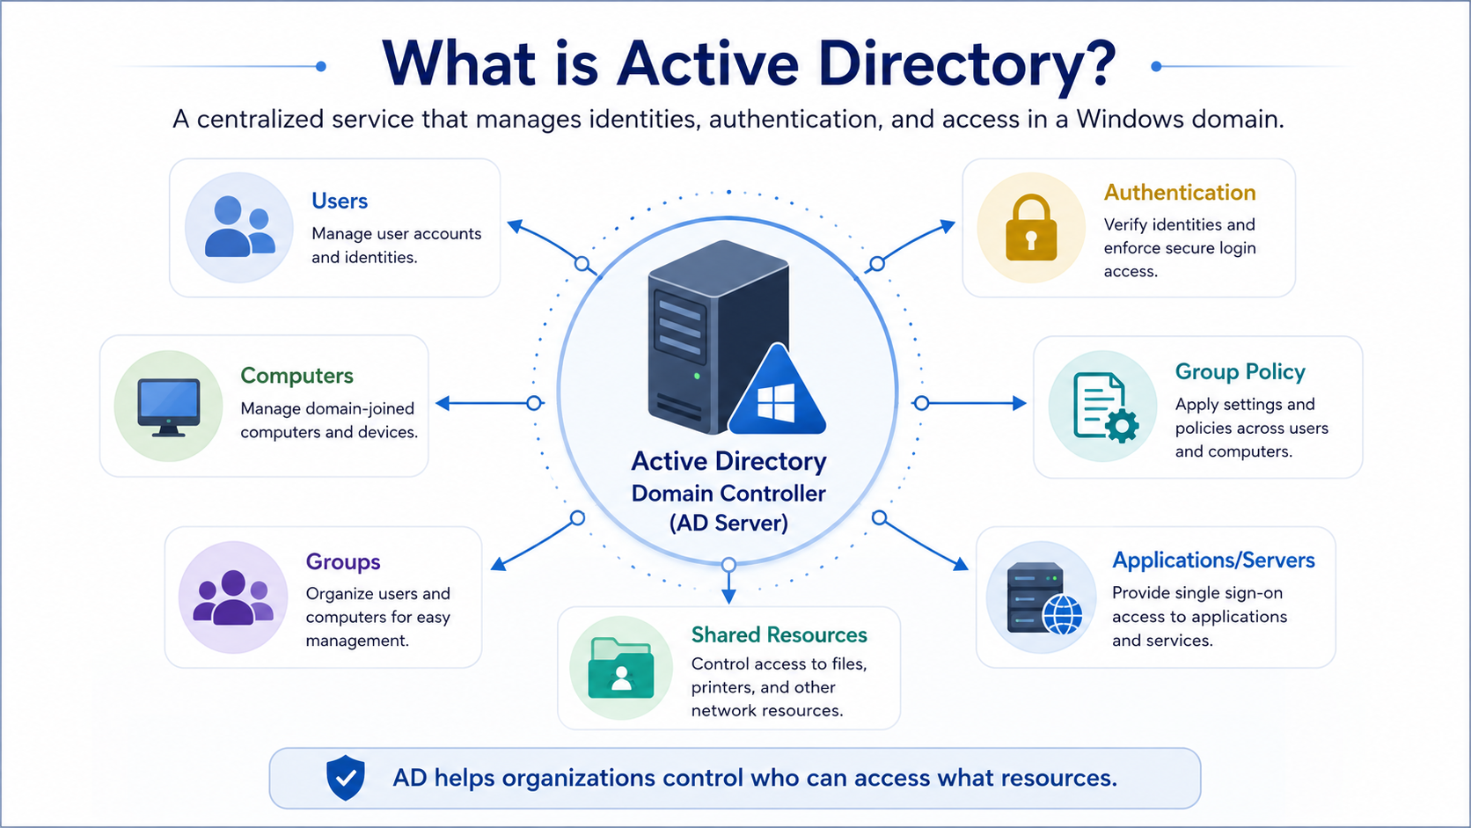
Introduction
Notes:
Quick grounding first. Active Directory is the identity backbone of almost every Windows enterprise — it manages users, computers, groups, authentication, and access to shared resources.
Because it decides who can access what, it's also the single most valuable target in a network.
If an attacker owns AD, they effectively own the organisation. That's why the two attacks I focus on matter so much: they don't break in the front door, they forge the keys AD itself trusts.

Slide 4
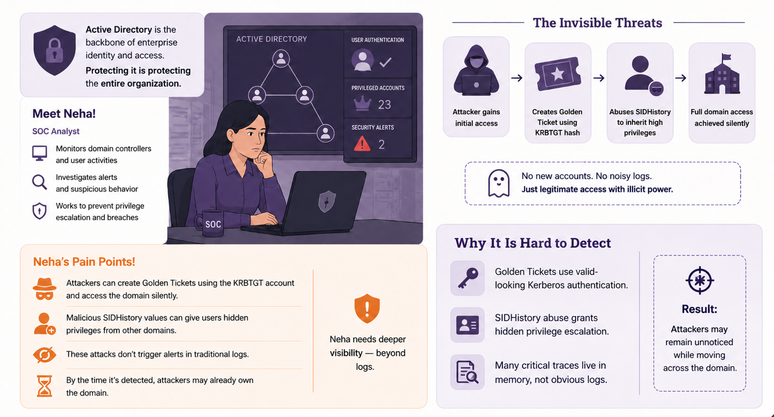
Introduction
Notes:
Meet Neha, a SOC analyst — she represents the real user of this system. Her problem is that the most dangerous attacks are the quiet ones.
In a Golden Ticket attack, the attacker steals the KRBTGT account hash and forges a Kerberos ticket that Active Directory treats as completely legitimate.
In SIDHistory abuse, they inject a privileged SID into an account's SIDHistory attribute, so an ordinary user silently inherits domain-admin rights.
The key phrase is on the right: no new accounts, no noisy logs — just legitimate-looking access with illicit power.
These attacks are hard to detect because Golden Tickets use valid Kerberos authentication, SIDHistory grants hidden escalation, and — critically — many of the real traces live in memory, not in the event log.
That last point is the entire motivation for my project: Neha needs visibility beyond the logs.

Slide 5
Literature Review
No. | Title | Author and Year | Journal | Description | Insights | Research Gaps/Comments
1 | Kerberos Authentication Security in Modern Enterprise Environments | Shostack et al., 2023 (IEEE S&P) | IEEE Symp. on Security & Privacy | Kerberos TGT / Golden Ticket forgery from stolen KRBTGT hashes; detection gaps in cloud SIEM. | RC4-HMAC downgrade and forged TGT lifetimes are reliable indicators; logs alone insufficient. | No memory-level corroboration; gap addressed by this project's LSASS pipeline.
2 | Detecting Pass-the-Ticket and Golden Ticket Attacks in AD | Metcalf, S., 2022 (SANS) | SANS Institute White Paper | Event IDs 4768/4769/4771 as primary signals; threshold analytics for anomalous TGT issuance. | RC4 (0x17) in AES domains is a strong anomaly signal. Recommends KRBTGT rotation. | Log-layer only; no volatile memory artifacts or automated response.
3 | SIDHistory Injection & Cross-Forest Trust Exploitation (incl. Hybrid) | Dod & Hao, 2021 (ACM CCS); Lundeen & Katz, 2023 (DEF CON 31) | ACM CCS; DEF CON 31 | SIDHistory privilege escalation (S-1-5-21-*-512 grants domain admin); extended to hybrid sync. | Auditing doesn't log SIDHistory; LDAP visibility needed. Entra ID inherits SIDs, widening reach. | Offensive focus, no cloud monitoring; closed by PowerShell + Blob + Sentinel KQL + Logic App.
Notes:
I reviewed six representative sources across three groups. The Kerberos and Golden Ticket work — Metcalf, and the IEEE study — establishes that event IDs 4768 and 4769 plus RC4 downgrade are reliable signals, but every one of them concludes the same thing: logs alone are insufficient, with no memory-level corroboration.
The SIDHistory research — the CCS and DEF CON work — shows that standard auditing doesn't even log SIDHistory changes, so you need LDAP-level visibility. The forensics and Sentinel sources — Ligh's Volatility work and Microsoft's own research — show Volatility 3 can pull Kerberos keys straight from LSASS, and that Sentinel can ingest external results through custom log tables.
The research gap, then: no existing work combines automated cloud log analytics with automated memory forensics in one pipeline. Each half exists; nobody joined them. That intersection is exactly what I built.

Slide 6
Literature Review
No. | Title | Author and Year | Journal | Description | Insights | Research Gaps/Comments
4 | Volatility 3 & Cloud-Integrated Memory Forensics for SOC | Ligh et al., 2022; Davis & Johnson, 2022 (Digital Investigation) | Elsevier Digital Investigation | Volatility 3 LSASS extraction of Kerberos artifacts; automated shipping to SIEM. | ISF symbols enable version-agnostic parsing; LSASS holds RC4/AES keys; cuts false positives. | Manual/offline, on-prem; this project automates Volatility via Blob → Service Bus → Functions.
5 | Scalable Threat Detection with Microsoft Sentinel: KQL & Automation | Microsoft Security Research, 2023 (MSR-TR-2023-15) | Microsoft Technical Report | Sentinel AD monitoring: KQL rules, UEBA, Logic App automated response. | Detects 4768/4769 anomalies but lacks memory corroboration; CL tables ingest external results. | No native LSASS pipeline; filled via MemoryForensics_CL and SIDHistoryDetection tables.
Notes:
The forensics and Sentinel sources — Ligh's Volatility work and Microsoft's own research — show Volatility 3 can pull Kerberos keys straight from LSASS, and that Sentinel can ingest external results through custom log tables.
The research gap, then: no existing work combines automated cloud log analytics with automated memory forensics in one pipeline. Each half exists; nobody joined them. That intersection is exactly what I built.

Slide 7
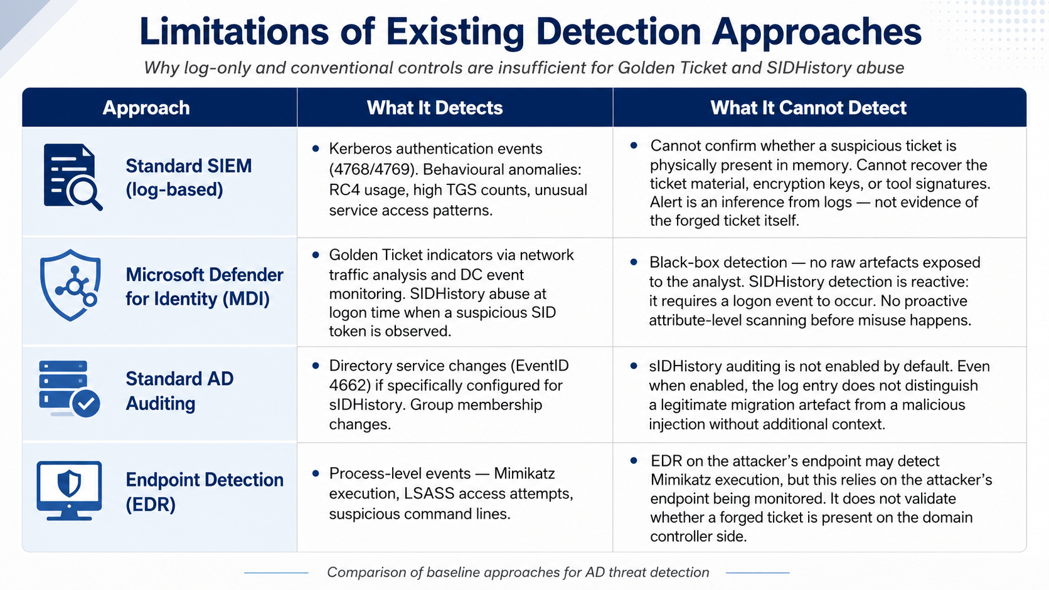
Problem Statement
Notes:
This is where I justify the whole project honestly. I compared four baseline approaches. Standard log-based SIEM detects the Kerberos events and behavioural anomalies, but it can never confirm the forged ticket is physically present in memory — the alert is an inference from logs, not evidence of the ticket itself.
Microsoft Defender for Identity is strong, but it's a black box — the analyst never sees the raw artefacts, and its SIDHistory detection is reactive, only firing at logon. Standard AD auditing doesn't distinguish a legitimate migration artefact from a malicious injection. And EDR watches the attacker's endpoint, not the domain controller side — so it can miss a ticket forged offline.
The common thread: each of these tells you something suspicious may have happened, but none gives you forensic proof from memory. That's the gap my dual-track design closes.

Slide 8
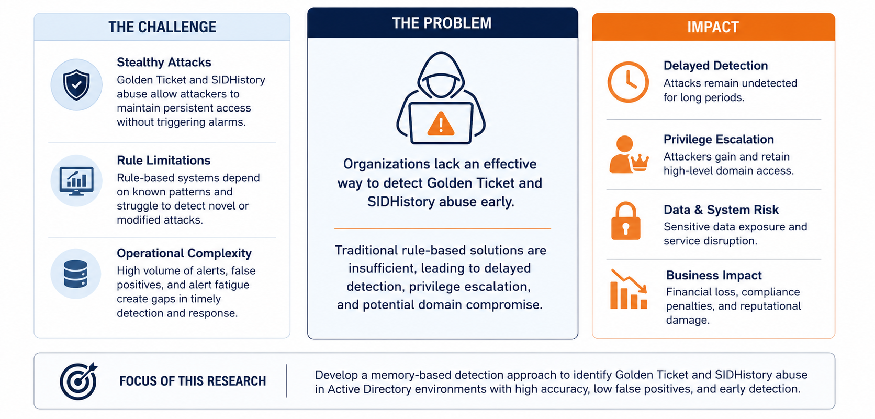
Problem Statement
Notes:
To frame it in one line: organisations lack an effective way to detect Golden Ticket and SIDHistory abuse early.
The challenge is that these attacks are stealthy and rule-based systems struggle with novel variants. The impact is real — delayed detection, silent privilege escalation, and potential full domain compromise, which carries financial, compliance, and reputational cost.
So the focus of this research is stated at the bottom: develop a memory-based detection approach that identifies these two attacks with high accuracy, low false positives, and early detection. Everything after this slide is me delivering against those three targets.

Slide 9
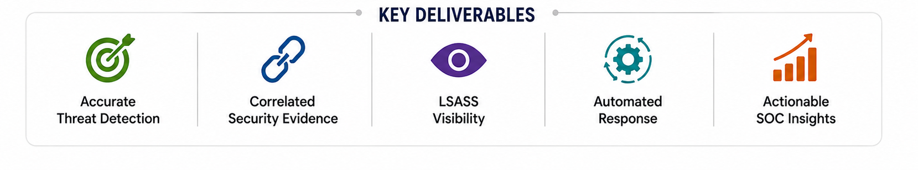
Project Objectives
To Develop Hybrid Cloud Detection Architecture
To Detect Golden Ticket Attacks and SID History Abuse
To Integrate Memory Forensics Capabilities
To Validate, Deploy, and Transfer Framework to Production
Notes:
"I set four objectives. First, develop a hybrid cloud detection architecture — connecting on-prem AD to Azure. Second, detect the two attacks — Golden Ticket and SIDHistory abuse.
Third, integrate memory forensics, so I'm not relying on logs alone. Fourth, validate, deploy, and transfer the framework to production.
The five deliverables below sum up what that produces: accurate detection, correlated evidence, LSASS visibility, automated response, and actionable SOC insights — and all four objectives were met and measured."

Slide 10
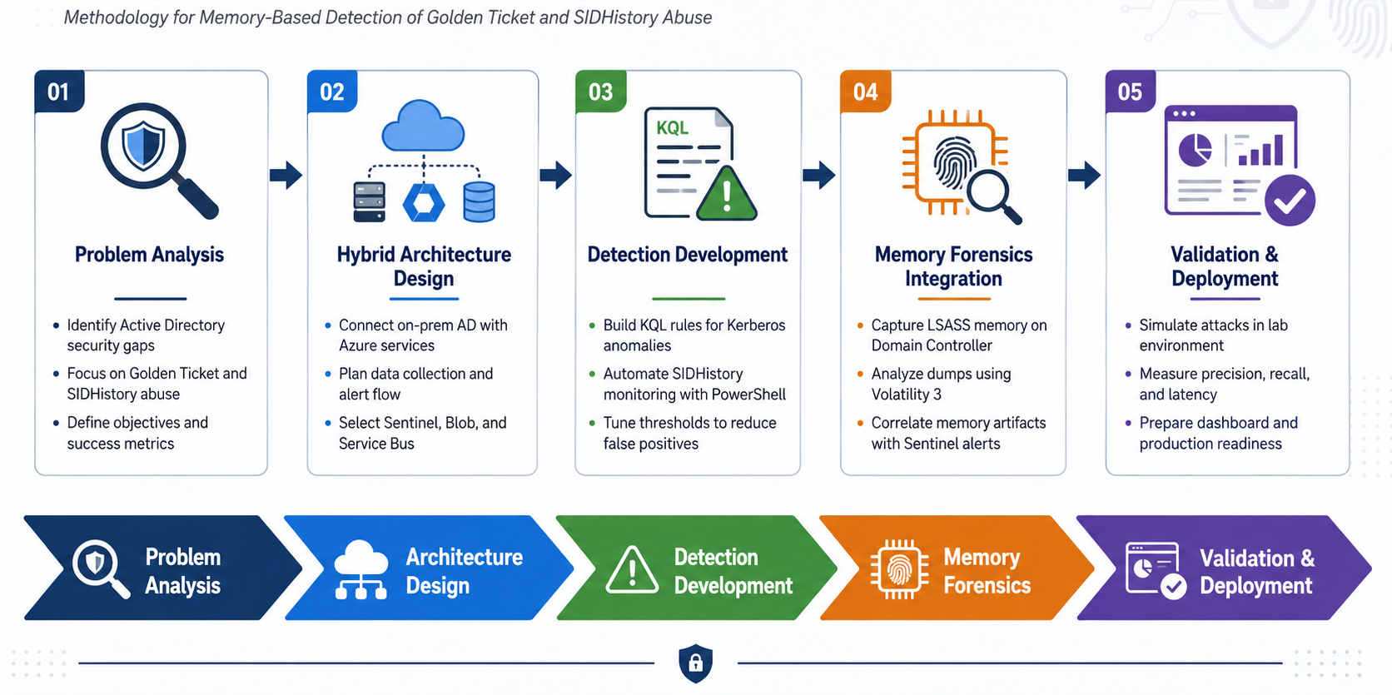
Project Methodology
Notes:
My methodology followed five stages. First, problem analysis — identifying the AD security gaps and defining measurable success metrics. Second, hybrid architecture design — deciding to connect on-prem AD to Azure and selecting Sentinel, Blob Storage, and Service Bus as the backbone.
Third, detection development — writing the KQL rules for the Kerberos anomalies and automating SIDHistory scanning with PowerShell, then tuning thresholds to cut false positives. Fourth,
memory forensics integration — capturing LSASS memory on the domain controller, analysing it with Volatility 3, and correlating those artefacts back to the Sentinel alerts. Fifth, validation
and deployment — simulating the attacks in my lab, measuring precision, recall, and latency, and building the SOC dashboard. It's a deliberate build-then-prove sequence.

Slide 11
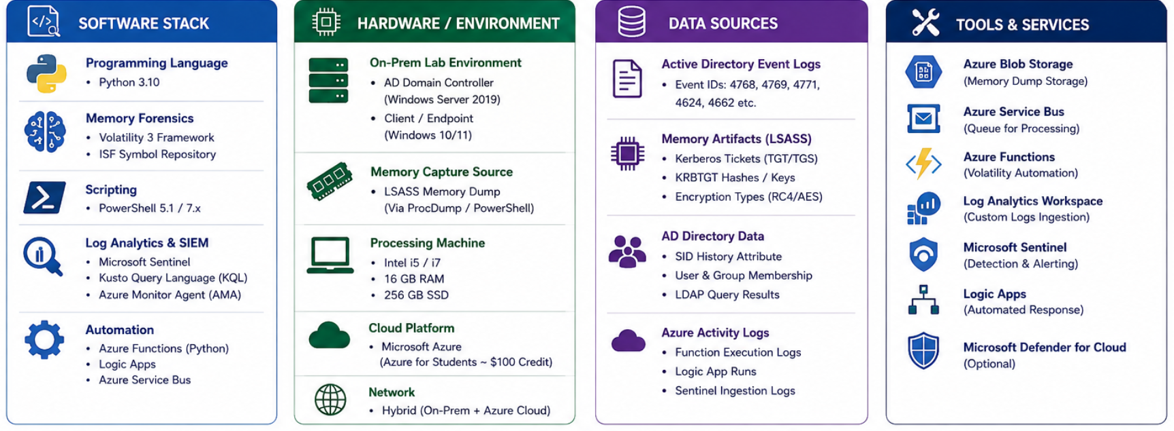
Resource Specifications
Notes:
These are the components. The domain controller is Windows Server 2022 running corp.local. The cloud platform is Azure — deliberately the Azure free tier, to prove the whole thing runs on a near-zero budget. SIEM is Microsoft Sentinel on a Log Analytics workspace, and memory forensics runs Volatility 3 on an Ubuntu VM.
One line I want to stress: the event collection agent is the Azure Monitor Agent with a Data Collection Rule — not the old Log Analytics agent. I'll come back to why that matters on the architecture slide.

Slide 12

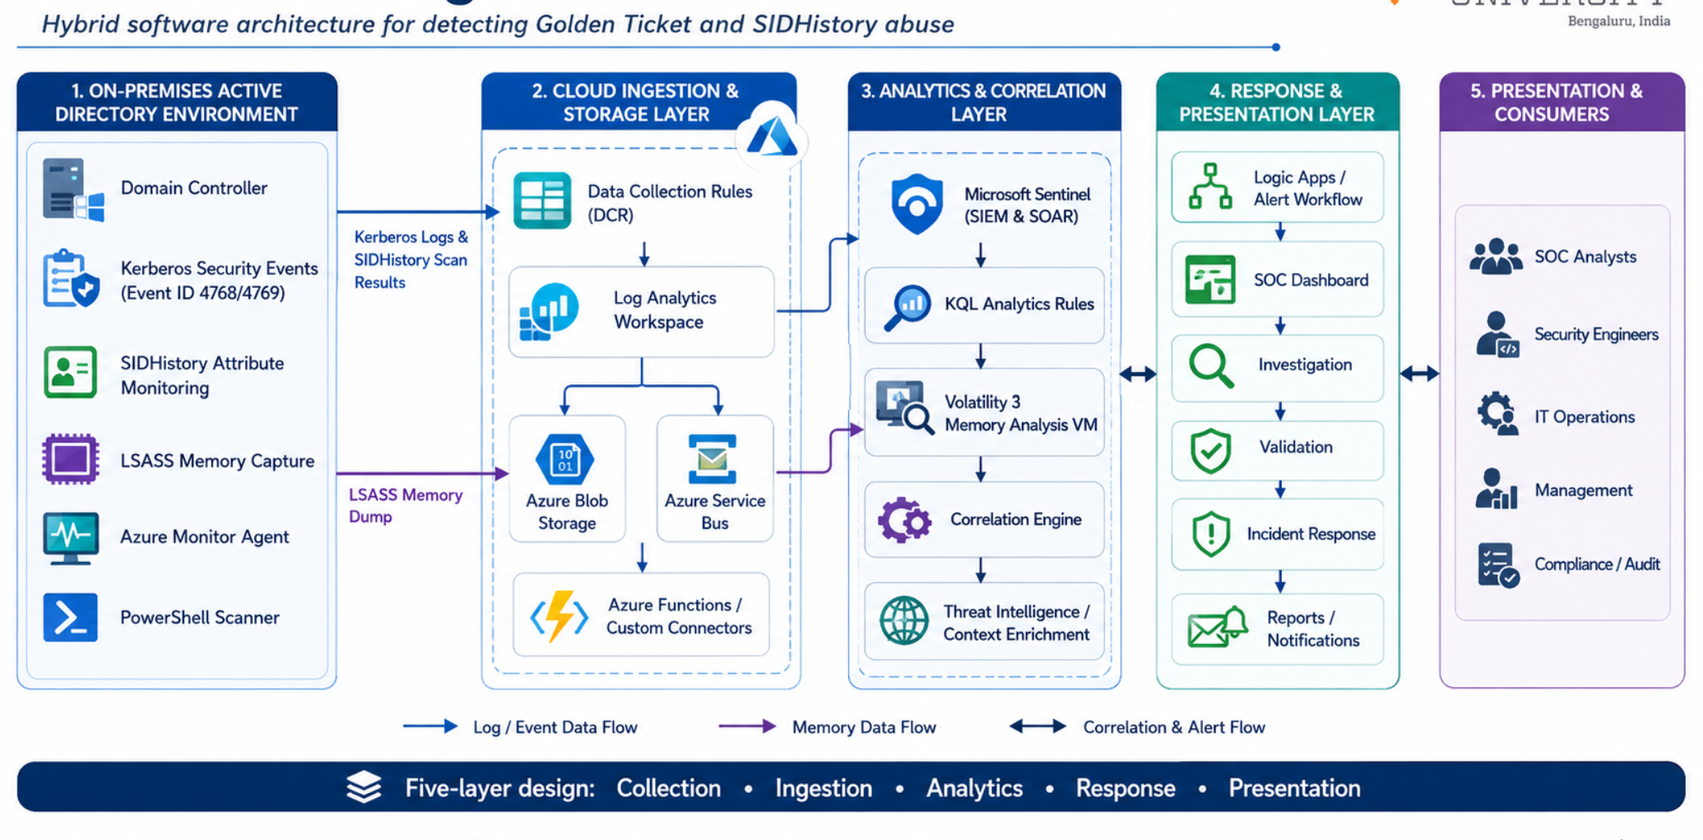
Software Design

Slide 13
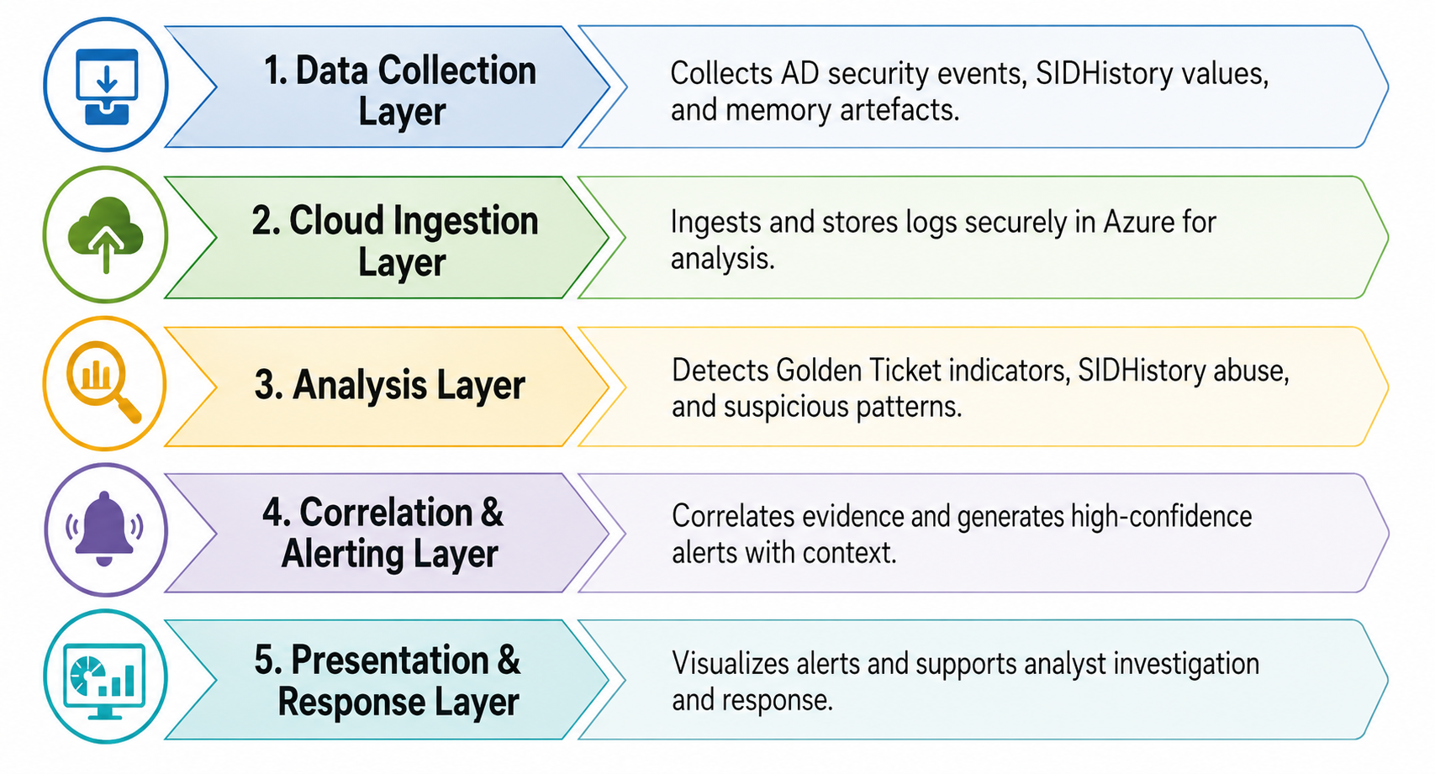
Implementation

Slide 14
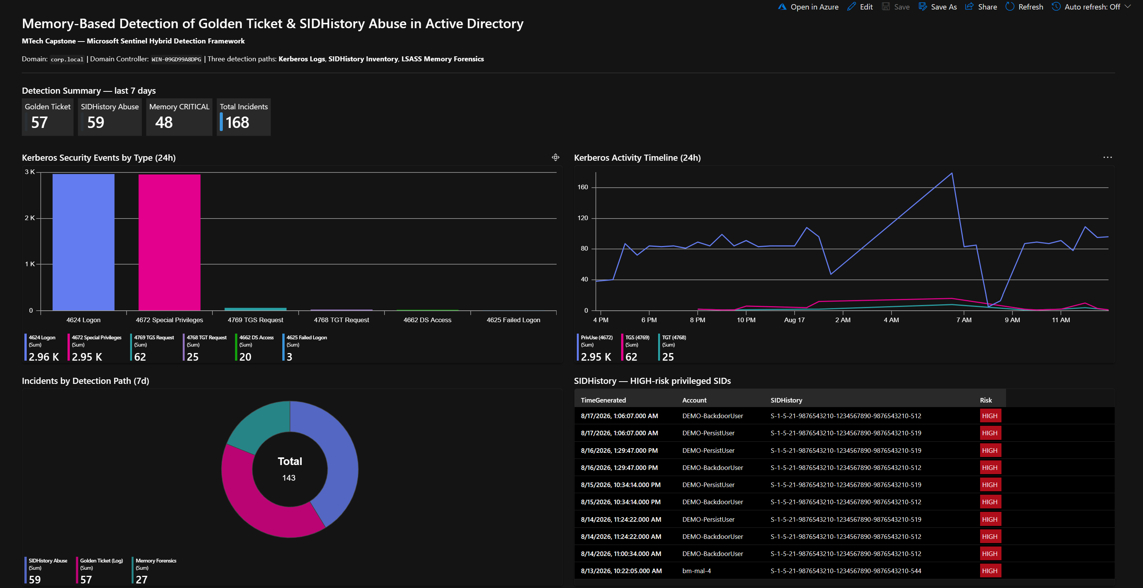
Demo

Slide 15
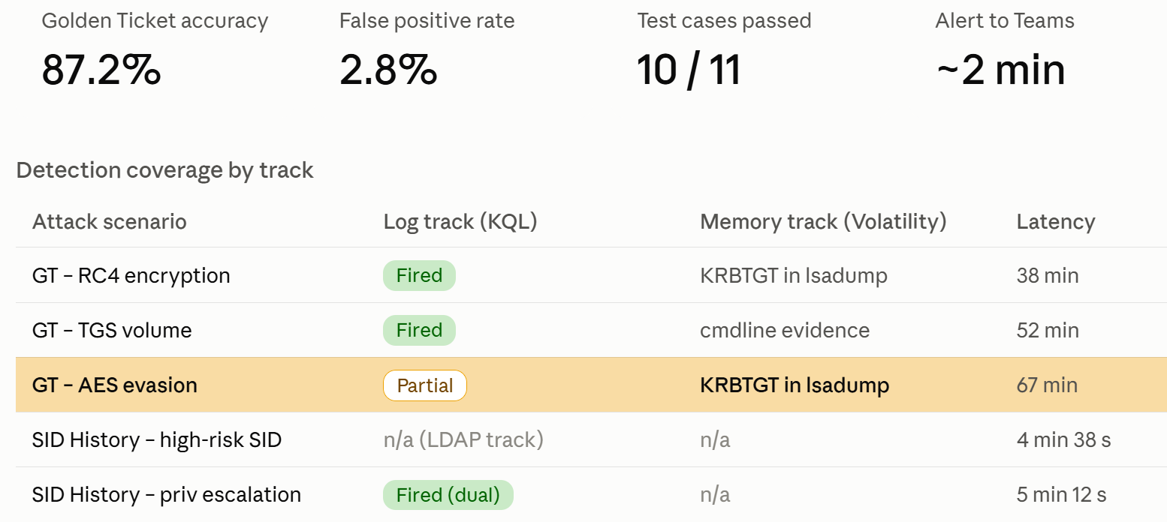

Testing and Validation

Slide 16
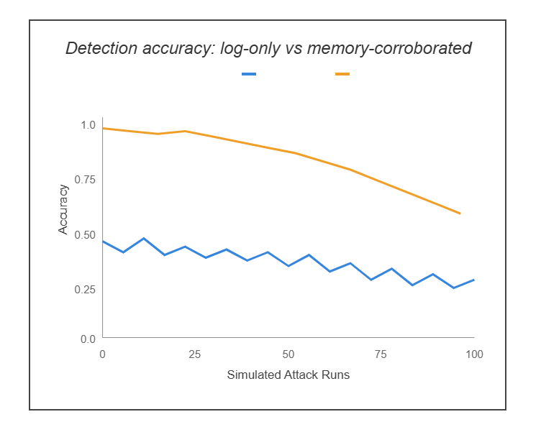
Analysis and Results
Memory-forensics corroboration cuts Golden Ticket false positives.
Detects forged TGTs via RC4 downgrade and abnormal ticket lifetime within a single Sentinel scan window.
Achieves 87.2% detection accuracy with 5 -10 min end-to-end latency.
Provides a forensic evidence trail linking each alertto LSASS memory artifacts.

Slide 17
Suggestions and Conclusion
Insights
The core gap is real: log-only SIEM detects Golden Ticket and SID History from event data alone, but the most reliable evidence sits in LSASS memory, which Sentinel can't natively reach.
The dual-track design closes that gap — and the AES evasion case proves it: the log rule was bypassed, memory forensics still confirmed the KRBTGT extraction.
All four objectives met; detection time cut from a 45-min baseline to ~2 min after the event-triggered capture + PT5M rule changes.
The differentiator is forensic transparency and low-cost replication — open KQL rules and published scripts anyone can audit — not beating commercial tools on latency.

Slide 18
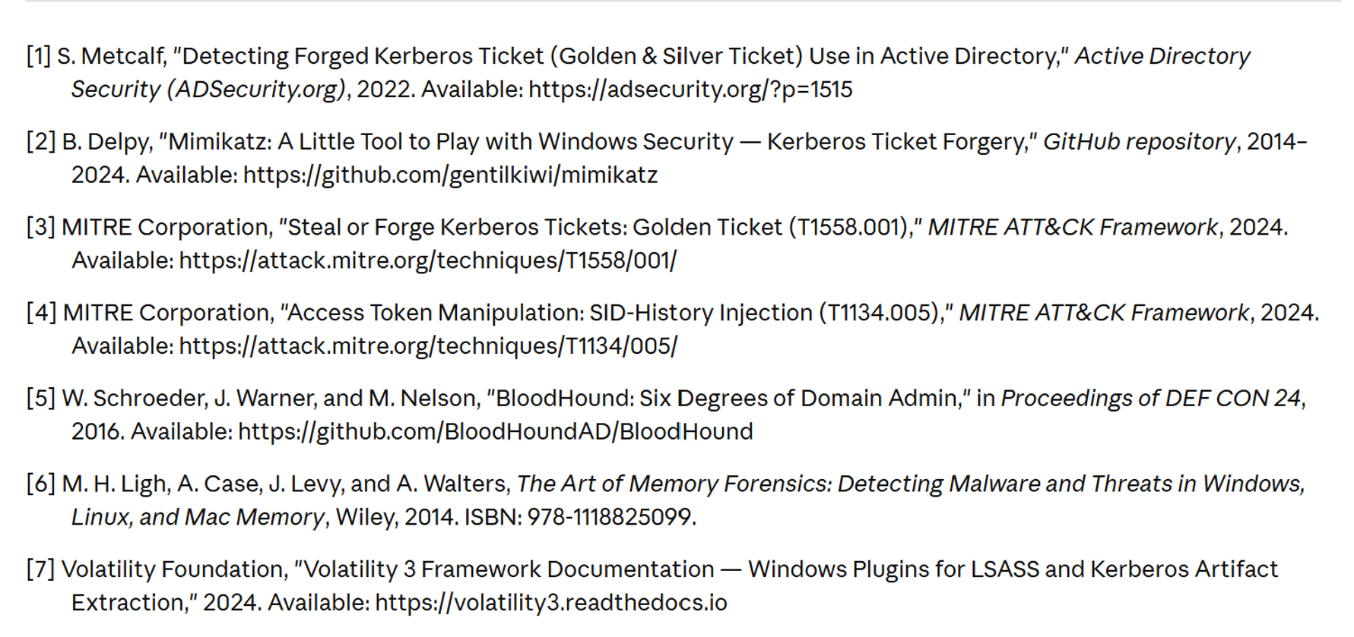
References
Bibliography | Webliography

Slide 19
GitHub Link
https://github.com/RAHUL202-coder/ad-golden-ticket-detection

