Slide 1
Detection of duplicate images
A presentation by
Aarushi Sharda
(140770107001)

Slide 2
Introduction
What is the need for detection of duplicated images?
Who can benefit from this algorithm and project in the long run?
What are the various applications?

Slide 3
Objectives
The tool can serve as a powerful medium for various individuals/organizations where they deal with large sets of images
Generates metadata from an image
Provides an interface for image operations
Provides image management to users

Slide 4
Related background
Google Image Search
Finding of products from a huge database for an E- commerce site
Recommendation system
Limiting duplicate posts

Slide 5
Tools and Technology
Backend server will use node.js
Frontend server will use node.js, HTML, CSS and JavaScript.
Tools used are VS code and Intellij community edition.
We will follow the Iterative model for developing this Project and whole Project will be developed using the SDLC.

Slide 6
Methodology (Modules)
A library which provides with metadata related to images which gets fed in as a learning database.
A server which operates on this data and gives the facility of checking duplicate images and also uploading new images.
A basic client which can register, login and perform image upload and duplicate image identification operations using the web panel.

Slide 7
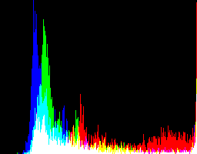
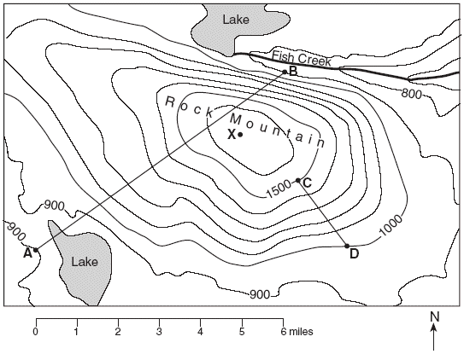
RGB Histogram
Contour map

Slide 8
Expected Outcome
The collection of images in the database would each have a metadata in the form of either a histogram or a contour image or both.
Each new image would be cross referenced with these metadata and a similarity score will be generated.
More images that are fed into the database, more the memoization.

Slide 9
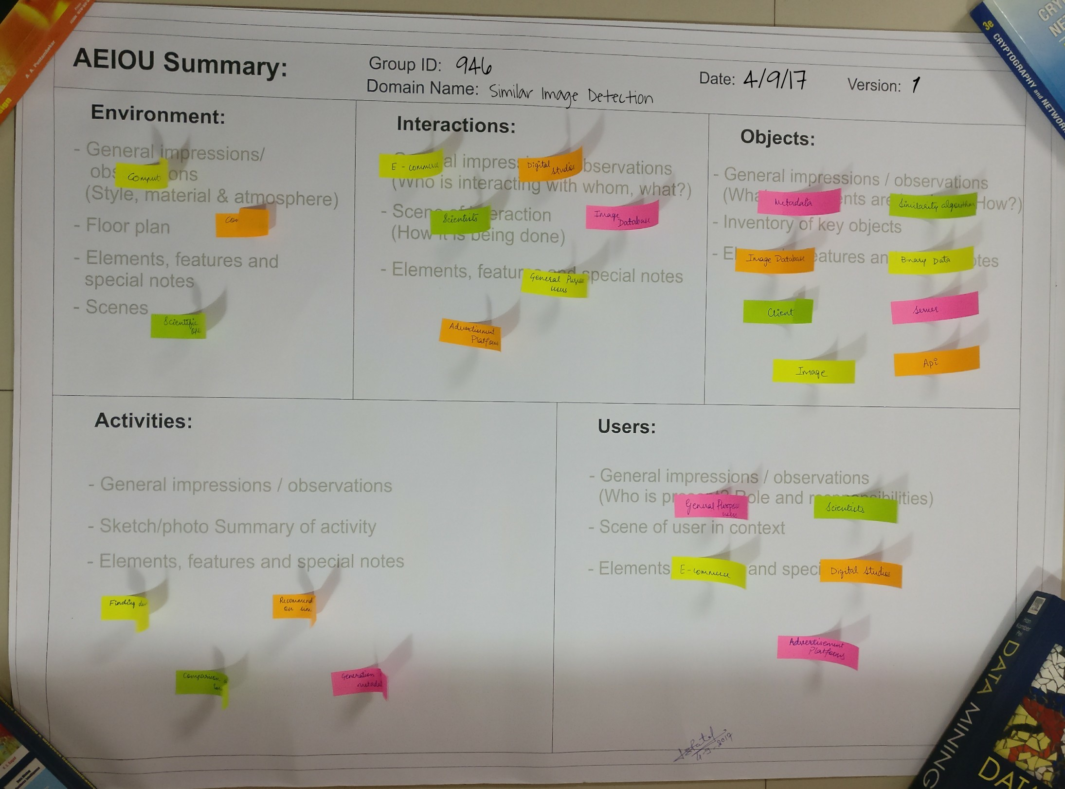
AEIOU Canvas

Slide 10
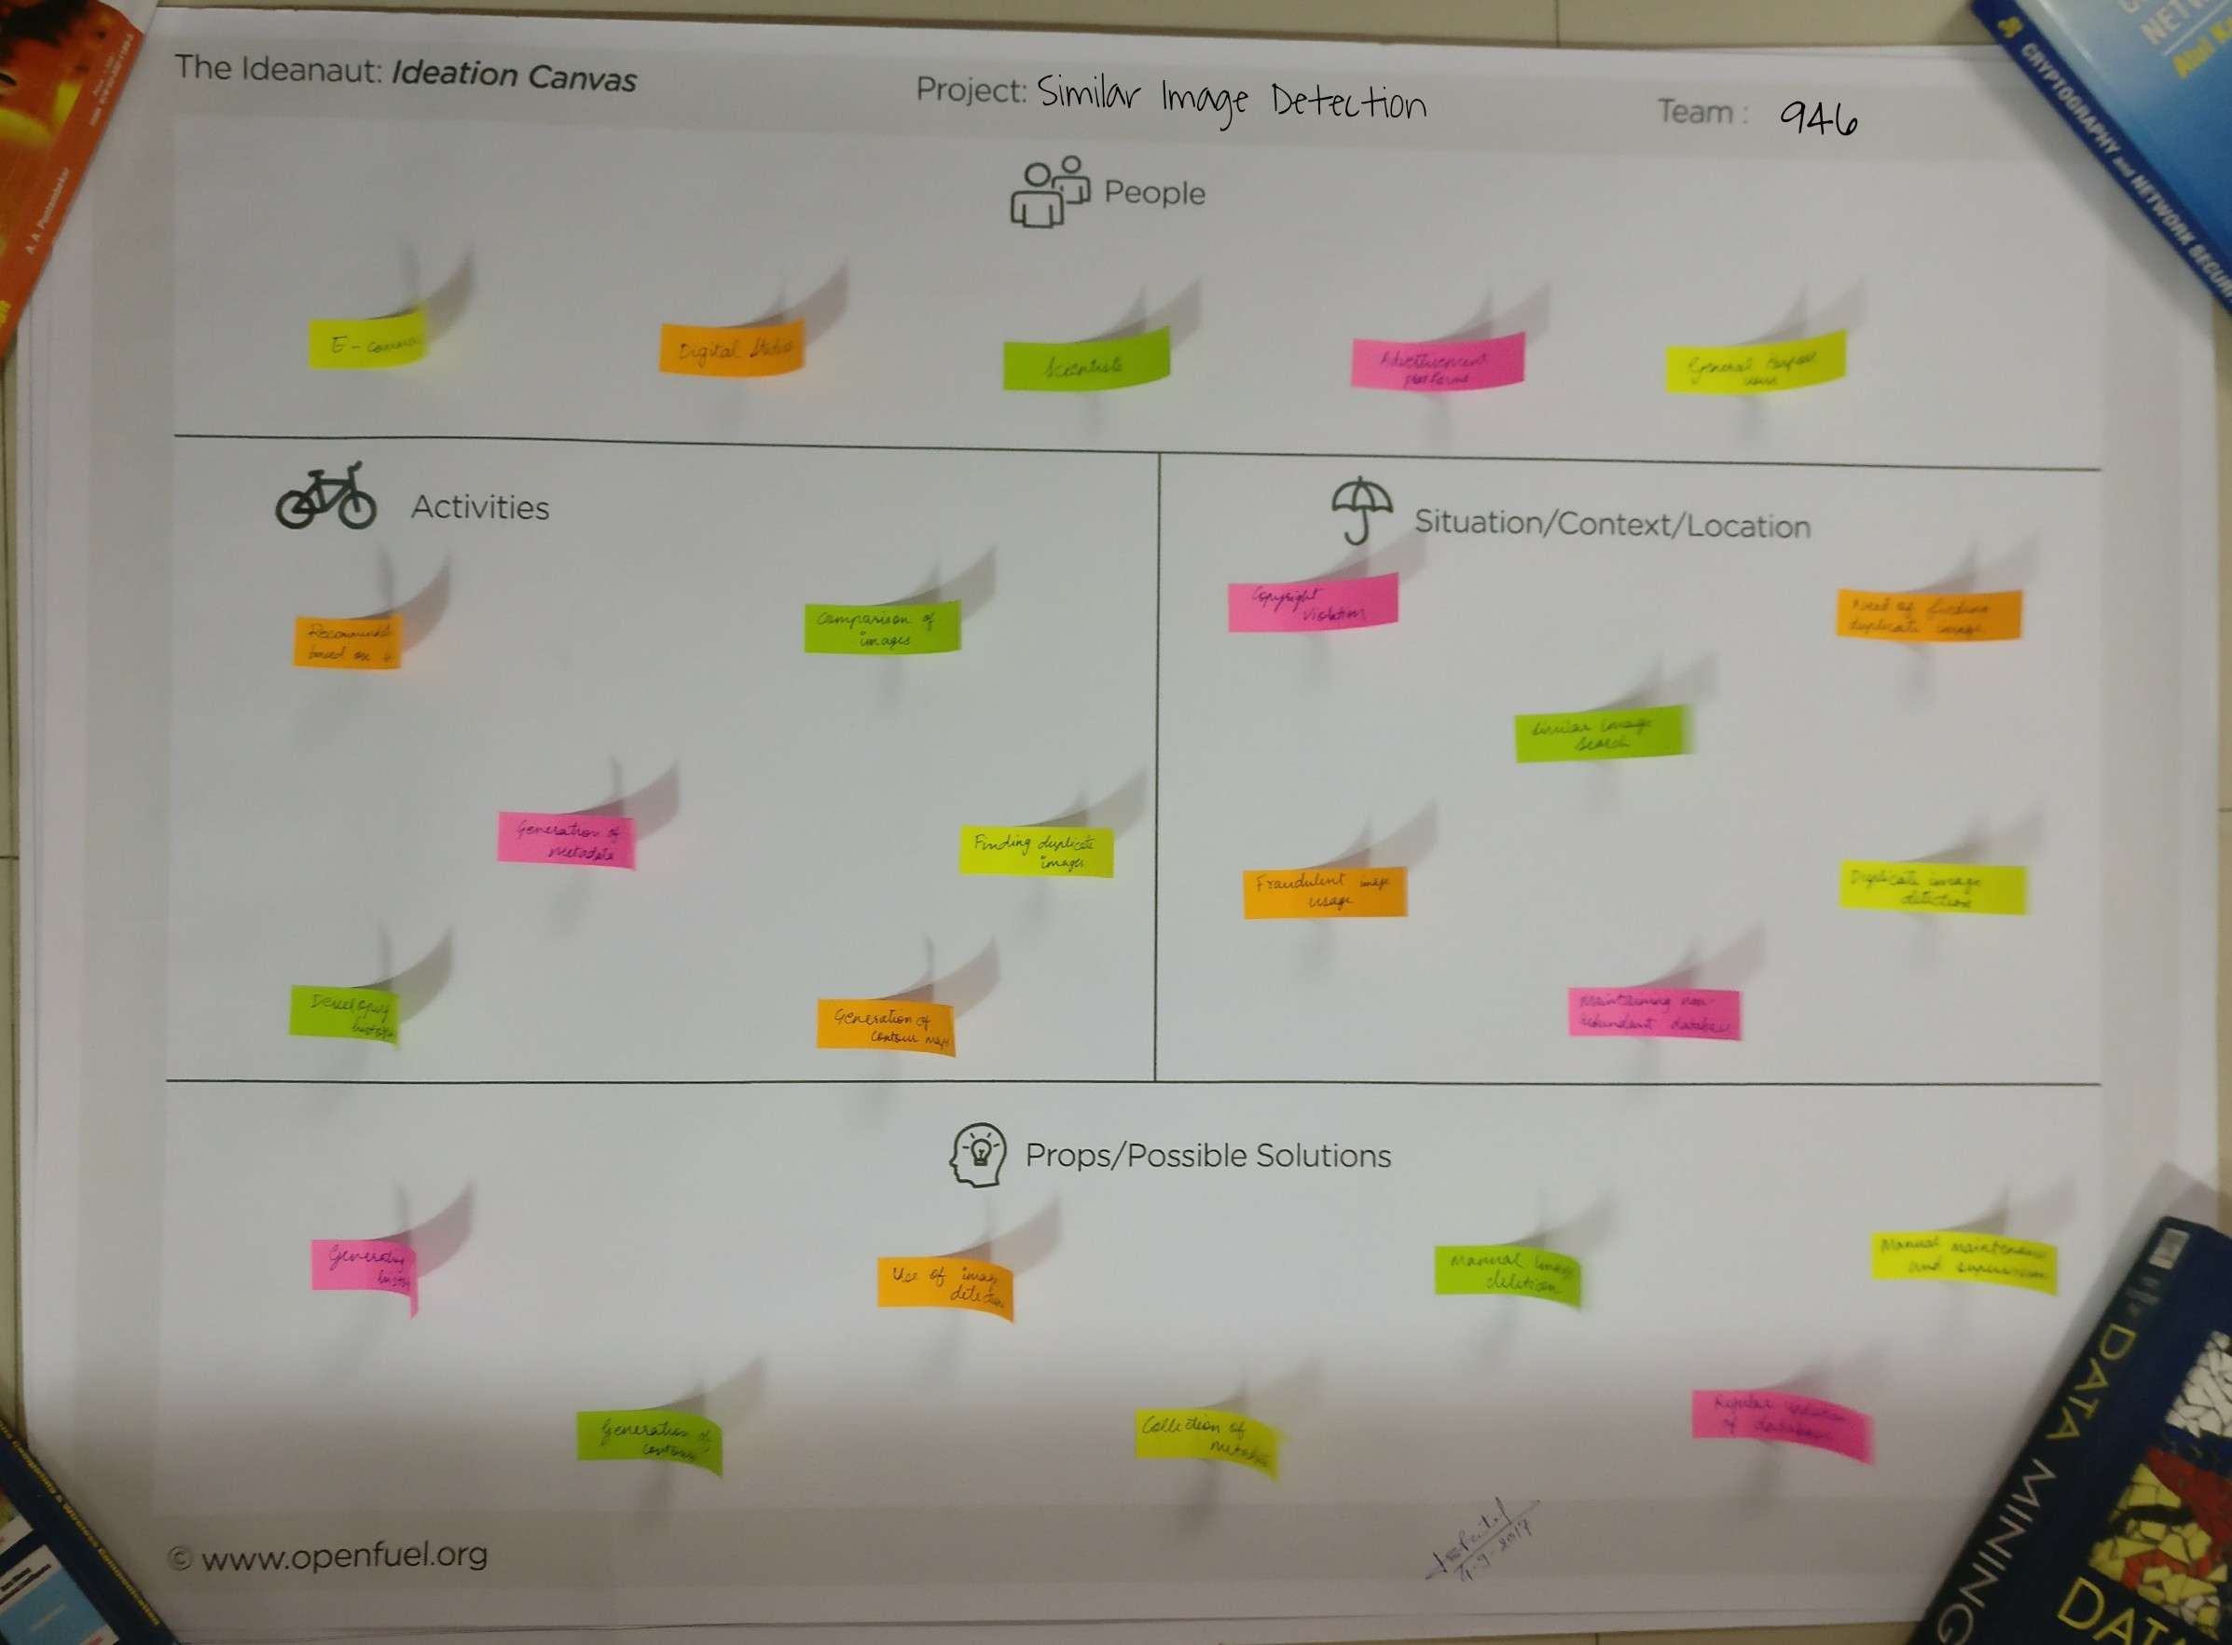
Ideation Canvas

Slide 11
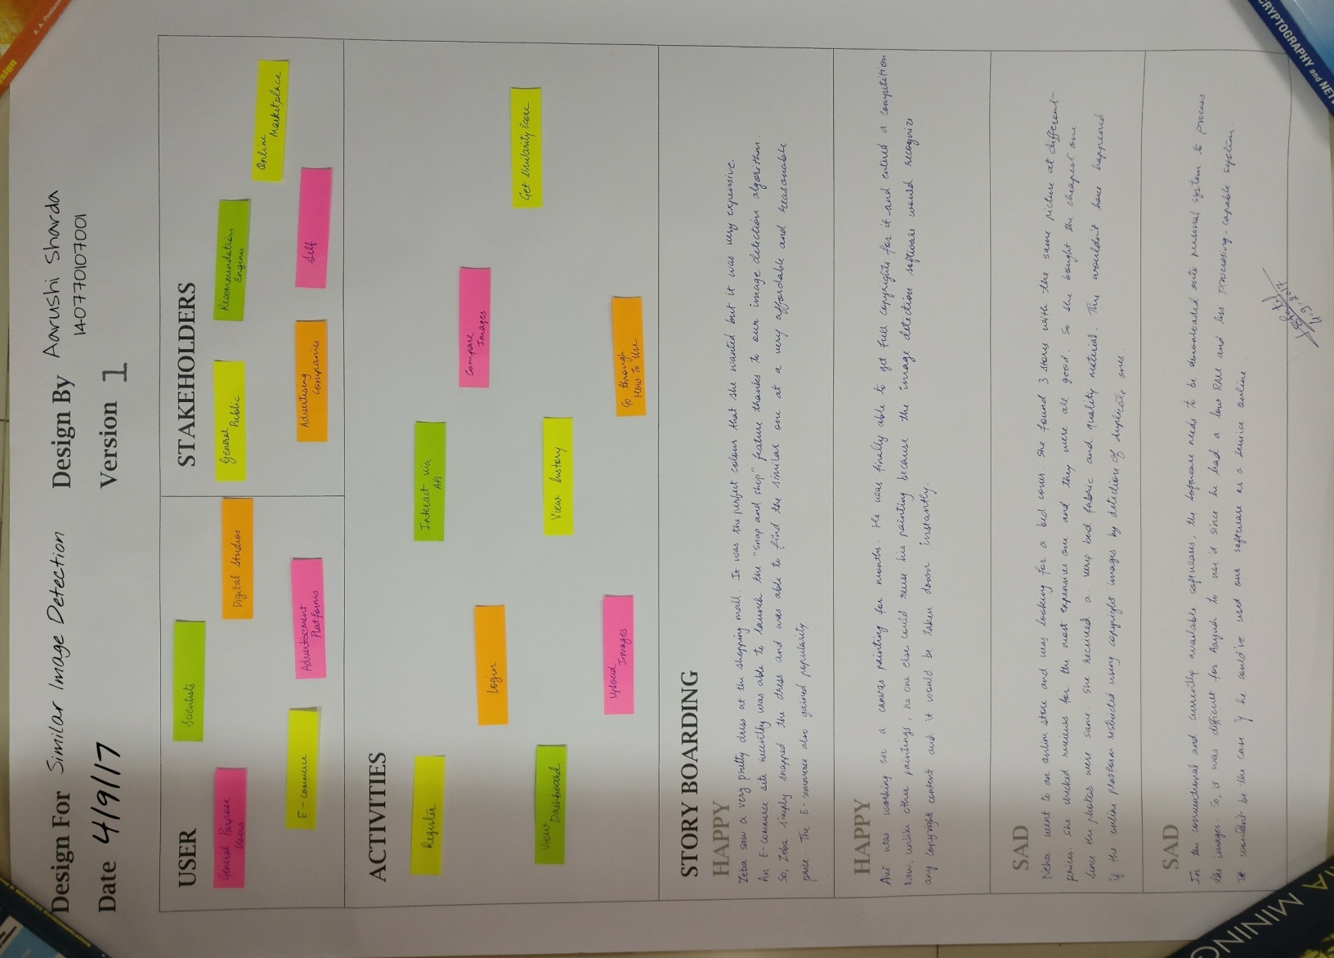
Empathy Canvas

Slide 12
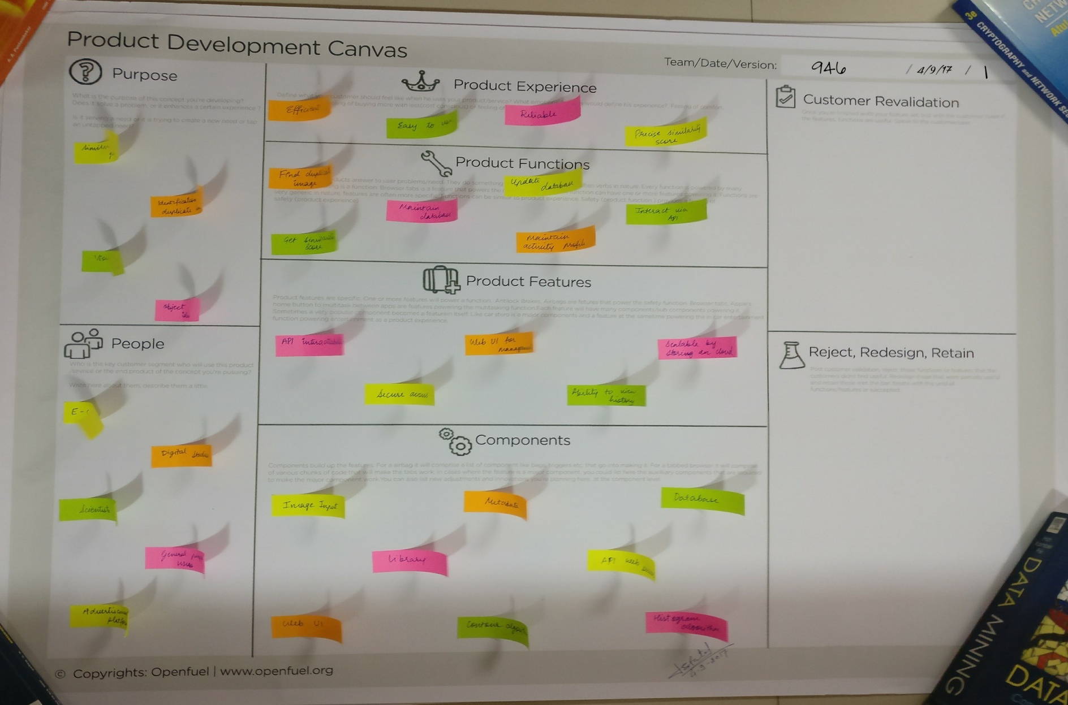
Product development Canvas

Slide 13
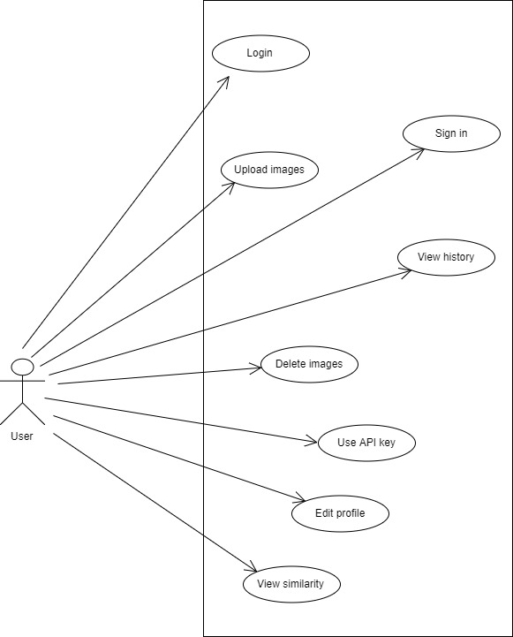
Use Case

Slide 14
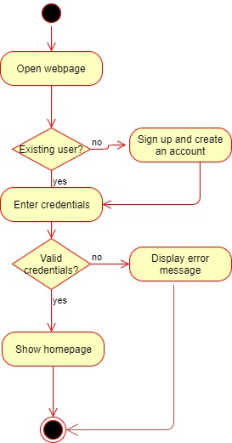
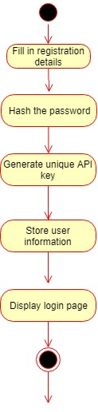
Activity diagrams
Login
Sign up

Slide 15
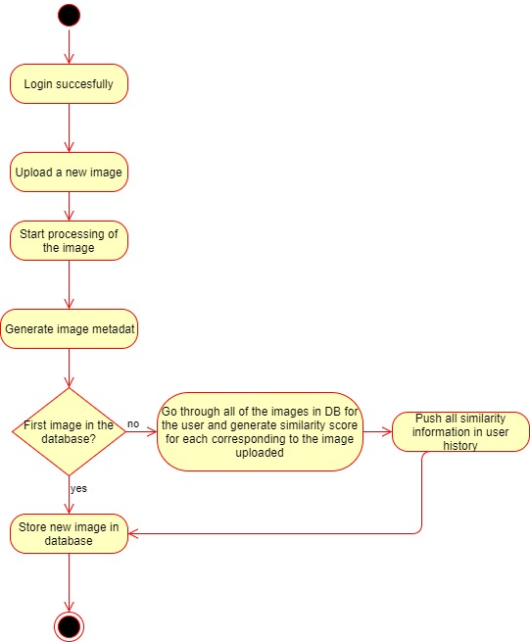
Image Upload

Slide 16
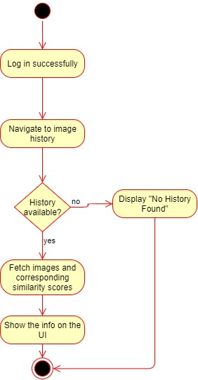
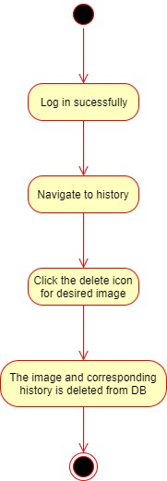
View history
Delete image

Slide 17
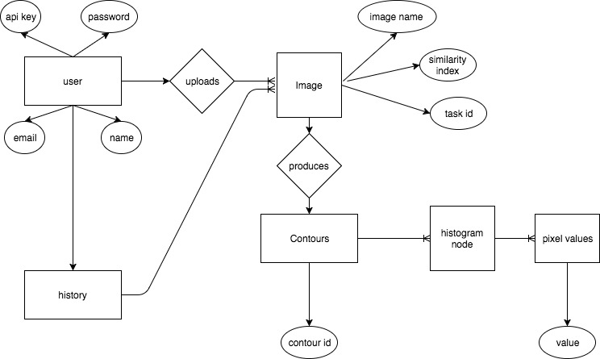
ER Diagram

Slide 18
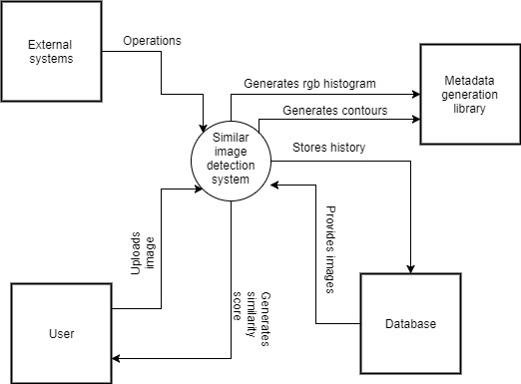
Context flow diagram

Slide 19
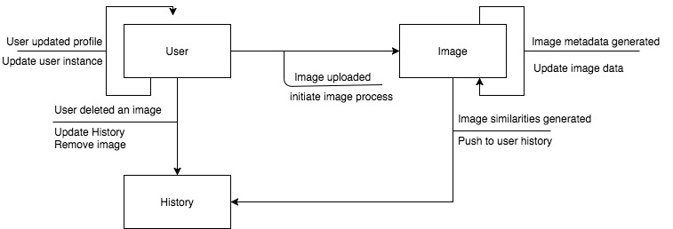
State-transition diagram

Slide 20
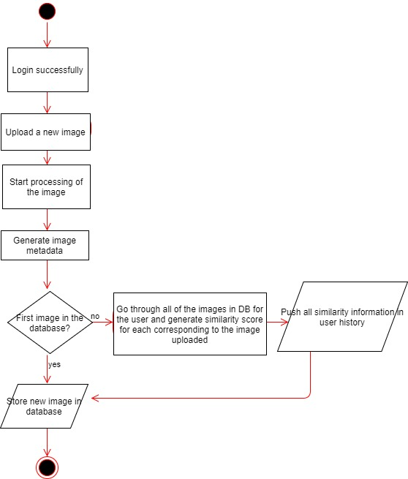
Flowchart

Slide 21
Conclusion
A useful website based on image processing that is aimed at E-commerce, digital studios, visual recommendation that detects duplicate and similar images based on contour maps and corresponding histogram.

Slide 22
Thank You

