Slide 1
Deep-Reinforcement Learning on Atari games
Course: Pattern Recognition
Submitted by Aishwarya Anilkumar
Paper reference: [1] Mnih, V., Kavukcuoglu, K., Silver, D., Graves, A., Antonoglou, I., Wierstra, D., & Riedmiller, M. (2013). Playing atari with deep reinforcement learning. arXiv preprint arXiv:1312.5602.

Slide 2


The basic idea being, how well the agent is navigating (exploit and explore) through the environment so that it maximizes its reward(Score in the Atari game)
Learning and improving based on experiences
Environment
Agent
Maximum reward as Score

Slide 3
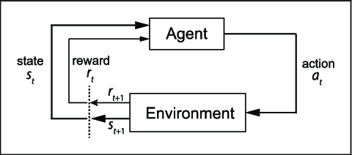
Reinforcement learning
Galatzer-Levy, Isaac & Ruggles, Kelly & Chen, Zhe. (2018). Data Science in the Research Domain Criteria Era: Relevance of Machine Learning to the Study of Stress Pathology, Recovery, and Resilience.

Slide 4
The process
The agent starts with an initial observation of the environment
In most cases, the only information available to the agent is the dimension of the state space (image) and the action space (no. of actions)
The agent collects more information by interacting with the environment
It choses an action a_{t} from a set of different possibilities
The environment responds to this action by generating a reward r_{t+1} (scalar value) and transitioning to another state a_{t+1}
The reward is the parameter of performance for the agent
This process is repeated several times
The only goal of the agent is to maximize its cumulative reward and nothing else
Paper reference: [1] Mnih, V., Kavukcuoglu, K., Silver, D., Graves, A., Antonoglou, I., Wierstra, D., & Riedmiller, M. (2013). Playing atari with deep reinforcement learning. arXiv preprint arXiv:1312.5602.

Slide 5
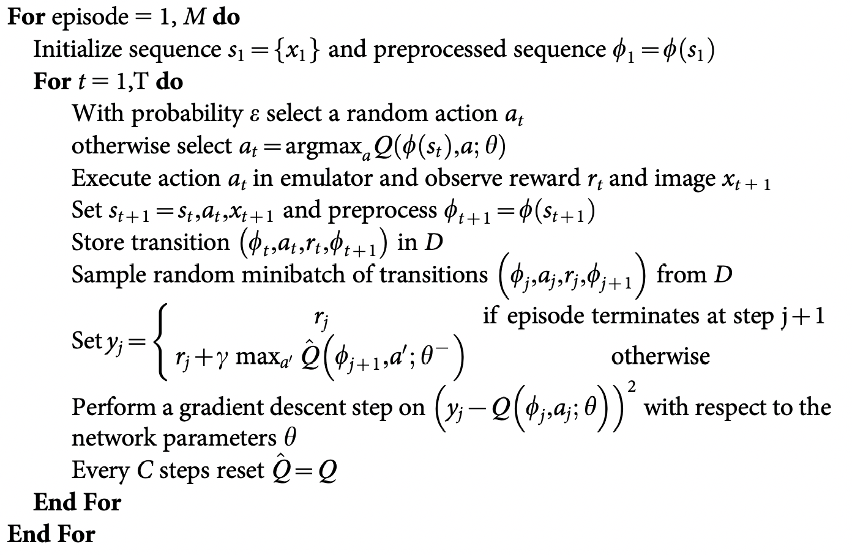
Algorithm
Paper reference: [1] Mnih, V., Kavukcuoglu, K., Silver, D., Graves, A., Antonoglou, I., Wierstra, D., & Riedmiller, M. (2013). Playing atari with deep reinforcement learning. arXiv preprint arXiv:1312.5602.

Slide 6
Architecture
The architecture of this project involves two models:
1) Q DNN (A convolutional Neural Network similar to the one implemented in the paper referenced above for action-value function Q)
2) Q_hat DNN (similar model as Q DNN for target action-value function Q_hat) The CNN has total 6 layers:
3 Convolutional 2D layers
3 Dense layers
The final layer outputs "Action-values"( Being in a state s_{t}, if we make action a_{t} how much will be the total reward)

Slide 7
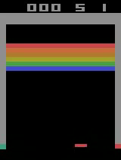
Result
Initial performance (Bad)

Slide 8
Conclusion
This paper presented a deep learning model for reinforcement learning
Demonstrated ability to master control policies using few pixels
Introduces replay buffer concept
Practical applications such as self driving cars, general AI (agent mastering multiple tasks) such as research by Dr David Silver, and Dr Peter Abbiel

Slide 9
Disadvantages
Produces unsatisfactory results where data generation is expensive, since training the neural network requires huge amount of data
Requires extensive iterations increasing the computational time cost
Low reproducibility of same results for empirical observations

