Slide 1
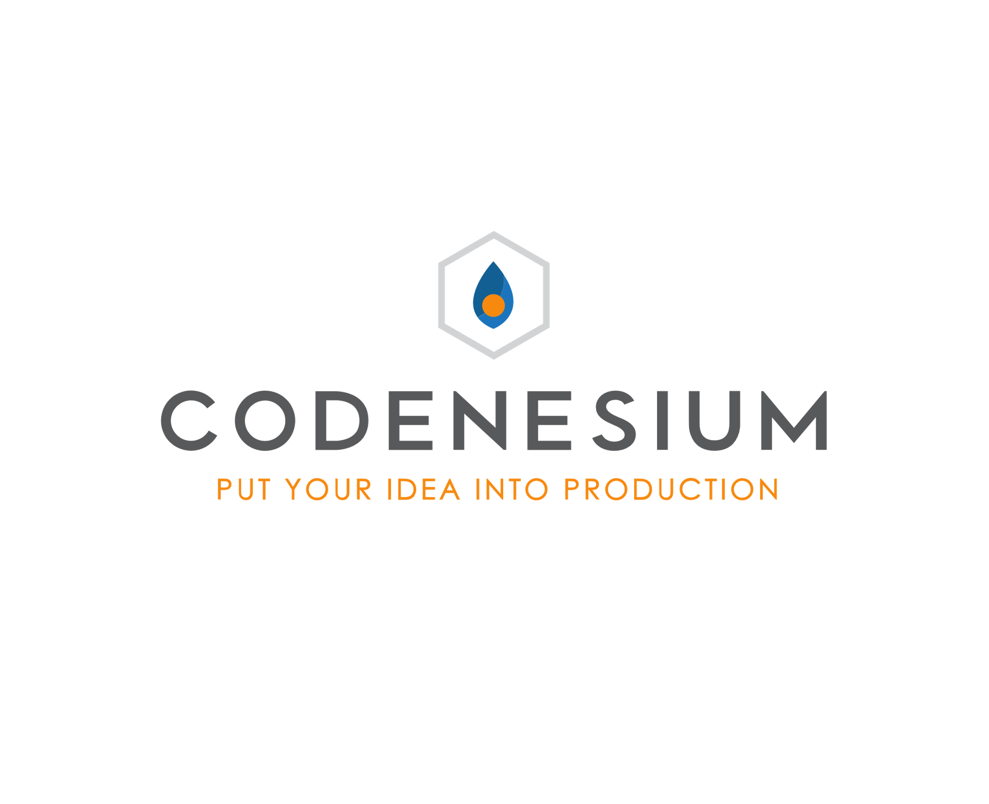




We generate modern web applications
We take a database schema and generate a complete ASP.NET Core + React application. SQL Server and PostgreSQL supported.
You get the complete source code for your application. A developer can modify it to be exactly what you need.
We use modern tech. TypeScript, Docker, integration and unit testing. Applications are designed to be modified, extended and easily deployed on-prem and to any cloud.
If you’re a maker and want to prototype fast we’ve got you covered. Apps are deployed to a playground server for immediate use.
If you’re a founder let us build your web app MVP. We’re reasonably priced. We’re focused on quality and speed.
https://www.codenesium.com
Demos

Slide 2

I’m looking for work!
Although I would love for Codenesium to be my full time gig it’s not there yet.
I’m looking for contract(6 months+) or full time employment working with some or all of these technologies.
.NET Core
React
JavaScript
TypeScript
SQL Server
Octopus Deploy
DevOps
Azure
AWS

