Slide 1

Hello, Git
by Ethan Burnet and Angus Wong

Slide 2
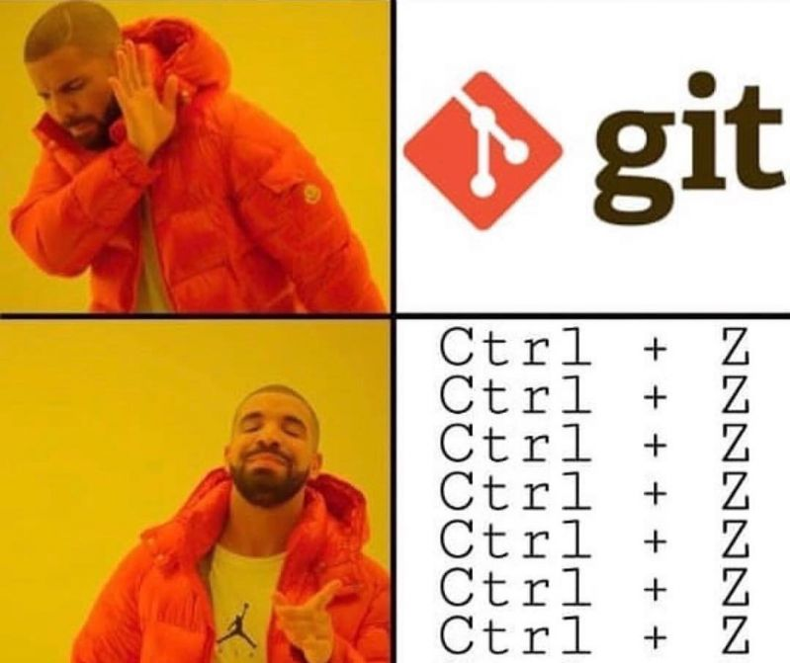

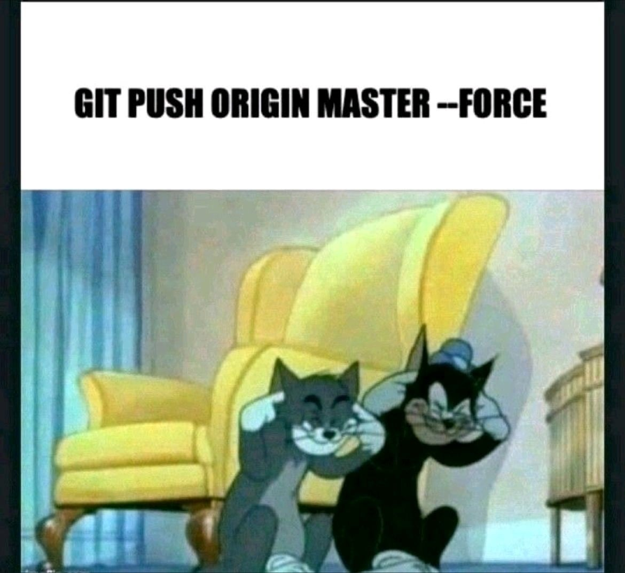
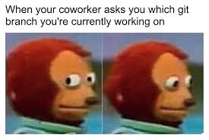
Agenda
Introduction to Git
Git vs GitHub/GitLab/BitBucket
How to collaborate on Git
Interactive Workshop

Slide 3
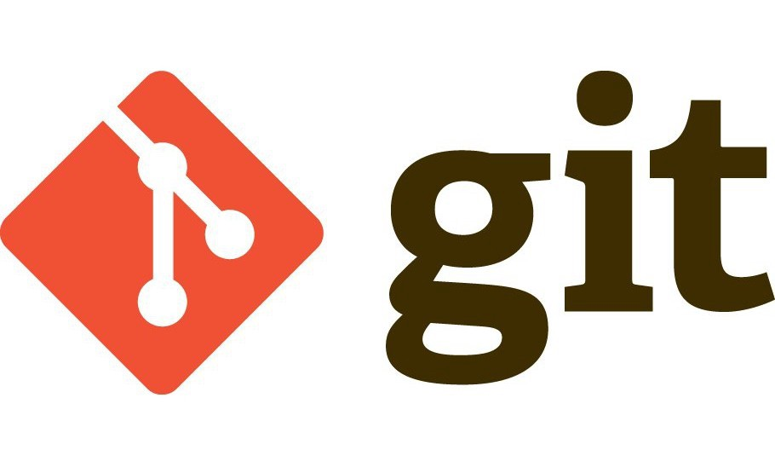
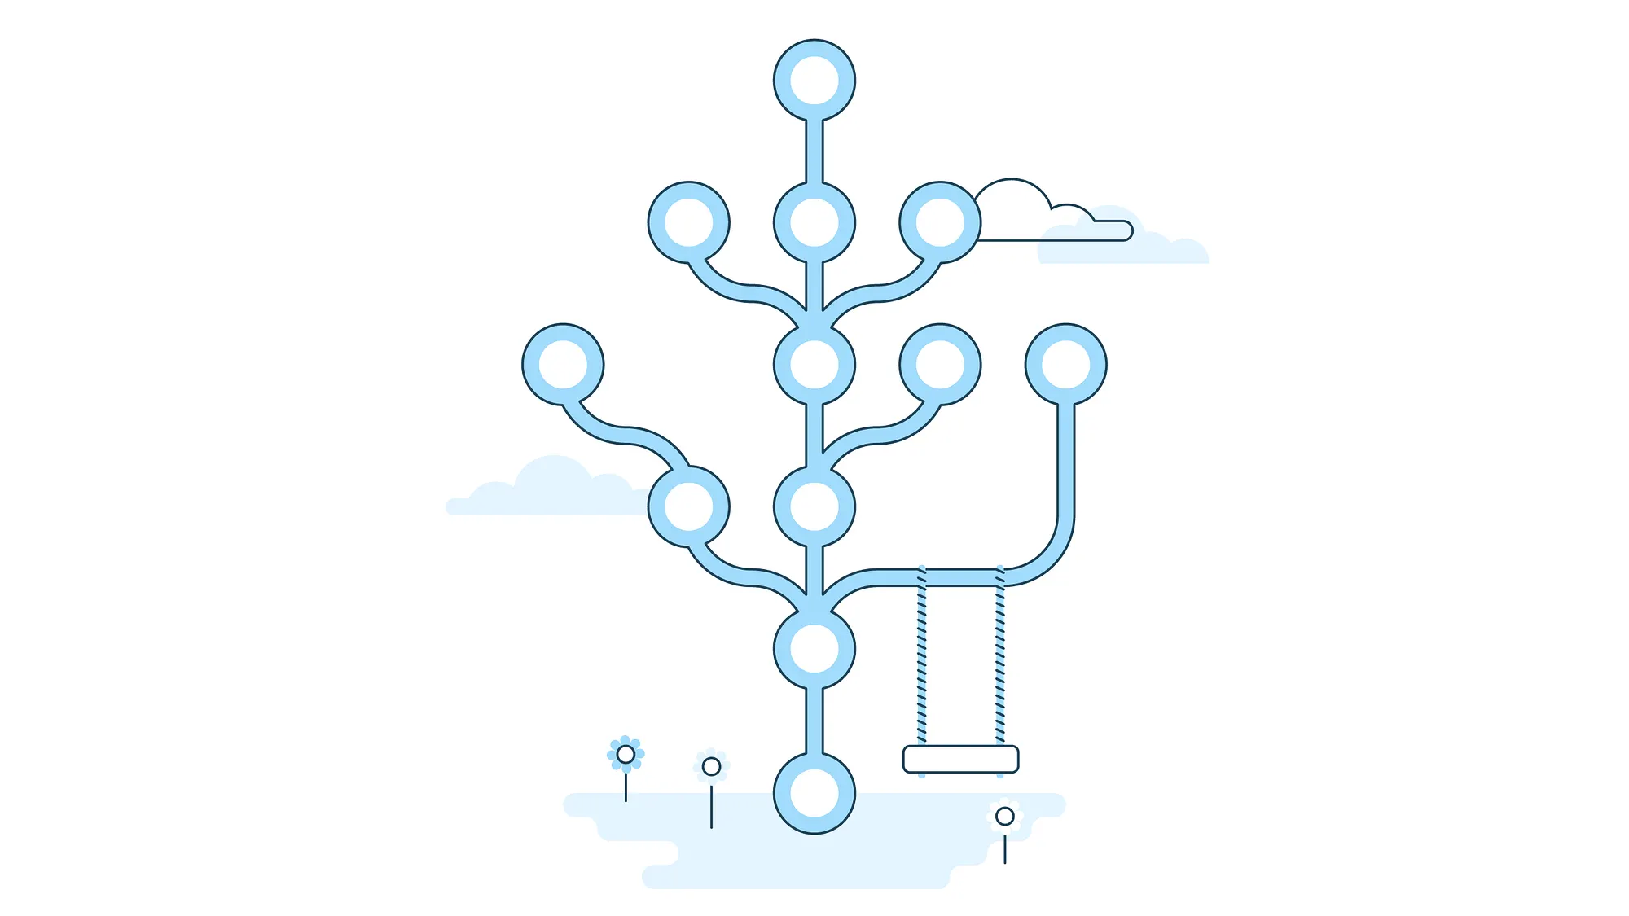
What is Git?
Version control software tools have existed since 1960s
Git is one of the most popular version control systems in the world
Developed by Linus Torvalds (yes, that guy) in 2005 as an open-source version control software to be used on Linux
Saves snapshot of all files inside a repository (folder)
Allows programmers to view history and checkout the files’ contents from any saved commits (version)

Slide 4
Git lets you keep a timeline of your changes, called a repository
added lockdown mode
removed transparency
fix: ethical concerns
Each point is called a commit
feat: legal permits
fixed geothermal power
added flux capacitor

Slide 5
merge (when ready)
implemented UN feedback
You can have multiple timelines
optimised uranium refining
experimental boominator
new branch: nuclear fission
added lockdown mode
removed transparency

Slide 6
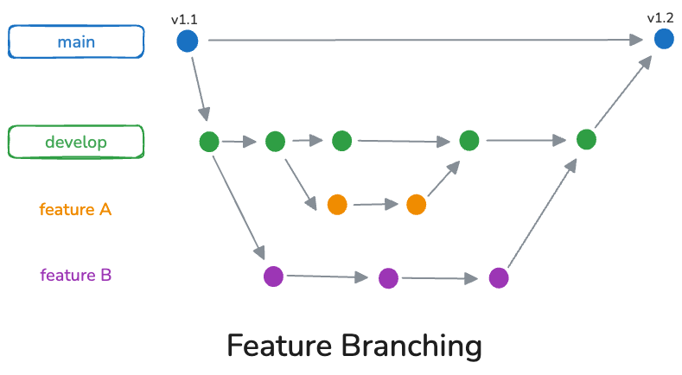
Branching
Branching allows for multiple developers to work on the same repo without interfering with each other’s work
Branches can be merged which will combine their changes and histories

Slide 7
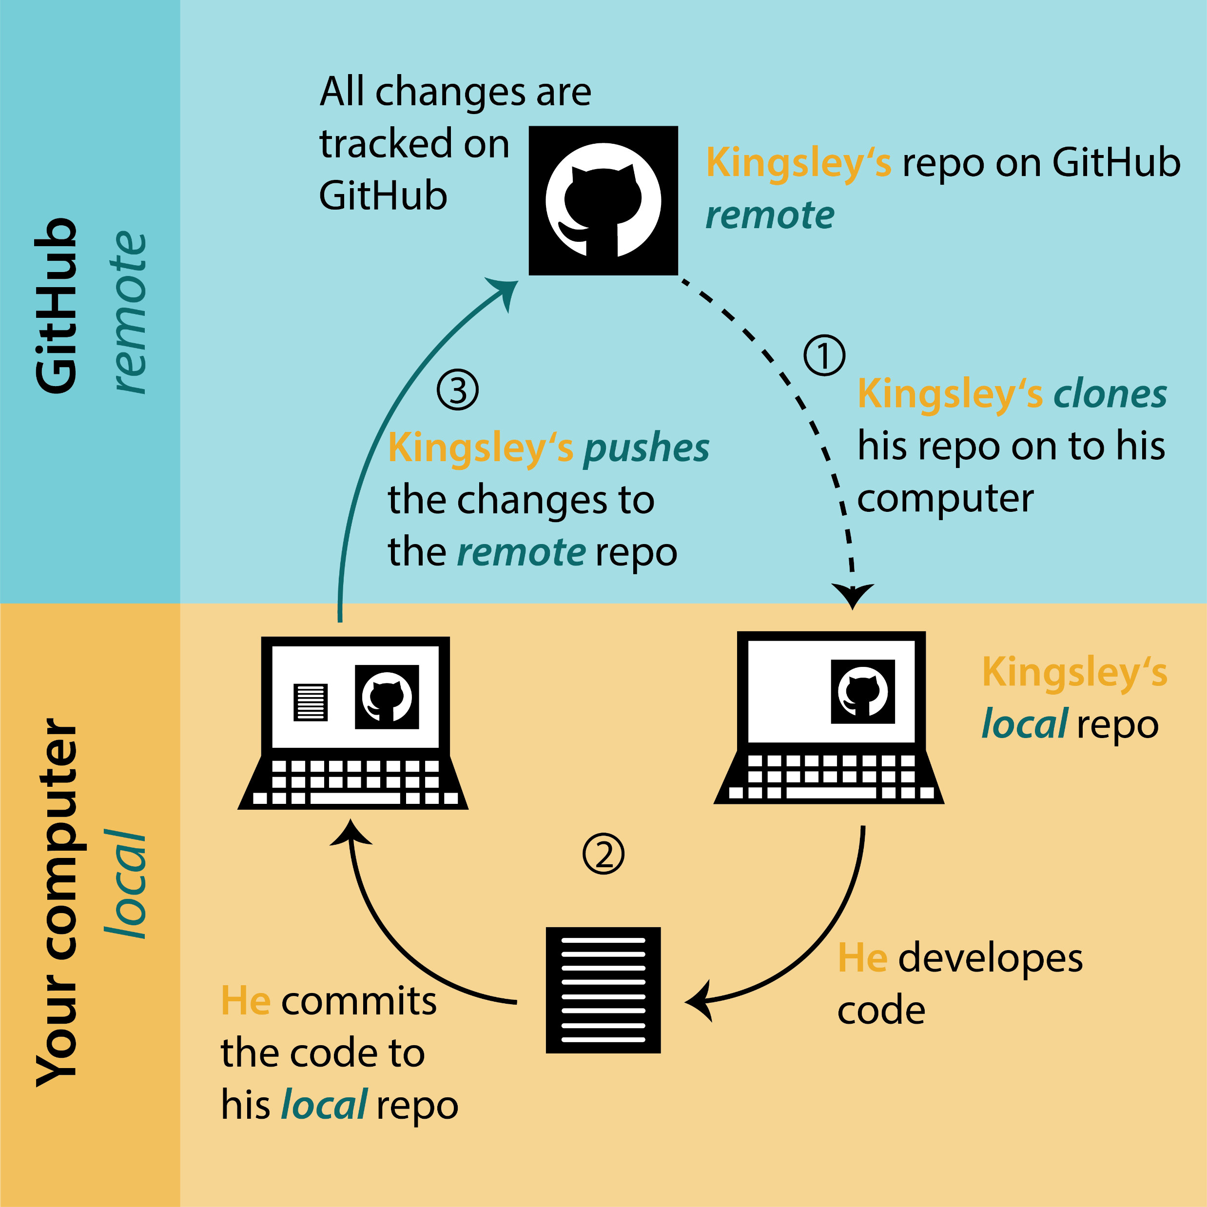
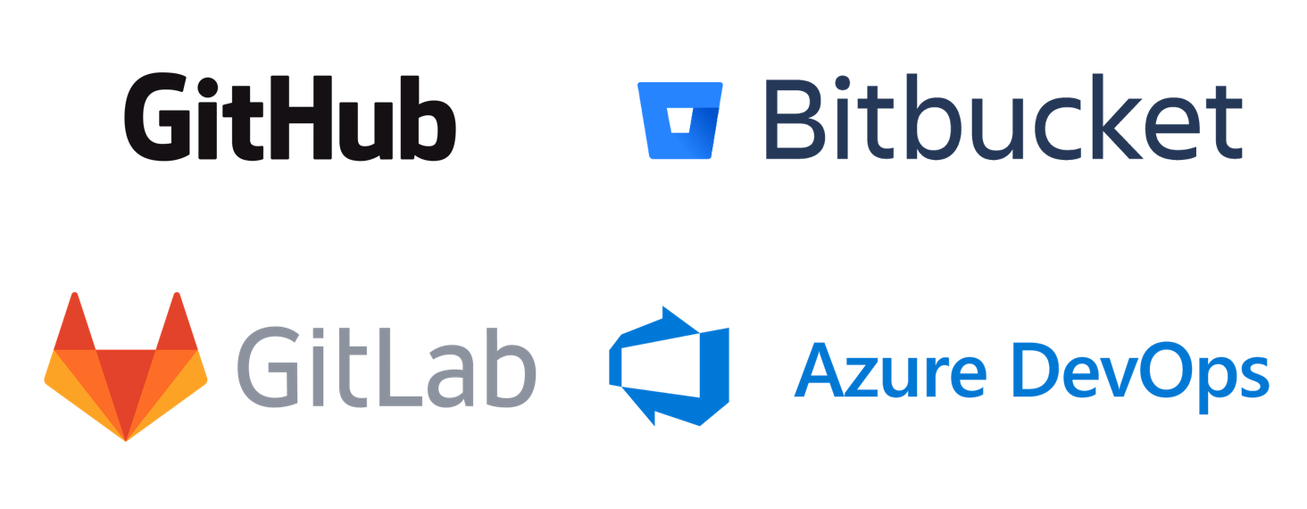
Git vs GitHub/GitLab/BitBucket
Git is a version control software. You can install Git on your computer
GitHub/GitLab/BitBucket are collaborative version control platforms that use Git for distributed version control
Git = File Explorer, GitHub = OneDrive/SharePoint

Slide 8

GitHub lets you share Git repositories with other people
Your local Git repository
Your GitHub repository
implemented UN feedback
optimised uranium refining
experimental boominator
push
implemented UN feedback
Netizens
optimised uranium refining
experimental boominator

Slide 9
Contributing to GitHub repos
Someone’s GitHub repo
Your fork
gave into consumerism
destroyed 14 wells
brought back diseases
pull request
gave into consumerism
achieved enlightenment
destroyed 14 wells
fork
brought back diseases
built 14 wells
achieved enlightment
built 14 wells
eradicated diseases
eradicated diseases

Slide 10
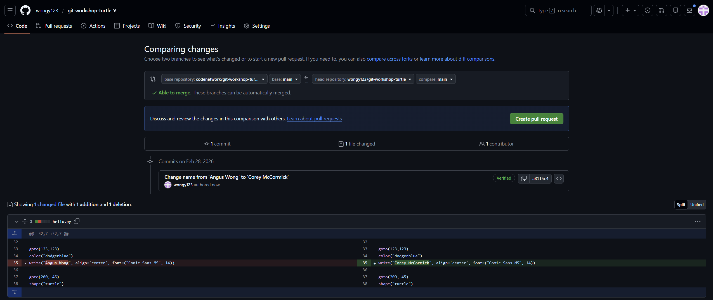
Forking
Forking is available on remote Git platforms
Forking creates a copy of the original repo under your control
Make changes and push to your fork, then create a Pull Request to the original repo

Slide 11
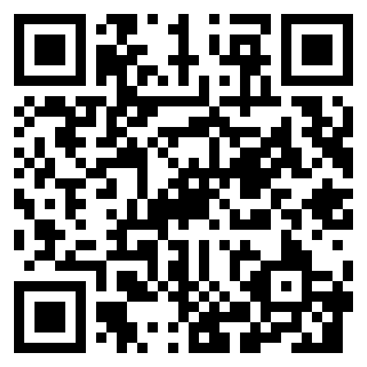
Workshop – make your first contribution
Visit https://github.com/codenetwork/git-101-2026
Read the instructions and set up your Git
Fork the repo, then clone your own forked repo
Add your name to Program.cs, add to stage, commit, and push
Create a pull request to the original repo
Put your hand up and a facilitator will help merge it!
Open https://codenetwork.github.io/git-101-2026/ to see the results, or scan the QR code

