Slide 1

Git 101
By Angus Wong
Code Network 2026

Slide 2
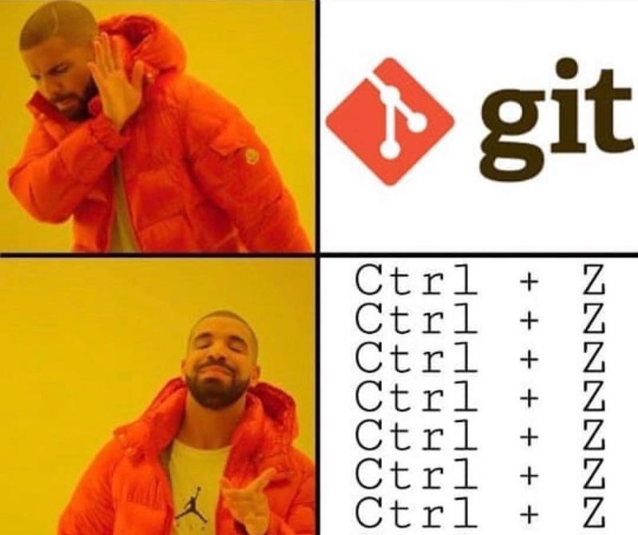

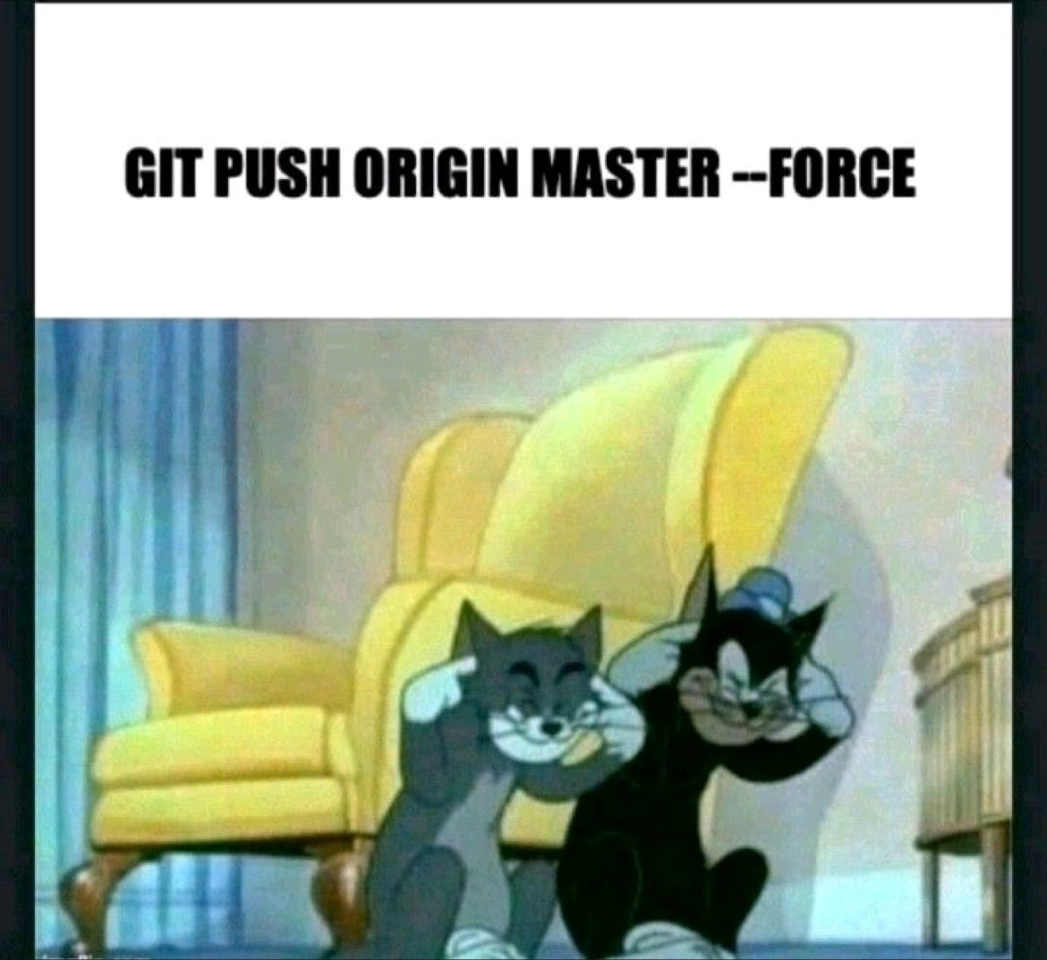

agenda
Introduction to Git
Git vs GitHub/GitLab/BitBucket
Common Git Operations
How to collaborate on Git
Hands on execise

Slide 3
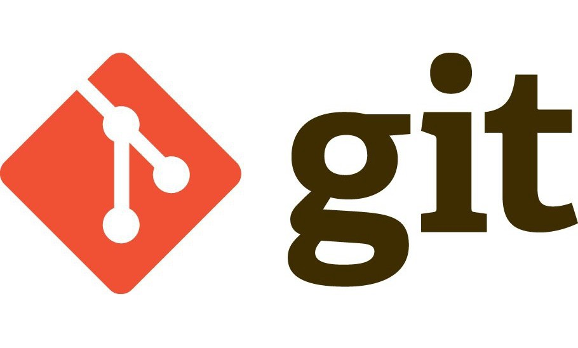
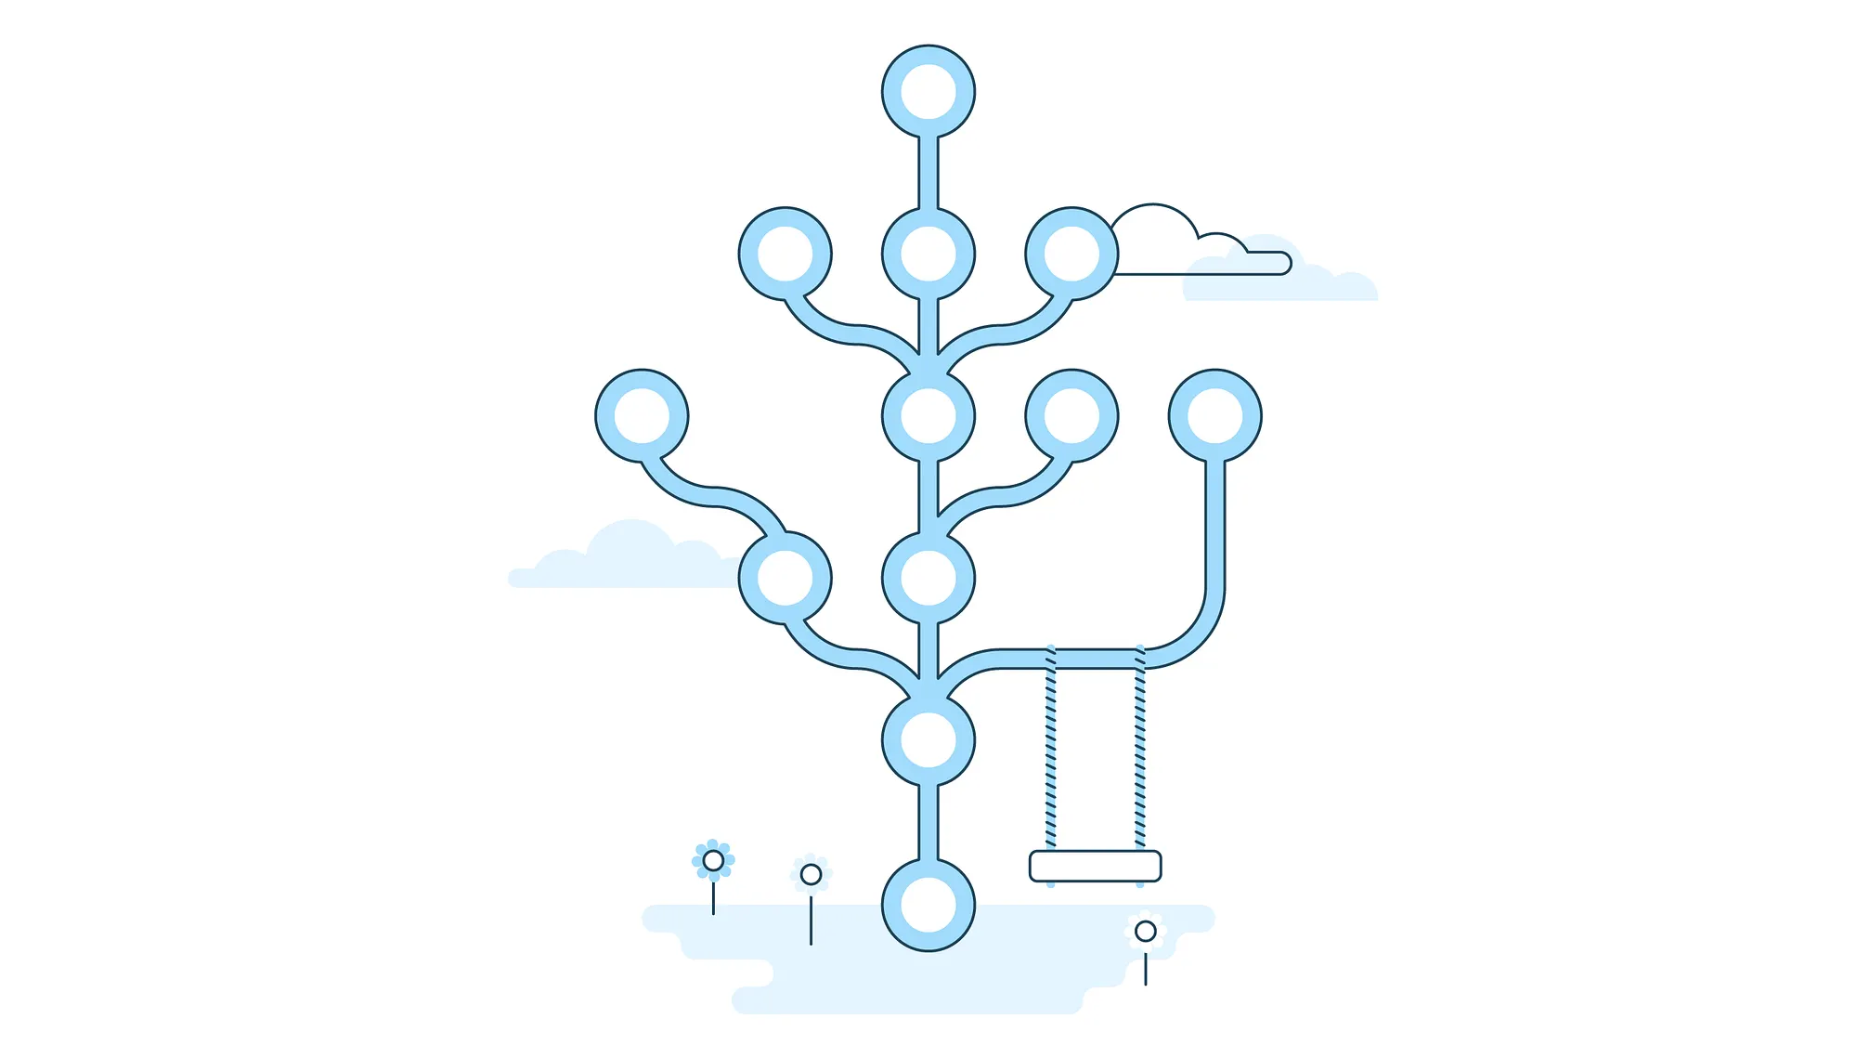
What is Git
Version control software tools have existed since 1960s
Git is one of the most popular version control systems in the world
Developed by Linus Torvalds (yes, that guy) in 2005 as an open-source version control software to be used on Linux
Saves snapshot of all files inside a repository (folder)
Allows programmers to view history and checkout
the files’ contents from any saved commits (version)

Slide 4
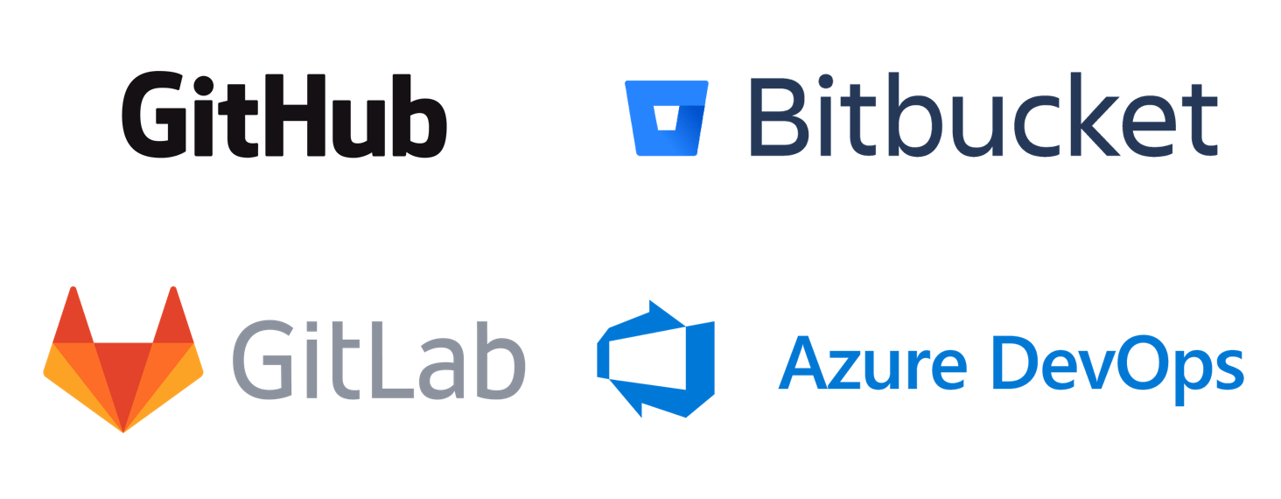
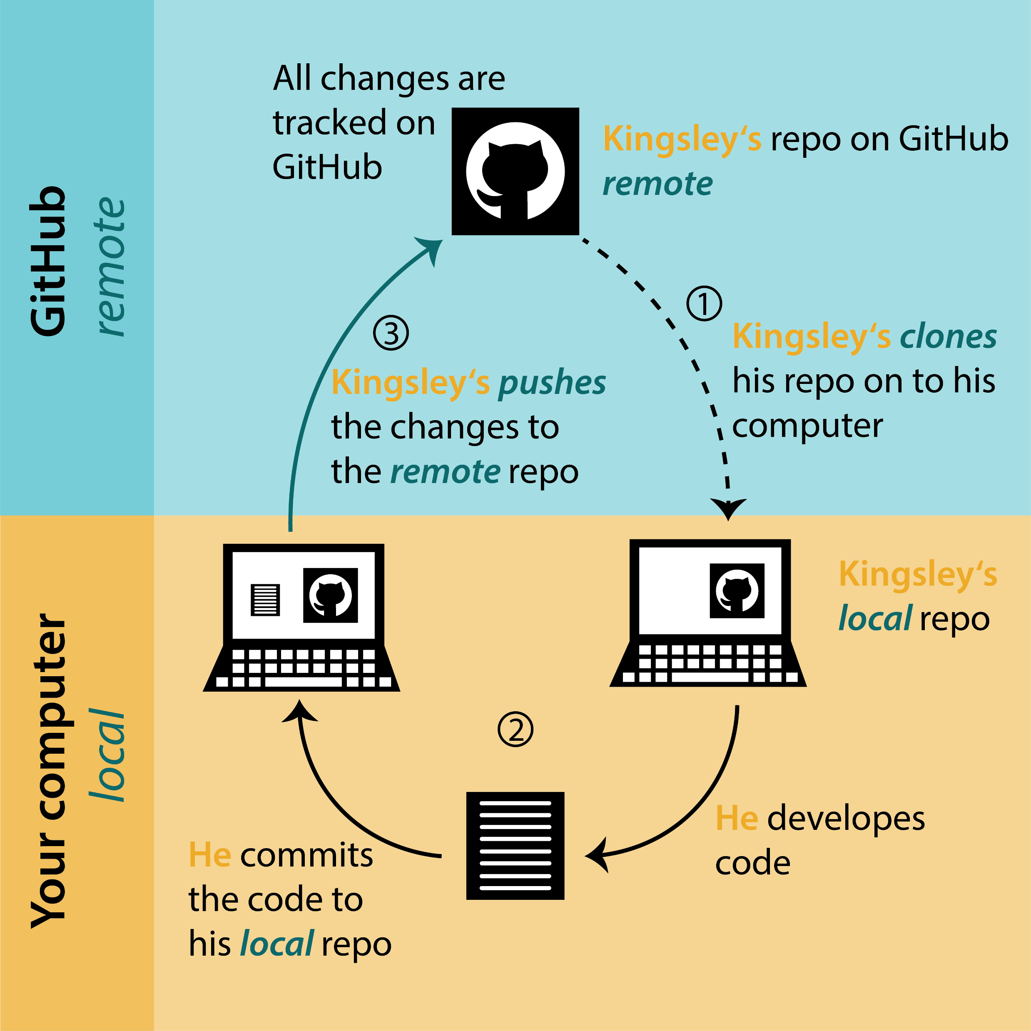
Git vs github/gitlab/bitbucket
Git is a version control software. You can install Git on your computer
GitHub/GitLab/BitBucket are collaborative version control platforms that use Git for distributed version control
Git = File Explorer, GitHub = OneDrive/SharePoint
You can download an entire folder (repo) from a remote
(git clone)
You can save the file history on your local Git,
then upload them (git push) to the remote
You can also get the remote history only (git fetch),
or download the latest file changes from the remote (git pull)

Slide 5
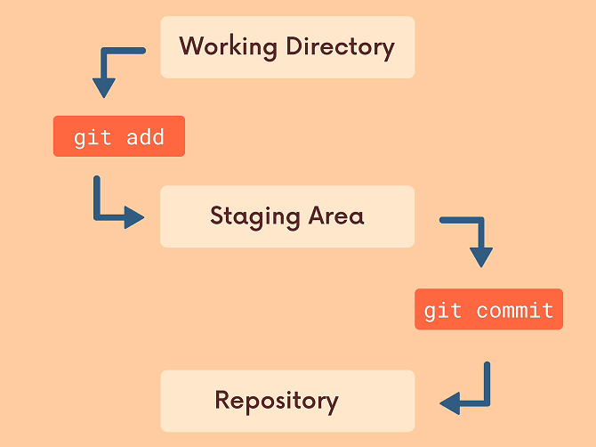
Local git operations
Working Directory: Your local folder
Staging Area: Contains file changes to be saved (committed)
Repository: Saved change history
git add <filename>: Tells git we want to save these changes
git commit: Tells git to save the changes from the staging area
git checkout <commit-id>: Look at the working directory’s state from a commit

Slide 6
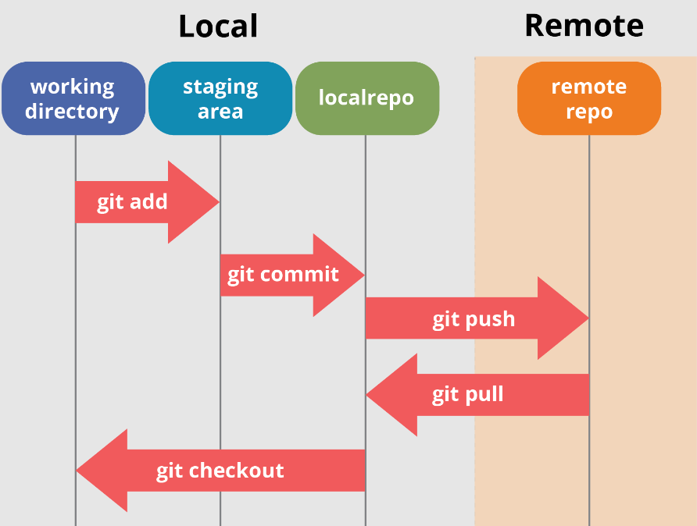
Remote git operations
git clone <repo-url>: Downloads remote repo (including working directory) to your computer
git push: Uploads commits that only exist on your local git to the remote
git fetch: Updates your local repo with the history from the remote (working directory unchanged)
git pull: Does a git fetch, then git checkout the latest commit from remote (working directory will change)

Slide 7
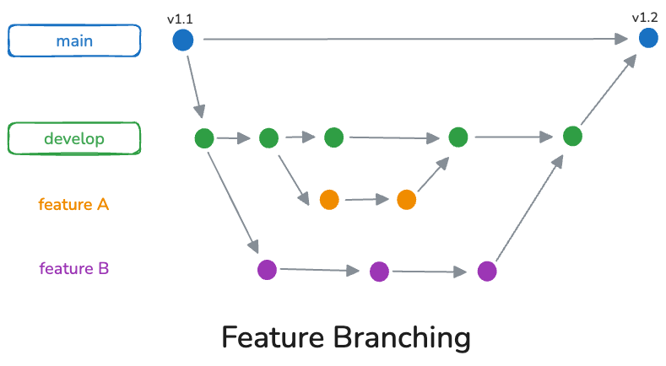
Branching
Branching allows for multiple developers to work on the same repo without interfering with each other’s work
Branches can be merged which will combine their changes and histories
On remote Git platforms, you can create a Pull Request (PR) which is a request to merge a branch into another
git branch <branch-name>: Creates branch
git checkout –b <branch-name>: Checks out your working directory to that branch
git merge <source-branch-name>: Merges the changes and history of the source branch into your current branch

Slide 8
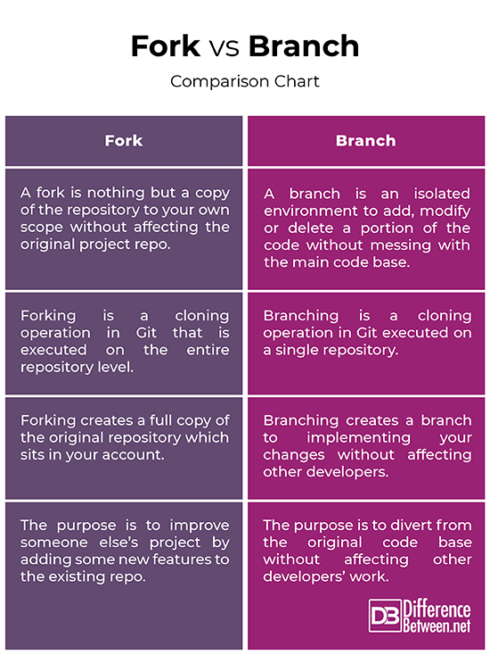
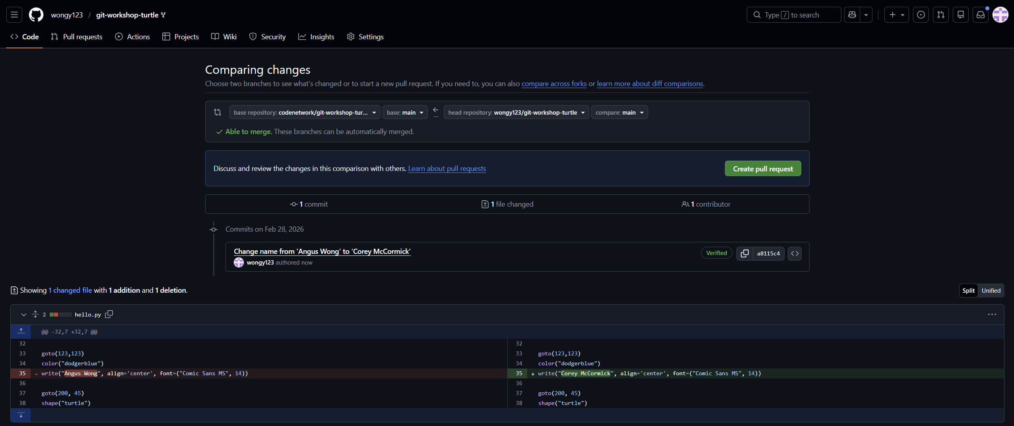
Forking
Forking is available on remote Git platforms
Forking creates a copy of the original repo under your control
Make changes and push to your fork, then create a Pull Request to the original repo

Slide 9

Workshop
Navigate to https://github.com/codenetwork/git-101-2026
Read the instructions and set up your Git
Fork the repo, then clone your own forked repo
Add your name to Program.cs, add to stage, commit, and push
Create a pull request to the original repo
Put your hand up and a facilitator will help merge it!
See the results: https://codenetwork.github.io/git-101-2026/

Slide 10
Thank you for joining us!
We hope you enjoy collaborating on our projects!

