Slide 1

70-483 c#
Programming in c#

Slide 2
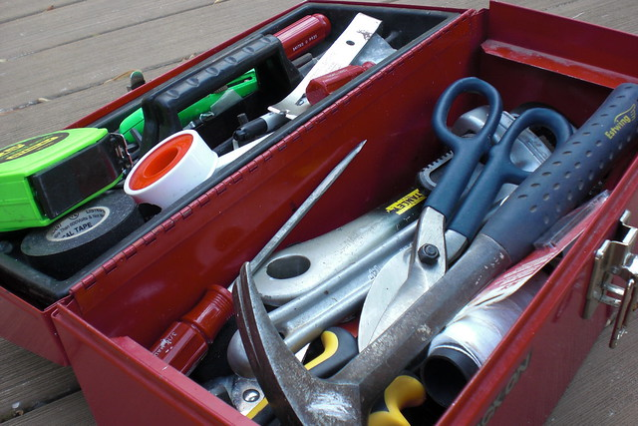
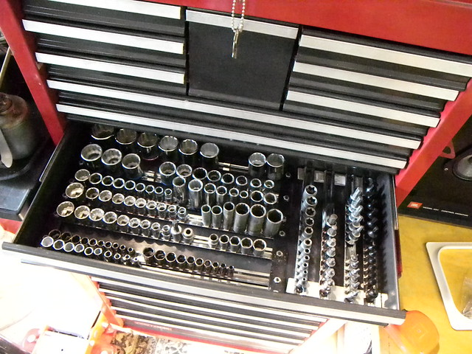
Why certify?
This Photo by Unknown Author is licensed under CC BY-SA-NC
This Photo by Unknown Author is licensed under CC BY-ND

Slide 3
How to certify
Study
Practice
Exercise

Slide 4

Multithreading & Async
Parallel.*
Tasks
Threads

Slide 5
Managing multithreading
Slicing
Locking
Exceptions

Slide 6
Program flow
Loops
More Loops
Even more loops

Slide 7

Thank You
Chris.w.mclean@gmail.com

