Slide 1

70-483 c#
Programming in c#

Slide 2

Application Input
Serialization
Gotchas
MVC
Notes:
XML

Slide 3
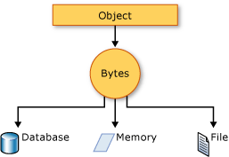
Bytes->Objects Objects->BYTES
This Photo by Unknown Author is licensed under CC BY-SA

Slide 4
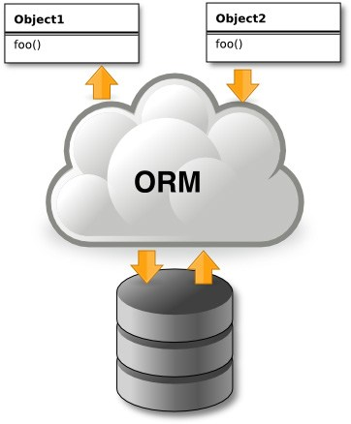
Entity Framework vs Nhibernate vs Dapper
This Photo by Unknown Author is licensed under CC BY-SA

Slide 5
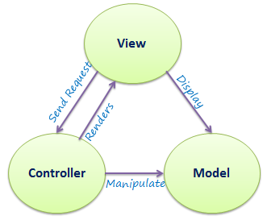
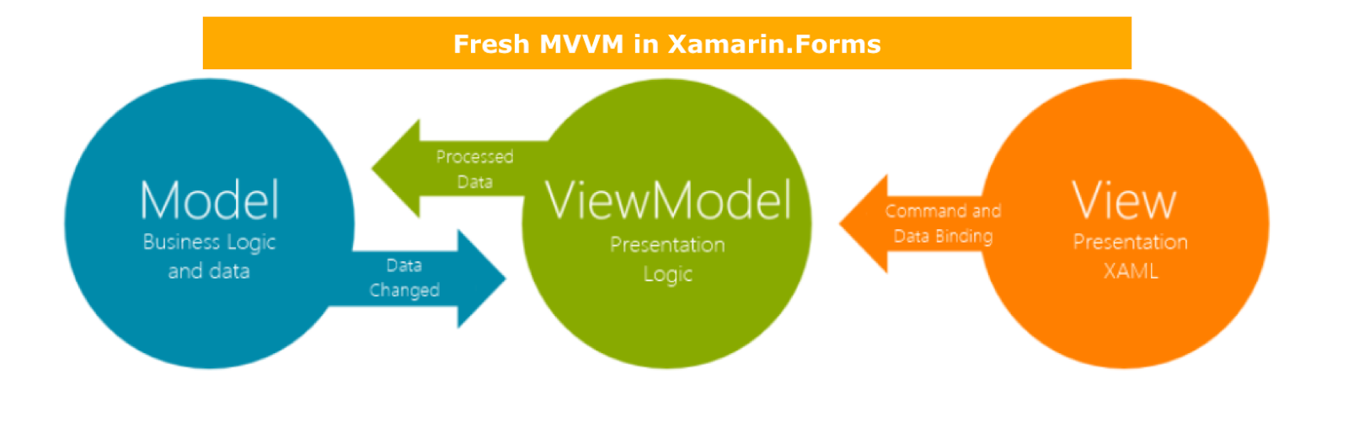
MVC vs MVVM
This Photo by Unknown Author is licensed under CC BY-SA
This Photo by Unknown Author is licensed under CC BY-SA-NC

Slide 6

Don’t put your legos in my burger!
This Photo by Unknown Author is licensed under CC BY-SA

Slide 7
Encryption
Symmetric
Asymmetric
Hashing

Slide 8
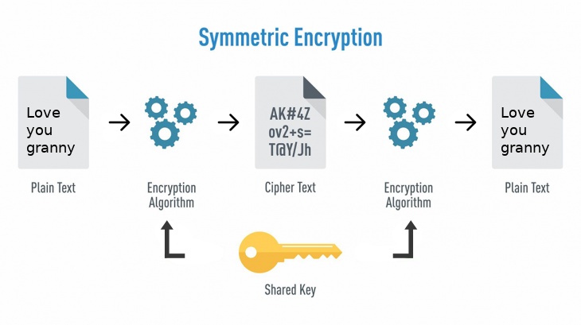
One key!
This Photo by Unknown Author is licensed under CC BY

Slide 9
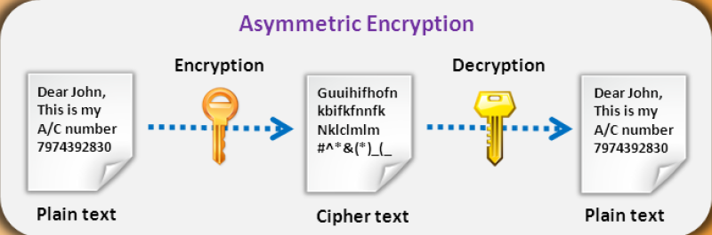
Two keys!
This Photo by Unknown Author is licensed under CC BY-NC-ND

Slide 10
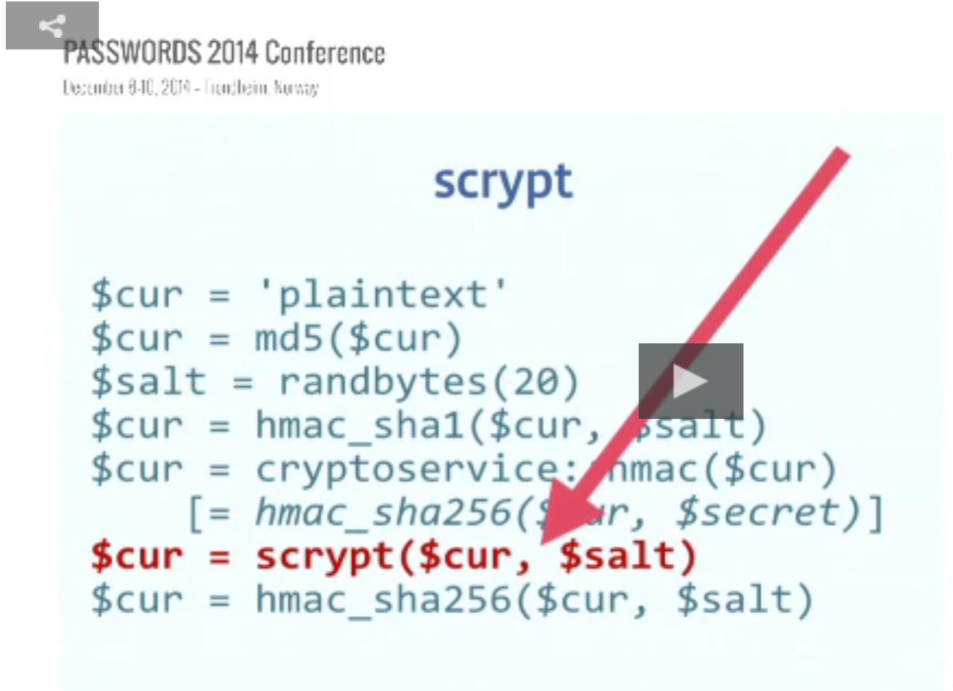
One way function!
This Photo by Unknown Author is licensed under CC BY-SA

Slide 11
Assemblies
GAC
Strong Names
Versions

Slide 12
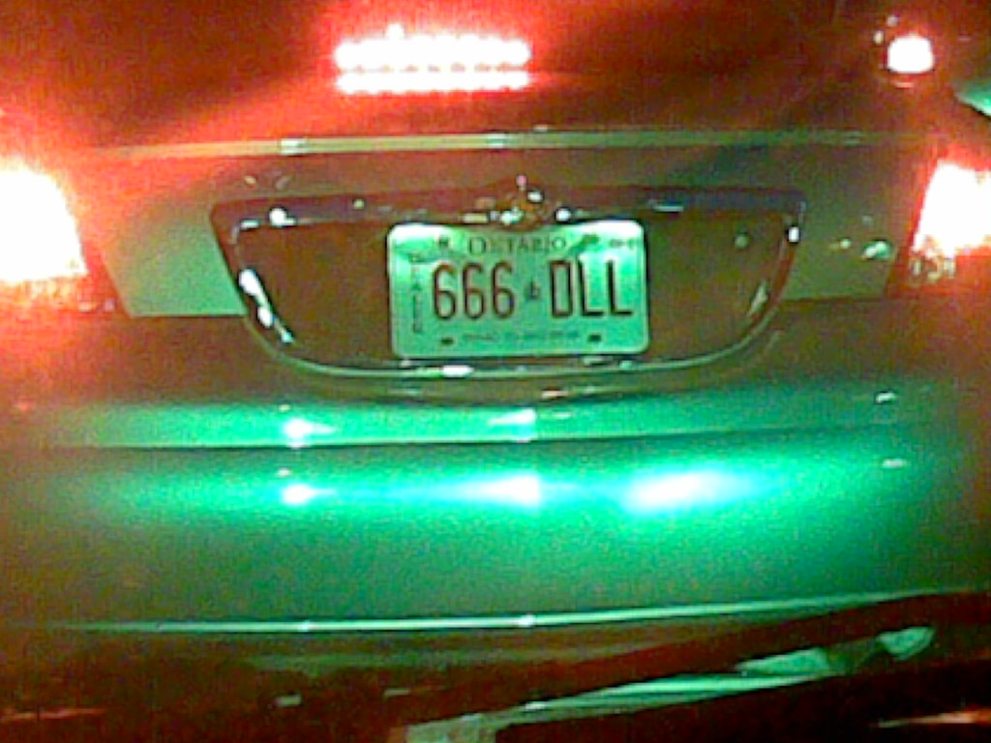
NO DLL HELL
This Photo by Unknown Author is licensed under CC BY-SA

Slide 13

Thank You
Chris.w.mclean@gmail.com

