Slide 1
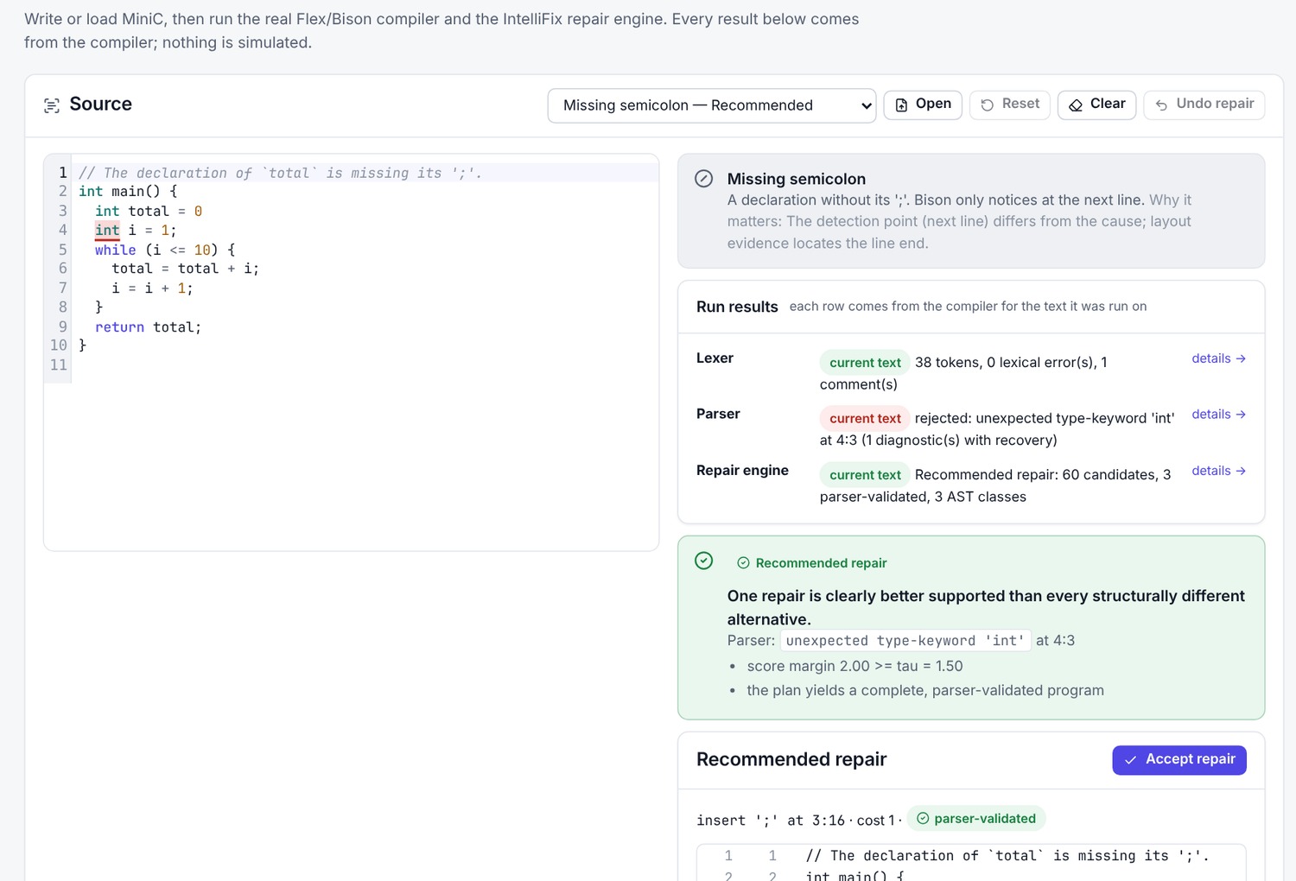
IntelliFix
An Intelligent Compiler for Syntax Error Analysis, Detection, and Correction
Goutam Jayasingh · 24BCE2417
S Charumeena · 24BCI0238
Raguraman Govindasamy · 24BDS0409
BCSE307P course project · Guide: [guide name, to be added]
Notes:
[Speaker: Goutam Jayasingh · about 0.5 min · in the app: Overview]
Good morning. We are presenting IntelliFix: an intelligent compiler for syntax error analysis, detection and correction. I am Goutam Jayasingh; with me are S Charumeena and Raguraman Govindasamy. In the next fifteen minutes we will show what problem IntelliFix solves, how it works, a live demonstration on the real compiler, and how we measured it, including the parts that did not work.

Slide 2



Detected on line 4, made on line 3
2 int main() {
3 int total = 0
4 int i = 1;
5 while (i <= 10) {
6 total = total + i;
7 i = i + 1;
8 }
9 return total;
10 }
Mistake: end of line 3
the ';' after int total = 0 is missing
Detected: 4:3
unexpected type-keyword 'int' — the parser can only notice here
Also valid: a different fix
int total = 0, i = 1; parses too. Which one did you mean?
Notes:
[Speaker: Goutam Jayasingh · about 1.25 min · in the app: Workbench → Missing semicolon → Run parser]
Here is a short program. The semicolon is missing at the end of line 3. But the parser only notices on line 4, when it reads the keyword int, because up to that point the input could still have been valid. This is the correct-prefix property of LR parsers: they stop at the first token that cannot continue any valid program. So the error is detected at 4:3, while the mistake is at the end of line 3. Second problem: many different edits make this program parse. Replacing int on line 4 with a comma also gives a valid program. A tool that simply picks one of them can be confidently wrong. IntelliFix addresses both: where the mistake is, and how sure we can be about a fix.

Slide 3



Existing approaches leave a gap
Panic-mode recovery
Least-cost repair
CPCT+ (ECOOP 2020)
3.85
55.2%
48.0–48.7%
diagnostics per case
top-1 restores the program
top-1, first repair (2 runs here)
skips to ';' or '}'; 61.1% of cases get a spurious error; never says what to change
the cheapest edit that parses is often not the intended one
all minimum-cost repairs; picks arbitrarily among equal-cost ones (built for recovery)
The gap: none of them uses layout or names, and none can say “I am not sure”.
Notes:
[Speaker: Goutam Jayasingh · about 1.25 min · in the app: Evaluation → Diagnostics-only baselines]
Three established approaches. Panic-mode recovery skips tokens until a semicolon or brace and continues. It finds later errors, but it invents spurious ones: on our test set it reported 3.85 diagnostics per case on average, and 61 percent of cases had at least one spurious diagnostic. Least-cost repair picks the cheapest edit that makes the program parse; cheapest is often not intended. CPCT+, by Diekmann and Tratt at ECOOP 2020, computes all minimum-cost repair sequences, which is excellent for recovery, but when it must present one, it chooses arbitrarily among equal-cost options. None of them uses layout, names, or says "I am not sure". That is the gap we target. We do not claim any of these techniques is wrong; they optimise different goals.

Slide 4
The IntelliFix pipeline
1
2
3
4
5
6
7
Lex
Parse
Localise
Generate & validate
Rank & group
Lanes
Decide
Flex: tokens with exact spans
Bison LALR(1), panic mode
first error, exact LAC expectations
bounded edits, each re-parsed
13 evidence features; AST classes
repair later errors per hypothesis
recommend, or say why not
Front end (Flex + Bison)
Repair engine (C++)
Decision
Every stage runs in the native compiler (parallaxc). The web interface only displays its output; nothing is simulated.
Notes:
[Speaker: Goutam Jayasingh · about 1 min · in the app: Overview → The processing pipeline]
IntelliFix is a pipeline of seven stages. A Flex lexer produces tokens with exact positions. A Bison LALR(1) parser accepts or rejects. Localisation finds the first error and the exact set of tokens the parser expected. Then we generate repair candidates and validate each one with the real parser. We rank them with named evidence and group the ones that mean the same thing. Hypothesis lanes repair later errors. Finally the decision stage either recommends one repair or explains why it will not. Every stage runs in the native C++ binary; the web interface only displays its output. Charumeena will now explain the stages.

Slide 5
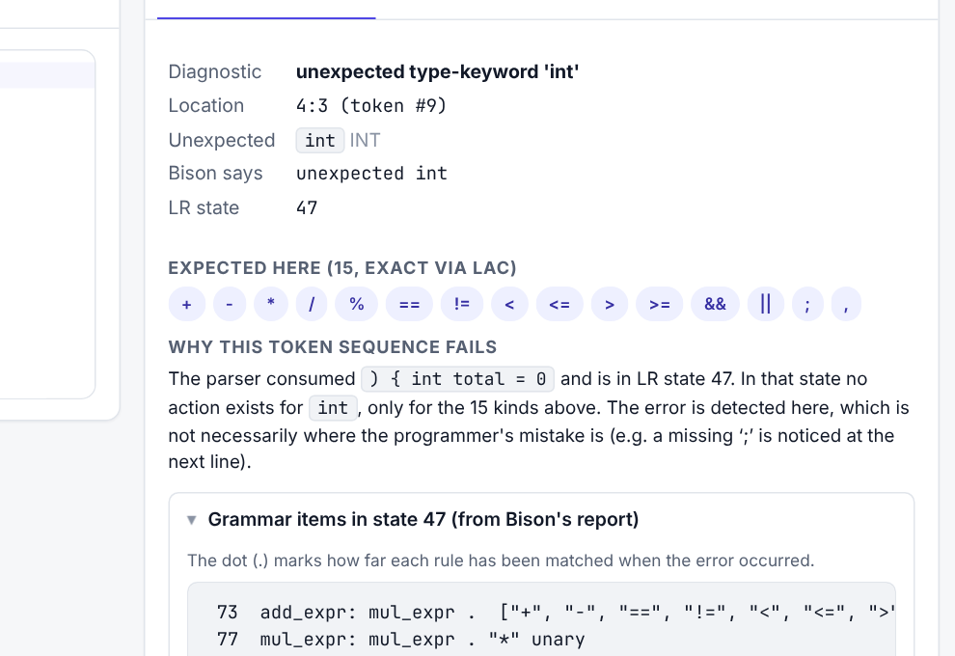
A real front end: Flex, Bison and LAC
97
grammar rules
168
LR states
0
conflicts (%expect 0)
15
tokens expected at the error (exact, via LAC)
Notes:
[Speaker: S Charumeena · about 1 min · in the app: Lexical analysis; Grammar & parsing]
MiniC is a C subset: four types, functions, arrays, if, while, for, and the usual operators. The lexer is a re-entrant Flex scanner. It reports lexical errors as tokens instead of crashing, and it recognises C features MiniC omits, like plus-plus or switch, so we can say "this is C, not MiniC". The parser is generated by Bison: 97 grammar rules, 168 LR states, and zero conflicts, which the build enforces. The key feature is LAC, lookahead correction. It makes the list of expected tokens at an error exact. In our example the parser is in state 47, has just read the zero, and expects one of 15 tokens: an operator, a semicolon or a comma. Those 15 tokens drive candidate generation.

Slide 6
Many candidates, each parser-checked
60
generated (LAC-guided edits, 4 positions)
3
accepted by the parser
1
recommended (after ranking and the margin test)
Round trip: each accepted fix is written back with your spacing and comments, re-lexed and re-parsed.
Notes:
[Speaker: S Charumeena · about 1.25 min · in the app: Repair laboratory → Rejected tab]
Candidates are single-token edits: insert, delete or replace, near the error, using only tokens the grammar allows there. Layout-aware generators also try a semicolon at line ends and braces where indentation changes. Two-edit combinations are tried only if no single edit works. For our example, 60 candidates were generated. Each is applied to a copy of the tokens and parsed again. It is accepted only if the whole program parses, or the parser gets at least three tokens further. Here 57 were rejected and 3 accepted. Every accepted candidate is then turned back into text using the user's own spacing and comments, re-lexed and re-parsed. We call that the round trip. "Parser-validated" always means the real parser accepted it.

Slide 7
Evidence, not a single cost
Feature | insert ';' | replace 'int' with ',' | replace 'int' with ';'
edit_cost | −1.00 | −1.50 | −1.50
resolves_all_errors | +2.00 | +2.00 | +2.00
deleted_content | 0 | −0.75 | −0.75
line_end_semicolon | +0.75 | 0 | 0
name_warnings | 0 | 0 | −3.75
score | +1.75 | −0.25 | −4.00
margin
2.00
≥ τ = 1.5 (chosen on dev)
→ Recommended
Weights frozen before the test run. The score ranks; it is not a probability.
8 more features are 0 for all three (placeholders, indentation, residual errors, …).
Notes:
[Speaker: S Charumeena · about 1.25 min · in the app: Repair laboratory → Evidence breakdown]
Each accepted candidate gets a score: the sum of 13 named features times fixed weights. The weights were set on the development split only and frozen before the test run. Look at the table. Inserting the semicolon costs minus one, makes the whole program parse, plus two, and puts the semicolon exactly at a line break, plus 0.75: total 1.75. Replacing int with a comma also parses, but costs one and a half and overwrites a keyword the user wrote: minus 0.25. Replacing int with a semicolon leaves i undeclared, and name resolution finds five warnings: minus 4. The score only ranks; it is not a probability. The margin between the best and the second-best alternative is 2.0.

Slide 8
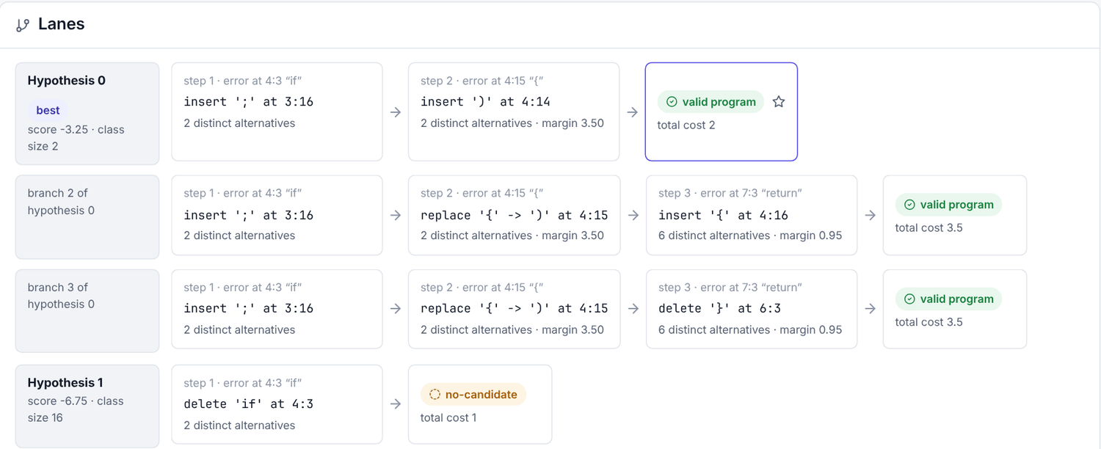
Grouping and hypothesis lanes
AST grouping
int b = (a + 2;
(a) + 2
(a + 2)
→ one AST:
Binary(+, a, 2)
Two edits, one meaning: they form one class and do not compete, so IntelliFix is not falsely unsure.
Real run, sample “Two errors”: hypothesis 0 fixes the missing ';' (step 1) and the missing ')' (step 2). Other lanes explore alternatives; the best complete plan is starred.
Lanes: 3 first-fix hypotheses × 2 alternatives per step, depth ≤ 4, ≤ 12 leaves.
Notes:
[Speaker: S Charumeena · about 1 min · in the app: Hypothesis explorer (Two errors sample)]
Two ideas here. First, grouping. For "int b = open-paren a plus 2 semicolon", inserting the closing parenthesis after a, or after 2, gives two different edits but the same syntax tree. We group candidates by their canonical abstract syntax tree, so equivalent repairs do not compete and do not make IntelliFix falsely unsure. Second, multiple errors. For the top three first-error hypotheses, IntelliFix keeps repairing the next error, with two alternatives per step, up to depth four and twelve leaves. The best complete path is the plan. For the "Two errors" sample, the plan inserts a semicolon and a closing parenthesis, one step each, with a margin of 3.5.

Slide 9
Recommend only when evidence is clear
Recommended
Multiple plausible
Low confidence
Unsupported construct
margin ≥ τ = 1.5
margin < τ
invents a name or value, incomplete, or drops hidden code
C feature MiniC omits, or nesting too deep
missing ';' (margin 2.00)
a b: 20 operators tie (0.00)
int = 42; → __hole
i++ → write x = x + 1
No repair needed
No safe repair
Budget exhausted
τ chosen on dev: most coverage with dev risk ≤ 10% (dev coverage 45.6%).
the program is valid
no bounded edit works
the search limit was hit (30,000 parses / 4 s)
valid sample
class A { public: … }
never on the benchmark
Notes:
[Speaker: S Charumeena · about 1.25 min · in the app: Ambiguous operator; Missing variable name; Unsupported C construct]
The decision stage has seven outcomes. No repair needed, when the program is valid. Recommended, only when the best structurally different alternative leads by at least tau equals 1.5; tau was chosen on the development split as the setting with the most coverage at no more than ten percent risk. Multiple plausible, when it does not: for "a b", twenty operators tie with margin zero. Low confidence, when the fix must invent a name, like a missing variable name, or would discard code hidden in an unterminated comment. Unsupported construct, for C features like i plus-plus, or nesting deeper than the parser supports. And no safe repair, or budget exhausted, when the bounded search finds nothing. Now let us show it live.

Slide 10
Live demo
Missing semicolon: lexer → parser → full analysis
Grammar & parsing: LR state 47
Evidence breakdown → Accept repair
Ambiguous operator · Missing name · i++
Two errors → Hypothesis explorer
Evaluation page
Your own input
Check first: badge says “Compiler 1.0.0”. Never show screenshots as live output.
Notes:
[Speaker: All (driver / narrator / checker) · about 7 min · in the app: Code workbench (follow IntelliFix_Demo_Script.md)]
Switch to the browser. Check the badge says Compiler 1.0.0. Follow the demo script: Missing semicolon with Run lexer, Run parser, Full analysis; the Grammar and parsing page; the evidence breakdown; Accept repair; then Ambiguous operator, Missing variable name, Unsupported C construct, Two errors with the Hypothesis explorer, and the Evaluation page. The checker compares the screen with the expected column and says so if anything differs. Invite the examiners to type their own code. If the badge says Compiler missing, stop: explain that the native compiler is not built on this machine, and never present screenshots as live output.

Slide 11

How we measured it
900
360
540
9
seeded synthetic cases from 30 programs
dev cases (12 programs): all tuning
test cases (18 programs): held out
systems: baselines, CPCT+, ablations
Split by program, not by case, so near-duplicate mutations cannot leak into the test set.
Weights and τ fixed on dev; model frozen before the first test run.
Systems: raw parser, panic mode, least-cost, CPCT+ (grmtools), and ablations without layout, stability, grouping or abstention.
Wilson 95% intervals; paired bootstrap (2000 resamples) for differences.
Synthetic single-token mutations, not real student code.
Notes:
[Speaker: Raguraman Govindasamy · about 1.25 min · in the app: Evaluation → Provenance]
Thank you. To measure IntelliFix beyond single examples, we wrote 30 valid MiniC programs and generated 900 seeded mutations: deleted, inserted, swapped or wrong tokens, 720 with one error and 180 with two. We split by program, not by case: 12 programs, 360 cases, for development; 18 programs, 540 cases, held out for the test. That prevents near-duplicate leakage. All tuning used the development split; the model was frozen before the test run. We compare nine systems: the raw parser, panic mode, least-cost repair, CPCT+ through grmtools, and ablations that remove one idea at a time. Every proportion has a Wilson 95% interval; differences use a paired bootstrap. Important: these are synthetic errors, not real student code.

Slide 12
Results on 540 held-out cases
+16.3 pts vs least-cost, CI [13.1, 19.4] · IntelliFix 71.5% [67.5, 75.1] · coverage 50.7%, selective accuracy 88.0%
CPCT+ varies between runs (ties broken arbitrarily); 540 synthetic test cases.
Notes:
[Speaker: Raguraman Govindasamy · about 1.5 min · in the app: Evaluation → headline cards and charts]
Left chart: how often the top-ranked repair restores the original program's syntax tree. IntelliFix 71.5 percent, interval 67.5 to 75.1. Least-cost repair on exactly the same candidates: 55.2 percent, so the evidence ranking adds 16.3 points, interval 13.1 to 19.4. Without layout evidence, 62.6. CPCT+'s first repair: about 48 percent; it varies between runs because CPCT+ breaks ties arbitrarily. Right chart: wrong answers presented as confident, as a share of all cases. Without abstention, 28.5 percent; with abstention, 6.1 percent, while still recommending in 50.7 percent of cases. Of those recommendations, 88 percent were correct. Note: this does not show IntelliFix is a better recovery algorithm than CPCT+; it was built for a different goal.

Slide 13

What did not work, and our limits
Did not work (reported, not hidden)
Limits
Stability evidence: +0.2 pts, CI [-0.4, 0.9]
Synthetic errors
no measurable effect
no claim about real student code
AST grouping: coverage 50.7% vs 48.9%
One author, 30 programs
small effect
consistent indentation flatters layout evidence
Test risk 12.0% vs 10% target
MiniC subset, syntax only
τ did not fully transfer
no types; a valid fix can change meaning
whlie (i < 3) { → insert ';'
Margin is not a probability
confident, parser-valid, wrong: becomes a call
no calibration claimed
Notes:
[Speaker: Raguraman Govindasamy · about 1.25 min · in the app: Evaluation → caveat rows; Workbench with the whlie input]
We report negative results too. The follow-on stability evidence gave plus 0.2 points, with an interval from minus 0.4 to plus 0.9: no measurable effect. AST grouping helped only a little. The threshold tau did not fully transfer: test risk was 12 percent against a 10 percent target. And a parser-valid fix can still be wrong: "whlie, open paren" with a typo gets a confident semicolon, which turns it into a function call. We left that unfixed, because re-tuning after seeing an example would be tuning on test data. Our robustness suite of 88 hand-written cases and 800 random inputs found two real defects, which we fixed with regression tests. Limits: synthetic errors, one author's programs, a C subset, no type checking.

Slide 14
Contribution
Part of the pipeline | Measured effect (test) | Verdict
Evidence ranking vs least-cost | +16.3 pts top-1 | Supported
Layout-aware generation and evidence | +8.9 pts top-1 | Supported
Confidence-aware abstention | wrong-confident 6.1% vs 28.5% | Supported, with caveat
AST equivalence classes | coverage 50.7% vs 48.9% | Weak
Follow-on stability evidence | +0.2 pts (CI includes 0) | Not supported
Claim: an integrated, inspectable, honestly evaluated pipeline on top of LAC-guided local LR repair. Not a new algorithm; no single technique is claimed as new.
Notes:
[Speaker: Raguraman Govindasamy · about 1 min · in the app: Documentation → Research contribution and novelty]
So what is our contribution? Not a new algorithm: local LR repair, edit costs, LAC, panic mode and selective prediction are all established. Our contribution is an integrated and inspectable pipeline that adds layout-aware generation, interpretable evidence ranking, AST grouping and confidence-aware abstention to LAC-guided local repair, with every step visible in a workbench on real compiler output. And an honest evaluation: a family-split benchmark, ablations, a real CPCT+ baseline and confidence intervals, showing that evidence ranking, layout and abstention help, while stability evidence does not. Next steps: a study with real student errors, learned weights on real data, and type-aware evidence.

Slide 15
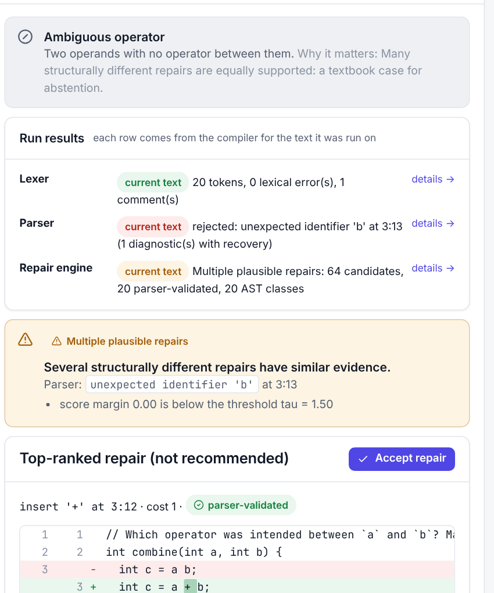
Thank you
Questions, and please try your own code in the workbench
Goutam Jayasingh · 24BCE2417
S Charumeena · 24BCI0238
Raguraman Govindasamy · 24BDS0409
Docs: parallax/docs/IntelliFix_*.md · results: evaluation/results/
Notes:
[Speaker: Raguraman Govindasamy · about 0.5 min · in the app: Code workbench, cleared]
Thank you for listening. We are happy to take questions, and you are welcome to type your own MiniC, or C, into the workbench: IntelliFix will tell you what it can and cannot fix.

