Slide 1
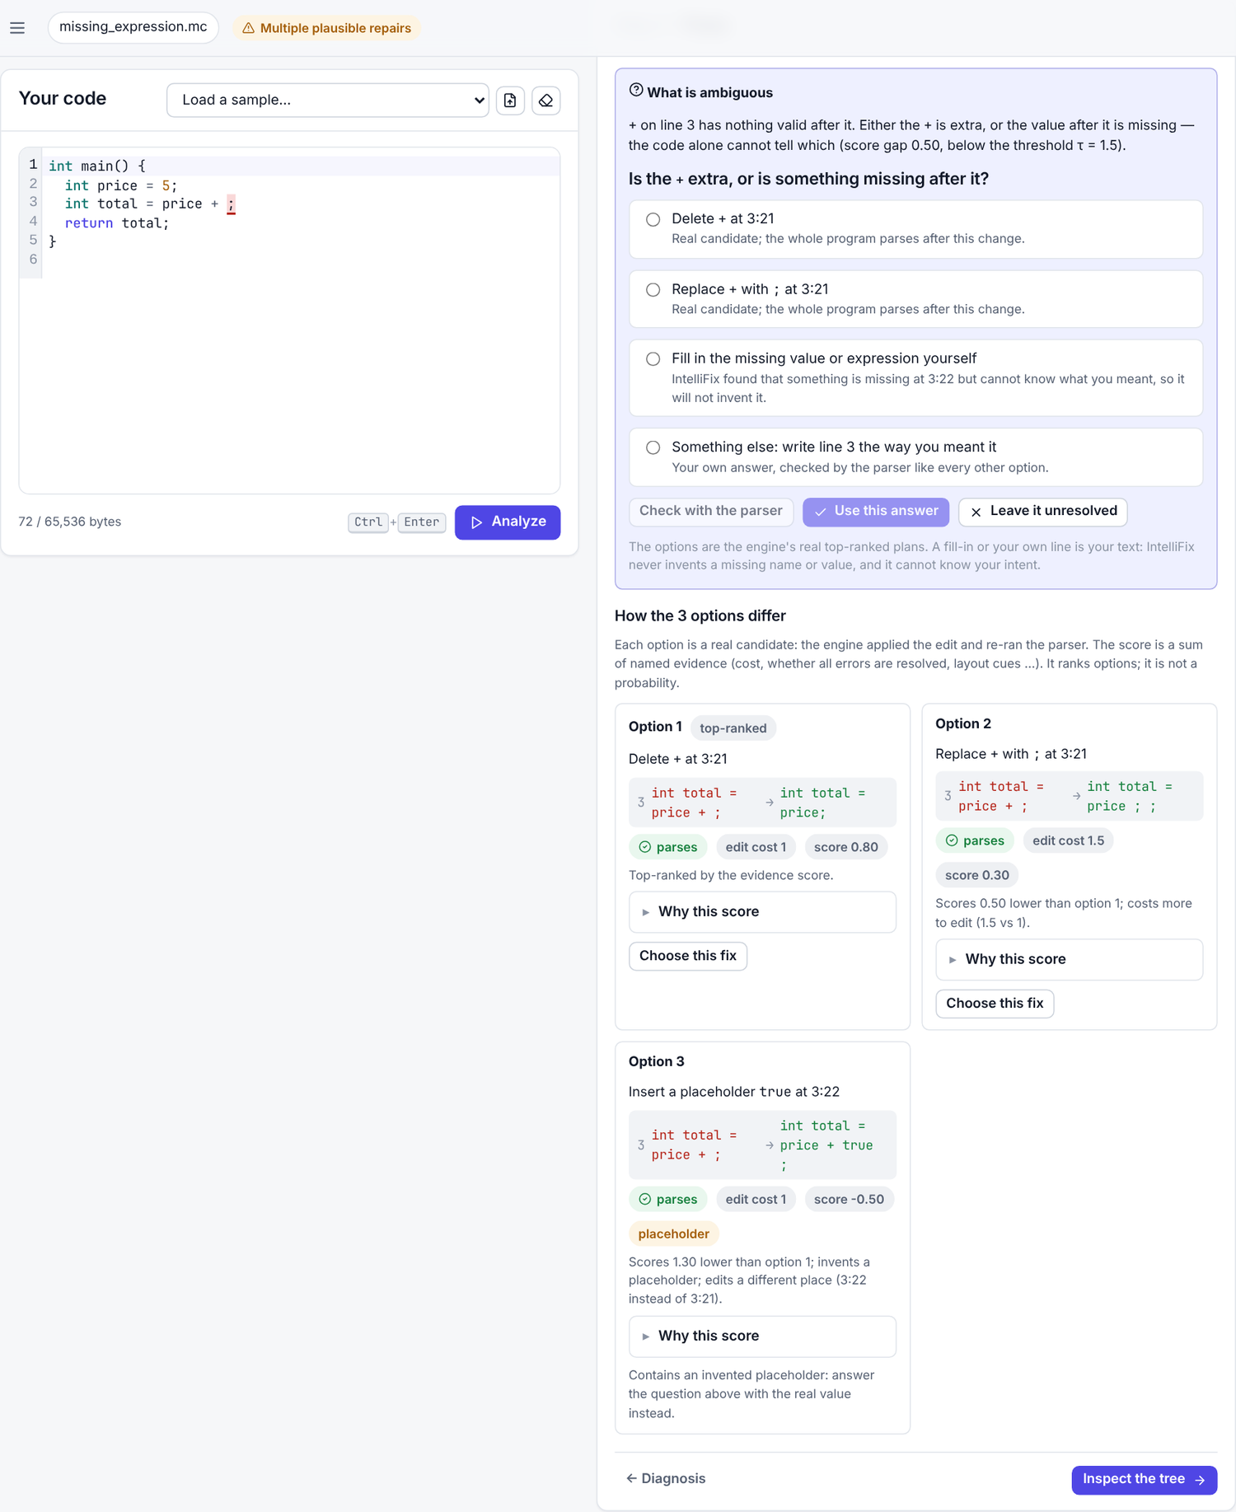
IntelliFix
An Intelligent Compiler for Syntax Error Analysis, Detection, and Correction
Goutam Jayasingh · 24BCE2417
S Charumeena · 24BCI0238
Raguraman Govindasamy · 24BDS0409
BCSE307P course project · Guide: [guide name, to be added]
Notes:
[Speaker: Goutam Jayasingh · about 0.5 min · demo: Browser open on the Workspace, compiler badge green.]
Good morning. We are presenting IntelliFix: an intelligent compiler for syntax error analysis, detection and correction, for a small C-like teaching language called MiniC. I am Goutam Jayasingh, and with me are S Charumeena and Raguraman Govindasamy. We will show the problem, how the system works, a live demo on the real compiler, and how we measured it — including what did not work.
Technical detail: Native C++17 compiler (Flex + Bison), FastAPI backend, React interface (Workspace, AST Explorer, Research & Method); everything shown comes from the real compiler.
Transition: Let us start with the problem every programmer has met.

Slide 2



Detected on line 4, made on line 3
2 int main() {
3 int total = 0
4 int i = 1;
5 while (i <= 10) {
6 total = total + i;
7 i = i + 1;
8 }
9 return total;
10 }
Mistake: end of line 3
the ';' after int total = 0 is missing
Detected: 4:3
unexpected type-keyword 'int' — the parser can only notice here
Also valid: a different fix
int total = 0, i = 1; parses too. Which one did you mean?
Notes:
[Speaker: Goutam Jayasingh · about 1 min · demo: Workspace → sample Missing semicolon → Analyze → step 2 Diagnosis (lexer → parser panel).]
In this program the semicolon is missing at the end of line 3, but the parser complains about line 4. An LR parser only notices a problem at the first token that cannot continue any valid program, so the detection point and the real mistake are different places. Second problem: many edits make the program parse. Replacing int on line 4 with a comma also gives valid code. A tool that silently picks one can be confidently wrong, and a beginner cannot tell.
Technical detail: Correct-prefix property of LR parsing; the error is detected at 4:3 (token int, LR state 47); the edit that restores the original is at 3:16.
Transition: So what exactly did we set out to build?
Likely questions:
- Why does the parser report line 4? Until it reads int, the input could still be a longer expression; only then does no valid continuation exist (correct-prefix property).

Slide 3






Objectives and scope
Exact errors
Checked repairs
MiniC scope
Flex + Bison front end; exact positions and expected tokens
every candidate validated by the real parser
In: int float char bool void, functions, 1-D arrays, if/else, while, for, return, break, continue, arithmetic / comparison / logical operators
Evidence, not cost
Honest decisions
13 named features; equivalent fixes grouped
recommend, ask, or explain why not
Recognised as C, not repaired: ++ += ?: switch do struct pointers strings #include
For beginners
Measured
Out of scope: type checking, code generation, running programs
plain explanations, hints, explained AST
held-out benchmark, baselines, ablations
Notes:
[Speaker: Goutam Jayasingh · about 1 min · demo: —]
Our objectives: a real MiniC front end with exact error positions; repair candidates that the real parser checks; ranking by evidence instead of edit cost alone; honest decisions that say when the tool is not sure; explanations a beginner can follow; and an evaluation with baselines and confidence intervals. MiniC has functions, arrays, if, while, for and the usual operators. It deliberately leaves out pointers, structs, strings and operators like plus-plus; IntelliFix recognises those C features and says so instead of inventing a repair. We do not do type checking or run programs.
Technical detail: 97 grammar rules, 168 LR states, %expect 0; C constructs are lexed as UNSUPPORTED tokens with advice.
Transition: Here is how the pieces fit together.
Likely questions:
- Why not full C? Typedef names make C's grammar context-sensitive and the preprocessor dominates; a subset keeps the repair research testable.

Slide 4
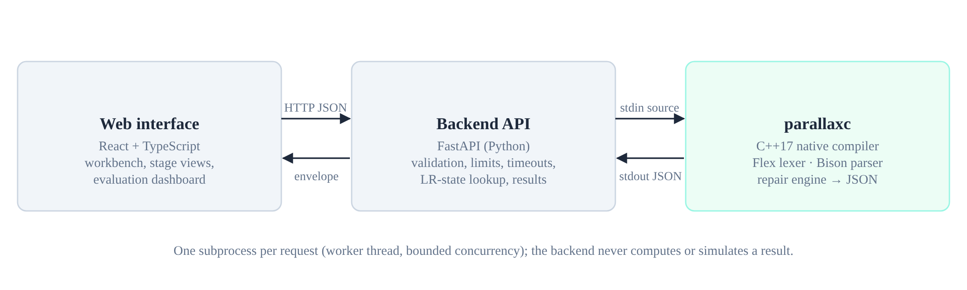
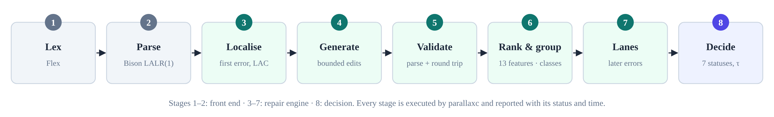
Architecture and workflow
Notes:
[Speaker: Goutam Jayasingh · about 1 min · demo: Research & Method → section 2 (how IntelliFix works).]
The browser sends your code to a FastAPI backend, which runs the native compiler, parallaxc, as a separate process for every request and passes its JSON back. The compiler runs eight stages: lex, parse, localise the first error, generate and validate candidates, rank and group them, follow later errors in hypothesis lanes, and decide. The interface only displays this output. If the compiler is not built, the site says so instead of showing anything fake.
Technical detail: Subprocess per request in a worker thread with size (64 KB), time and concurrency limits; HTTP 503 COMPILER_UNAVAILABLE when the binary is missing.
Transition: Charumeena will take you inside the compiler.
Likely questions:
- Why a subprocess instead of a library? Isolation and timeouts: a crash cannot take down the server, and one binary serves the CLI, the evaluation and the UI.

Slide 5
Lexer, parser and candidate validation
97
grammar rules, 168 LR states, 0 conflicts
15
tokens expected at the error (exact, via LAC)
60
candidate edits generated
3
accepted by the real parser
Round trip: each accepted fix is written back with your spacing and comments, re-lexed and re-parsed.
Notes:
[Speaker: S Charumeena · about 1.25 min · demo: Workspace step 2 → Compiler internals → Parser state (state 47); All candidates → Rejected tab.]
The Flex lexer turns text into tokens with exact positions and reports bad characters as error tokens instead of crashing. The Bison parser uses LAC, lookahead correction, which makes the list of expected tokens at an error exact — here 15 tokens. The repair engine tries insert, delete and replace edits near the error using only those tokens, plus layout edits such as a semicolon at a line end. For this example it generated 60 candidates; the real parser accepted 3. Every accepted fix is written back as text with your own spacing, re-lexed and re-parsed.
Technical detail: Window of the error token and 3 before; acceptance = full parse or ≥ 3 tokens of progress; two-edit search only if no single edit works; round-trip validation.
Transition: When several fixes parse, how does IntelliFix decide — and what if it cannot?
Likely questions:
- What does LAC change? Without it, default reductions and LALR state merging can make the expected-token list wrong; candidates are generated from that list.

Slide 6
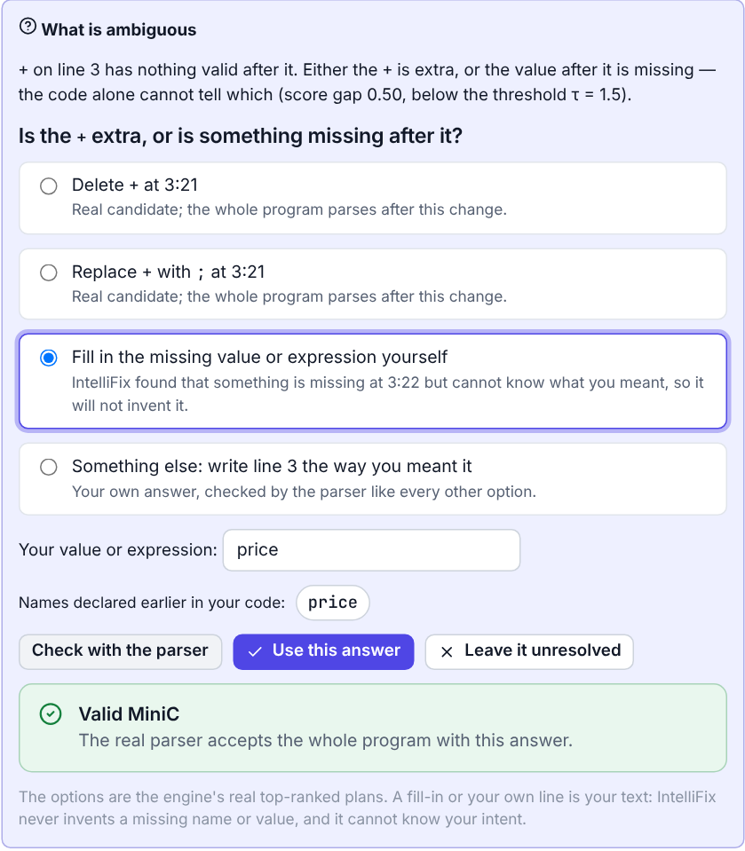
Interactive ambiguity resolution
The engine finds several fixes with similar evidence (margin 0.50 < τ 1.5), so it does not guess.
It explains what is ambiguous and asks: is the + extra, or is something missing? Options are the real top plans, a fill-in, or your own line.
It suggests price (declared earlier), not total (still being declared).
Check with the parser: the real parser validates the answer before it can be applied.
Then: inspect the tree (step 4), apply and verify by a real re-parse (step 5); Undo restores the original; you can also leave it unresolved.
Actual output: int total = price + ;
Notes:
[Speaker: S Charumeena · about 1.25 min · demo: Workspace: sample Missing expression after + → Analyze → step 3 Fixes → answer the question.]
For int total = price plus semicolon, an expression is missing after the plus. The engine finds several fixes with similar evidence, so instead of guessing it asks: delete the plus, replace it, or type the missing expression yourself. It suggests price, a name declared earlier, but not total, which is still being declared. Your answer is checked by the real parser before you can apply it; applying re-analyzes the program, and Undo brings the original back. IntelliFix never invents a missing value.
Technical detail: Options are the decision's real top plans; placeholder edits become a fill-in box; suggestions come from lexer tokens (declared before the error, excluding the declaration in progress); validation via /api/parse.
Transition: The same evidence also lets you compare repairs side by side.
Likely questions:
- Where do the options come from? From the repair engine's top three structurally different plans; a fill-in is the user's own text. Nothing is generated by the interface.
- What if the user picks something wrong? The parser check shows whether it parses; name warnings may flag an undeclared name; Undo restores the original.

Slide 7
Explainable repair comparison
Feature | insert ';' | replace 'int' with ',' | replace 'int' with ';'
edit_cost | −1.00 | −1.50 | −1.50
resolves_all_errors | +2.00 | +2.00 | +2.00
deleted_content | 0 | −0.75 | −0.75
line_end_semicolon | +0.75 | 0 | 0
name_warnings | 0 | 0 | −3.75
score | +1.75 | −0.25 | −4.00
margin
2.00
≥ τ = 1.5 (chosen on dev)
→ Recommended
Step 3 (Fixes) shows every structurally different repair with its line change, cost, score and parser validity, and “Choose this fix”. The score ranks; it is not a probability.
Live compiler output for the missing-semicolon sample; 8 more features are 0 for all three.
Notes:
[Speaker: S Charumeena · about 1.25 min · demo: Workspace step 3 Fixes → option cards → Why this score; Compiler internals → All candidates for the full evidence.]
Each accepted candidate gets a score from 13 named pieces of evidence. Inserting the semicolon costs minus one, makes the whole program parse, plus two, and lands exactly at a line break, plus 0.75: total 1.75. Replacing int with a comma costs more and overwrites a keyword you wrote: minus 0.25. The best leads by 2.0, above our threshold of 1.5, so it is recommended. The score only ranks; it is not a probability, and parsing does not prove the meaning is right.
Technical detail: Weights set on the development split and frozen before testing; candidates with the same canonical AST form one class; margin = best class − second class; τ = 1.5 chosen on dev.
Transition: Next, the structure itself: the AST.
Likely questions:
- How were the weights chosen? By hand on the 360-case development split only, then frozen; the test split was used once.
- Is the margin a confidence? No — a score difference used for abstention; no calibration is claimed.

Slide 8
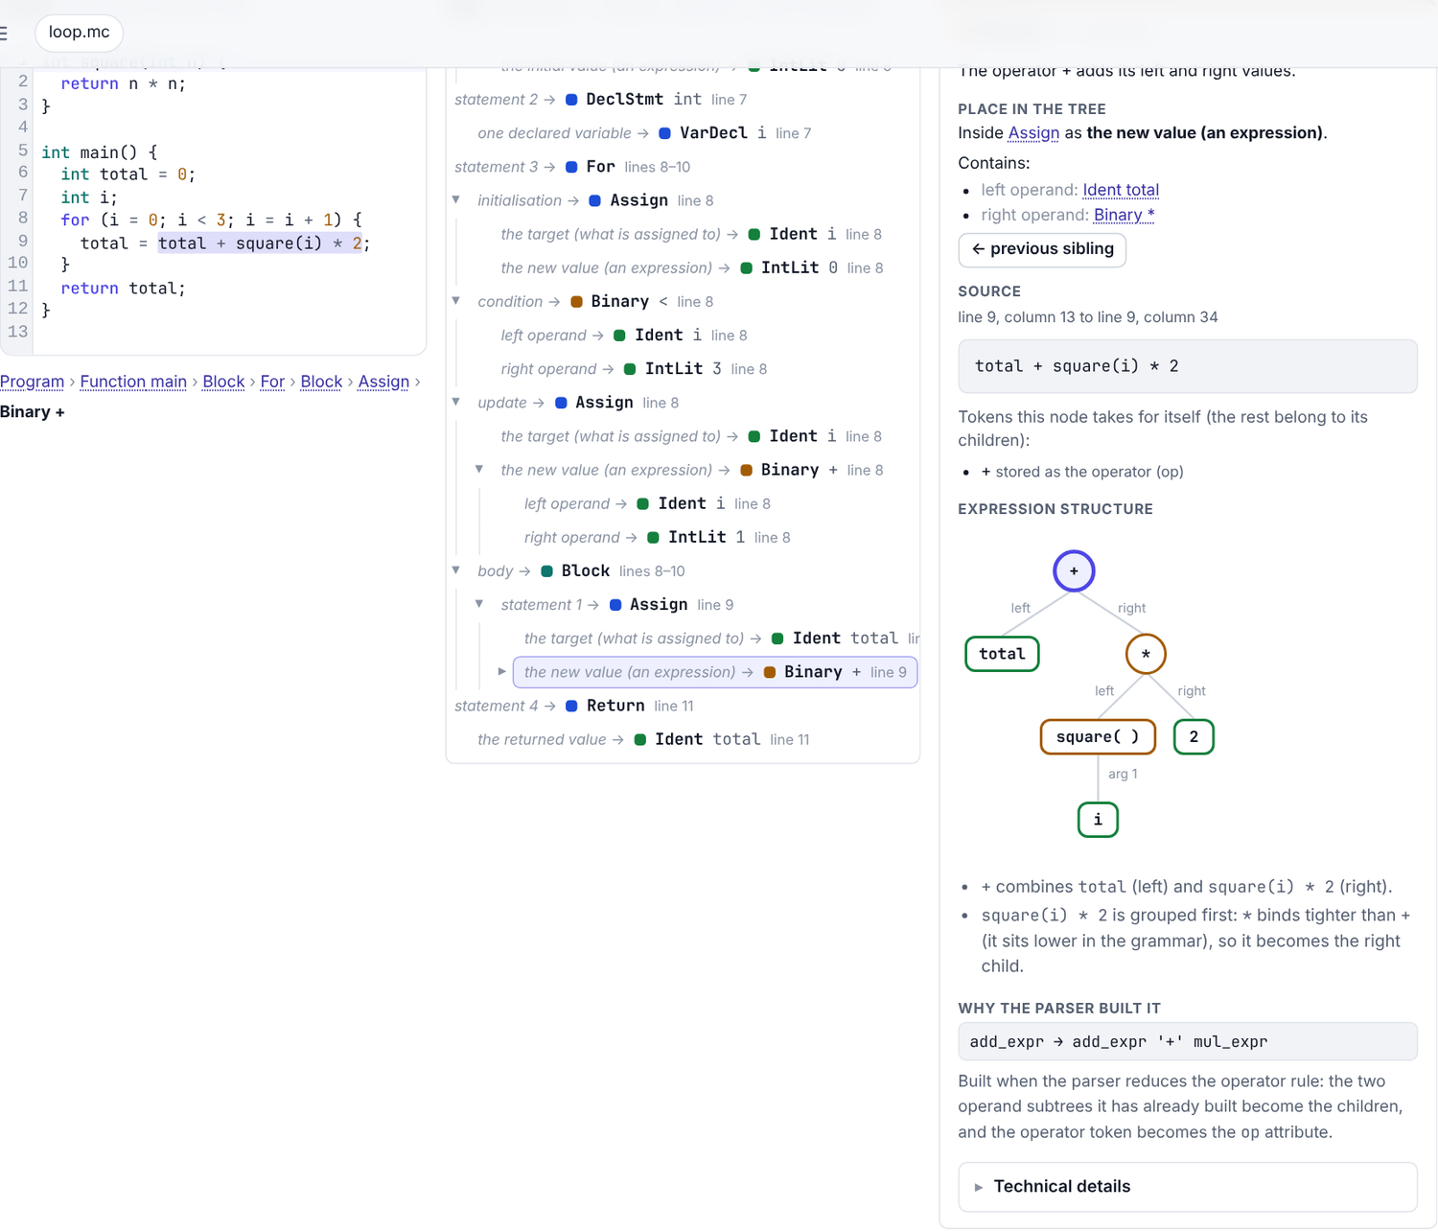
A detailed AST explorer
For every selected node
Its meaning and category
Its role in the parent and each child
The source it covers (click code ↔ node)
The tokens it absorbs (; ( ) op)
The grammar rule that built it
An expression diagram with precedence
Plus: search, expand/collapse, before & after, JSON. Grammar rules come from minic.y for all 26 node kinds.
Actual output: the Binary + node of total + square(i) * 2
Notes:
[Speaker: S Charumeena · about 1.25 min · demo: AST Explorer → click the Binary + node, then click a ; in the code; search for square.]
Our professor asked for an AST that beginners can understand, so every node explains itself. Click a node and you see what it represents, a plain-English sentence — here “the operator times multiplies its left and right values” — its role in its parent, what each child means, the exact source code it came from, highlighted in the editor, and what changed after a repair. You can search the tree and expand or collapse it. Everything comes from the compiler's real AST.
Technical detail: AST from Bison actions (arena, canonical form, FNV-1a hash); explanations for all 26 node kinds; source spans in UTF-8 byte offsets mapped to the editor.
Transition: What happens to the tree when the code is broken, or after a repair?
Likely questions:
- Is this a parse tree? No: the AST drops tokens with no meaning, such as parentheses and semicolons; the parser view shows the parse steps.

Slide 9
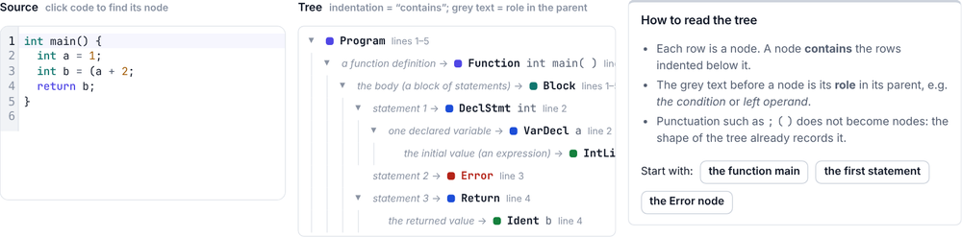
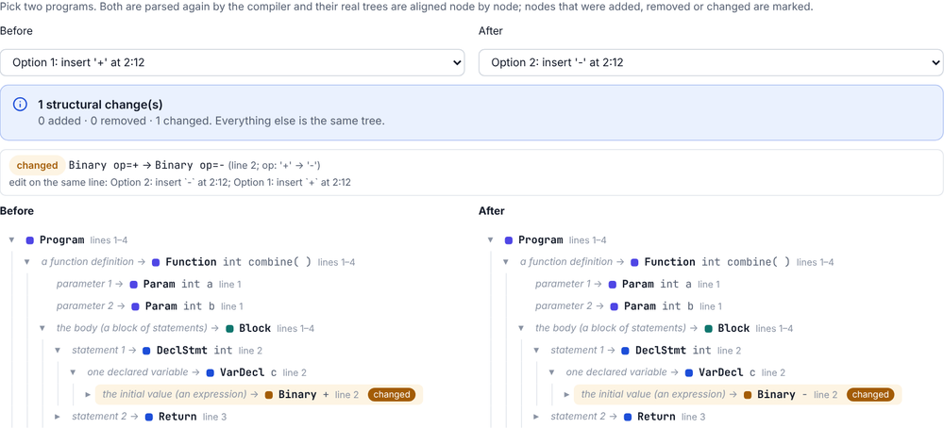
Before and after a repair
Invalid code: a labelled partial tree with Error nodes, never a fake AST
Option 1 (+) vs option 2 (−): exactly one changed node, from the compiler's diff
Notes:
[Speaker: S Charumeena · about 1 min · demo: Ambiguous operator sample → Analyze → AST Explorer → Before & after.]
Code with a syntax error has no complete AST, and we do not fake one: the explorer shows the partial tree the parser built while recovering, with Error nodes where it skipped text, and clearly labelled. It can also show the real AST of the top-ranked repair. To compare structures, both programs are parsed again; here, plan 1 inserts plus and plan 2 inserts minus, and the comparison marks exactly one changed node: the Binary operator.
Technical detail: Structural diff aligns children by LCS over canonical subtrees; marks only where kind and span match; no diff is claimed when either side is invalid.
Transition: All of this is wrapped in explanations for beginners.
Likely questions:
- Why not show the AST of invalid code? There is none; the recovered tree is labelled partial because recovery may not match the programmer's intent.

Slide 10
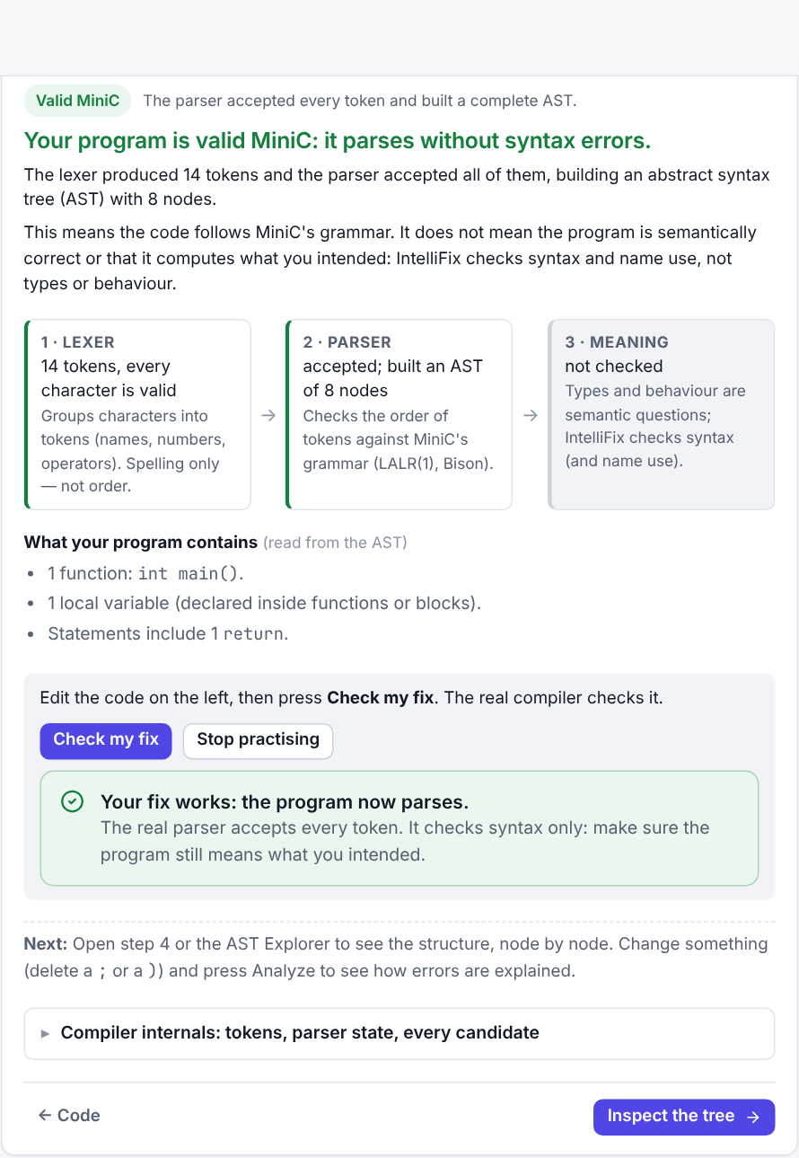
Explanations and guided repair
1
Where: the line and token where the parser stopped
2
What is expected: the expected tokens, in words
3
Options: the fixes the engine verified
✓
Check my fix: the real compiler checks the student's edit
Every result has its own explanation: valid code, empty input, missing tokens, cascades, ambiguity, missing names, invalid characters, unsupported C, nesting limit, no safe repair. Tested on all 88 professor-style inputs.
Actual output: the student's own fix, checked
Notes:
[Speaker: S Charumeena · about 1.25 min · demo: Workspace: int x = 1 (no ;) → Analyze → Show a hint ×3 → I'll try it → type ; → Check my fix.]
Every analysis starts with a plain-language answer. For a valid program it summarises what the program contains and says that valid syntax does not mean correct behaviour. For errors it says where the parser stopped, what MiniC expects there in words, and why the cause may be on an earlier line. When there are several errors it explains which report to trust first. Students can ask for hints step by step — where, then what is expected, then the possible fixes — and try their own fix; the real compiler checks it.
Technical detail: Explanations are pure functions over the compiler response; tested on all 88 professor-style inputs (102 unit tests); every result state has its own wording, including empty input, unsupported C and the nesting limit.
Transition: Raguraman will now show how we measured the system.
Likely questions:
- Are the explanations generated by AI? No; they are written rules over the real diagnostics, expected-token sets and repair plans, so they are deterministic and testable.

Slide 11
Method and verified results
900
360 / 540
seeded synthetic cases, 30 programs
dev / held-out test (split by program)
86.7%
9
first edit at the exact mistake
systems incl. CPCT+ and ablations
Synthetic mutations, not real student code. Wilson 95% intervals; paired bootstrap.
+16.3 points vs least-cost, 95% CI [13.1, 19.4] · CPCT+ 47.4–49.1% over three runs
Notes:
[Speaker: Raguraman Govindasamy · about 1.5 min · demo: Research & Method → sections 3–4.]
We wrote 30 valid MiniC programs and generated 900 seeded mutations with one or two errors. We split by program: 360 cases for development and 540 held out for testing, so near-duplicates cannot leak. On the test set the top-ranked repair restored the original program's syntax tree in 71.5 percent of cases, against 55.2 percent for a least-cost repair over the same candidates, and about 48 percent for CPCT+. The first edit was at the exact mistake in 86.7 percent of cases. These are synthetic errors, not real student code.
Technical detail: Top-1 71.5% [67.5, 75.1]; paired difference vs least-cost +16.3 points [13.1, 19.4]; CPCT+ 47.4–49.1% over three runs (non-deterministic ties); Wilson intervals, paired bootstrap.
Transition: Just as important: what helped, and what did not.
Likely questions:
- Are you better than CPCT+? Only at one thing we measured — whether the first repair restores the original program. CPCT+ was designed for recovery, which we did not measure.

Slide 12
Ablations and negative results
Part | Measured on the test split | Verdict
Layout evidence | 71.5% vs 62.6% top-1 without it | Supported
Abstention | wrong-but-confident 6.1% vs 28.5%; coverage 50.7%; selective acc. 88.0% | Supported
Risk target | 12.0% selective risk vs 10% set on dev | Missed
AST grouping | coverage 50.7% vs 48.9% | Weak
Stability evidence | +0.2 points, CI [-0.4, 0.9] | Not supported
Clarification options | correct repair offered in 153 of 256 abstained cases | Simulation only
Usability and learning effects of the interactive features are not measured yet; a user study is proposed (docs/IntelliFix_Interactive_Features.md).
Notes:
[Speaker: Raguraman Govindasamy · about 1.25 min · demo: Research & Method → section 5 (ablation) and 6 (limitations).]
Removing layout evidence drops accuracy from 71.5 to 62.6 percent, so layout matters. Abstention cuts wrong answers presented as confident from 28.5 to 6.1 percent of all cases, while still recommending in 50.7 percent; of those recommendations 88 percent were correct. But the stability evidence gave no measurable gain, grouping helped only a little, and our risk target was missed: 12 percent instead of 10. For the new question feature we only have a simulation: when IntelliFix abstains, the correct repair is among the offered options in 153 of 256 cases. Real usability is not yet measured.
Technical detail: Stability +0.2 points, CI [−0.4, 0.9]; grouping coverage 50.7% vs 48.9%; clarification bound from stored top-3 results (evaluation/experiments/clarification_bound.py), labelled as simulation.
Transition: How do we know it behaves on unexpected input?
Likely questions:
- Why report negative results? They show which parts actually work, and they keep the claims honest.
- Did the new interface change the numbers? No: the compiler and repair engine were not changed for the interface features, so the stored evaluation still describes the system.

Slide 13
Testing, limits and platforms
Test layer | Result
Compiler unit tests (C++) | 68 / 68
Backend API tests (pytest) | 33 / 33
Evaluation tests (pytest) | 161 / 161
Frontend unit tests (Vitest) | 219 / 219
End-to-end (real browser) | 15 / 15
Limits
synthetic errors; 30 programs by one author
MiniC subset; syntax only, no types
valid ≠ intended (e.g. whlie (…) { gets ;)
Platforms
Linux: all layers tested
Windows: MinGW build passes 68/68 under Wine
Not run yet: real Windows, MSVC, PowerShell scripts, macOS
Plus 88 professor-style inputs, 800 seeded random inputs and 7 HTTP sequences: 0 crashes; 2 real defects found and fixed.
Notes:
[Speaker: Raguraman Govindasamy · about 1.25 min · demo: —]
We have C++ unit tests, API tests, evaluation tests, frontend tests and real-browser end-to-end tests, all passing. A professor-style suite of 88 unfamiliar inputs and 800 random inputs checks that nothing crashes and every claim of validity is a real parse; it found and we fixed two real defects. Limits: synthetic errors, one author's programs, a C subset, syntax only, and two known confident but unintended repairs. Linux is fully tested; the Windows build passed its tests under Wine, but has not been run on a real Windows machine yet.
Technical detail: Test counts from the final run are on the slide; Windows: MinGW cross-build + Wine 68/68; MSVC and PowerShell scripts not executed.
Transition: Now let us show it live.
Likely questions:
- What breaks it? Errors needing three or more edits at one place, very distant causes, and valid-but-wrong fixes like whlie (…) { receiving a semicolon.

Slide 14
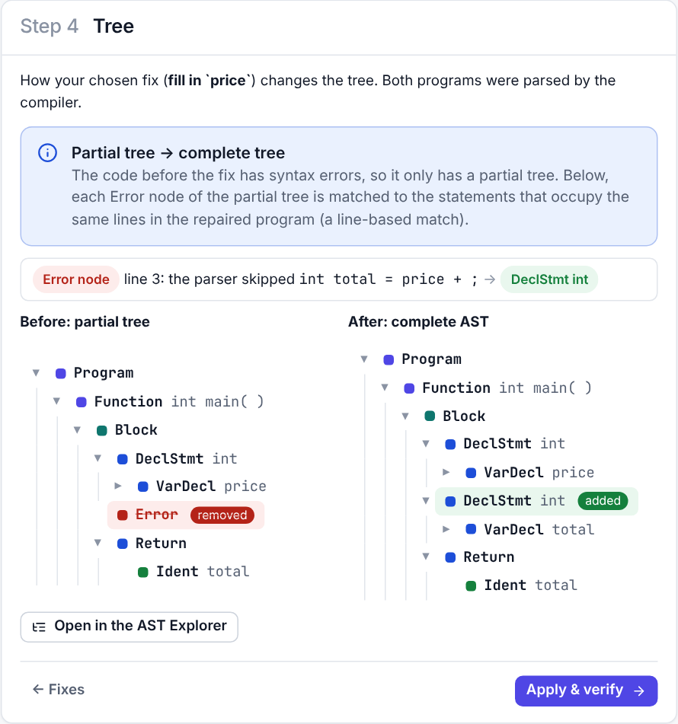
Live demo
Missing semicolon: Analyze → Diagnosis → Fixes → Apply & verify
int total = price + ; → answer the question in step 3
Step 4: partial tree → complete tree
AST Explorer: click a node or the code
Hints and Check my fix
Your own input
Check first: the badge says “Compiler 1.0.0”. Never show screenshots as live output.
Notes:
[Speaker: All three (driver, narrator, checker) · about 6 min · demo: Follow the demo steps on the slide; invite the examiners to type their own code.]
We will run the real compiler now. First a missing semicolon, with the explanation and the recommended fix; then an ambiguous expression where IntelliFix asks us what we meant; then the AST explorer and a before-and-after comparison; and finally anything you would like to type. If the compiler badge ever says Compiler missing, that means the native compiler is not built on this laptop — we never show screenshots in place of live output.
Technical detail: Checker compares the screen with the expected outcome in the demo script and says so if they differ.
Transition: To finish, our contribution and next steps.

Slide 15
Contribution and future work
What we contribute
Next steps
An integrated, inspectable repair pipeline on known LR techniques
Evidence ranking, layout, grouping, abstention — each measured
Questions instead of guesses; hints; an explained AST
An honest evaluation, including what did not work
Study with real, anonymised student errors
User study of the question feature (protocol written)
Learned and calibrated evidence weights
Native Windows verification (MSVC, MSYS2)
Thank you — questions, and please try your own code.
Goutam Jayasingh (24BCE2417) · S Charumeena (24BCI0238) · Raguraman Govindasamy (24BDS0409)
Notes:
[Speaker: Raguraman Govindasamy · about 1 min · demo: Workspace cleared, ready for questions.]
Our contribution is not a new algorithm. It is an integrated, inspectable pipeline that adds layout evidence, interpretable ranking, structural grouping, abstention and interactive clarification to known LR repair techniques, with explanations and an AST explorer for beginners, and an honest evaluation. Next we want to test it with real student errors, run a user study of the question feature, learn the weights from real data, and verify the Windows build natively. Thank you — we are happy to take questions.
Technical detail: Supported: ranking +16.3, layout +8.9, abstention −22.4 points wrong-confident. Not supported: stability. Not measured: usability.
Transition: Questions.
Likely questions:
- What is new here? The combination and its measurement, plus the explanation layer; each ingredient is established and cited.

