Slide 1
REQUIRED INFO :
Team name: coden’t
Project category: healthcare
Title : A.T.A.C - A Tech Against Covid
Members list :
Yaswanthi.O
Anju Vilashni
Sai Shreya Kumar

Slide 2
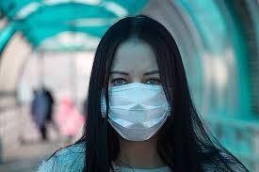
Hello world !

Slide 3
I am yaswanthi
And this is
Anju vilashni
AND
SAI SHREYA KUMAR

Slide 4
And we’re
Team
Coden’t

Slide 5
Today we present to you ….

Slide 6

A
G
A . T . a . c
E
C
H
I
N
S
T
O
V
I
D
YOURS TRULY .. CODEN’T

Slide 7
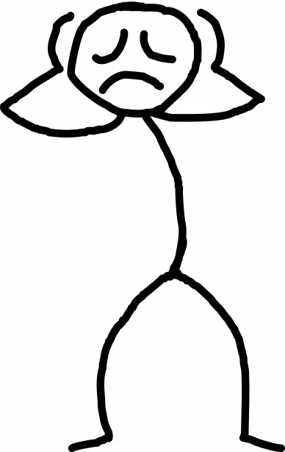
Problem !!!
Exclusively for this pandemic or any pandemic. ¯\_(ツ)_/¯.
EASIER AND FLEXIBLE PROCEDURE
SAFETY OF STAFF AND PATIENTS
WE NEED ACCURATE RESULTS
WE NEED FASTER RESULTS
WE NEED AN EARLIER TREATMENT
WE NEED AN EARLIER TREATMENT
WE NEED TO SAVE PEOPLE
EQUAL ACCESSIBILITY OF HEALTHCARE SERVICES TO ALL

Slide 8
WOAH WOAH wait!!… THE LIST IS GETTING TOO BIG

Slide 9
Crazy pandemic
SIMPLE SOLUTION

Slide 10
Solution – 3 STEPS
Let’s nationalize our healthcare facilities..
to make it easy for patients to access them at any part of the country

Slide 11
Solution – 3 STEPS
Computer vision for analysis of xrays and scans..
For amazingly accurate results
after referring through
thousands of sample data

Slide 12
Solution – 3 STEPS
Automate processes
and promote
e- services

Slide 13
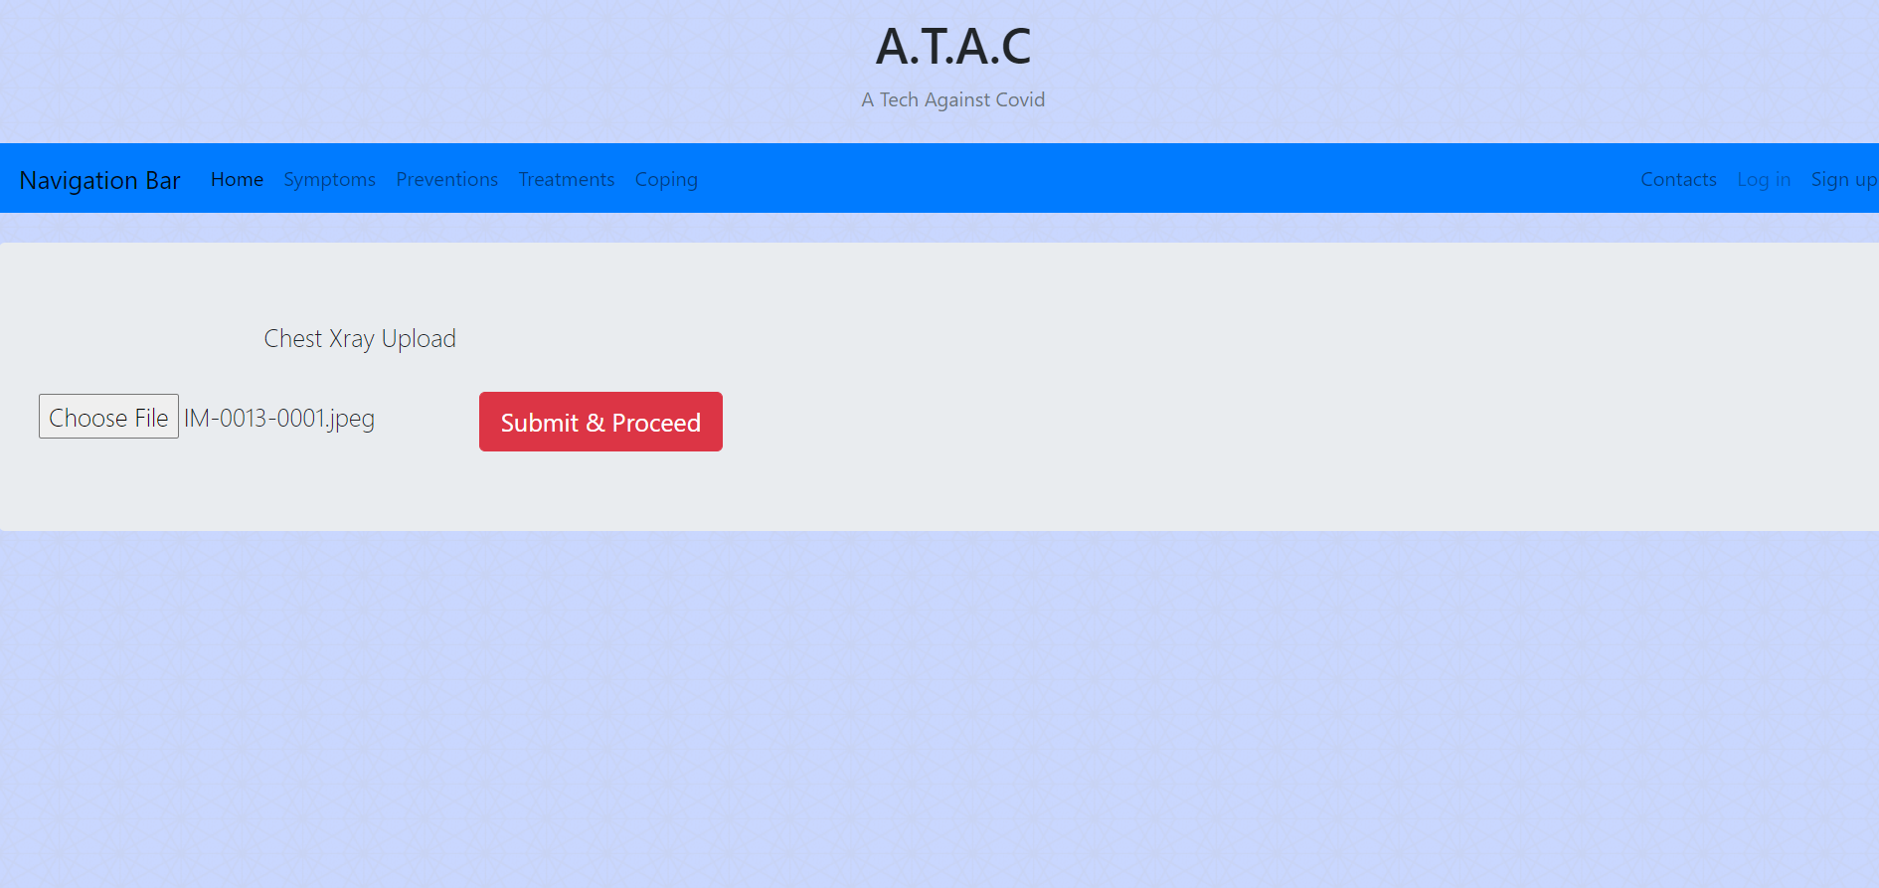
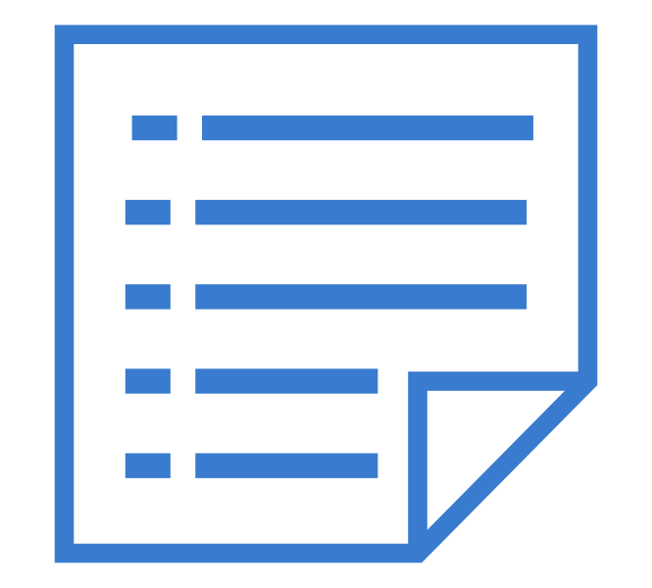
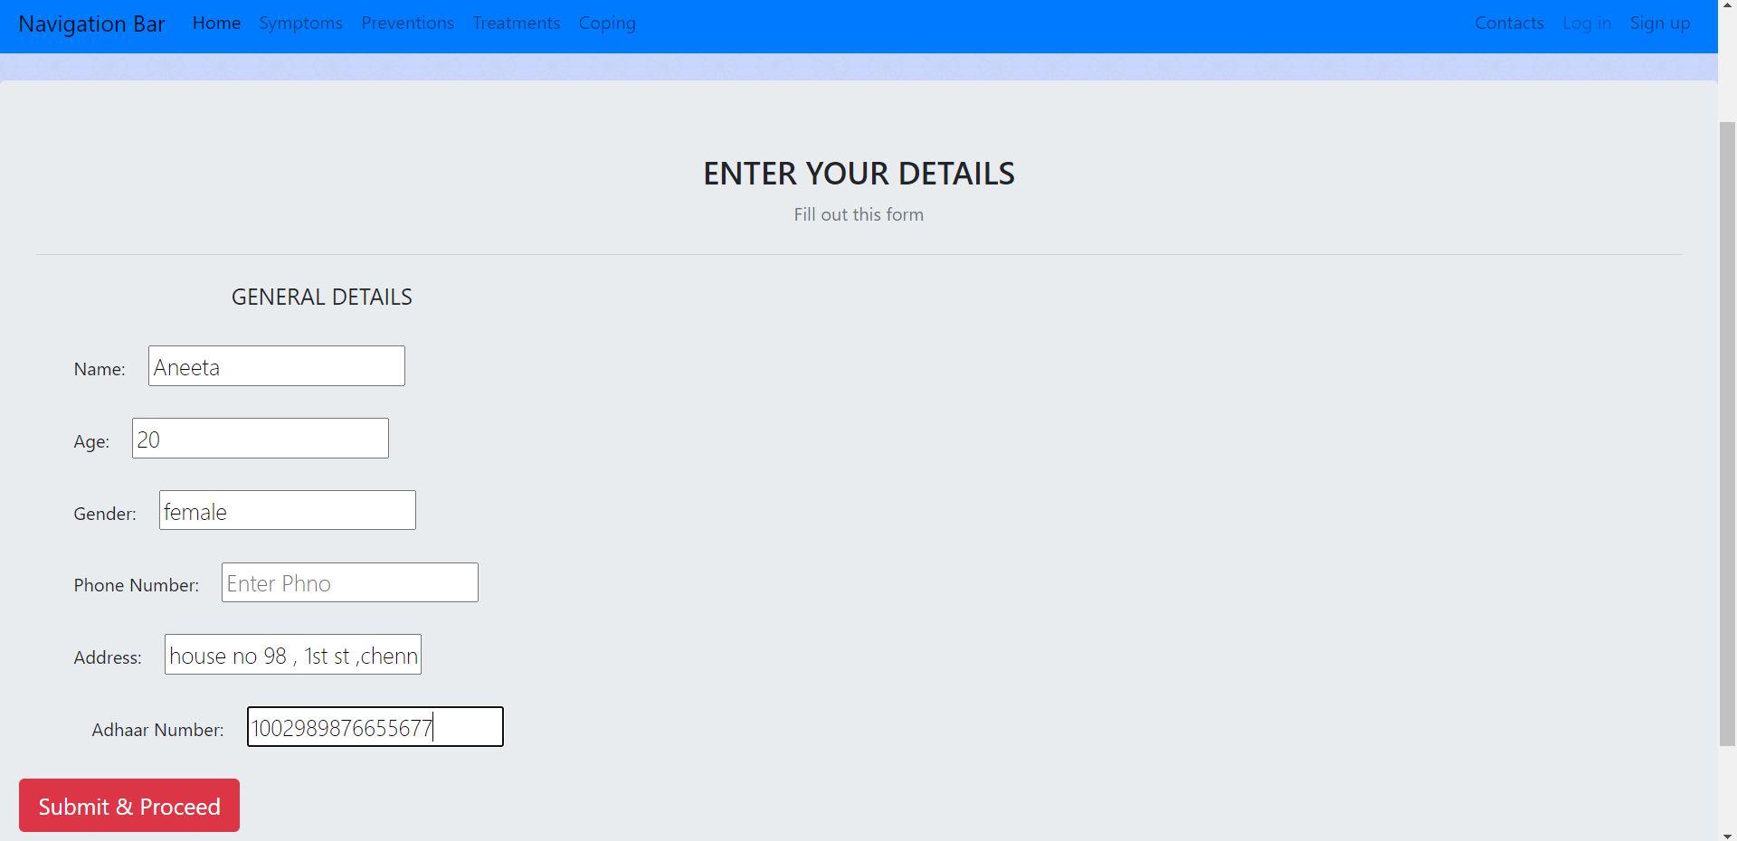
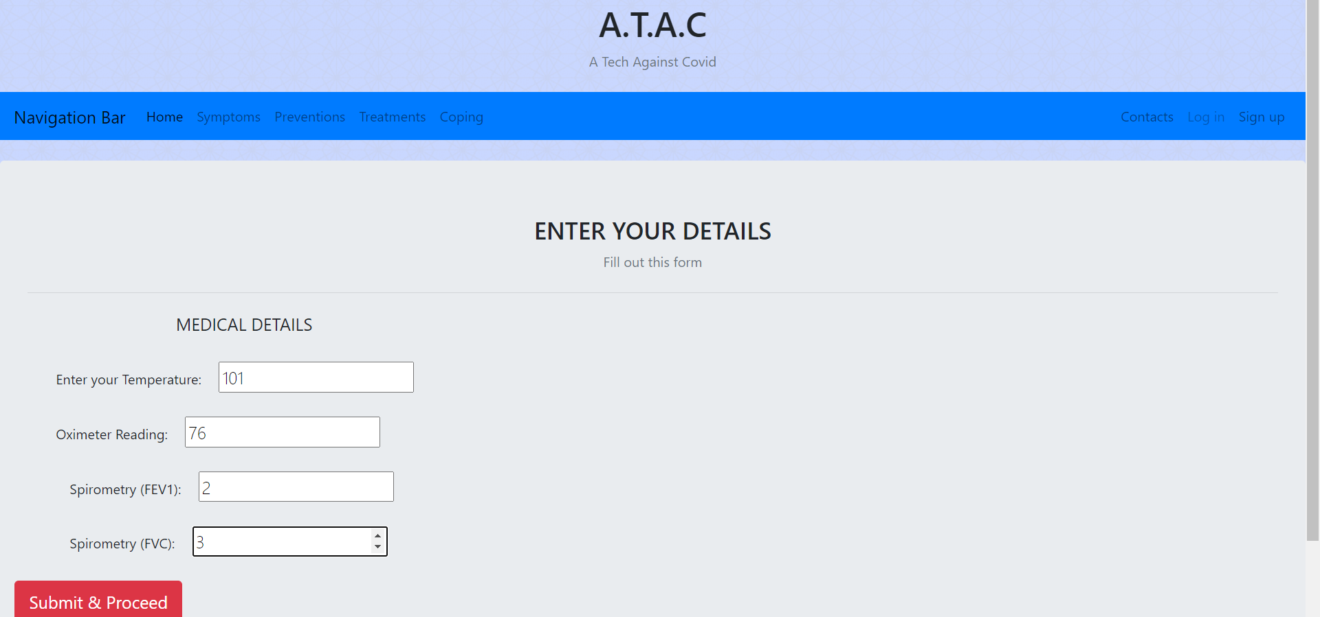

SO WHAT DOES A.T.A.C DO ??
Patient stats are recorded –
general details
medical details -
temperature
oximeter reading
spirometer reading (fev1 and fvc reading)
image of chest x ray
9898767687

Slide 14
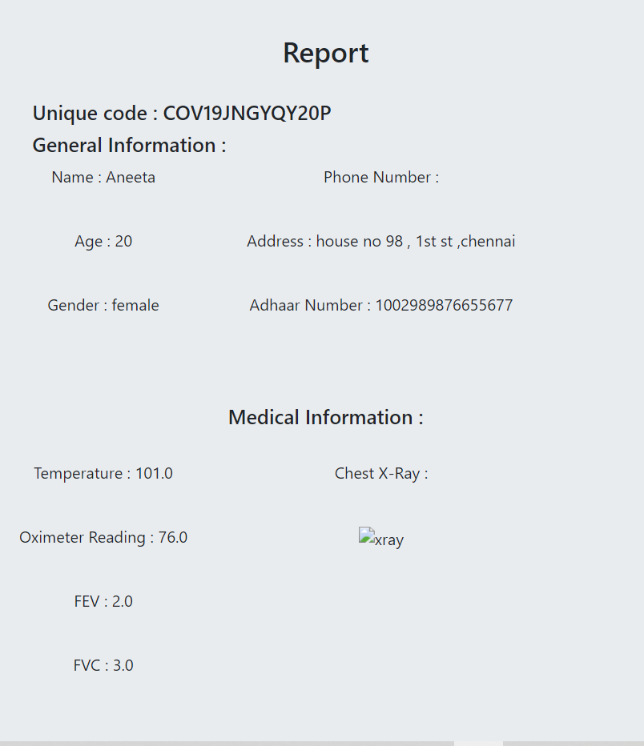
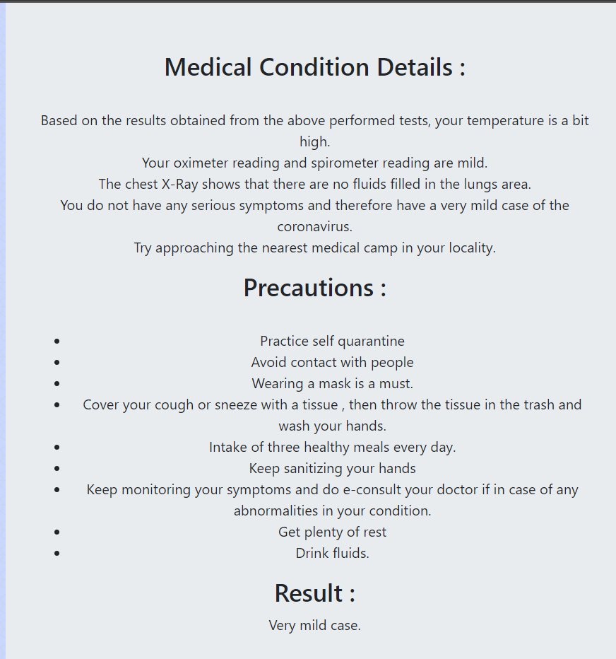
completely automated
Result generation
Each positive patient gets a unique id .
INPUT
PROCESSED
SEVERITY OF THE CONDITION OF THE VIRUS IN ONES BODY
Readings obtained
Critical points of each test are assessed and the severity of the disease is predicted

Slide 15
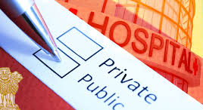
Future scope
First step to
Standardizing
Healthcare
throughout the nation
Better features
*Hospital bed availability system
*E- consultaion facility

Slide 16
Future scope
No more corruption
in the healthcare sector due to the
extremely transparent system
Better features
*Patients can re-analyse their reports while sitting rite at home
*easy to maintain medical records

Slide 17
Don’t trust our app ?
Think again : )

Slide 18
Mindblowing tech
used with
extreme accuracy
Use of a
highly trained neural networks model that renders high accuracy

Slide 19
All hospitals.
Most organized
Easy results.
Trillions of patients
A constantly training machine for the best results
Satisfactory treatment
The most accurate

Slide 20
Drawbacks
The typical doctor patient relationship is not observed
This page is kinda empty XD ….

Slide 21
Tech stacks
-python
-keras – tensorflow – for ml model – cnn
-database – sqlite3
-html
-css
-flask
-jinja templates

Slide 22
So ..
Are You
Ready to
a.t.a.c ?

Slide 23
thanks!
Any questions?

