Slide 1
What is the backend?
The "backend" in web development refers to the server-side logic, databases, and APIs that power a website or application, handling data storage, processing, and communication behind the scenes, which users don't directly interact with. The back-end, or server-side, of a website or application handles the logic, data storage, and processing that users don't directly interact with, like managing user accounts, processing payments, or updating databases. The back-end is the code that runs on the server, that receives requests from the clients, and contains the logic to send the appropriate data back to the client. The back-end also includes the database, which will persistently store all of the data for the application.

Slide 2
What is the workflow of backend?
The backend workflow involves a developer understanding project requirements, designing systems, writing code, testing, deploying, and maintaining applications, all while ensuring data security and efficient performance.

Slide 3
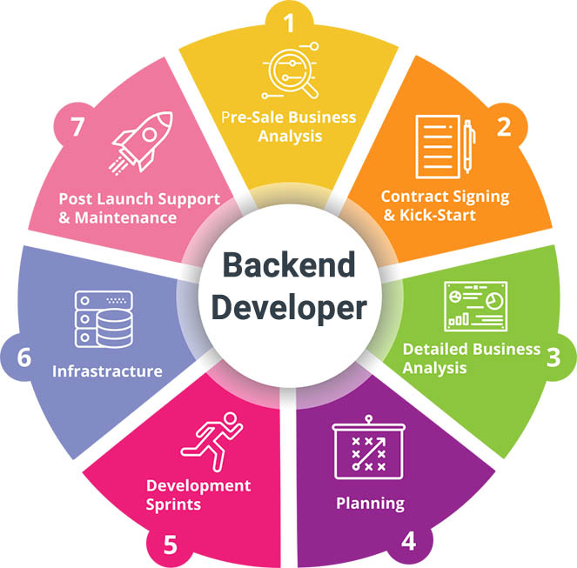
What are the responsibilities of backend developer?

Slide 4
Which technologies and databases are used in the backend?
Backend development utilizes various technologies and databases, including programming languages like Python, Java, and Node.js, frameworks such as Django and Express.js, and databases like MySQL, PostgreSQL, and MongoDB.

Slide 5
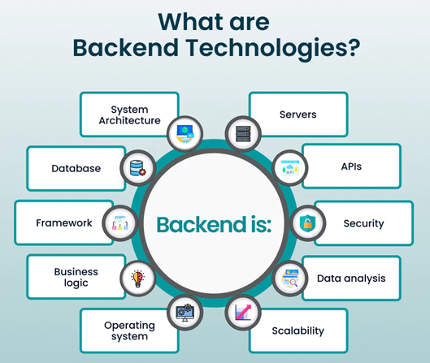

Slide 6
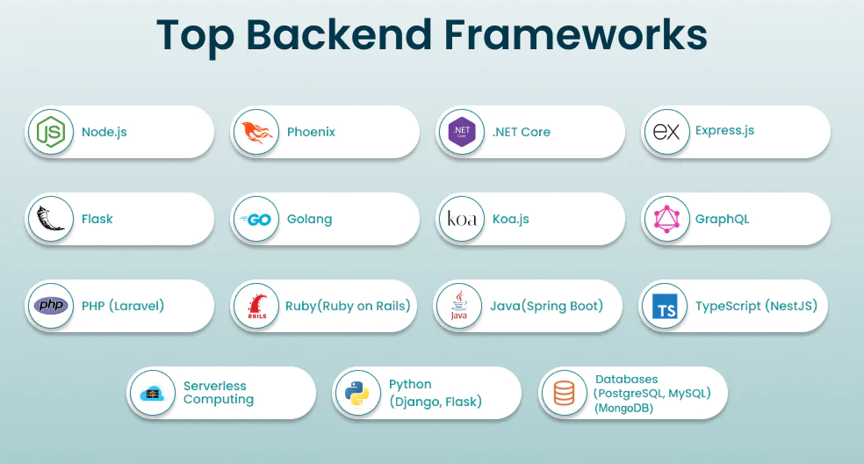

Slide 7

Introduction to Node.js
Node.js is a JavaScript runtime environment that allows developers to create web applications and servers outside of a browser. It's open-source, cross-platform, and free to use. Node.js is an open-source and cross-platform javaScript runtime environment. It is a popular tool for almost any kind of project. Node.js runs the V8 javascript engine, the core of Google Chrome, outside of the browser.

Slide 8

the power of communication

Slide 9

overcoming nervousness
CONFIDENCE-BUILDING STRATEGIES

Slide 10
selecting visual aids
ENHANCING YOUR PRESENTATION

Slide 11
effective delivery techniques
Effective body language enhances your message, making it more impactful and memorable:
Meaningful eye contact
Purposeful gestures
Maintain good posture
Control your expressions
This is a powerful tool in public speaking. It involves varying pitch, tone, and volume to convey emotion, emphasize points, and maintain interest:
Pitch variation
Tone inflection
Volume control

Slide 12
navigating q&a sessions
Know your material in advance
Anticipate common questions
Rehearse your responses
Maintaining composure during the Q&A session is essential for projecting confidence and authority. Consider the following tips for staying composed:
Stay calm
Actively listen
Pause and reflect
Maintain eye contact

Slide 13

speaking impact
Your ability to communicate effectively will leave a lasting impact on your audience
Effectively communicating involves not only delivering a message but also resonating with the experiences, values, and emotions of those listening

Slide 14
speaking impact
Learn to infuse energy into your delivery to leave a lasting impression
One of the goals of effective communication is to motivate your audience
METRIC | MEASUREMENT | TARGET | ACTUAL
Audience attendance | # of attendees | 150 | 120
Engagement duration | Minutes | 60 | 75
Q&A interaction | # of questions | 10 | 15
Positive feedback | Percentage (%) | 90 | 95
Rate of information retention | Percentage (%) | 80 | 85

Slide 15
final tips & takeaways
CONSISTENT REHEARSAL
Strengthen your familiarity
REFINE DELIVERY STYLE
Pacing, tone, and emphasis
TIMING AND TRANSITIONS
Aim for seamless, professional delivery
PRACTICE AUDIENCE
Enlist colleagues to listen & provide feedback
Seek feedback
Reflect on performance
Explore new techniques
Set personal goals
Iterate and adapt

Slide 16
speaking engagement metrics
IMPACT FACTOR | MEASUREMENT | TARGET | ACHIEVED
Audience interaction | Percentage (%) | 85 | 88
Knowledge retention | Percentage (%) | 75 | 80
Post-presentation surveys | Average rating | 4.2 | 4.5
Referral rate | Percentage (%) | 10 | 12
Collaboration opportunities | # of opportunities | 8 | 10

Slide 17
thank you
BRITA TAMM
502-555-0152
brita@firstupconsultants.com
www.firstupconsultants.com

