Slide 1
Upload Individual Project
Title
Description
Auto fill based on Description??
Domain
Drop Down with Add Option
Topics
Comma separated topics
Theme
Science,Arts,Domain
Demo Url
Source Code Url
Project Summary
Fiile Upload

Slide 2
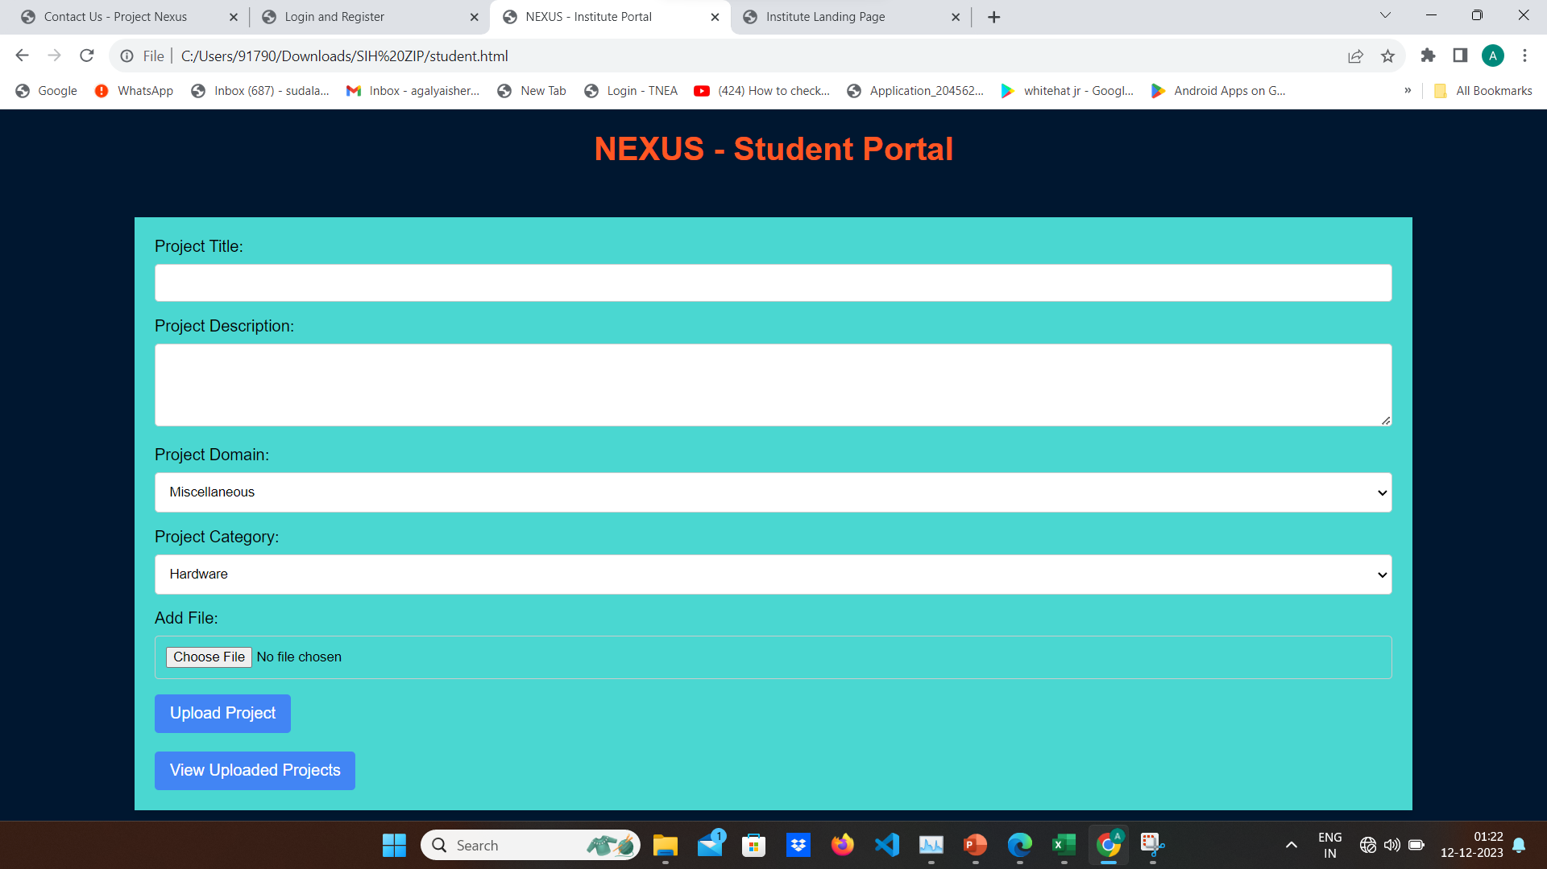

Slide 3
Institute Upload
ACADEMIC YEAR
FROM:
TO:
UPKOAD EXCEL SHEET
csv FORMAT
DEPARTMENT
UPLOAD INDIVIADUAL PROJECT BUTTON
Navigate to invidual project upload page

Slide 4
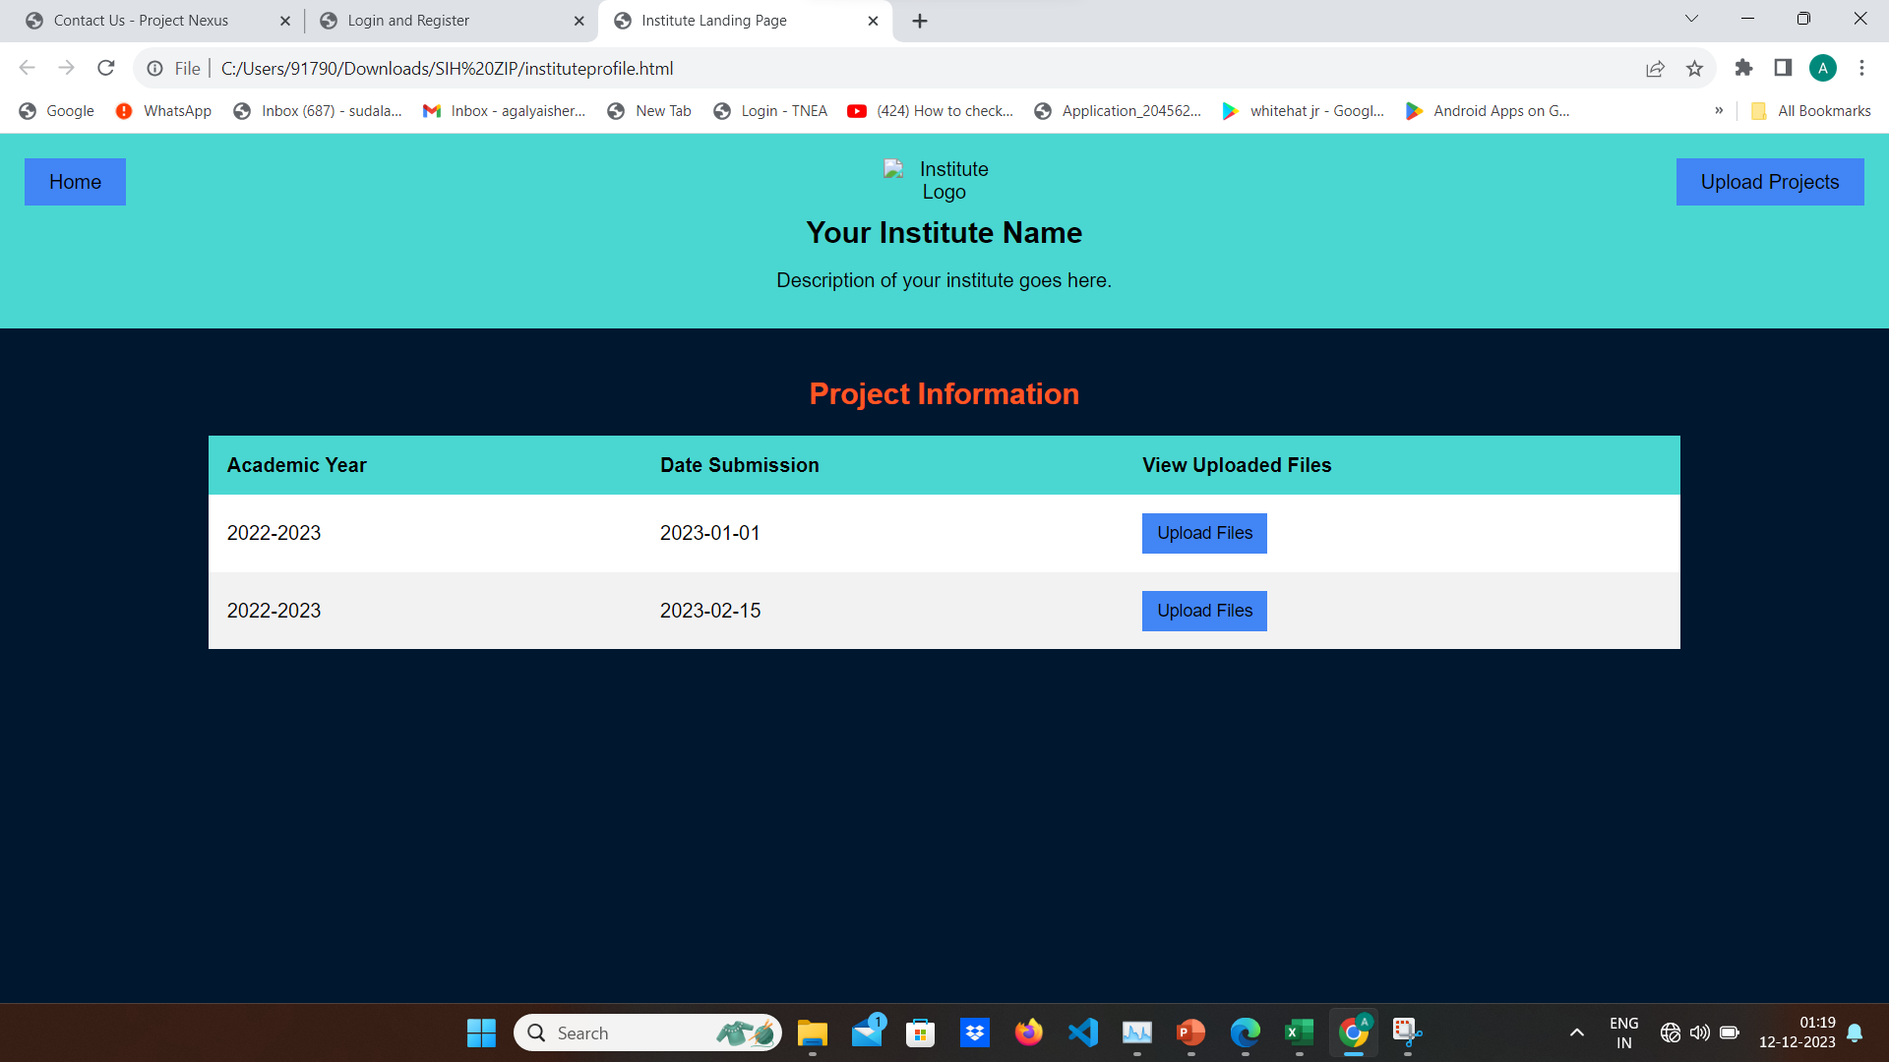

Slide 5
REGISTER
USERNAME
EMAIL ID
PASSWORD
SIGN UP WITH GOOGLE

Slide 6
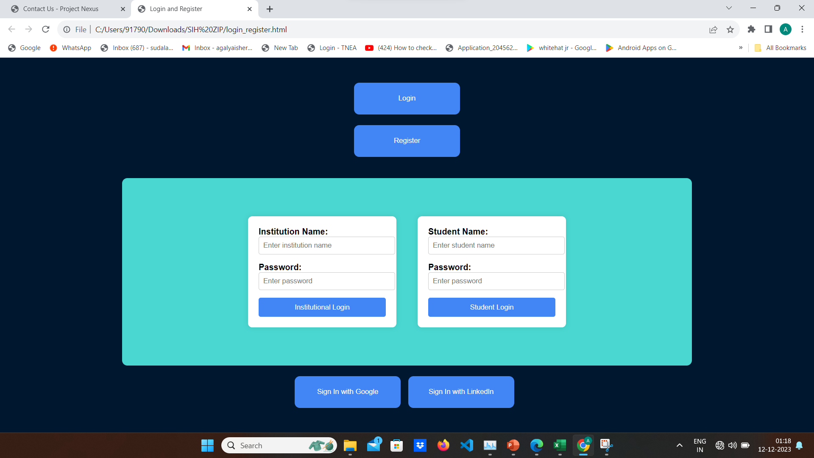

Slide 7
LOGIN
USERNAME
EMAIL ID
PASSWORD
SIGN IN WITH GOOGLE

Slide 8
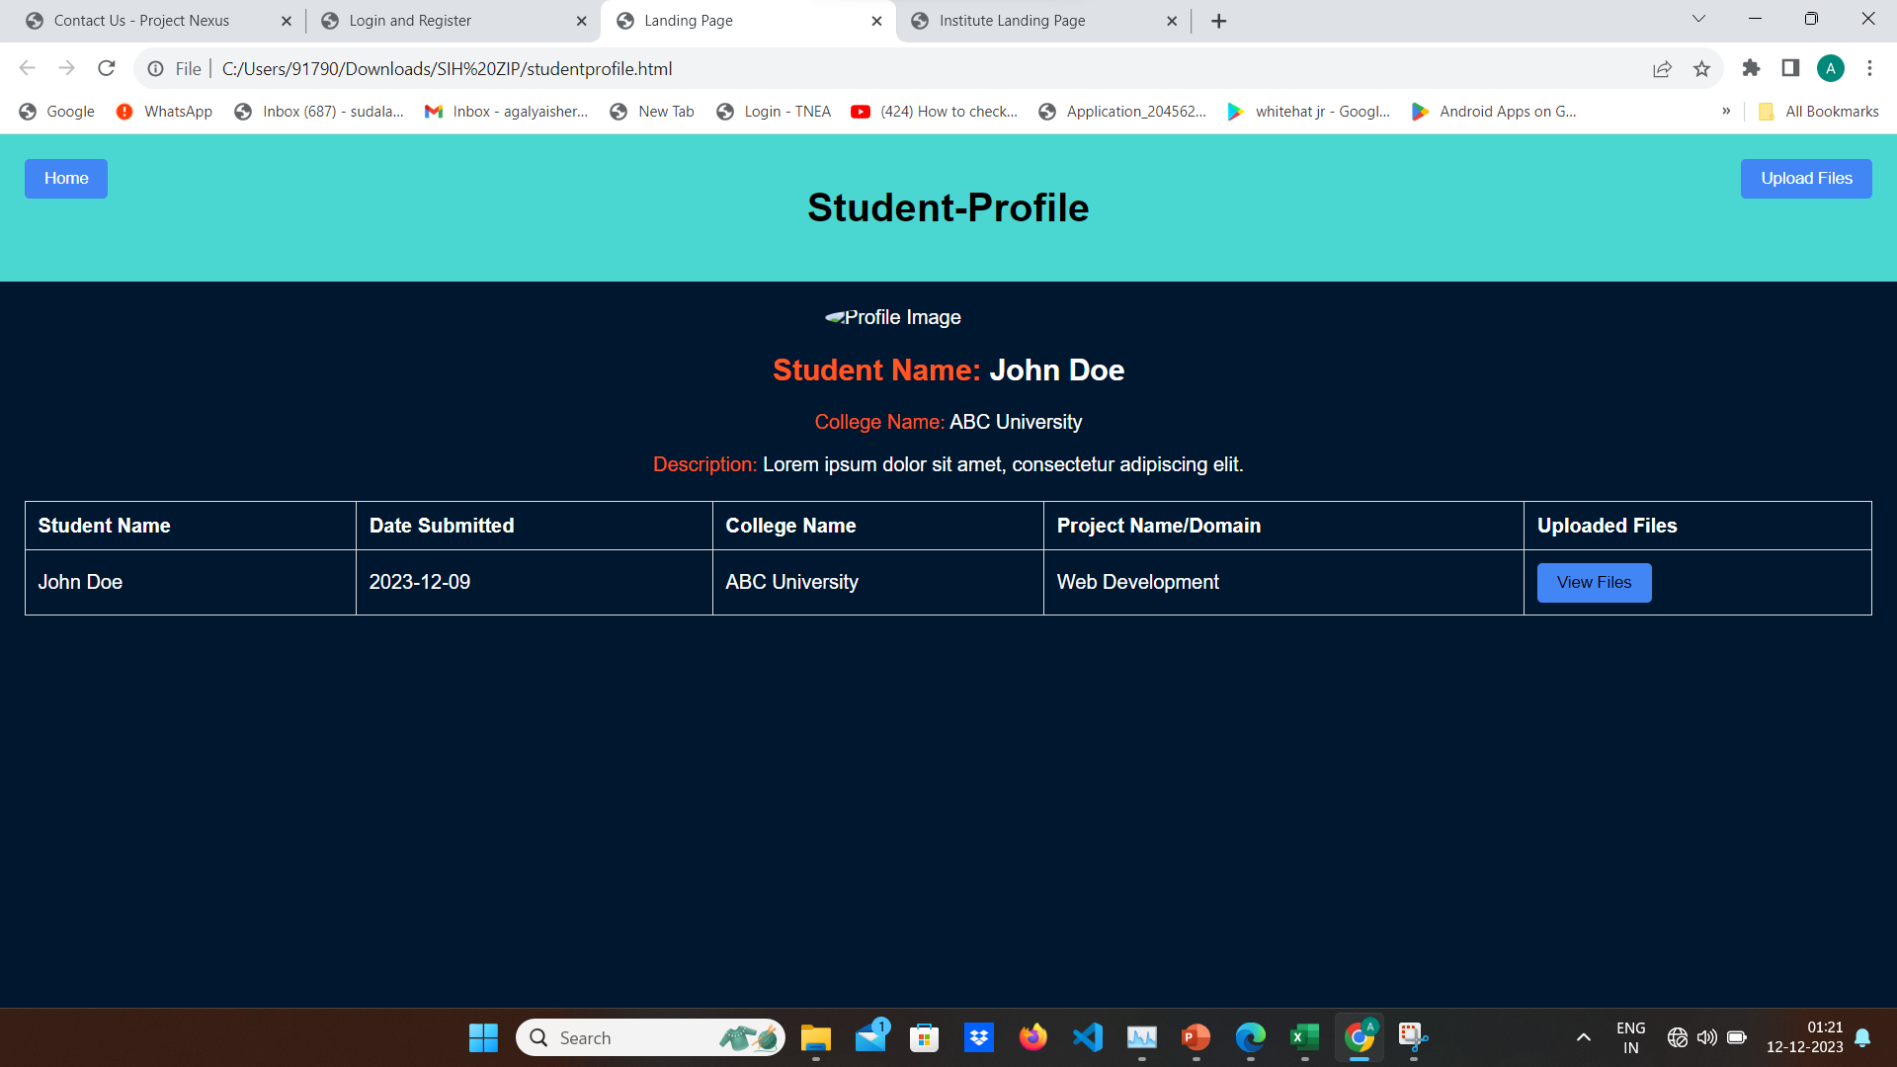

Slide 9
PROFILE
PROFILE
USER NAME
CONTACT
UNIQUE USER ID
INBOX
VIEW UPLOADED PROJECTS
PRFERENCES
RATING
SETTINGS
EDIT/REMOVE UPLOADED PROJECTS
UPLOAD NEW PROJECTS

