Slide 1
Project: Design a Data Warehouse for Reporting and OLAP:
Effects of Weather on Restaurant Reviews:

Slide 2
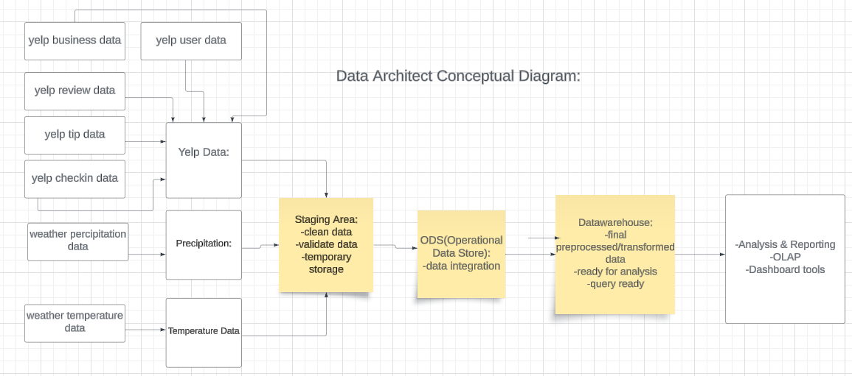
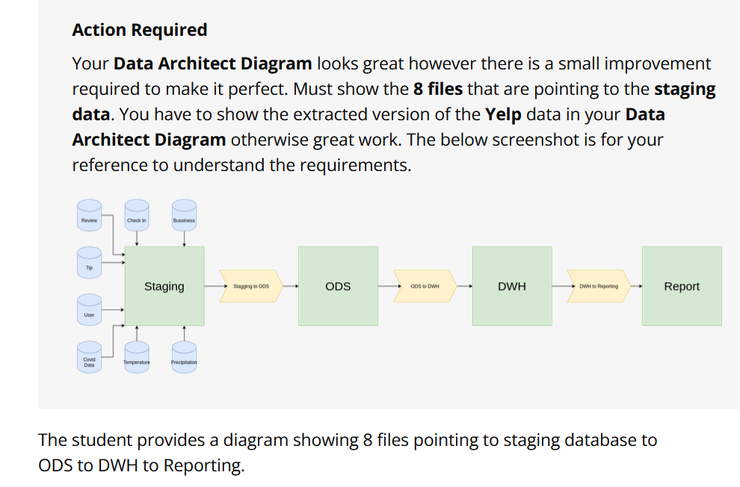
Data Architecture Diagram - Conceptual Model
Notes:
Conceptual models: Data flows in these systems can be represented by conceptual models. The conceptual model focuses on the high-level entities and their relationships without diving into attributes or data types.

Slide 3
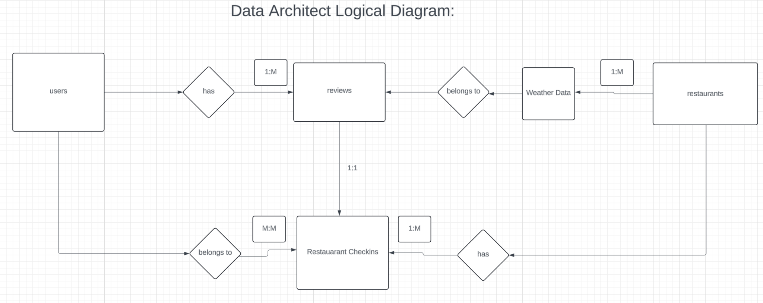
Data Architecture Diagram - Logical Model
Notes:
Logical models represent business concepts within a relationship diagram. The primary relationships are 1 to 1, 1 to many, many to many. The logical model adds more detail such as specific attributes and their data types, and specifies relationships in more detail. Think about how your Customer Rep has many Customers. Each of those Customers orders many different products, and can submit many orders
Precipitation headers: date, precipitation, precipitation_normal
Temperature headers: date, min max, normal_min, normal_max
—-----
Yelp_academic_tip headers: user_id, business_id, text, date, compliment_count
Yelp_academic_user headers: user_id, name, review_count, yelping_since, useful, funny, Cool, elite, friends
Yelp_academic_checkin headers: business_id, Date Yelp_academic_business headers: Business_id, name:"Temple Beth-El", address:"400 Pasadena Ave S"," city:"St.Petersburg", state:"FL", Postal_code:"33707", Latitude: 27.76659, Longitude:-82.732983, Stars:3.5, Review_count:5, Is_open:1, Attributes:null categories:"Synagogues, Religious Organizations", hours:{"Monday":"9:0-17:0","Tuesday":"9:0-17:0","Wednesday":"9:0-17:0","Thursday":"9:0-17:0","Friday":"9:0-17:0"}}
Yelp_academic_reviews headers: Reivew_id, User_id, Business_id, Stars, Text, Date,

Slide 4
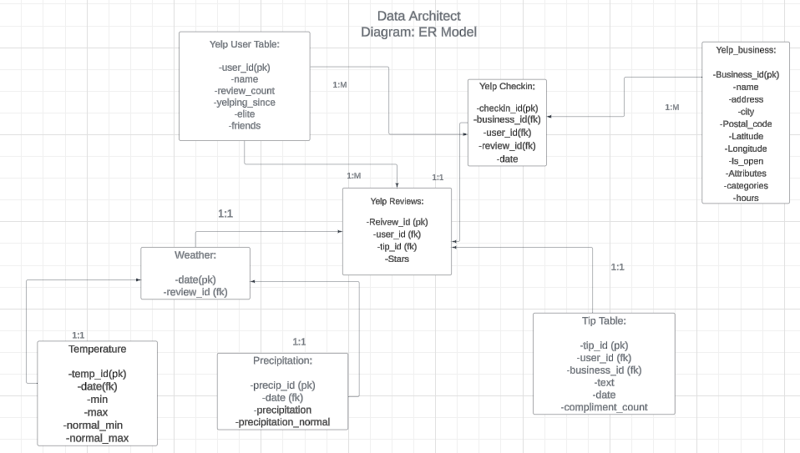
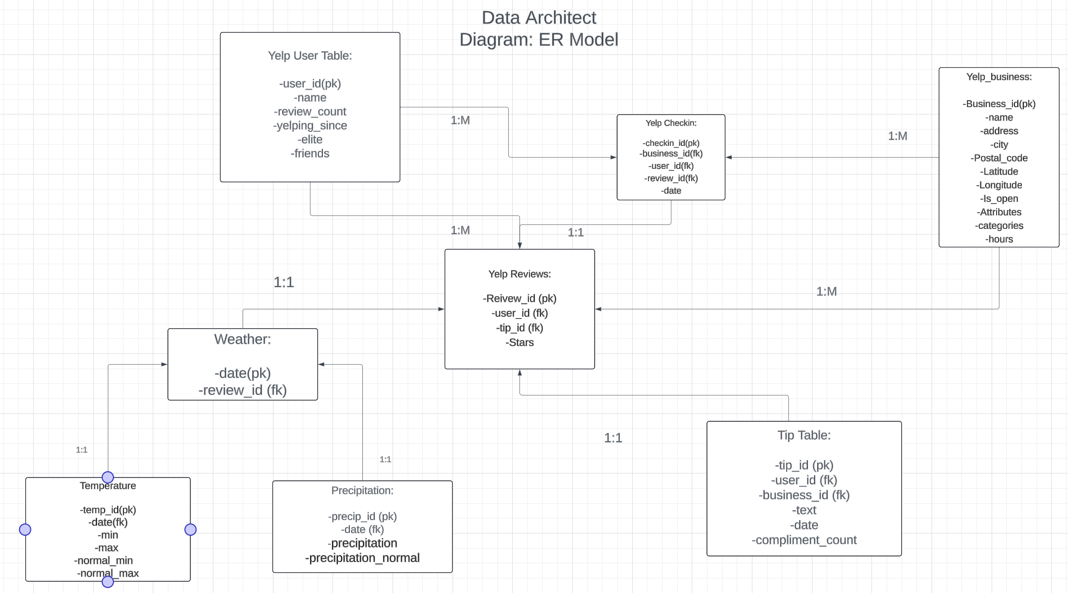
Data Architecture Diagram - ER Model

Slide 5
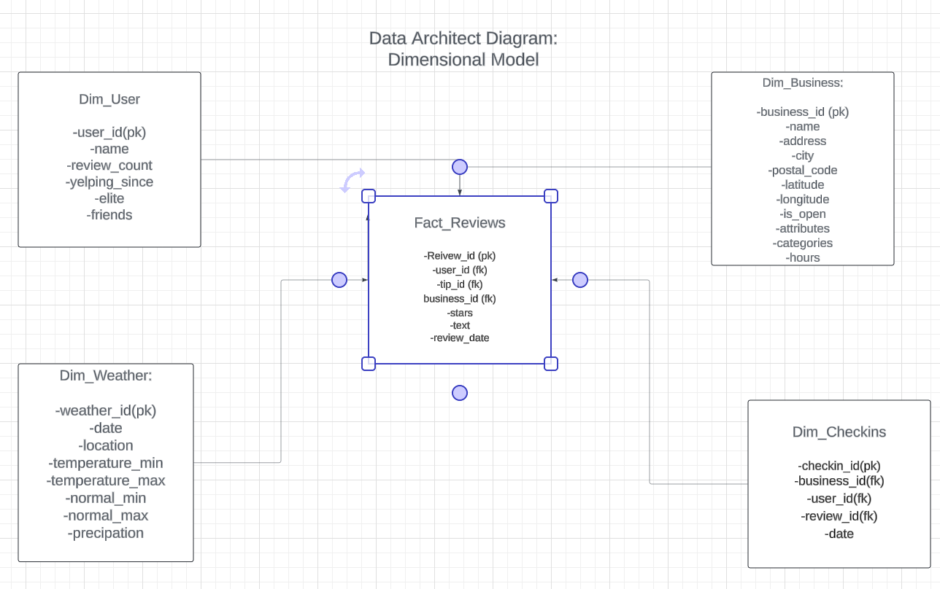
Data Architect Diagram: Dimensional Model

Slide 6
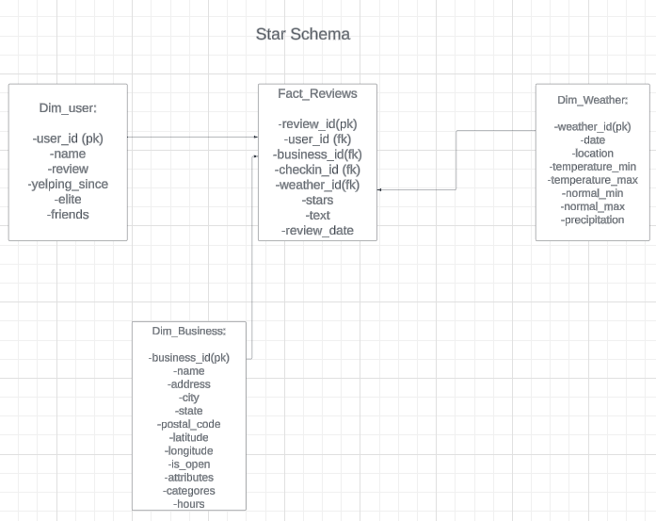
Star Schema

Slide 7
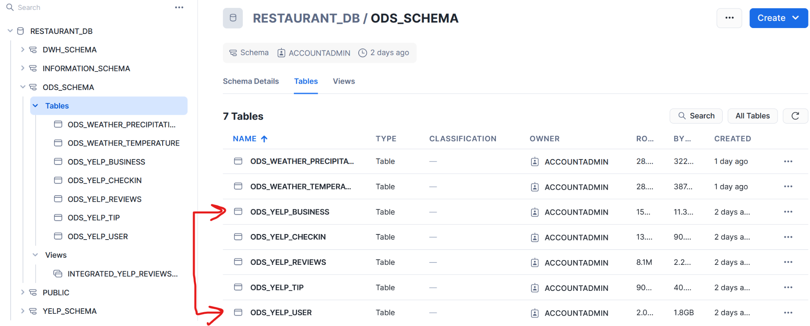
6 Tables for Yelp Data

Slide 8
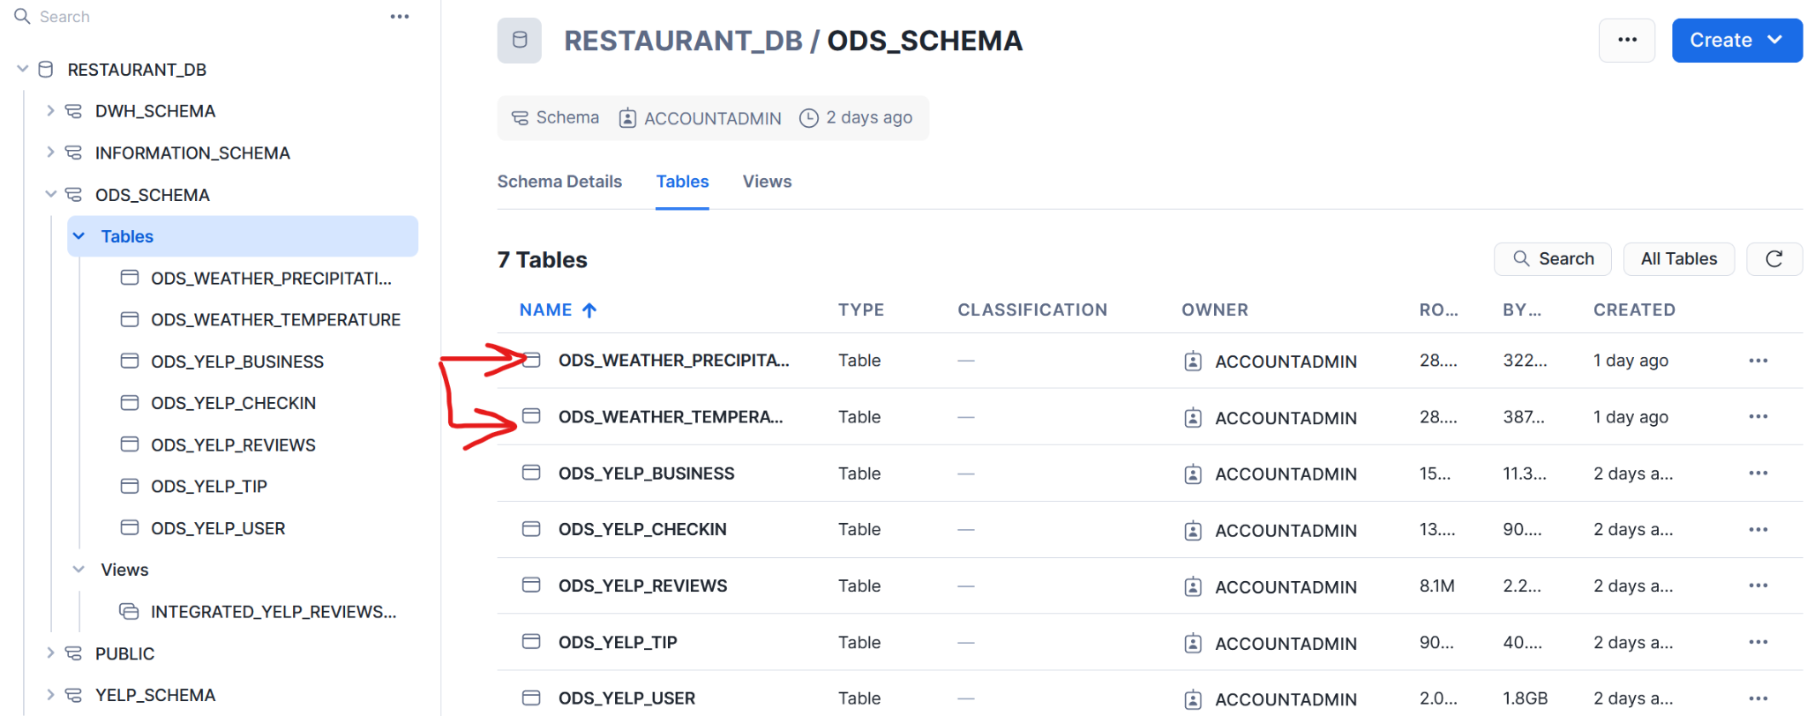
2 Tables for Weather Data

Slide 9
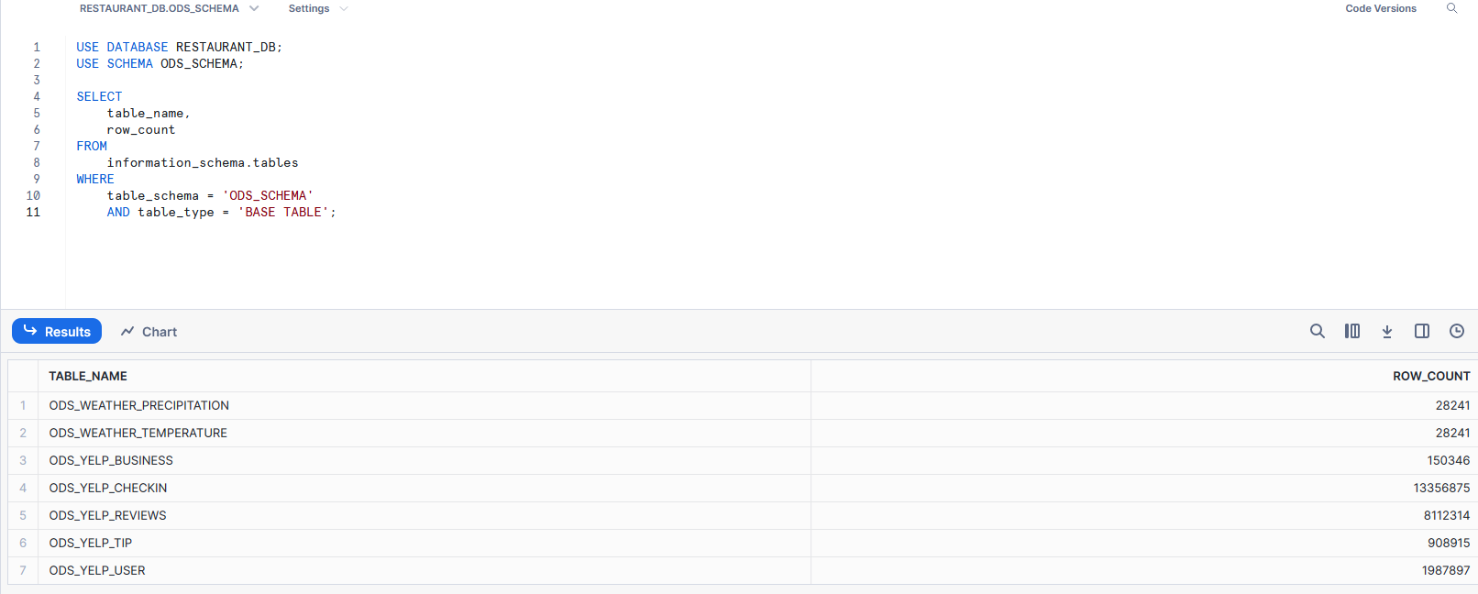
Table Row Counts

Slide 10
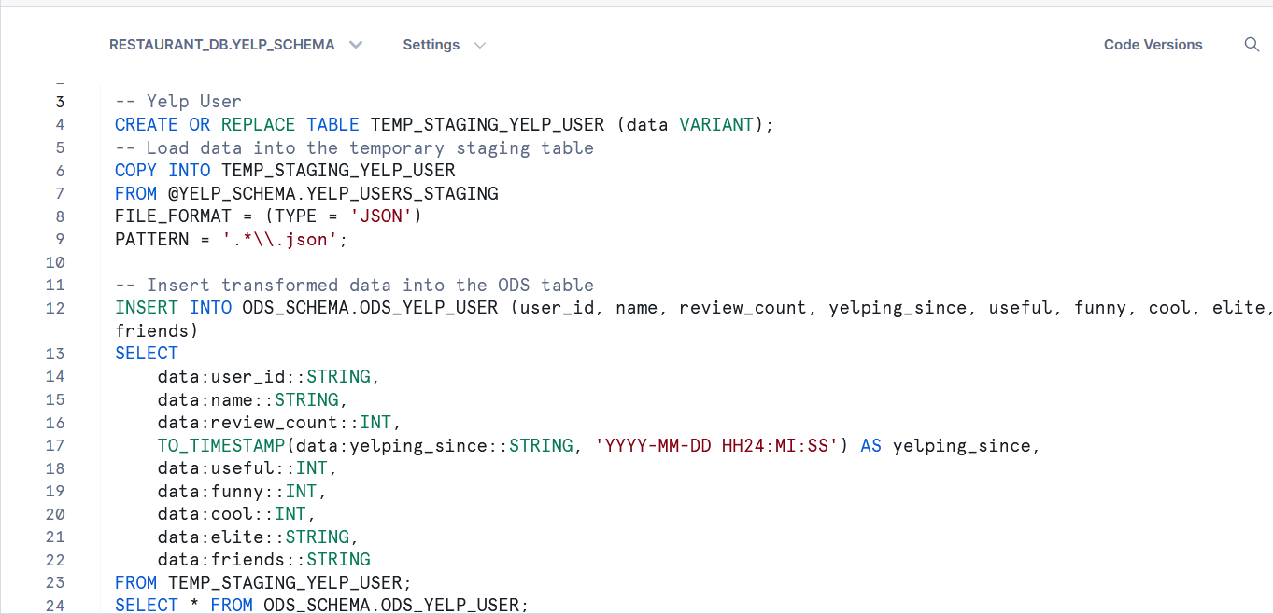
SQL Staging to ODS Queries/json functions to transform data from json to multiple columns in ods
Notes:
-- Yelp User
CREATE OR REPLACE TABLE TEMP_STAGING_YELP_USER (data VARIANT);
-- Load data into the temporary staging table
COPY INTO TEMP_STAGING_YELP_USER
FROM @YELP_SCHEMA.YELP_USERS_STAGING
FILE_FORMAT = (TYPE = 'JSON')
PATTERN = '.*\\.json';
-- Insert transformed data into the ODS table
INSERT INTO ODS_SCHEMA.ODS_YELP_USER (user_id, name, review_count, yelping_since, useful, funny, cool, elite, friends)
SELECT
data:user_id::STRING,
data:name::STRING,
data:review_count::INT,
TO_TIMESTAMP(data:yelping_since::STRING, 'YYYY-MM-DD HH24:MI:SS') AS yelping_since,
data:useful::INT,
data:funny::INT,
data:cool::INT,
data:elite::STRING,
data:friends::STRING
FROM TEMP_STAGING_YELP_USER;
SELECT * FROM ODS_SCHEMA.ODS_YELP_USER;
---------------------------------------------------------------------------------
-- Yelp Checkin
-- Create temporary staging table for Yelp Checkin
CREATE OR REPLACE TABLE TEMP_STAGING_YELP_CHECKIN (data VARIANT);
-- Load data into the temporary staging table
COPY INTO TEMP_STAGING_YELP_CHECKIN
FROM @YELP_SCHEMA.YELP_CHECKIN_STAGING
FILE_FORMAT = (TYPE = 'JSON')
PATTERN = '.*\\.json';
-- Insert transformed data into the ODS table
INSERT INTO ODS_SCHEMA.ODS_YELP_CHECKIN (business_id, date)
SELECT
data:business_id::STRING AS business_id,
TO_TIMESTAMP(LTRIM(seq.value::STRING), 'YYYY-MM-DD HH24:MI:SS') AS date
FROM TEMP_STAGING_YELP_CHECKIN,
LATERAL FLATTEN(input => SPLIT(data:date::STRING, ',')) seq;
SELECT * FROM ODS_SCHEMA.ODS_YELP_CHECKIN LIMIT 10;
-----------------------------------------------------------------------------------------
--Yelp Business
CREATE OR REPLACE TABLE TEMP_STAGING_YELP_BUSINESS (data VARIANT);
-- Load data into the temporary staging table
COPY INTO TEMP_STAGING_YELP_BUSINESS
FROM @YELP_SCHEMA.YELP_BUSINESS_STAGING
FILE_FORMAT = (TYPE = 'JSON')
PATTERN = '.*\\.json';
-- Insert transformed data into the ODS table
INSERT INTO ODS_SCHEMA.ODS_YELP_BUSINESS (business_id, name, address, city, state, postal_code, latitude, longitude, stars, review_count, is_open, attributes, categories, hours)
SELECT
data:business_id::STRING,
data:name::STRING,
data:address::STRING,
data:city::STRING,
data:state::STRING,
data:postal_code::STRING,
data:latitude::DOUBLE,
data:longitude::DOUBLE,
data:stars::DECIMAL(2, 1),
data:review_count::INT,
CASE
WHEN data:is_open::STRING = '1' THEN TRUE
WHEN data:is_open::STRING = '0' THEN FALSE
ELSE NULL
END AS is_open,
data:attributes::STRING,
data:categories::STRING,
data:hours::STRING
FROM TEMP_STAGING_YELP_BUSINESS;
SELECT * FROM ODS_SCHEMA.ODS_YELP_BUSINESS
-----------------------------------------------------------------------------------------------------
--Yelp Reviews
CREATE OR REPLACE TABLE TEMP_STAGING_YELP_REVIEWS (data VARIANT);
-- Load data into the temporary staging table
COPY INTO TEMP_STAGING_YELP_REVIEWS
FROM @YELP_SCHEMA.YELP_REVIEWS_STAGING
FILE_FORMAT = (TYPE = 'JSON')
PATTERN = '.*\\.json';
INSERT INTO ODS_SCHEMA.ODS_YELP_REVIEWS (review_id, user_id, business_id, stars, text, date)
SELECT
data:review_id::STRING,
data:user_id::STRING,
data:business_id::STRING,
data:stars::DECIMAL(2, 1),
data:text::STRING,
TO_TIMESTAMP(LTRIM(data:date::STRING), 'YYYY-MM-DD HH24:MI:SS') AS date
FROM TEMP_STAGING_YELP_REVIEWS;
SELECT * FROM ODS_SCHEMA.ODS_YELP_REVIEWS
------------------------------------------------------------------------------------------------------
-- Yelp Tip
CREATE OR REPLACE TABLE TEMP_STAGING_YELP_TIP (data VARIANT);
-- Load data into the temporary staging table
COPY INTO TEMP_STAGING_YELP_TIP
FROM @YELP_SCHEMA.YELP_TIP_STAGING
FILE_FORMAT = (TYPE = 'JSON')
PATTERN = '.*\\.json';
-- Insert transformed data into the ODS table
INSERT INTO ODS_SCHEMA.ODS_YELP_TIP (user_id, business_id, text, date, compliment_count)
SELECT
data:user_id::STRING,
data:business_id::STRING,
data:text::STRING,
TO_TIMESTAMP(LTRIM(data:date::STRING), 'YYYY-MM-DD HH24:MI:SS') AS date,
data:compliment_count::INT
FROM TEMP_STAGING_YELP_TIP;
SELECT * FROM ODS_SCHEMA.ODS_YELP_TIP
limit 10
----------------------------------------------------------------------------------------------------------
--Weather Temperature
-- Create temporary staging table with appropriate columns
CREATE OR REPLACE TABLE TEMP_STAGING_WEATHER_TEMPERATURE (
date STRING,
temp_min DOUBLE,
temp_max DOUBLE,
normal_min DOUBLE,
normal_max DOUBLE
);
-- Load data into the temporary staging table
COPY INTO TEMP_STAGING_WEATHER_TEMPERATURE
FROM @YELP_SCHEMA.TEMPERATURE_STAGING
FILE_FORMAT = (FORMAT_NAME = YELP_SCHEMA.CSV_FORMAT)
PATTERN = '.*\\.csv'
ON_ERROR = 'CONTINUE';
-- Create ODS_WEATHER_TEMPERATURE table if it doesn't exist
CREATE OR REPLACE TABLE ODS_SCHEMA.ODS_WEATHER_TEMPERATURE (
weather_id INT AUTOINCREMENT,
date TIMESTAMP,
temp_min DOUBLE,
temp_max DOUBLE,
normal_min DOUBLE,
normal_max DOUBLE
);
-- Insert transformed data into the ODS table
INSERT INTO ODS_SCHEMA.ODS_WEATHER_TEMPERATURE (date, temp_min, temp_max, normal_min, normal_max)
SELECT
TO_TIMESTAMP(LTRIM(date), 'YYYYMMDD') AS date,
temp_min,
temp_max,
normal_min,
normal_max
FROM TEMP_STAGING_WEATHER_TEMPERATURE;
SELECT * FROM ODS_SCHEMA.ODS_WEATHER_TEMPERATURE
---------------------------------------------------------------------------------------------------------------------
--Weather Precipitation
-- Create temporary staging table with appropriate columns
CREATE OR REPLACE TABLE TEMP_STAGING_WEATHER_PRECIPITATION (
date STRING,
location STRING,
precipitation DOUBLE
);
-- Define a file format to explicitly specify the CSV structure
CREATE OR REPLACE FILE FORMAT YELP_SCHEMA.CSV_FORMAT
TYPE = 'CSV'
FIELD_OPTIONALLY_ENCLOSED_BY = '"'
SKIP_HEADER = 1;
-- Load data into the temporary staging table
COPY INTO TEMP_STAGING_WEATHER_PRECIPITATION
FROM @YELP_SCHEMA.PERCIPITATION_STAGING
FILE_FORMAT = (FORMAT_NAME = YELP_SCHEMA.CSV_FORMAT)
PATTERN = '.*\\.csv'
ON_ERROR = 'CONTINUE';
-- Create ODS_WEATHER_PRECIPITATION table if it doesn't exist
CREATE OR REPLACE TABLE ODS_SCHEMA.ODS_WEATHER_PRECIPITATION (
weather_id INT AUTOINCREMENT,
date TIMESTAMP,
location STRING,
precipitation DOUBLE
);
-- Insert transformed data into the ODS table
INSERT INTO ODS_SCHEMA.ODS_WEATHER_PRECIPITATION (date, location, precipitation)
SELECT
TO_TIMESTAMP(LTRIM(date), 'YYYYMMDD') AS date,
location,
precipitation
FROM TEMP_STAGING_WEATHER_PRECIPITATION;
-- Verify the data in the ODS table
SELECT * FROM ODS_SCHEMA.ODS_WEATHER_PRECIPITATION LIMIT 10;

Slide 11
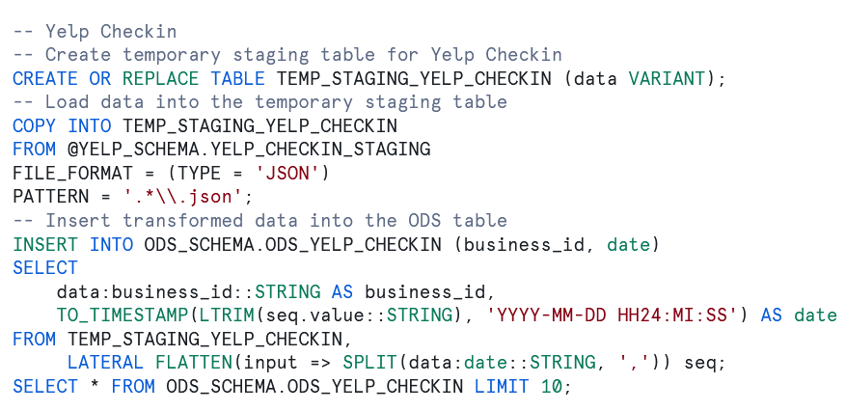
SQL Staging to ODS Queries/json functions to transform data from json to multiple columns in ods

Slide 12
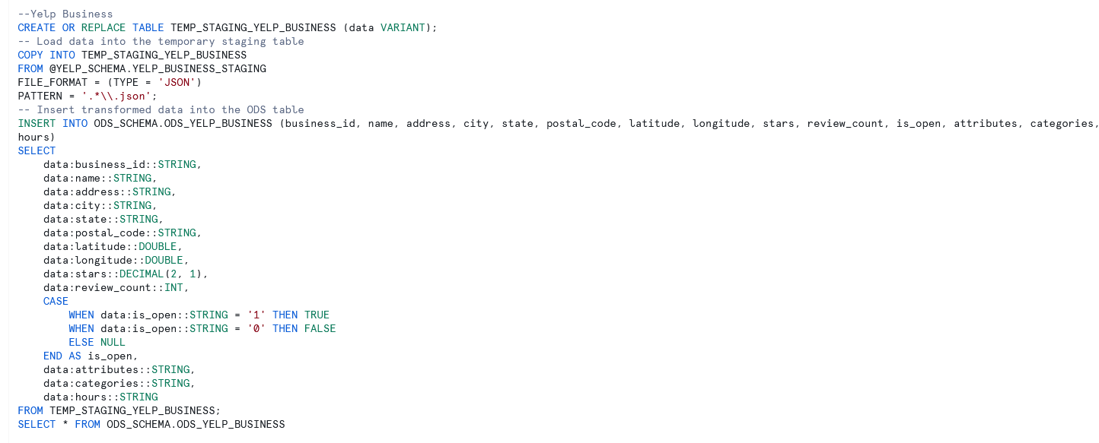
SQL Staging to ODS Queries/json functions to transform data from json to multiple columns in ods

Slide 13
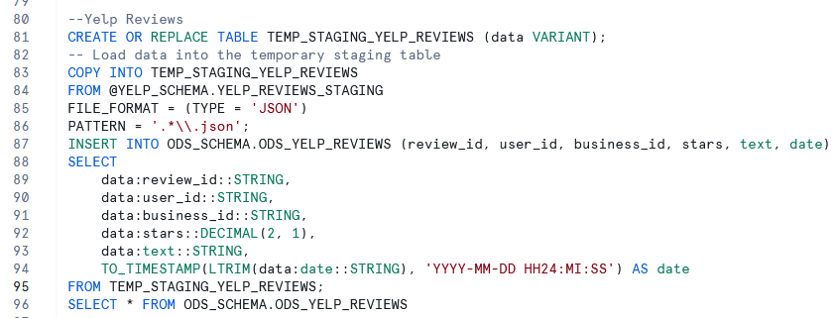
SQL Staging to ODS Queries/json functions to transform data from json to multiple columns in ods

Slide 14
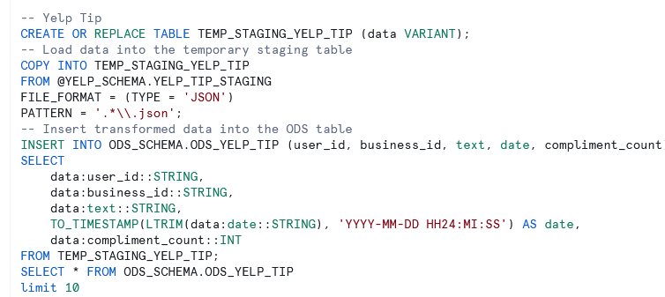
SQL Staging to ODS Queries/json functions to transform data from json to multiple columns in ods

Slide 15
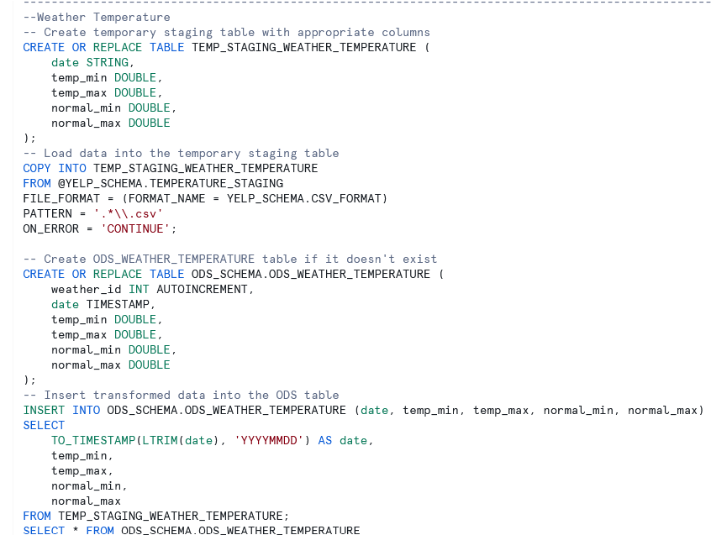
SQL Staging to ODS Queries/json functions to transform data from json to multiple columns in ods

Slide 16
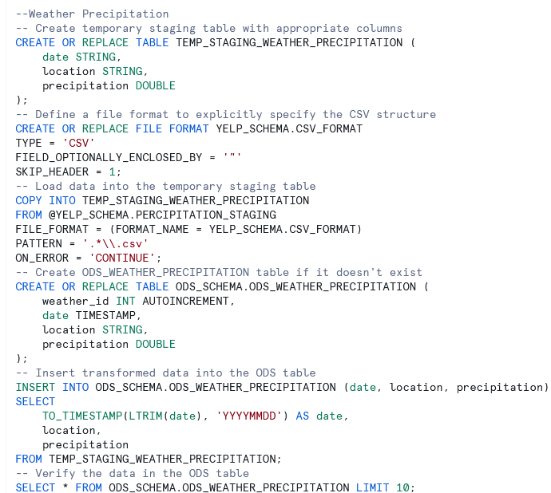
SQL Staging to ODS Queries/json functions to transform data from json to multiple columns in ods

Slide 17
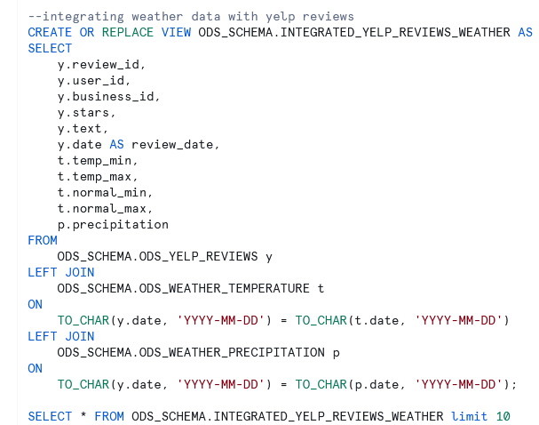
SQL Query to integrate climate and yelp data
Notes:
--integrating weather data with yelp reviews
CREATE OR REPLACE VIEW ODS_SCHEMA.INTEGRATED_YELP_REVIEWS_WEATHER AS
SELECT
y.review_id,
y.user_id,
y.business_id,
y.stars,
y.text,
y.date AS review_date,
t.temp_min,
t.temp_max,
t.normal_min,
t.normal_max,
p.precipitation
FROM
ODS_SCHEMA.ODS_YELP_REVIEWS y
LEFT JOIN
ODS_SCHEMA.ODS_WEATHER_TEMPERATURE t
ON
TO_CHAR(y.date, 'YYYY-MM-DD') = TO_CHAR(t.date, 'YYYY-MM-DD')
LEFT JOIN
ODS_SCHEMA.ODS_WEATHER_PRECIPITATION p
ON
TO_CHAR(y.date, 'YYYY-MM-DD') = TO_CHAR(p.date, 'YYYY-MM-DD');
SELECT * FROM ODS_SCHEMA.INTEGRATED_YELP_REVIEWS_WEATHER limit 10

Slide 18
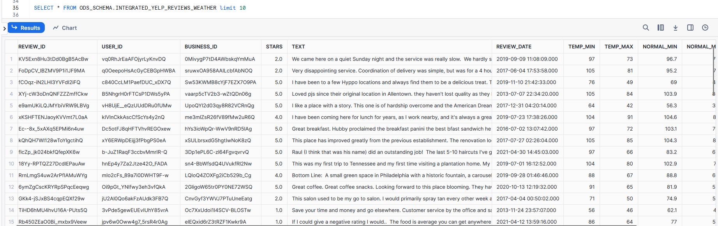
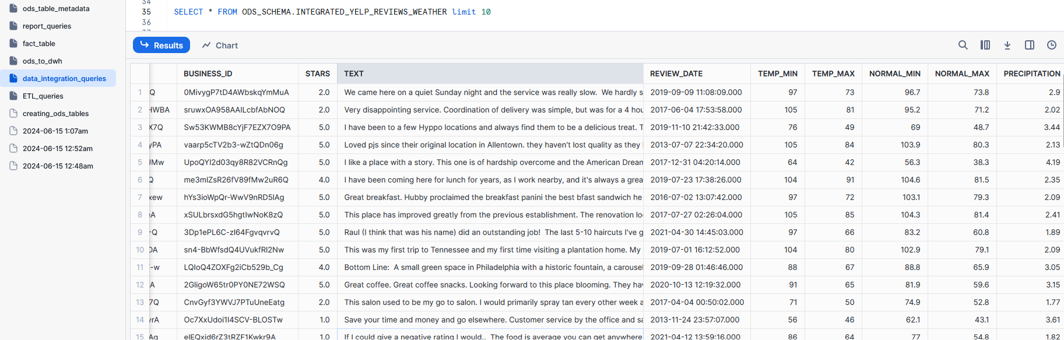
SQL Query to integrate climate and yelp data results

Slide 19
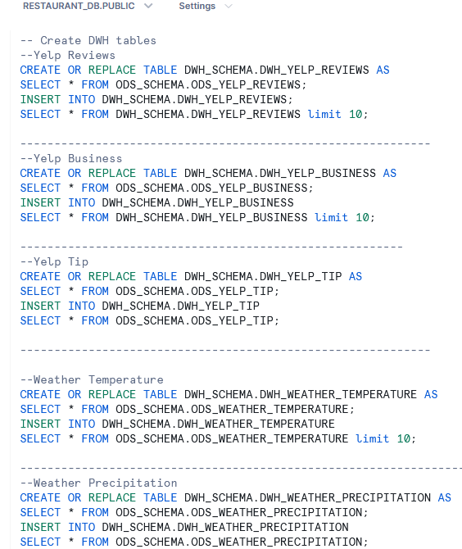
SQL Queries code to move data from ODS to DWH
Queries in the text section below
Notes:
-- Create DWH tables
--Yelp Reviews
CREATE OR REPLACE TABLE DWH_SCHEMA.DWH_YELP_REVIEWS AS
SELECT * FROM ODS_SCHEMA.ODS_YELP_REVIEWS;
INSERT INTO DWH_SCHEMA.DWH_YELP_REVIEWS;
SELECT * FROM DWH_SCHEMA.DWH_YELP_REVIEWS limit 10;
------------------------------------------------------------
--Yelp Business
CREATE OR REPLACE TABLE DWH_SCHEMA.DWH_YELP_BUSINESS AS
SELECT * FROM ODS_SCHEMA.ODS_YELP_BUSINESS;
INSERT INTO DWH_SCHEMA.DWH_YELP_BUSINESS
SELECT * FROM DWH_SCHEMA.DWH_YELP_BUSINESS limit 10;
--------------------------------------------------------
--Yelp Tip
CREATE OR REPLACE TABLE DWH_SCHEMA.DWH_YELP_TIP AS
SELECT * FROM ODS_SCHEMA.ODS_YELP_TIP;
INSERT INTO DWH_SCHEMA.DWH_YELP_TIP
SELECT * FROM ODS_SCHEMA.ODS_YELP_TIP;
------------------------------------------------------------
--Weather Temperature
CREATE OR REPLACE TABLE DWH_SCHEMA.DWH_WEATHER_TEMPERATURE AS
SELECT * FROM ODS_SCHEMA.ODS_WEATHER_TEMPERATURE;
INSERT INTO DWH_SCHEMA.DWH_WEATHER_TEMPERATURE
SELECT * FROM ODS_SCHEMA.ODS_WEATHER_TEMPERATURE limit 10;
-----------------------------------------------------------------
--Weather Precipitation
CREATE OR REPLACE TABLE DWH_SCHEMA.DWH_WEATHER_PRECIPITATION AS
SELECT * FROM ODS_SCHEMA.ODS_WEATHER_PRECIPITATION;
INSERT INTO DWH_SCHEMA.DWH_WEATHER_PRECIPITATION
SELECT * FROM ODS_SCHEMA.ODS_WEATHER_PRECIPITATION;

Slide 20
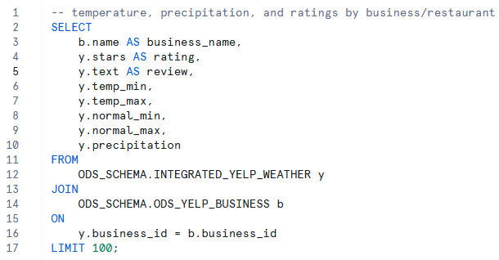
SQL Queries that reports business name, temp, precip, and ratings
Notes:
SELECT
b.name AS business_name,
y.stars AS rating,
y.text AS review,
y.temp_min,
y.temp_max,
y.normal_min,
y.normal_max,
y.precipitation
FROM
ODS_SCHEMA.INTEGRATED_YELP_WEATHER y
JOIN
ODS_SCHEMA.ODS_YELP_BUSINESS b
ON
y.business_id = b.business_id
LIMIT 50;

