Slide 1
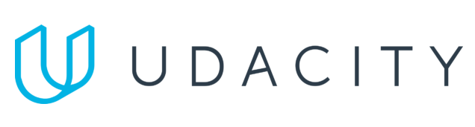
Data Lake Value Proposition
Medical Data Processing Company
Richard A.
Udacity IPS Version 1.0

Slide 2
What is a Data Lake
Executive summary
A data lake is a centralized repository that allows you to scale your data enterprise to store structured, semi-structured and unstructured data.
It enables raw data storage in its native format until it is needed, then it goes through cleaning, preprocessing and transformation so it is ready to be saved and used by stakeholders and end users.
Data lakes also facilitate scalable, cost effective data management solutions allowing for optimized analytics and dashboarding.
This architecture supports various types of analytics, including big data processing, real-time analytics, and machine learning.

Slide 3
Components of Data Lake
Ingestion Layer: Apache Nifi, Apache Kafka
Storage Layer: Apache HDFS, Apache Cassandra
Orchestration Layer: Apache Airflow
Processing Layer: Apache Spark
Serving Layer: Apache Presto, Tableau, Apache Druid

Slide 4
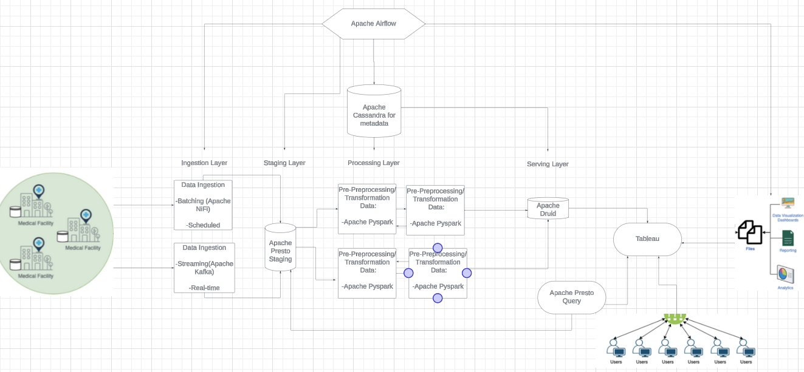
Data Lake Architecture Diagram

Slide 5
Data Warehouse
Data Lake
Specializes in structured data.
High query performance
Supports ACID (Atomicity, Consistency, Isolation, Durability)
Ideal for BI, OLAP, OLTP, dashboards, visualizations.
Handling large volumes of raw, structured,unstructured/semi-structured data.
Supports eventual consistency model.
High availability and high throughput.
Can scale much more efficiently.
Ideal for data science, machine learning and big data analytics.
Udacity IPS Ver. 1 2/2020
Notes:
< Think about: Research if a Data Warehouse can still be a viable solution instead of a Data Lake? What is the difference between both? >
< You will complete this information on the next slide. Please provide at least 3 items for each. No need to add any content on this slide >
< Video tip: While presenting the differences, elaborate why a Data Lake solution makes more sense for Medical Data Processing Company over a Data Warehouse approach? How the Data Lake / Big Data characteristics different from Data warehouse>

Slide 6
Business Value of Data Lake
Allows the company to implement a fault tolerant multi-node solution mitigating system downtime, distributing the load between different nodes, while increasing operations efficiency.
Scales in storage, and processing capability of the data system and removes the need to only process data at night.
Provides cost effective solutions for storage.
Data lakes can integrate data from various sources and formats under a unified data repository.
Can also be configured with robust data governance frameworks ensuring data quality, security and compliance with law regulations.

Slide 7
THANK YOU
Udacity IPS Version 1.0

