Slide 1

Spotify Collab Playlist
Pod 22
Sean Stevens, Eyoel Feleke, Xiqi Fei, Kusch Qin

Slide 2
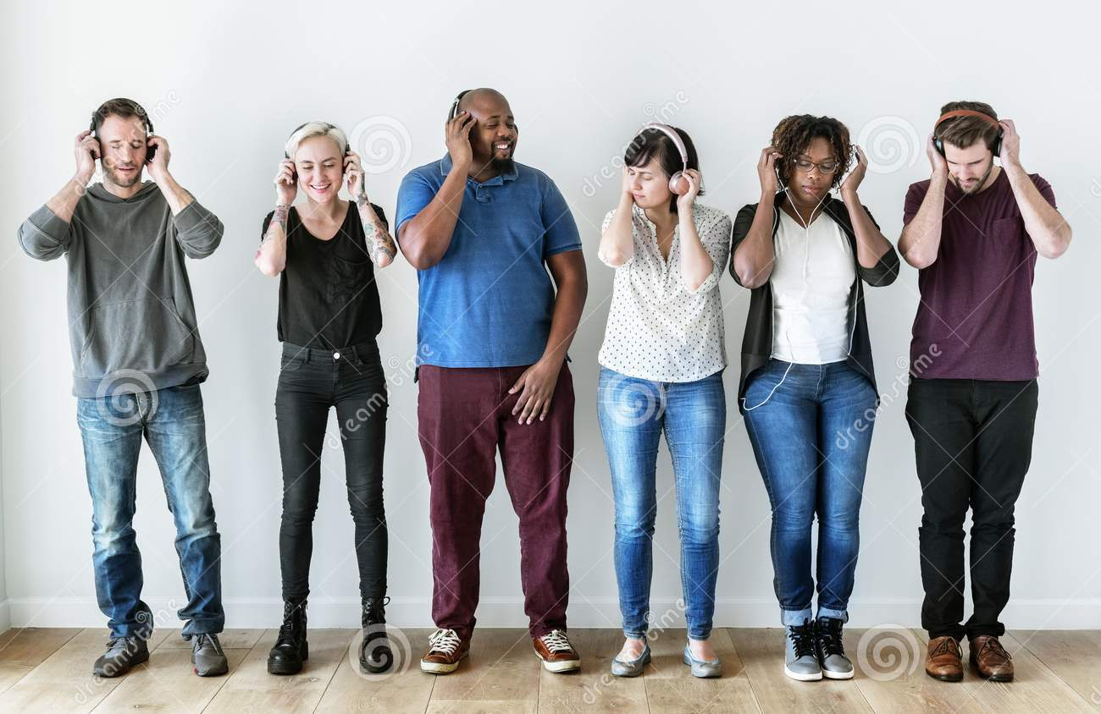
Introduction
Spotify-Collab-Playlist
Play music that everybody likes!
Notes:
Partying, road trip, hard to find a good playlist that everyone like the music

Slide 3

How it works?

Slide 4
Rationale
Create Playlist
Throw in tracks
Team members approval

Slide 5
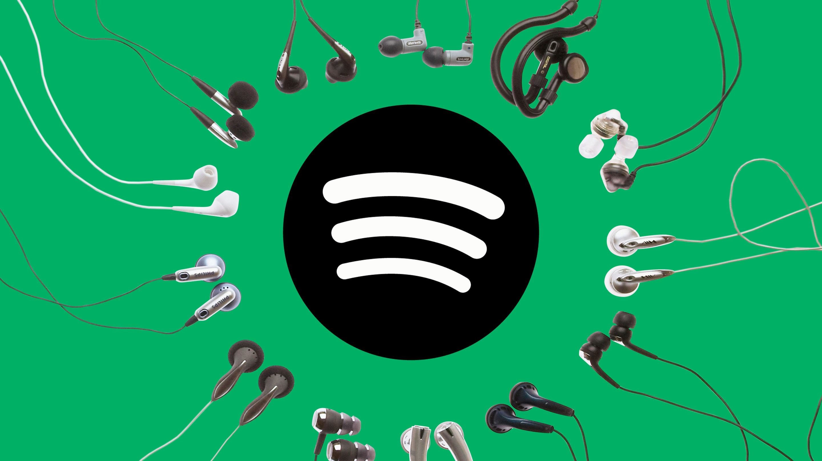
Live Demo!

Slide 6
Future works
Edit team members
Approval logic
Listen to music in the app

