Slide 1
Performance Portability in Practice
John Pennycook and Jason Sewall, Intel Corporation
Acknowledgements: Doug Jacobsen, Google Tom Deakin and Simon McIntosh-Smith, University of Bristol

Slide 2
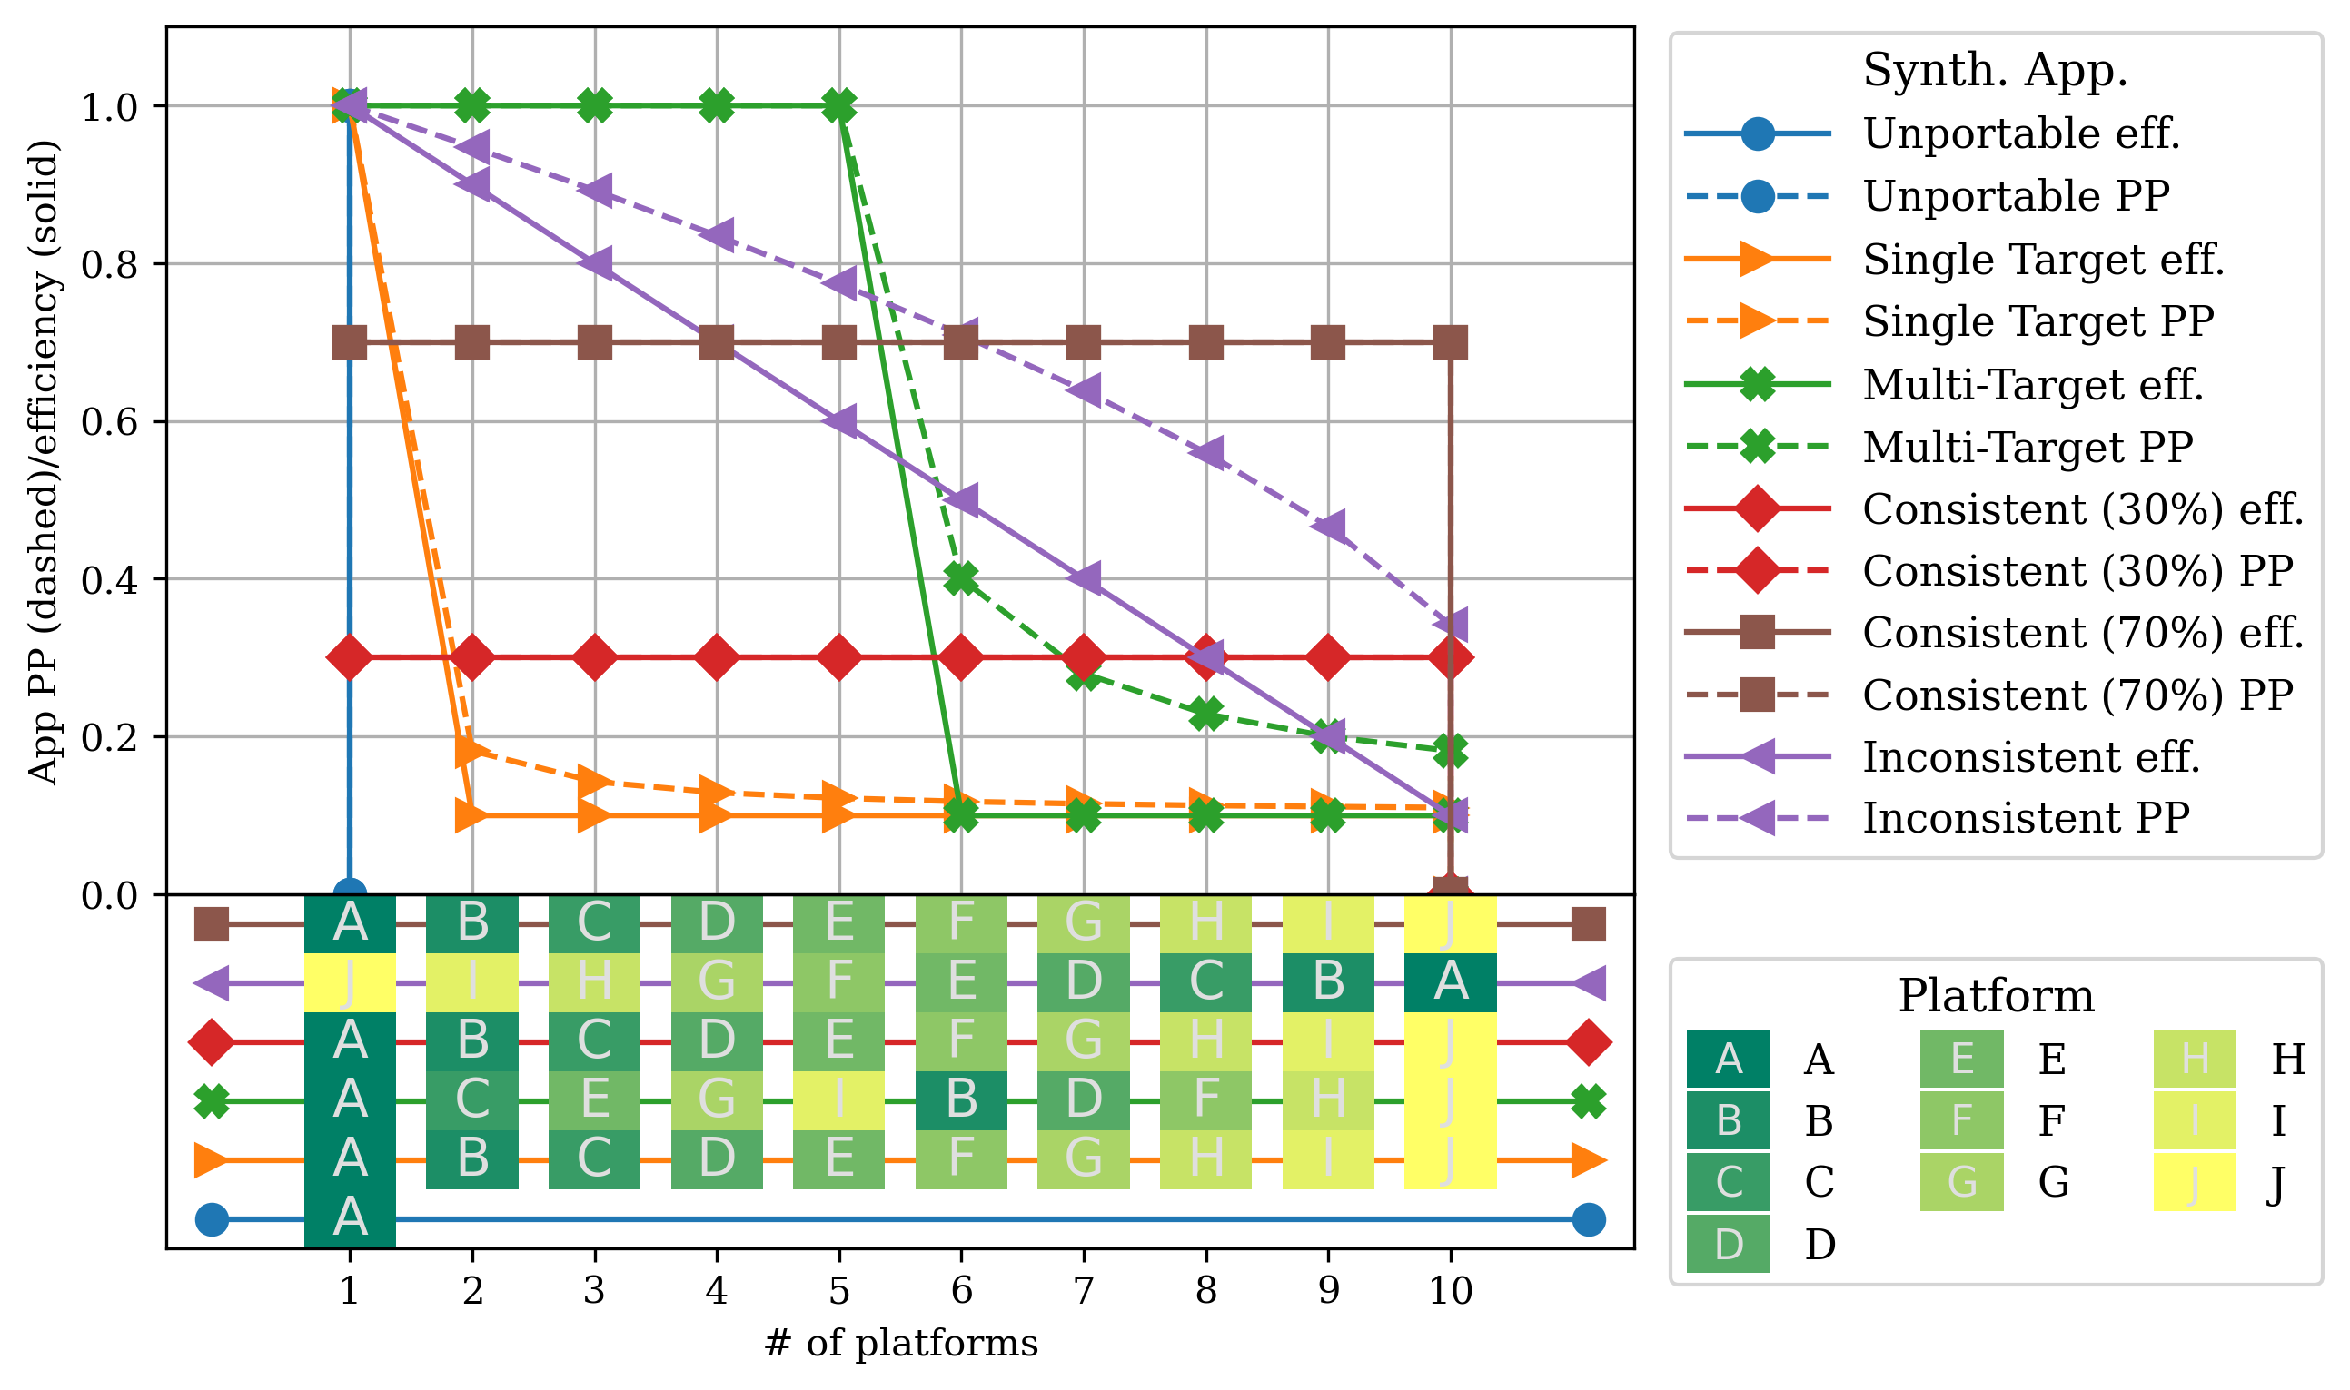
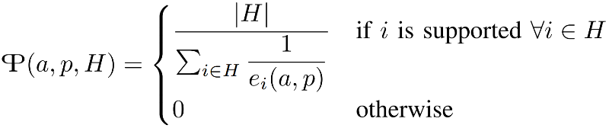
What is “Performance Portability”?
Enables objective comparisons of implementations, algorithms, etc
See our publications for more detail:
“Implications of a Metric for Performance Portability”
“Navigating Performance, Portability and Productivity”
“Revisiting a Metric for Performance Portability” (to appear in P3HPC 2021)
“A measurement of an application’s performance efficiency for a given problem that can be executed correctly on all platforms in a given set.”
An “efficiency cascade” plot, highlighting performance trends across platforms of interest. Plot your own using these scripts.
Notes:
Start with a few definitions: difficult to pin down the meaning of the words, so we turned to an objective measurement instead
Every time we say “Performance Portability” we mean “high performance everywhere”, ignoring what the code looks like

Slide 3
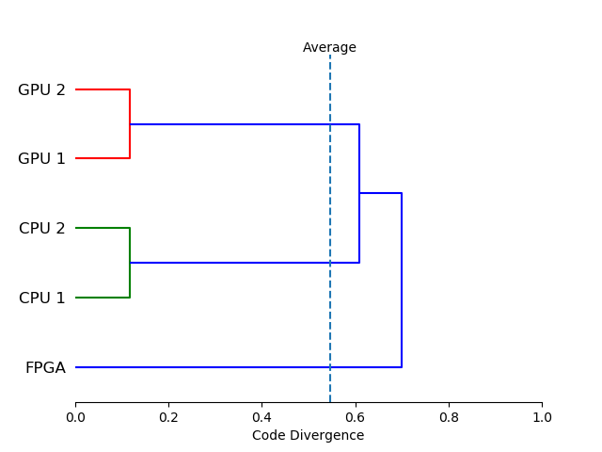


What About Productivity?
Per-platform code increases developer effort:
Initial development
Debugging
Maintenance
We measure this via “Code Divergence”:
Codebase 1
shared.cpp: void whereami() { #ifdef CPU printf(“CPU\n”); #else printf(“GPU\n”); #endif }
Codebase 2
cpu.cpp: void whereami() { printf(“CPU\n”); } gpu.cpp: void whereami() { printf(“GPU\n”); }
$$\frac{8 lines −6 shared lines}{8 lines}=0.25$$
$$\frac{8 lines −0 shared lines}{8 lines}=1.0$$
A dendrogram clustering platforms by “code divergence”. Plot your own using our Code Base Investigator tool.
Notes:
If seeking high levels of performance portability without any attention to productivity/effort, just use a “duct-tape” solution
Sometimes introducing platform-specific code is going to be unavoidable (or even desirable), but maintenance costs rise with each platform-specific branch you introduce
Not trying to argue that the C preprocessor is a good solution!

Slide 4
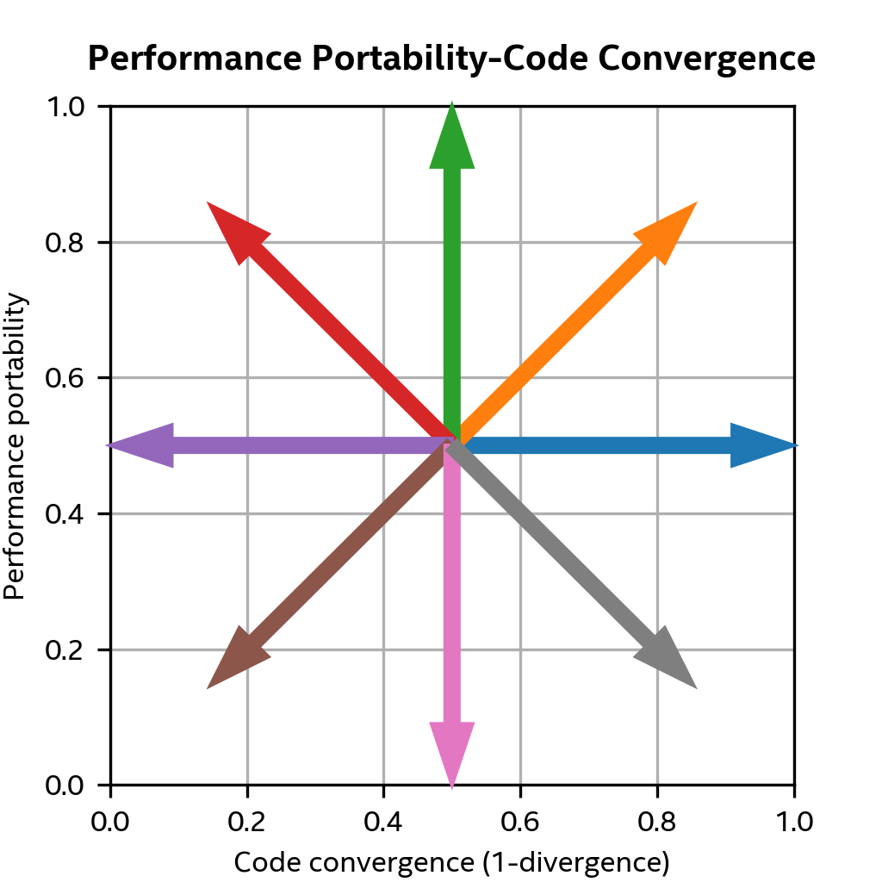
Setting Goals and Tracking Progress
Trade-offs abound:
Abstraction ⇒ Higher Convergence
Specialization ⇒ Lower Convergence
Optimization ⇒ Higher Performance
SYCL provides tools to help us manage these trade-offs
But we must set our own goals (and manage our expectations!)
Per-platform source, best perf.
Single source, best perf.
Optimization
Specialization
Abstraction
Regression
x-axis: Unportable

Slide 5
Specialization: Device Queries Lower Convergence, Higher Performance
Inspect where you’re running and dynamically adapt to the capabilities available.
sycl::queue q(sycl::default_selector{});
sycl::device d = q.get_device();
// Process input in the largest chunks we can allocate
uint64_t chunk_size = d.get_info<sycl::info::device::max_mem_alloc_size>();
// Prefer double precision if it's supported
if (d.has(sycl::aspect::fp64)) {
run<double>(chunk_size);
} else {
run<float>(chunk_size);
}
Many queries, e.g.: cache size, work-group and sub-group sizes, availability of scratchpad memory, atomics capabilities
Notes:
We can use query results in conjunction with C++ metaprogramming (e.g. templates) to keep code divergence low
In some cases we might not even need to specialize code: something like a work-group size is a runtime parameter to the kernel
Performance: adapt to where we’re running
Portability: don’t use features a device doesn’t support
Productivity: standard queries; don’t need to worry about using different low-level driver APIs

Slide 6
Abstraction: Device Selectors Higher Convergence, Higher Performance
Select the best device for your application
struct MySelector : sycl::device_selector {
// SYCL 2020 allows this to be a lambda
int operator()(const sycl::device& d) const {
int score = 0;
if (not d.has(sycl::aspect::fp64)) {
score = -1;
} // Return negative if required features are not supported
else if (d.has(sycl::aspect::gpu)) {
score = 1;
} // Return a higher score for GPU devices
std::cout << "Scoring: " << d.get_info<sycl::info::device::name>() << " " << score << std::endl;
return score;
}
};
int main() {
// Create a queue associated with the selected device
sycl::queue q(MySelector{});
std::cout << "Selected: " << q.get_device().get_info<sycl::info::device::name>() << std::endl;
...
Notes:
Builds on queries
Performance: can write a selector to score based on optimizations you want to employ using any device queries (e.g. size of local memory, availability of atomics)
Portability: can write an application-specific device selector that will pick the device where your code will run.
Productivity: much quicker to write a standard scoring function than something which steps over all platforms, devices, etc

Slide 7
Abstraction: Subdevices (e.g. NUMA) Higher Convergence, Higher Performance
using namespace sycl::info; constexpr auto by_affinity_domain = partition_property::partition_by_affinity_domain; auto has_numa_domains = [=](sycl::device &d) { auto props = d.get_info<device::partition_properties>(); auto domains = d.get_info<device::partition_affinity_domains>(); bool by_affinity = std::find(props.begin(), props.end(), by_affinity_domain) != props.end(); bool by_numa = std::find(domains.begin(), domains.end(), partition_affinity_domain::numa) != domains.end(); return by_affinity && by_numa; }; // Try to split selected device into sub-devices along NUMA boundaries sycl::device root = sycl::device(sycl::default_selector{}); std::vector<sycl::device> devices; if (has_numa_domains(root)) { devices = root.create_sub_devices<by_affinity_domain>(partition_affinity_domain::numa); } else { devices = std::vector<sycl::device>{root}; } std::cout << "Split " << root.get_info<device::name>() << " into " << devices.size() << " NUMA domains." << std::endl;
Notes:
Standard way to programmatically/procedurally query hardware configuration and split devices into sub-devices.
Performance: Provides greater control over NUMA behavior(s), scheduling to individual compute units within a device
Portability: All code after this point can be the same (programmed to a single device from the vector, or the whole vector)
Productivity: Trade-off with perf. here (i.e. more effort than ignoring NUMA) but low divergence

Slide 8
Specialization: Specialization Constants Lower Convergence, Higher Performance
q.submit([&](auto &h) {
h.template set_specialization_constant<BLOCKSIZE>(blocksize);
h.parallel_for(nd_range<2>({(size_t)N,(size_t)M},{blocksize,blocksize}),
[=](nd_item<2> it, kernel_handler kh) {
const auto BS = kh.template get_specialization_constant<BLOCKSIZE>();
auto id = it.get_group().get_id();
const int i = id[1]*BS;
const int j = id[0]*BS;
if(BS == 4) {
do_block_static<4>(it, i, j, M, N, K, C, A, B);
}
else if(BS == 8) {
do_block_static<8>(it, i, j, M, N, K, C, A, B);
}
else if(BS == 16) {
do_block_static<16>(it, i, j, M, N, K, C, A, B);
}
else {
do_block_dyn(BS, it, i, j, M, N, K, C, A, B);
}
});
}).wait();
Specialization constants are runtime values known to be constant during Just-in-Time (JIT) compilation
Notes:
Performance: Eliminate branches, control unroll factors, block for cache based on runtime parameters
Portability: Dynamically recompile kernels for different architectures
Productivity: Admit there’s a hit here; not compatible with template parameters, etc, because it’s not really known at compile-time ☹

Slide 9
Abstraction: Group Algorithms Higher Convergence, Higher Performance
Syntax and semantics based on ISO C++ algorithms
any/all/none_of, shift_left/right, reduce, exclusive/inclusive_scan
SYCL specific: permute, select
Available for work-groups and sub-groups
// Joint algorithms divide an explicit range across work-items in a group // e.g. reduce elements held in global memory, described by [first, last) iterators auto sum = sycl::joint_reduce(it.get_group(), first, last, sycl::plus<>()); // Algorithms with group prefix/suffix operate on implicit range (the group itself) // e.g. reduce x values held in private memory of each work-item auto sum = sycl::reduce_over_group(it.get_group(), x, sycl::plus<>());
Notes:
Performance: Implementation provides highly tuned implementations of algorithms at different levels of hardware hierarchy (e.g. across threads, across SIMD)
Portability: All implementations provide them!
Productivity: Simple to get going, hopefully a familiar interface to standard C++

Slide 10
Specialization: invoke_simd (DPC++ Extension) Lower Convergence, Higher Performance
Exploring ways to provide interoperability between SPMD and SIMD programming
int popcount(sycl::ext::oneapi::experimental::simd_mask<bool, 8> mask) {
// Utilize SIMD APIs with no SPMD equivalent, e.g., popcount
return sycl::ext::oneapi::experimental::popcount(mask);
}
...
q.parallel_for(sycl::nd_range<1>{N},
sycl::nd_item<1> it) [[sycl::reqd_sub_group_size(8)]] {
// Express algorithm in SPMD where convenient
bool cond = (it.get_local_id() % 2);
// Pass control to explicitly vectorized SIMD function
sycl::sub_group sg = it.get_sub_group();
int ct = sycl::ext::oneapi::experimental::invoke_simd(sg, popcount, cond);
// Resume SPMD coding
...
}
Draft extension at https://github.com/intel/llvm/blob/sycl/sycl/doc/extensions/InvokeSIMD/InvokeSIMD.asciidoc
Notes:
popcount() used as an example here of a function not (yet) exposed to SPMD in SYCL. Over time we hope there will be more sufficient SPMD abstractions to cover things, but SIMD coding remains convenient for some algorithms
Call attention to relationship between reqd_sub_group_size and the SIMD size assumed by invoke
Use of high-level SIMD interface, based on proposed interface for C++, should reduce the need for platform-specific intrinsics

Slide 11
Summary and Call to Action
SYCL exposes many features to help us achieve our desired balance of performance, portability and productivity
Achieving high levels of performance (portability) may require non-trivial effort; what is “acceptable” effort is subjective
Help us improve SYCL and implementations:
SYCL Specification: https://github.com/KhronosGroup/SYCL-Docs
DPC++: https://github.com/intel/llvm
hipSYCL: https://github.com/illuhad/hipSYCL
Codeplay Proposals: https://github.com/codeplaysoftware/standards-proposals
Notes:
Achieving high levels of performance portability is not automatic
Every developer needs to look at their goals and make a plan for P3: our tools and metrics can help
If you write code and it is slower than you expected, or there’s a common pattern you find yourself using to improve portability, let us know!

