Slide 1
Can FPGAs accelerate your workload?
Mike Kinsner, Principal Engineer @ Intel

Slide 2
1) Mapping an Algorithm to Hardware
A framework for thinking about Field Programmable Gate Arrays (FPGAs)

Slide 3
Data Flow Graph: The Core of Modern Compilers
for (int i=1; i < 10; ++i) {
A[i] += B[i-1] * 5;
}
load
load
5
store

Slide 4
Data Flow Graph: The Core of Modern Compilers
for (int i=1; i < 10; ++i) {
A[i] += B[i-1] * 5;
}
load
load
5
store
Hardware?

Slide 5
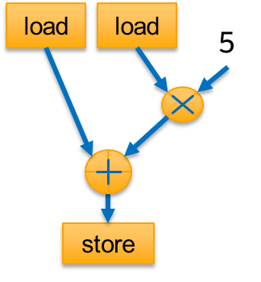
Executing in Silicon: Two key options
Option 1:
Instruction set architecture (ISA) machine
Option 2:
Materialize data flow graph directly on reconfigurable spatial hardware
for (int i=1; i < 10; ++i) {
A[i] += B[i-1] * 5;
}
Register file
Data memory
Instruction memory
Hardware with configurable spatial “regions”
load
load
5
IP
store
ALU
Execute consecutive instructions on same hardware via time multiplexing
Execute instructions on different hardware by specializing device regions in pipeline

Slide 6
Many Architectural Tradeoffs
Instruction Set Architecture
Spatial Architecture
Materialize data flow graph directly on reconfigurable spatial hardware
for (int i=1; i < 10; ++i) {
A[i] += B[i-1] * 5;
}
Register file
Data memory
Instruction memory
Hardware with configurable spatial “regions”
IP
load
load
5
store
ALU
+ Easy to program
+ General purpose at runtime
- Not all hardware may be used every clock cycle
+ Excellent Perf, Perf/Watt from specialization
- Historically inaccessible by SW developers
- Data path not typically runtime context switched

Slide 7

Think of as a Reconfigurable Custom Chip
Spatial Architecture
Fixed Spatial (e.g. ASIC)
Reconfigurable Spatial (e.g. FPGA)
load
load
5
Register file
Data memory
Instruction memory
store
IP
Think of FPGA as able to implement what you would build as a custom data path on a dedicated chip/ASIC!
(there is an overhead cost to FPGA reconfigurability vs ASIC, but much less expensive in low/medium volumes and reconfigurable)
ALU

Slide 8
2) Field Programmable Gate Arrays (FPGAs)

Slide 9
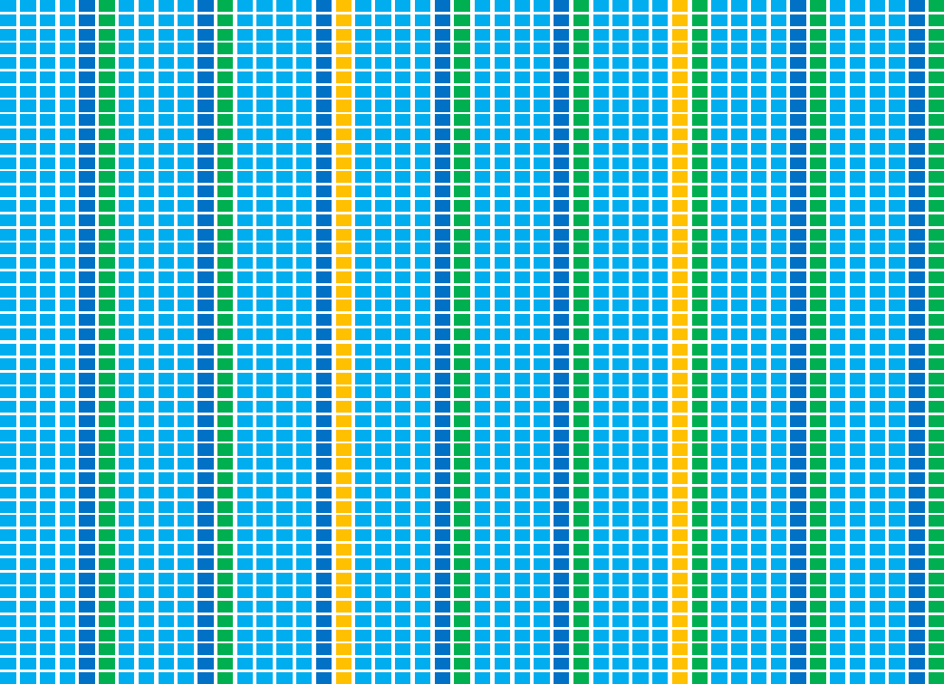
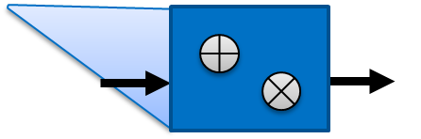
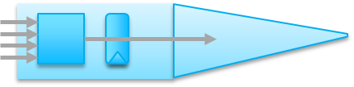
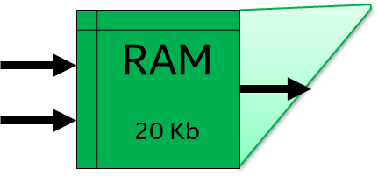
What is a Modern FPGA?
Massive array of small processing units
1-bit ALUs (~millions)
Dual-ported memories (~ten thousand)
Floating point MAC (~thousands)
Connected by mesh of programmable wires
Sitting inside a ring of high-speed I/O
With an optional embedded processor
Common within infrastructure hardware
Can buy on PCIe cards ready to go today
Numerics/
DSPs
Lookup
tables
RAMs

Slide 10
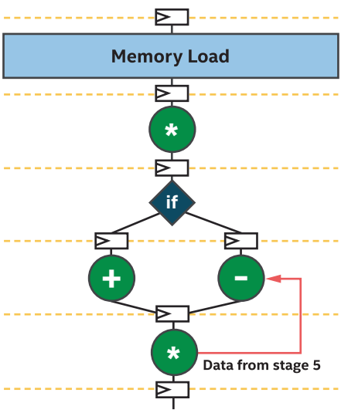
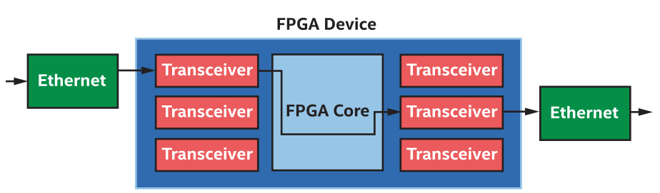
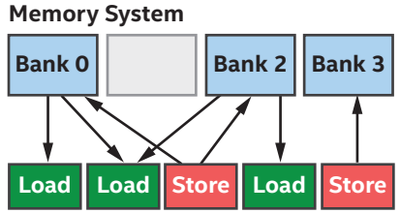
FPGA Value
Spatial architecture – many data flow algorithms map well
Data dependences across parallel work
Streaming and graph processing patterns
Enables some algorithms, makes others tractable to express
Rich I/O
Network, memory, custom interfaces and protocols
Very low + deterministic latencies
Large distributed on-chip memory BW
Custom topologies tuned to algorithm

Slide 11
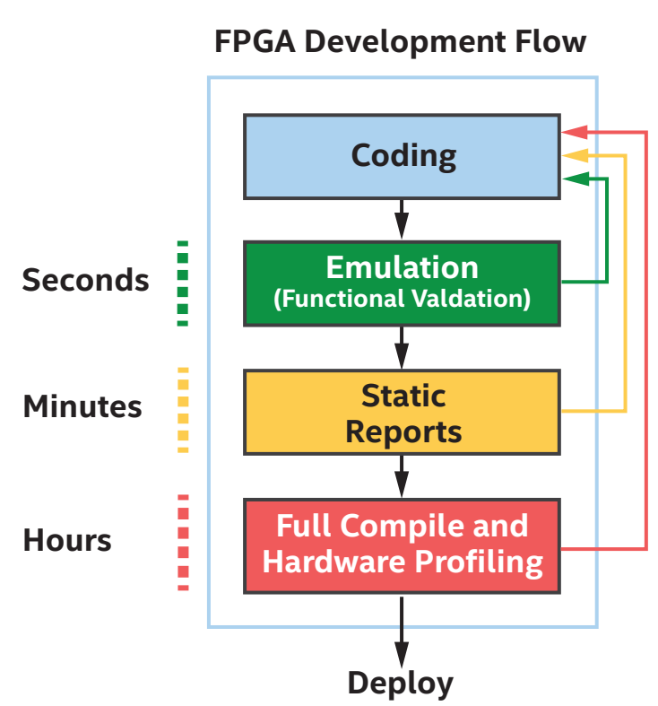
Development Flows
Compile times to hardware longer than SW developers are used to
Tools + reporting allow most development to be done without HW compilation

Slide 12
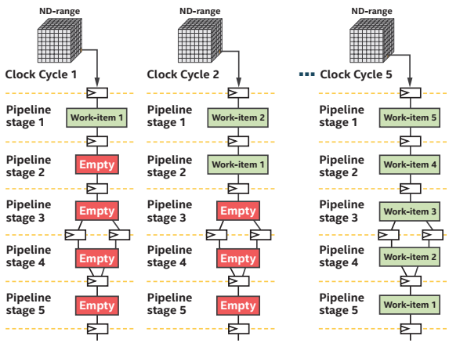
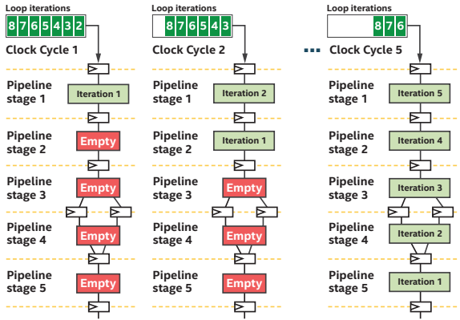
Deep Spatial Pipelines: Creating Parallelism
ND-range:
h.parallel_for({8,8,8}, [=](auto I) {
output[I] = in[I] * 5;
});
Loop:
h.single_task([=] {
for (int i=2; i < size; i++) {
A[i] = A[i-1] * foo(A[i-2]); …;
} });

Slide 13
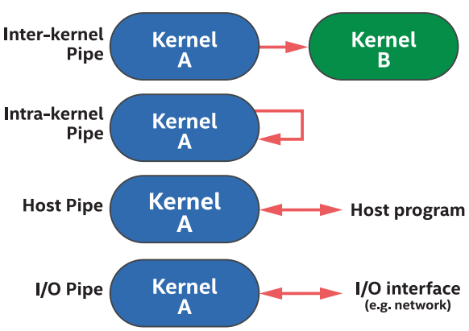
One FPGA-Specific Language Feature (of many)
constexpr int count = 1024; using my_pipe = pipe<class some_pipe, int>;
std::array<int, count> in_array;
for (int i=0; i < count; i++) { in_array[i] = i;} // Init
buffer B_in{ in_array }; // Init from std::array
buffer<int> B_out{ range{count} }; queue Q{ INTEL::fpga_emulator_selector{} };
// ND-range kernel
Q.submit([&](handler& h) {
auto A = accessor(B_in, h);
h.parallel_for(count, [=](auto idx) {
my_pipe::write( A[idx] );
}); });
// Single_task kernel
Q.submit([&](handler& h) {
auto A = accessor(B_out, h);
h.single_task([=]() {
for (int i=0; i < count; i++) {
A[i] = my_pipe::read();
}
}); });
Data flow pipes:
Combine task graph abstraction with data flow

