Slide 1
SYCL GPU Best Practices
Ben Ashbaugh (Intel)

Slide 2
Occupancy
Give the GPU enough work!

Slide 3
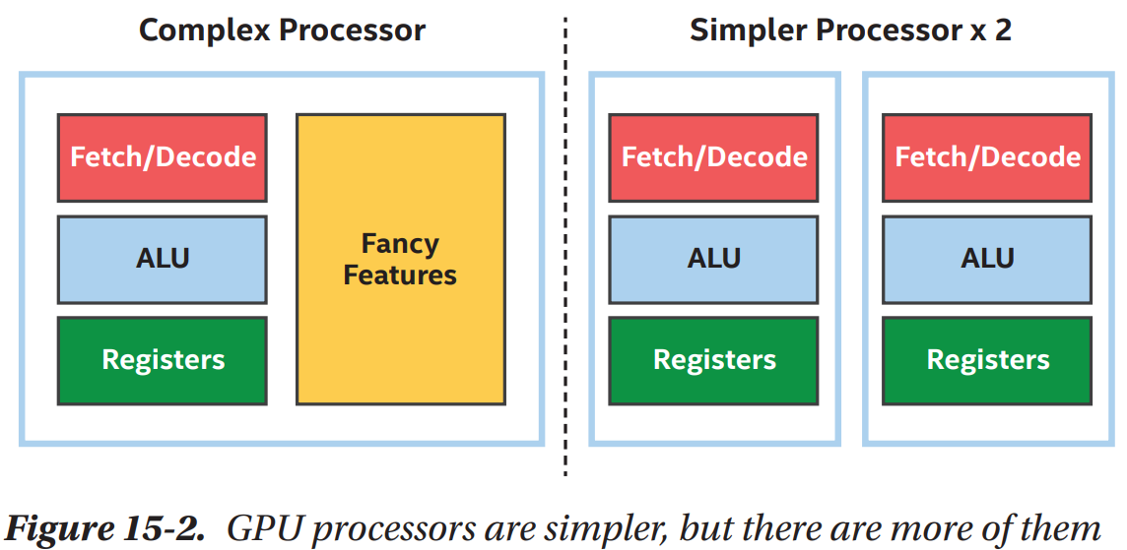
GPU != CPU
CPUs: Optimized for latency
Fewer fancier processors
GPUs: Optimized for throughput
Many simpler processors

Slide 4
GPUs need lots of data!
Graphics and games requires processing millions of pixels per second
GPUs prefer many work-items for general-purpose computation
Many work-items keeps GPU execution resources busy (occupied)!

Slide 5
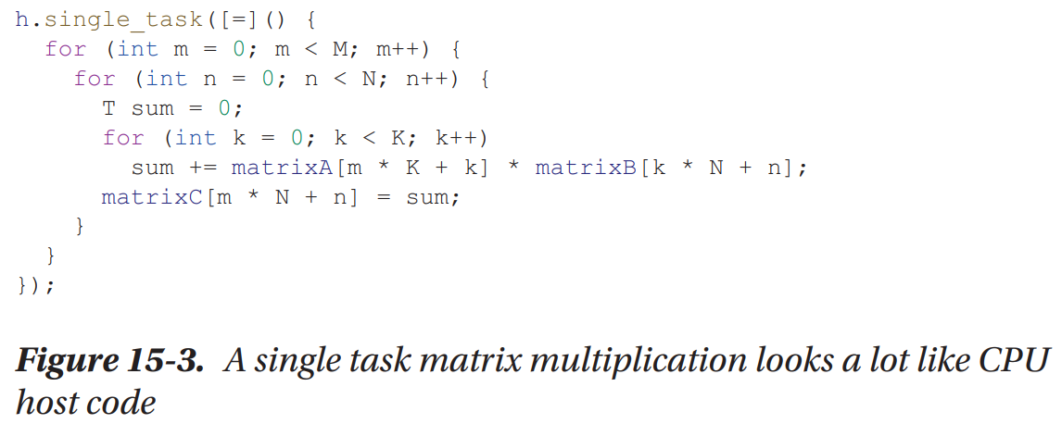
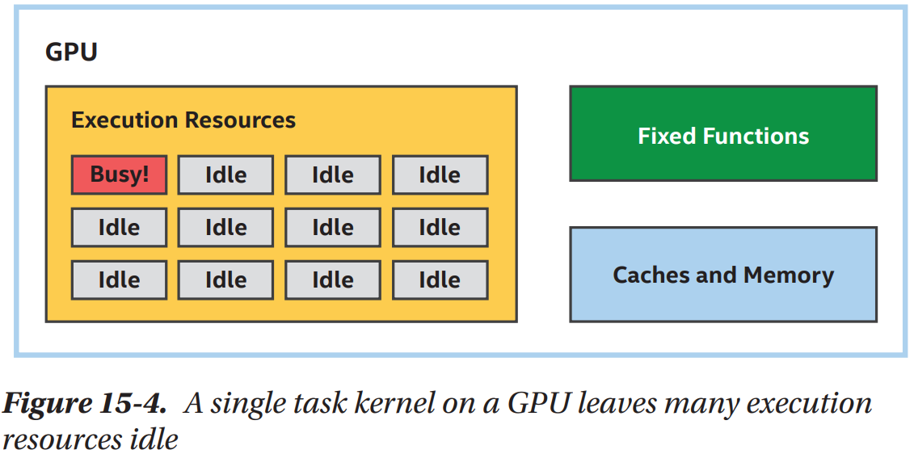
Bad: Not Enough Parallelism

Slide 6
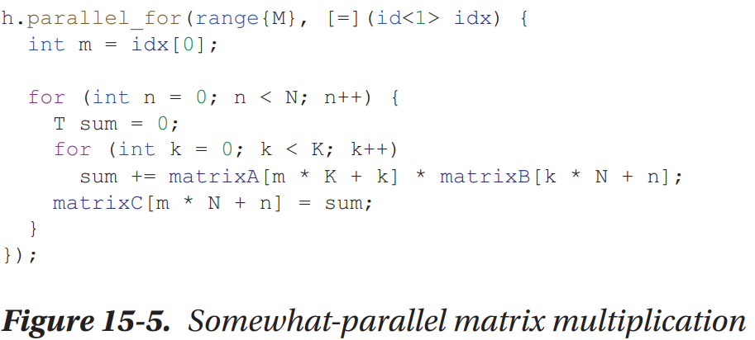
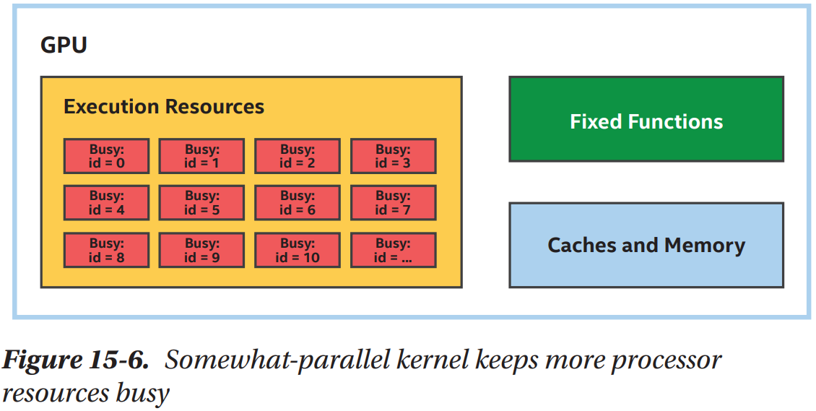
Better: More Parallelism

Slide 7
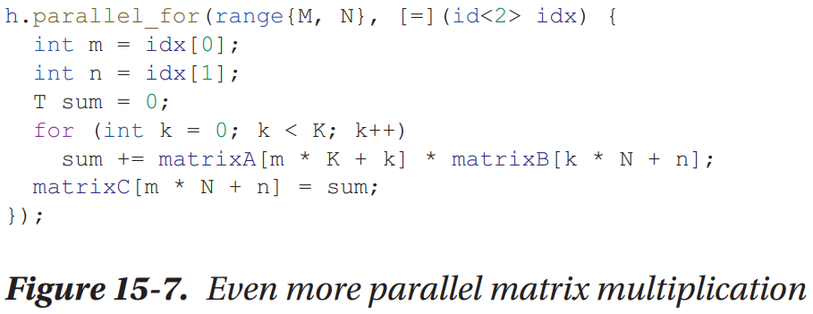
More Parallelism is Even Better!

Slide 8
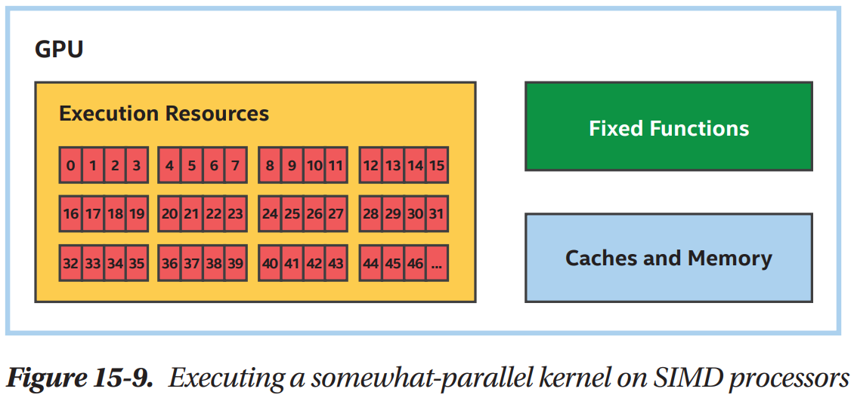
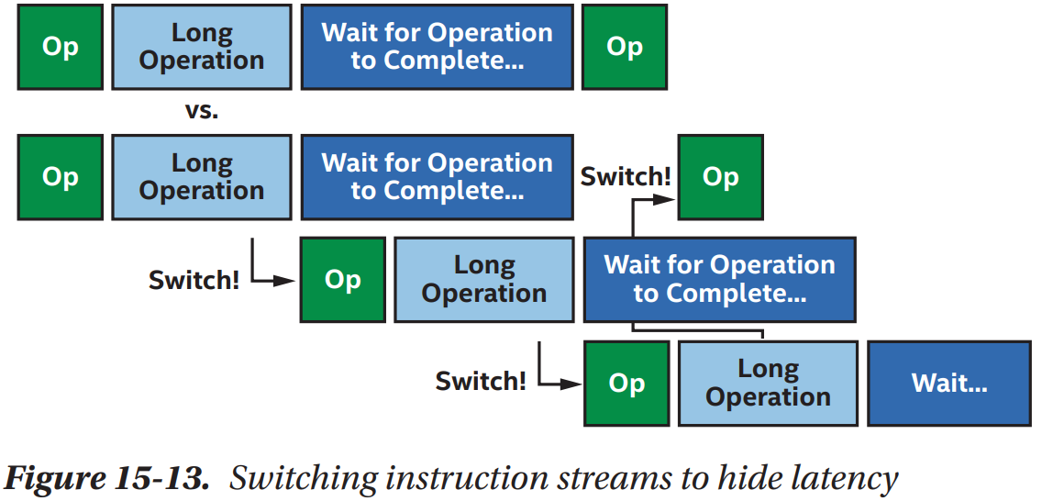
Why is so much parallelism important?
In addition to keeping processing elements busy…
Many GPU processors operate on multiple data elements simultaneously:
Many GPU processors use multiple threads to hide latency:

Slide 9
Memory
Keep the GPU fed and happy!

Slide 10
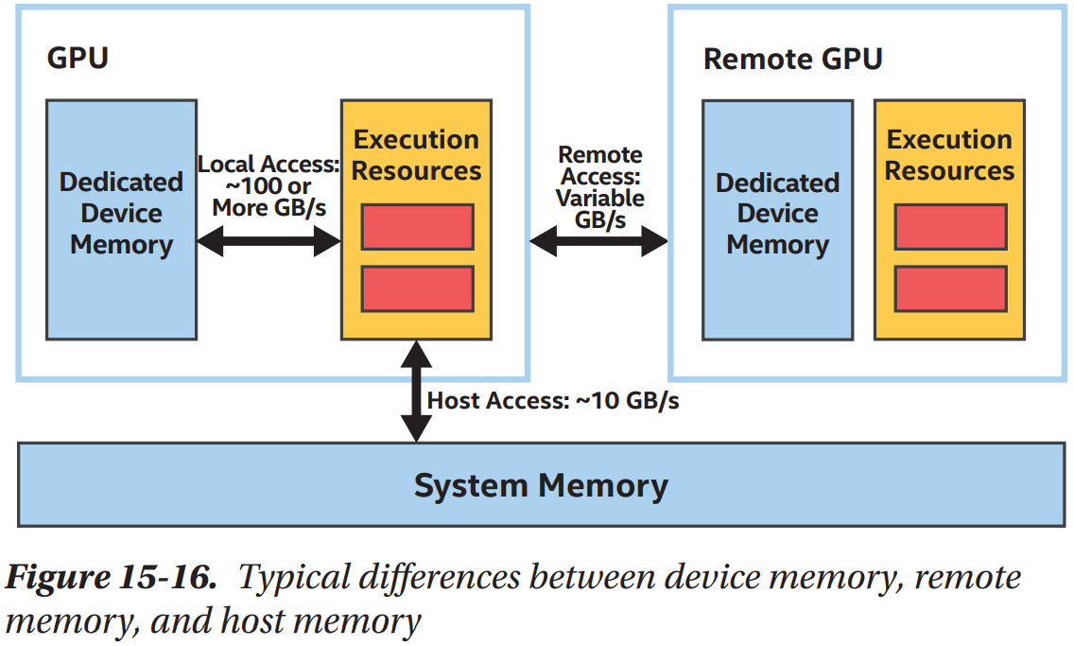
Beware the Costs of Offload
Moving data to or from a GPU is not free
Moving an algorithm to or from a GPU is not always profitable

Slide 11
Accessing Memory in Kernels
Maximize performance by maximizing locality
Typically means organizing data structures efficiently
Or, choosing the right dimension to parallelize
Not sure which dimension is best? Try both and profile!

Slide 12
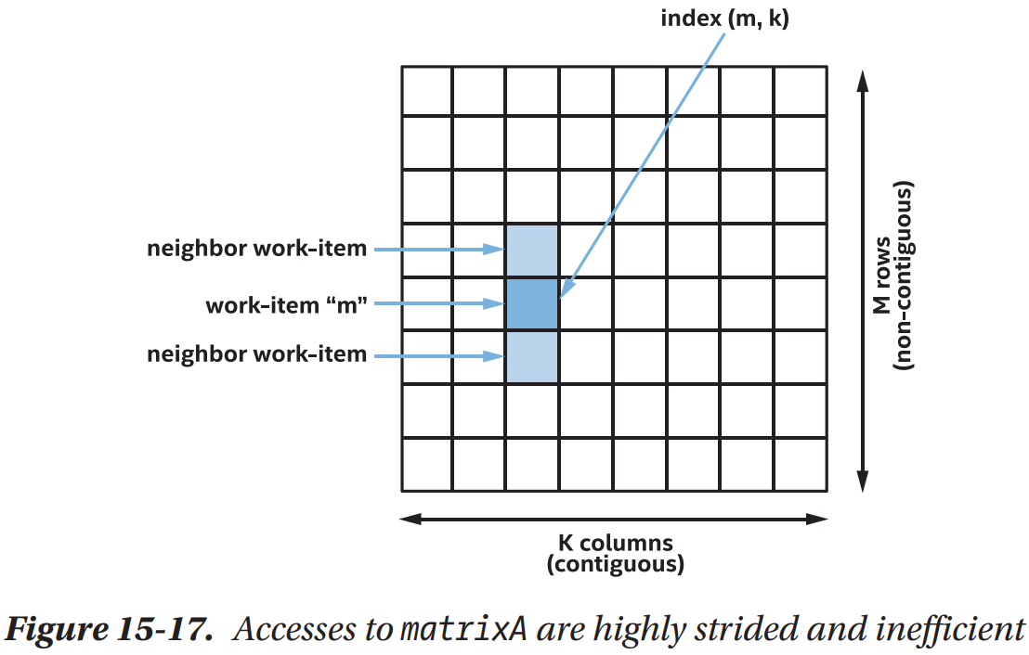
Bad: Strided Memory Accesses

Slide 13
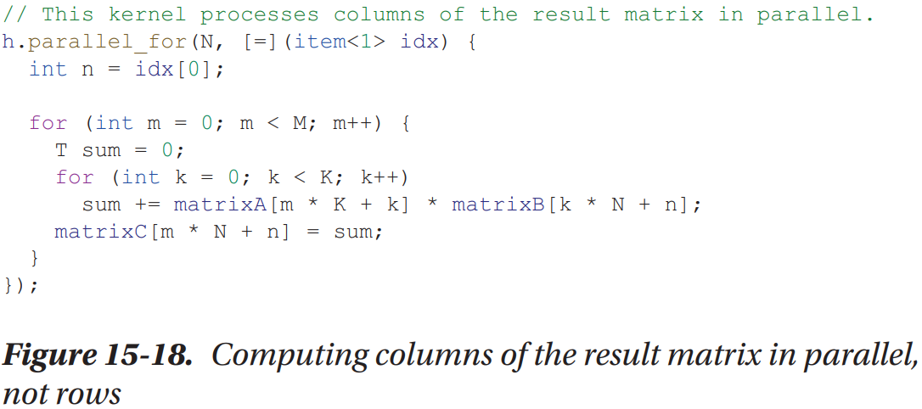
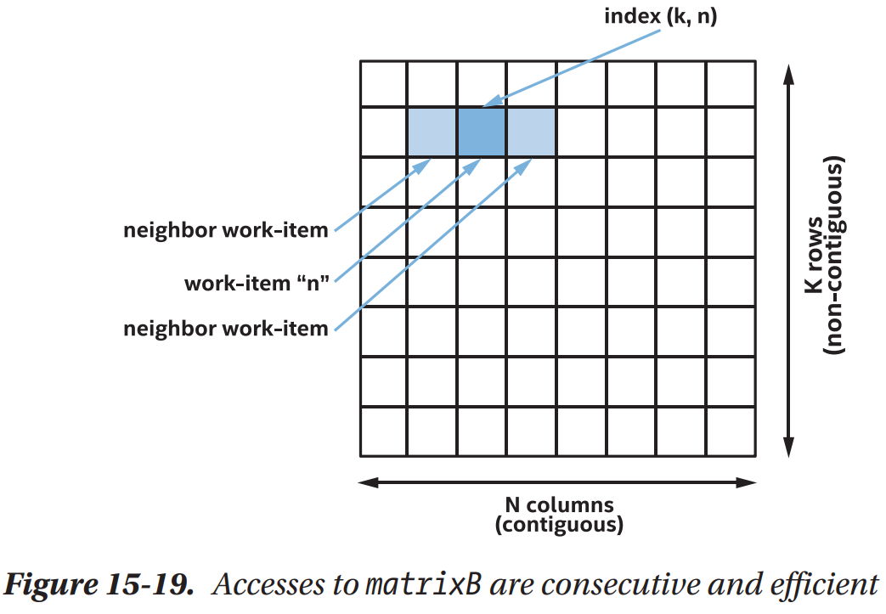
Good: Contiguous Memory Accesses

Slide 14
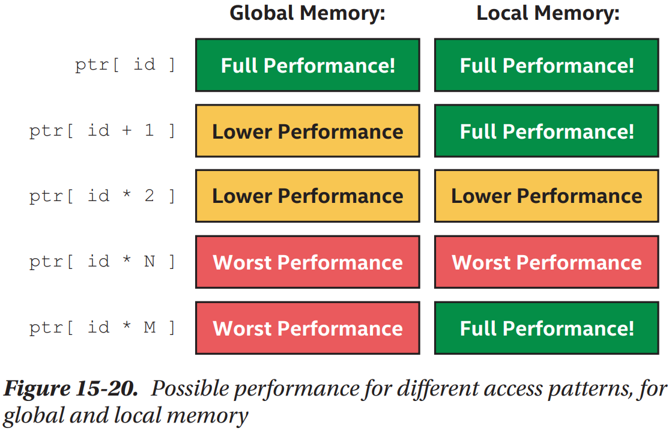
Local Memory
Beyond the scope of this talk
Know that local memory supports more access patterns efficiently than global memory!

Slide 15
Compute
Cater to GPU strengths!

Slide 16
Optimizing for GPU Compute
GPUs are traditionally optimized for graphics tasks
Typically, 32-bit floating-point math on vertices or pixels

Slide 17
GPU Compute Best Practices
Prefer smaller data types, 32-bits or less
Some 64-bit data types may be slow or unsupported (e.g., double)
Watch for 64-bit address arithmetic, use of 64-bit size_t
16-bit or smaller data types may be faster (e.g., half-precision fp16)
Use MAD or FMA, don’t disable contractions
Trade precision for performance using sycl::native math functions
Trade portability for performance using vendor-specific extensions
Special operations found in various devices, including GPUs: MAD = multiply-add; FMA = Fused multiply add There use can change the results slightly (typically more accurate, but also different); they are generally are much faster than using the individual instructions.

Slide 18
Summary and Recap

Slide 19

Summary
GPUs are massively parallel throughput devices
Important to give a GPU lots of work, thousands or millions of work-items
Optimize Memory First
Monitor and minimize data transfer costs to or from the GPU
Improve performance by rearrange data or computation for locality
Optimize Compute Next
Prefer smaller data types, trade precision for performance
Thank you!
ben.ashbaugh@intel.com, @bashbaug

