Slide 1

Encoder and Decoder using Morse Table

Slide 2
What to do during Encoding ?
Every character replaced by a series of ‘dots’ and ‘dashes’
In case of encryption, we take each letter or character (if not a space) from a word one at a time and match it with its corresponding morse table stored in data structure that we have chosen like Tree.

Slide 3
What to do during Decoding ?
In case of decoding, we
traverse till separator and compare with table.
Now we convert that code to character and append to outputted string.

Slide 4
Functionalities
Encode
Decode
Both For Strings
Also, for File
GUI based

Slide 5
Data Structures
Tree Data Structures: -
For storing Morse code for respective character
Node Structure:
Node pointer Dot
Node pointer Dash
Character
Arrays
For storing buffer data & morse code
Files
For storing Encoded code/Decoded characters

Slide 6
Usage
--help print the help list
-d [morse] Decode the morse code
-e [text] Encode the text in morse code
-g Launch the program with SDL2
-a Print the morse table
-f [filename] -d/-e Decode or Encode a file

Slide 7
Time Complexity Analysis
new_node() – O(1)
It returns tree node in constant time
add_char() – O(n) n- number of nodes
It takes linear time to add character to string.(For given program it will take constant
i.e., O(1) because we add only limited character in tree.)
initTree() – O(1)
This function calls add_char() for constant time
seekChar() – O(n) n- number of nodes
It search for character in tree
Decoding() – O(n) n- number of nodes
Takes linear time to decode

Slide 8

Continue..
Encoding() – O($n^{2})$
n- number of nodes
In while loop program first search for code of character till program reaches to end of string.
Destroy_Tree() – O(n)
n- number of nodes
Program erases dot and dash & at end tree becomes NULL
Split() – O(n)
n- number of nodes
This function splits strings into characters
MorseTable() – O(1)
This function takes constant time for printing morse table
Other functions –
Other functions runs till program ends.

Slide 9
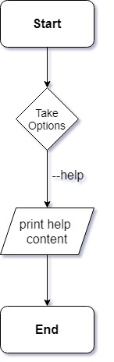
Control Flow: -
If user entered --help as option

Slide 10
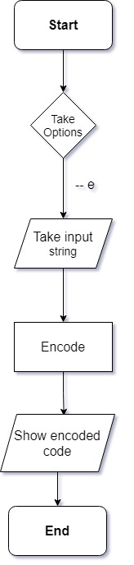
Control Flow: -
If user entered –e [text] as option

Slide 11
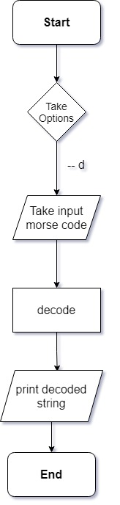
Control Flow: -
If user entered –d [text] as option

Slide 12
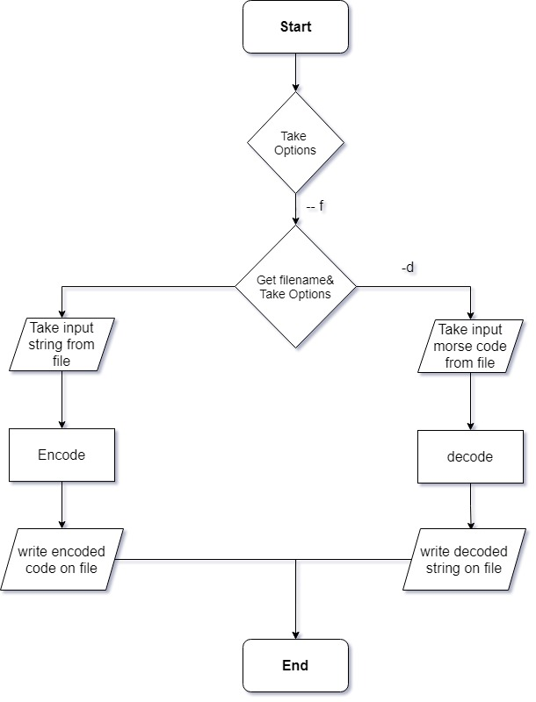
Control Flow: -
If user entered –f [filename] as option

Slide 13
For graphics of application
To improve user experience better added some graphics using SDL2 library(Simple DirectMedia layer)
Also, for images we used SDL_image and for font SDL_TTF.

Slide 14
Resources
https://en.wikipedia.org/wiki/Morse_code
https://www.libsdl.org/
https://www.libsdl.org/projects/SDL_image/
https://www.libsdl.org/projects/SDL_ttf/

Slide 15
Thank You!

