Slide 1
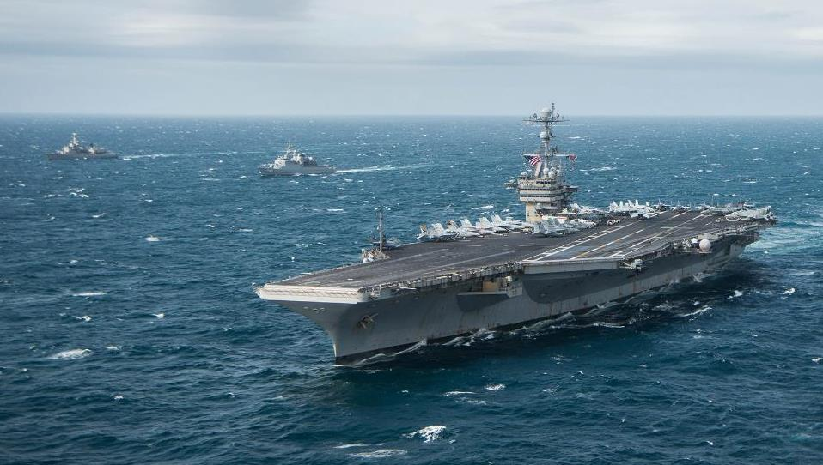
THE NAVY THE NATION NEEDS
OUR ENDURING MISSION
Notes:
My goal today is to provide you with a look at America’s Navy – YOUR Navy – and our enduring mission to protect and defend America and its interests worldwide.
I say "enduring" because the mission of America's Navy has endured since the very beginnings of our nation.

Slide 2
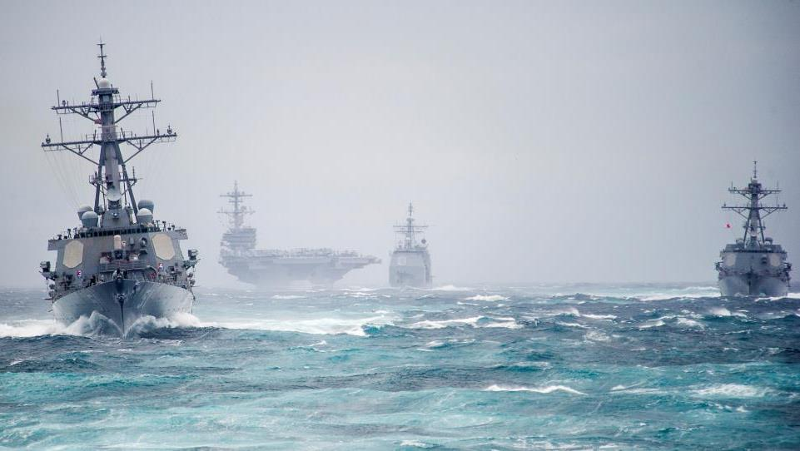
THE NAVY THE NATION NEEDS
OUR ENDURING MISSION
Promote American interests
Preserve the peace
Protect the homeland
Notes:
And while everything else has changed during the past two centuries...ships, aircraft, people, even the world...your Navy’s enduring mission has remained: to deliver combat-ready naval forces to win conflicts and wars while maintaining security and deterrence through a sustained forward presence.
What does that mean? It means the U.S. Navy will remain ready at all times to conduct combat operations at sea, that we will protect the American homeland from attack, and that we will always fight to advance American interests around the world.
We promote American prosperity and advance American interests
We preserve peace through strength
We protect the homeland, the American people, and the American way of life

Slide 3
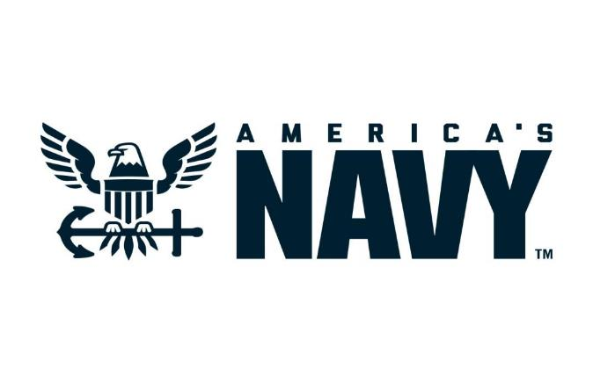
THE NAVY THE NATION NEEDS
Notes:
(Introduction and welcoming remarks.)
UPDATED 18 DEC 2018

Slide 4
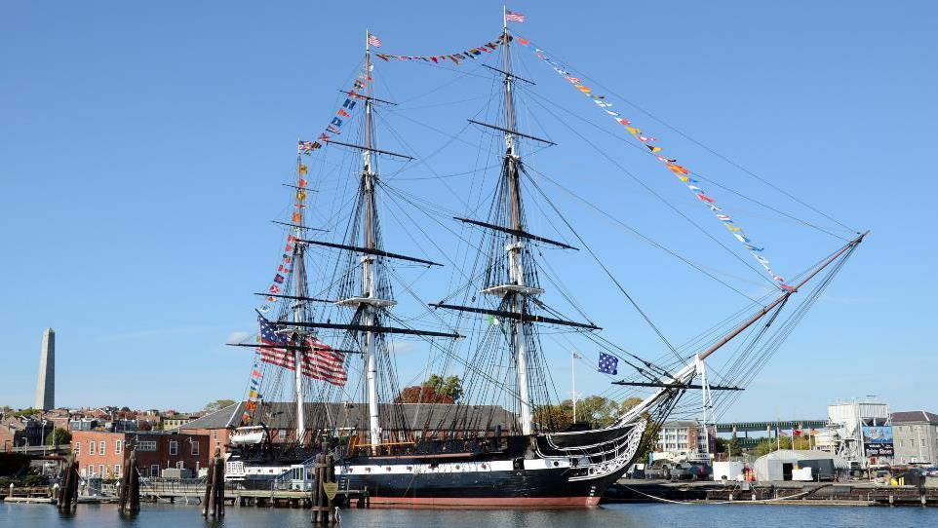
THE NAVY THE NATION NEEDS
OUR ENDURING MISSION
“Whereas the depredations committed by the Algerine corsairs on the commerce of the United States render it necessary that a naval force should be provided for its protection…”
- Naval Act of 1794
Notes:
More than two centuries ago, after winning the Revolutionary War, the newly independent United States disbanded the Continental Navy. Why? We didn’t need it, we said. The British had gone home. What’s the point of spending money on ships we’ll never use?
But then hostile forces began to threaten and capture our merchant vessels in Europe. It quickly became clear that our young nation needed what all of the world's great powers had...a front-line, oceangoing Navy. This fleet of ships would have an important mission: to defend our shores and protect our interests, no matter where they were in the world.
So in 1794, Congress authorized the construction of six frigates – one of which was the legendary USS Constitution – with the acknowledgment that attacks on our merchant vessels rendered it necessary “that a naval force should be provided” for protection. Those six frigates were the genesis of the Navy we know today.

Slide 5
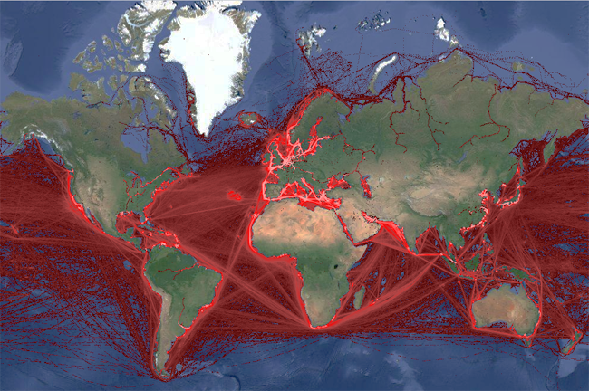
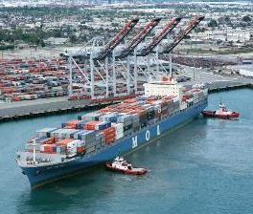
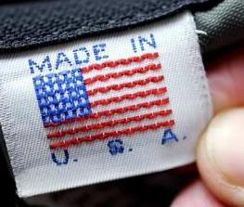

26%
OF U.S. JOBS ARE TIED TO GLOBAL TRADE
26%
OF U.S. MANUFACTURING JOBS DEPEND ON EXPORTS
20%
OF U.S. AGRICULTURAL PRODUCTS ARE SOLD OVERSEAS
Notes:
Preserving America’s strategic interests overseas is an important part of our Navy’s mission. But America’s Navy also plays a large part in preserving trade around the world.
How does this matter to you? Well, as the global economy continues to expand and become more connected, this network of oceans, seas and waterways – what we call the classic maritime system – is becoming increasingly used by the United States and the world as a whole.
- More than 41 million U.S. jobs – 26 percent – are directly or indirectly tied to global trade. (Source: Figure of 41 million jobs from U.S. Chamber of Commerce; total employment of 156.795 million from Bureau of Labor Statistics)
- 26 percent of U.S. manufacturing jobs depend on exports. (Source: U.S. International Trade Administration, July 2016 based on 2014 figures)
- More than 20 percent of all U.S. agricultural products are exported. (Source: U.S. Department of Agriculture Foreign Agricultural Service, 2018)
So, you see that the free flow of goods over the world’s oceans is a national security issue. And the Navy, operating forward, ensures this flow of goods remains unimpeded.
And it’s something most Americans don’t think about, but more than 95 percent of all international phone and internet traffic is transmitted via undersea communication cables. America’s Navy plays a critical role in protecting these vital electronic conduits.

Slide 6
70%
OF THE EARTH
IS COVERED
IN WATER
90%
OF GLOBAL COMMERCE
IS CONDUCTED
BY SEA
Notes:
(OPTIONAL)
The contributions of America’s Navy don’t just benefit Americans, however.
The oceans of the world have long served as a path to new frontiers and new opportunities far beyond national borders. As a nation with multiple maritime borders, the United States has always been a nation with global interests. Those interests have grown in number and diversity since the turn of the 20th century…and they are increasingly dependent on secure maritime trade routes throughout the world.
Consider the following:
- More than 70 percent of the earth is covered in water. (Source: U.S. Geological Service, December 2016 – actual figure is “about 71 percent”)
- More than 90 percent of global commerce is conducted by sea. (Source: International Maritime Organization)
In this day and age, the security of maritime trade routes is vital to the global economy – not just for the United States, but for all seafaring nations. And despite a century’s worth of changes around the world, one thing has not changed…in an increasingly globalized world, America’s success is even more reliant on our Navy.

Slide 7
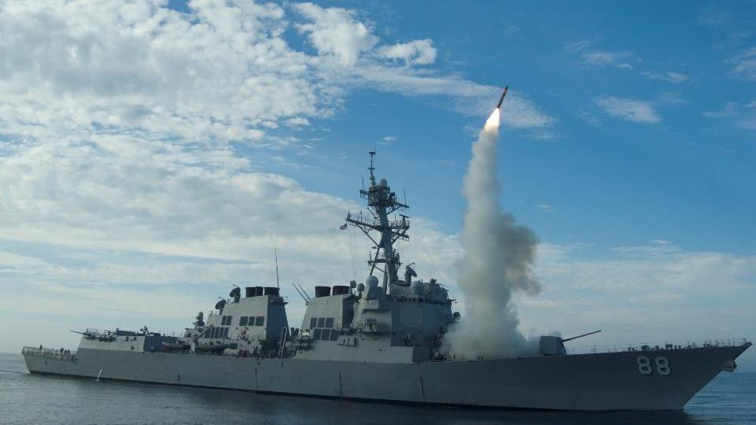
NAVAL POWER…
FROM THE SEA
Notes:
America's Navy is ready to defend America, our allies and partners, and our strategic interests at all times. We're uniquely positioned to do so because the world’s oceans provide us with the access to protect America’s interests anywhere, around the clock…using naval power from the sea.
The material foundation of our Navy, of course, is our ships. From those original six frigates, the Navy now possesses a wide variety of surface vessels, from 97,000-ton aircraft carriers to fast, agile littoral combat ships and coastal patrol vessels. The presence of these vessels anywhere in the world helps deter potential conflicts and avoid escalating tensions. But when combat power is required, ships like the workhorse of our fleet, the Arleigh Burke-class destroyer, possess a staggering range of offensive capabilities – giving our military leadership the warfighting ability to fight and defeat other navies and destroy targets located hundreds of miles inland.

Slide 8
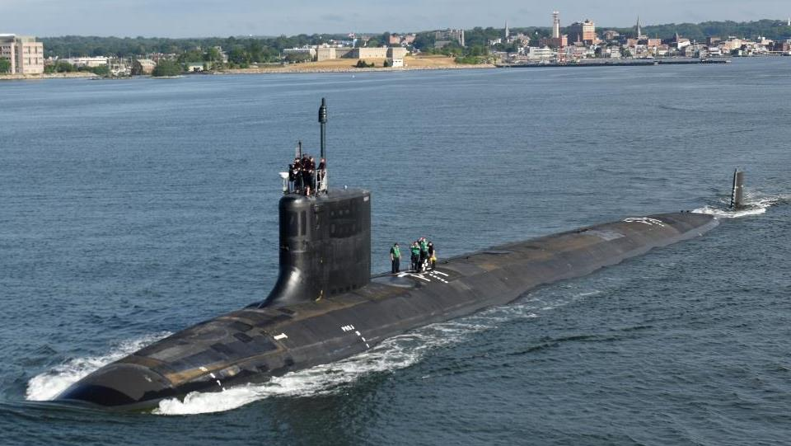
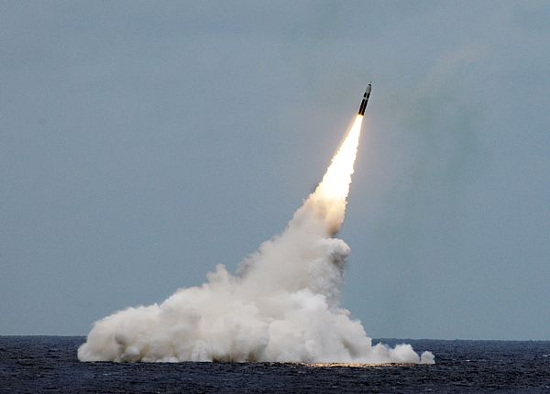
NAVAL POWER…
FROM UNDER THE SEA
Notes:
Undersea warfare has long been a specialty of America’s Navy, and that tradition continues today. Our submarine force has evolved from the diesel-electric boats of old to today’s nuclear-powered vessels, armed with everything from torpedoes to Tomahawks to ballistic missiles. Yet the most valuable assets of submarines like the VIRGINIA-class USS ILLINOIS pictured here is stealth – the ability to strike from the deep without warning.

Slide 9
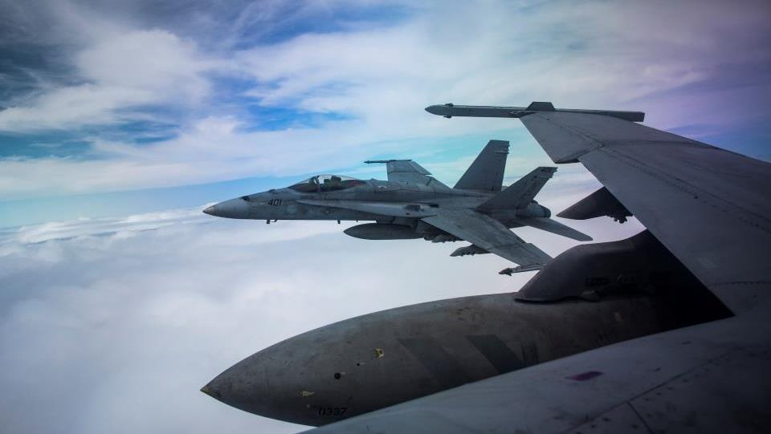
NAVAL POWER…
FROM THE AIR
Notes:
It has long been held that the first question an American leader asks during times of crisis is: “Where is the nearest carrier?” Such a question confirms the importance of naval aviation to America’s Navy. And the most prominent component of naval aviation today is the F/A-18 Super Hornet – a multi-mission jet capable of carrying out ground-attack missions and air-to-air combat, as well as midair refueling and even electronic warfare.
The Super Hornet is just one example of the planes, helicopters and yes, even unmanned aircraft that form the backbone of projected American power – all of which allow us to do a great number of things at sea without the need of another country’s permission to operate within its borders.

Slide 10
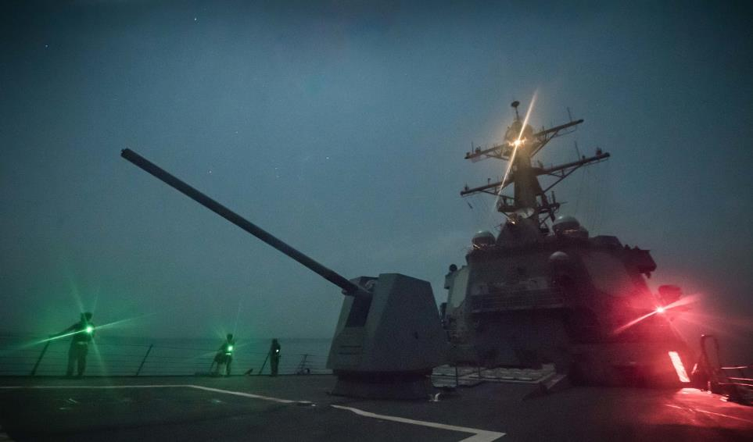
COMPETE
DETER
WIN
Notes:
The Navy is America’s primary forward deployed force. Because we’re constantly improving and enhancing our lethality and because we’re investing time and resources into increasing our capabilities, your Navy continues to be the most effective global maneuver force in the world. What does that mean? It means that as great power competitors—such as China and Russia—attempt to remake the rules and to disrupt free trade and interfere with our right to sail the world’s oceans, the Navy stands ready to compete with those forces when called upon, to deter them from even trying to challenge us, and, when it becomes necessary, to win every challenge that arises.
Your Navy protects the American homeland and protects our economic prosperity by keeping the world’s oceans open for transit and open for business. We partner with other American forces to meet these challenges, to maintain our maritime superiority, to protect the American homeland, and to protect our economic prosperity.

Slide 11
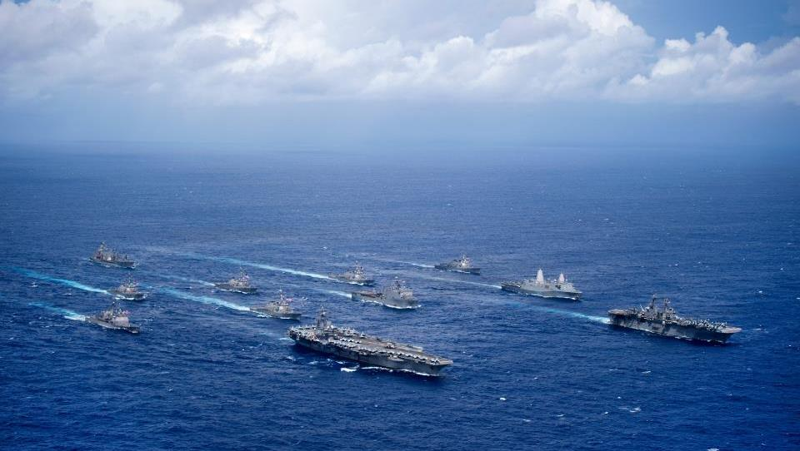
AMERICA’S NAVY
PEOPLE & CAPABILITIES
Notes:
In building the Navy the Nation Needs, the Navy has identified that our top priorities are to continually strengthen our People, our Capabilities, and our Processes. By focusing on speed, value, results, and partnerships, we’re making sure our forces are strong enough to provide the American people with the modern fleet we need to stay on top.
Today, there are 287 ships in the Navy’s battle force, nearly 100 of which are based overseas – what we call “forward-deployed” – in locations such as the Middle East, Europe or Japan. Of the Navy’s more than 425,000 active and Reserve Sailors, more than 70,000 are forward-deployed to support our operations around the globe.
As just one example of the kind of power America’s Navy can show, this photo features a total of 11 ships – a typical Carrier Strike Group and Amphibious Ready Group – and approximately 10,000 Sailors.
(NOTE: NUMBERS AS OF NOV 2018—WILL NEED TO BE UPDATED)

Slide 12
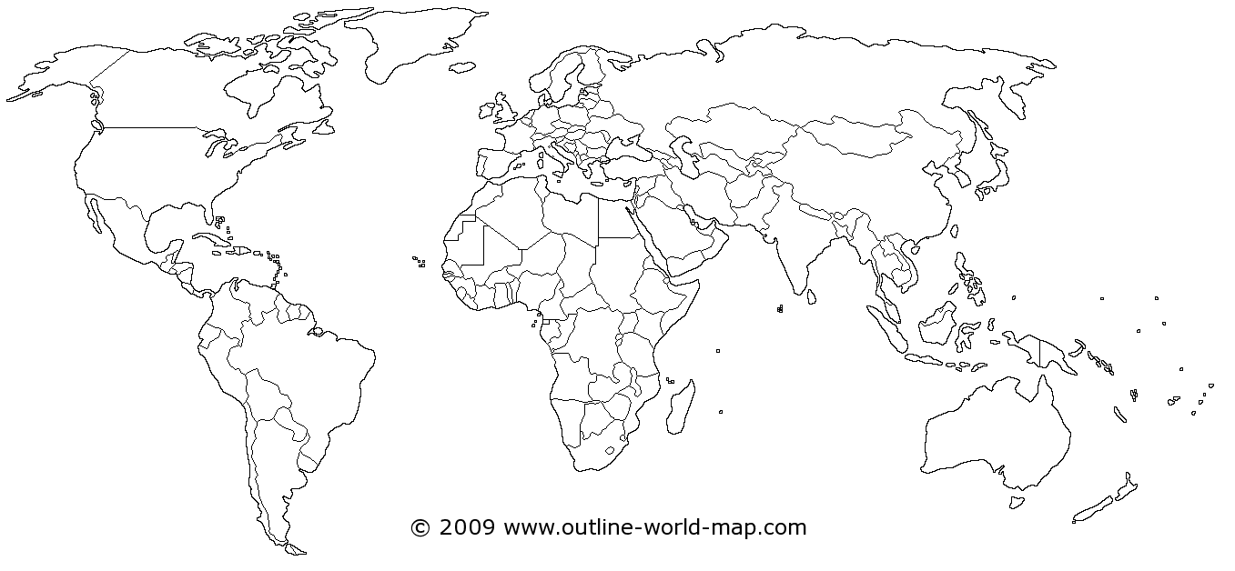
U.S. Naval Forces Europe
Theater Security Cooperation
NATO Support
Black Sea Operations
Ballistic Missile Defense
U.S. Naval Forces
Central Command
Operation Inherent Resolve
Maritime Security Operations
Counter-Piracy Operations
Ballistic Missile Defense
U.S. Fleet Forces
Standing Naval Forces Atlantic
Ballistic Missile Defense
AMERICA’S NAVY
OPERATIONS UPDATE
U.S. Pacific Fleet
Forward Deployed Naval Force
Strategic Presence
South China Sea Interactions
Pacific Partnership
Ballistic Missile Defense
Theater Security Cooperation
U.S. Naval Forces
Southern Command
Counter-Narcotics Operations
Southern Partnership Station
U.S. Naval Forces Africa
Africa Partnership Station
Counter-Piracy Operations
Counter-Terrorism Operations
Maritime Security Operations
Notes:
America’s Navy reaches into every corner of the world. We have six major commands responsible for naval operations – ranging from our own shores to Europe and the Middle East, from Central and South America to Africa, and from one side of the Pacific Ocean to the other. As you can see, these commands carry out a wide variety of missions every day.
And here are a few examples of what your Navy is doing right now:

Slide 13
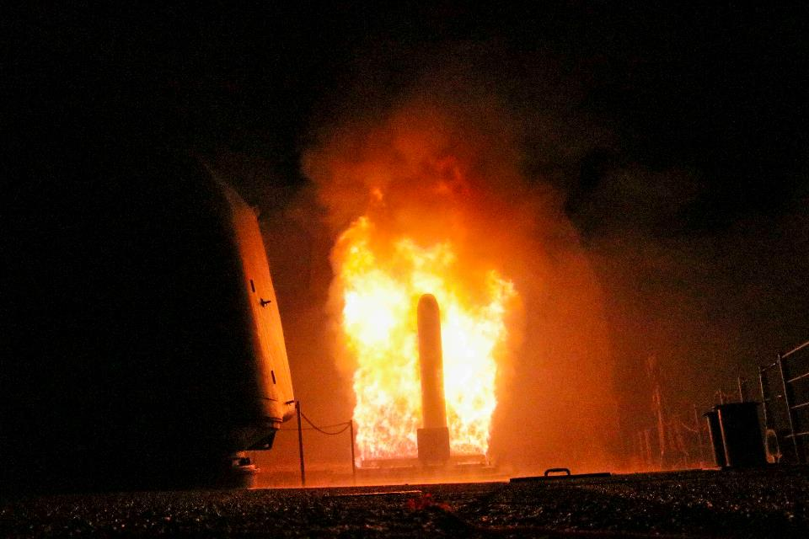
MIDDLE EAST
Strike operations
Notes:
The Navy provides regular support to operations against the Islamic State (ISIS) in the U.S. Fifth Fleet and Sixth Fleet areas of responsibility. Current operations against ISIS in Iraq and Syria include air strikes from ships in the Middle East and the Mediterranean Sea.
(DESIRED PHOTO: LATEST IMAGES OF CARRIER AIR STRIKES)

Slide 14
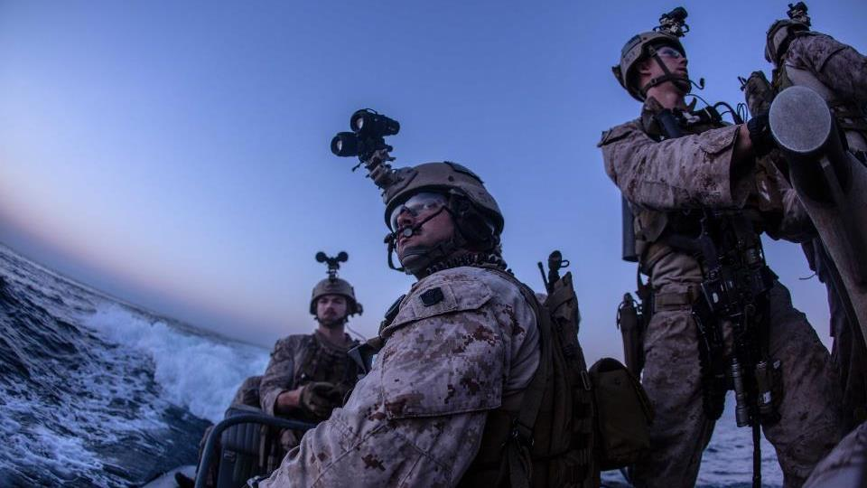
GULF OF ADEN
MARITIME SECURITY
Notes:
Maritime security operations are a major part of our operations around the world, including counter-terror operations in the Middle East and Africa and counter-illicit trafficking operations in Central and South America.

Slide 15

USNS comfort
Humanitarian assistance
Notes:
The Navy’s ability to carry out rapid-response humanitarian assistance operations was demonstrated in the summer of 2017 after a series of hurricanes struck the Gulf Coast and the Caribbean, including Puerto Rico and the U.S. Virgin Islands. Sailors and Marines from helicopter squadrons and amphibious assault ships responded immediately to help local authorities carry out search and rescue missions and deliver humanitarian relief supplies.
This year, the hospital ship USNS COMFORT deployed on an 11-week medical support mission to Central and South America as part of U.S. Southern Command’s Enduring Promise initiative. Working with health and government partners in Ecuador, Peru, Colombia and Honduras, the embarked medical team provided care on board and at land-based medical sites, helping to relieve pressure on national medical systems. The deployment reflected the United States’ enduring promise of friendship, partnership and solidarity with the Americas.

Slide 16
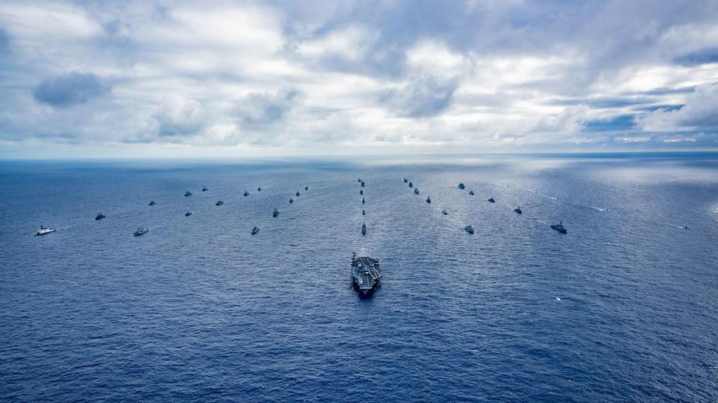
RIM OF THE PACIFIC
ALLIES & PARTNERS
Notes:
In fact, today’s great power competition requires the Navy to stay focused on developing partnerships built on shared interests. Expanding and strengthening these partnerships means working hard to forge unity with our allies and partners, to work together as one team.
RIMPAC, or the Rim of the Pacific Exercise, seen here, is the largest maritime exercise in the world. In 2018, the Navy trained with forces from 25 other nations during the RIMPAC exercise, including 47 ships, 200 aircraft, and more than 25,000 people, working together to strengthen worldwide diplomatic cooperation through shared military interaction.
America is strengthened by our strategic partnerships with nations that share our commitment to defending freedom. We are stronger when we join forces with like-minded allies.

Slide 17
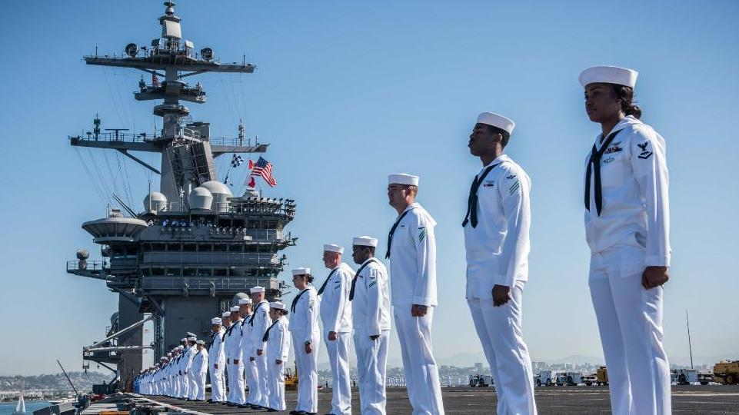
OUR CHALLENGES
Notes:
At the same time, America’s Navy is faced with more than its share of challenges. Some are material, some are financial. Needless to say, all of these challenges pose significant issues for our Sailors and their leaders going forward.

Slide 18
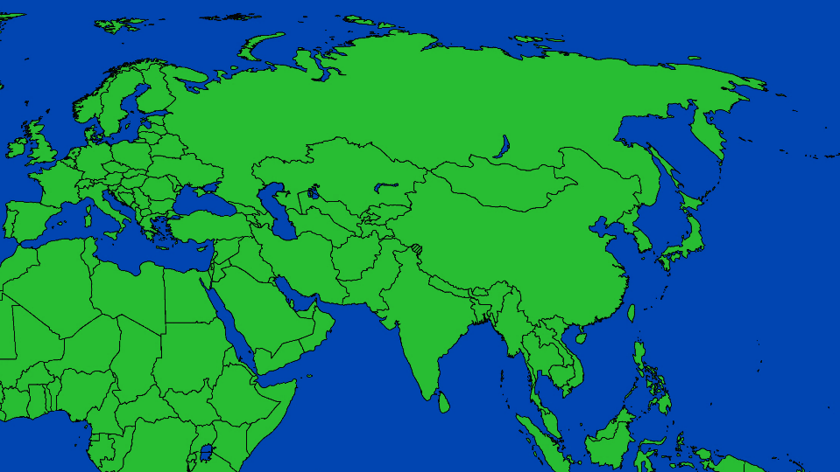
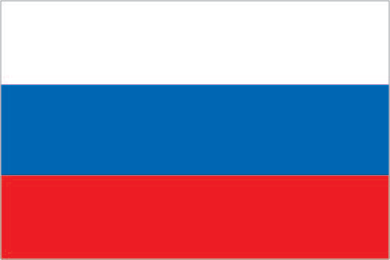
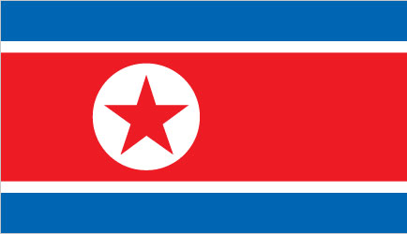


CHALLENGES
Areas of Concern
RUSSIA
SYRIA / IRAQ
NORTH
KOREA
AFGHANISTAN
BLACK SEA
CHINA
SOUTH CHINA SEA
LIBYA
IRAN
Notes:
It is often said that we live in an increasingly complex world, and nowhere is this clearer than on the world’s oceans.
The demand for American naval forces is rising in areas such as the South China Sea, where territorial claims are under dispute, and the Black Sea, where we continue to support our NATO partners.
America’s Navy is also engaged in operations in the Middle East and Mediterranean Sea, where we use our combat power against targets in Iraq, Syria, Afghanistan and Libya.
Another concern is the emergence of competitors and adversaries with increasingly sophisticated forces such as China and Russia, as well as countries like Iran and North Korea who want to deter naval powers from operating near their territory.
The advancement of these potential adversaries and competitors makes it more important for our Navy to advance its own forces as well. To do so, we need to modernize our existing ships, aircraft and weapons to make them more capable.

Slide 19
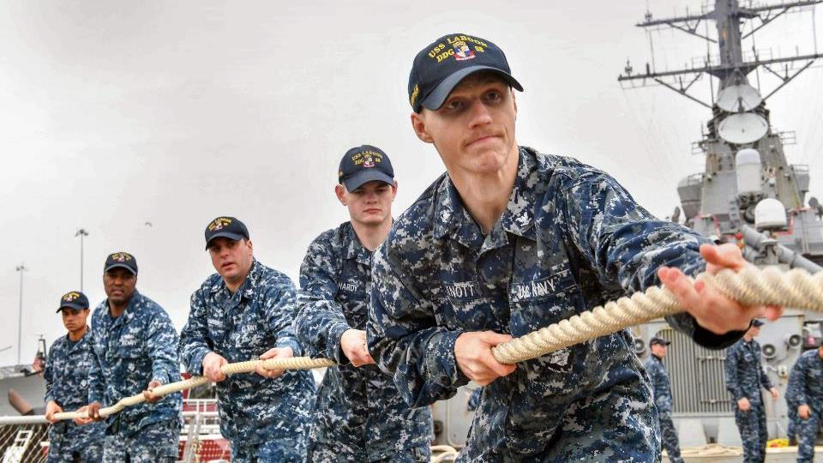
CHALLENGES
High Operational Demand
Notes:
America’s Navy has the flexibility to take on a wide variety of missions. Our military leaders have recognized this flexibility, and often call upon the Navy to take on an increasing range of operations around the world.
Unfortunately, this higher operational demand has placed a significant strain on our fleet. Not only are we seeing accelerated wear and tear on our ships, submarines and aircraft, but it has also imposed stress on Sailors and their families, who have to cope with longer and more frequent deployments. As a result, the Navy has had to forgo necessary investments in our hardware and our Sailors so that we can keep doing our job in an increasingly complex and fast-paced security environment.
But we’re on our way back. Overall investment in the Navy has increased across the board, enabling us to begin building a more lethal and ready force.

Slide 20
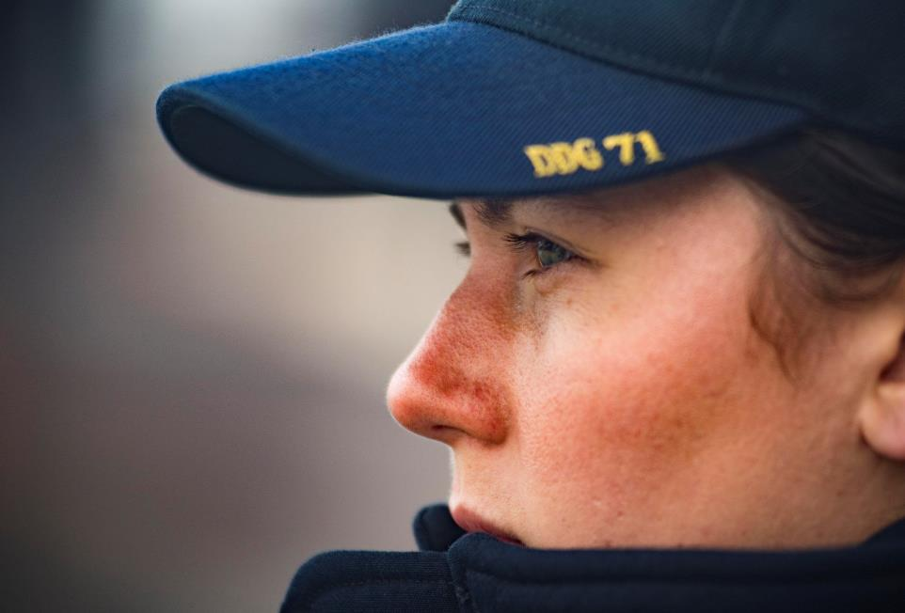
WHAT
WE’RE
DOING
Notes:
Yes, America’s Navy faces its share of challenges. And here’s what we’re doing to meet those challenges every day – now and into the future.

Slide 21
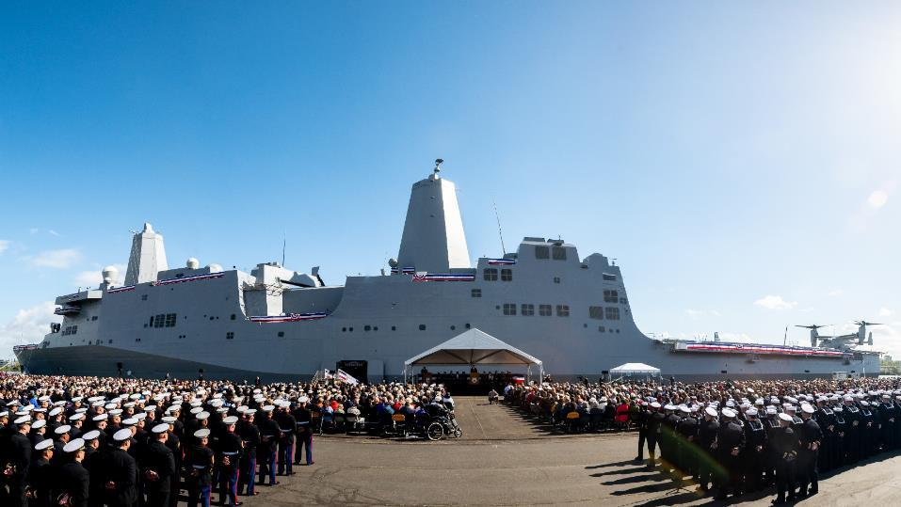
RESTORING READINESS
Maintaining Modern Platforms
Notes:
The Navy’s Enduring Lines of Effort demand that we build the right sized force of highly trained, well-equipped Sailors and get them combat-ready, ready to win conflicts and wars while maintaining security and deterrence through a sustained forward presence around the world and wherever we need to be.
Your Navy is continuing to build—and in some cases re-build—a fully-funded and ready service; we are working to ensure the Navy is as resilient as it is powerful and that we will always remain ready to deter and defeat adversity.
Restoring and maintaining the Navy’s operational and combat readiness is an immediate concern. Not only must we make immediate investments in the readiness of our afloat forces, but we must also accelerate and extend active ship and aircraft production lines such as the Littoral Combat Ship, the Arleigh Burke-class destroyer and the F/A-18 Super Hornet, all of which provide relevant capabilities now and in the years ahead.

Slide 22
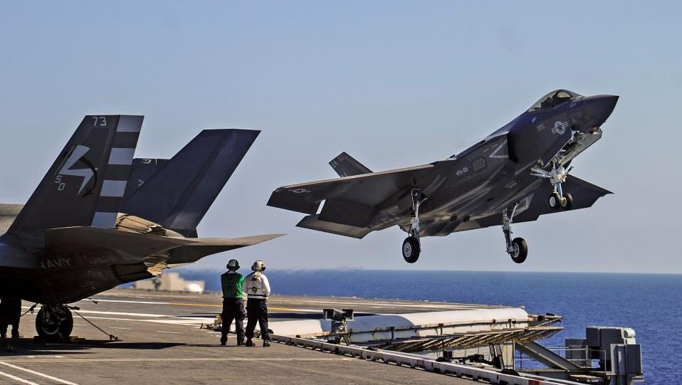
INCREASING LETHALITY
Investing in the Next Generation
Notes:
We’re making the necessary investments to develop superior innovative technology, which are really investments in our ability to maintain the competitive edge against global competitors and ensure we remain the world’s finest Navy.
America’s Navy is investing in the next generation of naval and aviation technology, including the F-35 Joint Strike Fighter. It is only through these investments that the Navy is able to increase our lethality to maintain our competitive edge.

Slide 23
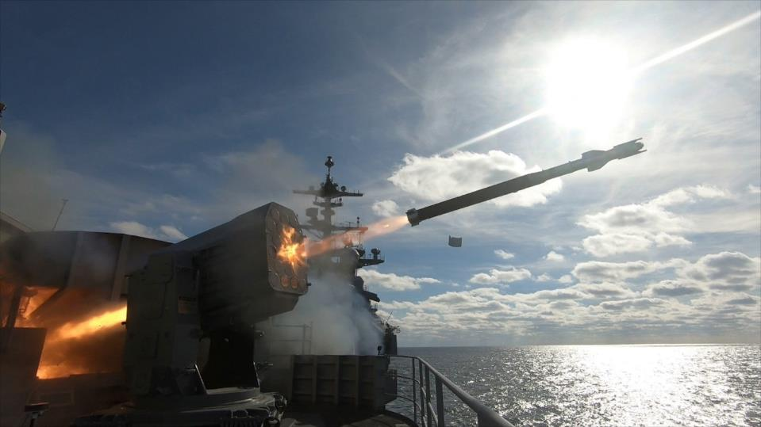
BUILDING CAPACITY
Flexibility to Project Power
Notes:
We’re increasing our capacity, working to make sure the Navy is better positioned to provide focused flexibility to respond to threats and to project our power around the world.
Because we need to increase our naval power, we’re building a bigger, better, more agile and ready fleet. This new and improved fleet will also need to be networked to connect the bigger and better naval force so we can more easily share and act on information and do so at the speed of light. Effective networking exponentially increases naval power so we can deliver more lethality, more quickly than ever before.

Slide 24
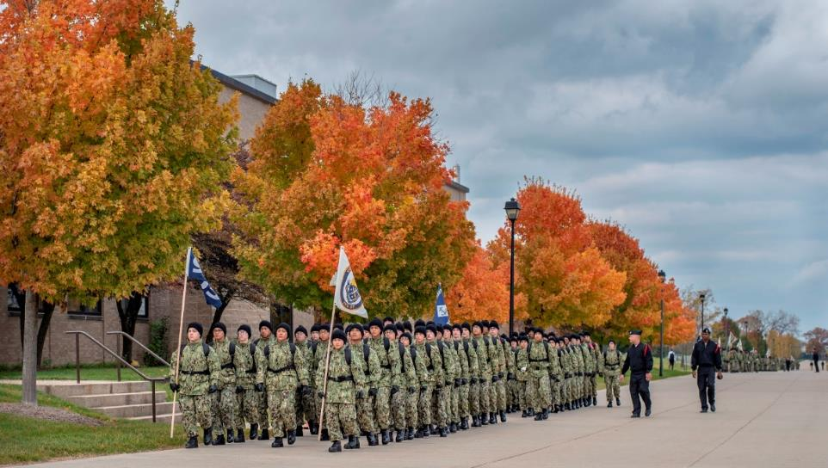
OUR PEOPLE
Recruiting & Training Sailors
Notes:
Above all, we will build the most talented fleet the world has ever known. America’s Navy is nothing without its most important component…the American Sailor. Our people have always been our greatest advantage over any competitor and our most important means to achieving our desired ends.
In the Navy, our uniformed and civilian workforce is our greatest resource. The men and women of the Navy serve in a wide variety of jobs throughout the fleet, manning and maintaining our ships, submarines and aircraft around the clock.
Recruiting, training and properly equipping our Sailors—the best Sailors in the world—is an important step in keeping America’s Navy at the forefront of the world’s sea services.

Slide 25
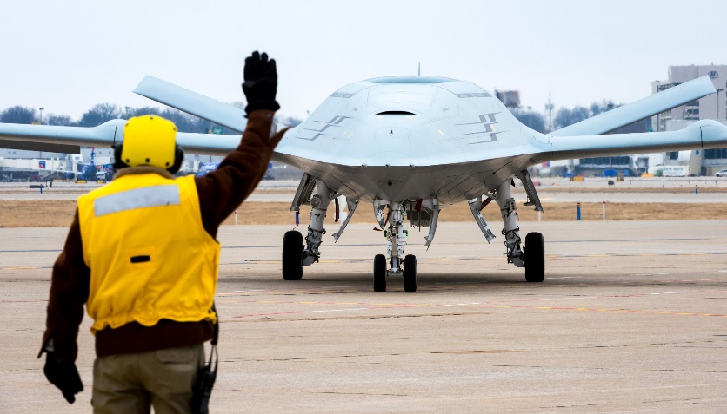
WHAT WE’RE DOING
The Future Navy
Notes:
What about the future? What will our fleet look like years from now?
In the last few years, there has been a lot of discussion about what America’s Navy will look like in the decades to come. Two central themes have emerged. First, the Navy and Congress have determined that we’ll need 355 ships to maintain our superiority on the seas, with a focus on both manned and unmanned platforms. Second, “more” doesn’t automatically mean “better.” As we build new ships, we need to change the way we operate the fleet.
The fact is, these goals aren’t for the distant future. The current security environment guarantees that the world won’t stop and wait for us to improve our Navy. So we’re working right now on bringing new assets into the fleet—platforms like the unmanned aircraft you see here, the MQ-25A, the America-class amphibious assault vessel, and other new vessel classes that will allow us to keep your Navy on the leading edge. And we’ll continue to innovate as we go along, with an emphasis on expanded power capability, improved networking and rapid modernization of weapons and sensors.
We can’t afford to be complacent or rest on our laurels. We must build a larger, more agile and more sustainable fleet. And by increasing our investments in current and future readiness, we will ensure that our current and future leaders have the timely, agile and effective options needed to carry out the Navy’s continuing mission: protecting America’s interests at home and around the world.

Slide 26
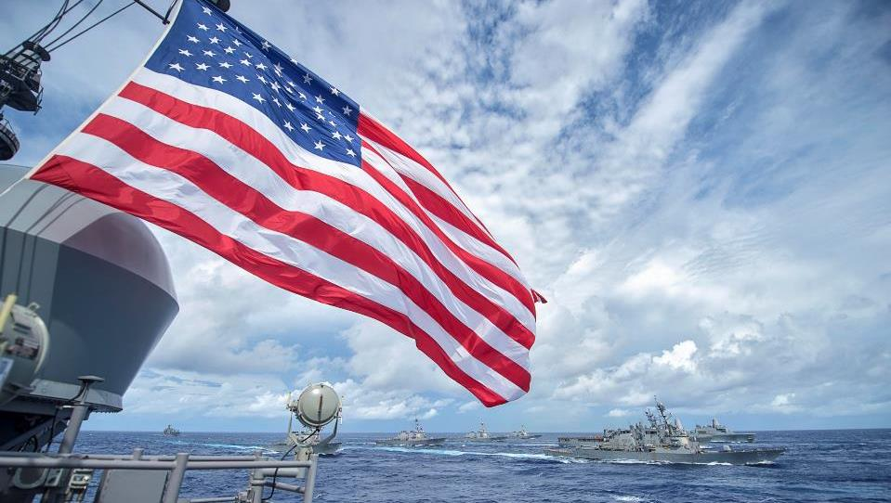
America’s navy
THE MISSION CONTINUES
Notes:
Hopefully, this presentation has given you an idea of what America’s Navy does on a daily basis – and what it has been doing for more than two centuries.
Through generations of Sailors and ever-changing technology, the U.S. Navy is all about defending our country’s interests and protecting America. It always has been, and it always will be.
That’s the mission of America’s Navy…and our mission continues.

Slide 27
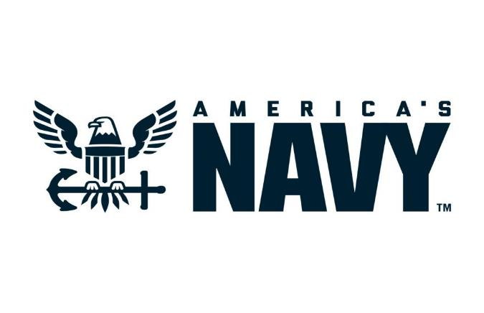
THE NAVY THE NATION NEEDS
BACKUP SLIDES
Notes:
(Slides to be added as needed by presenter.)

Slide 28
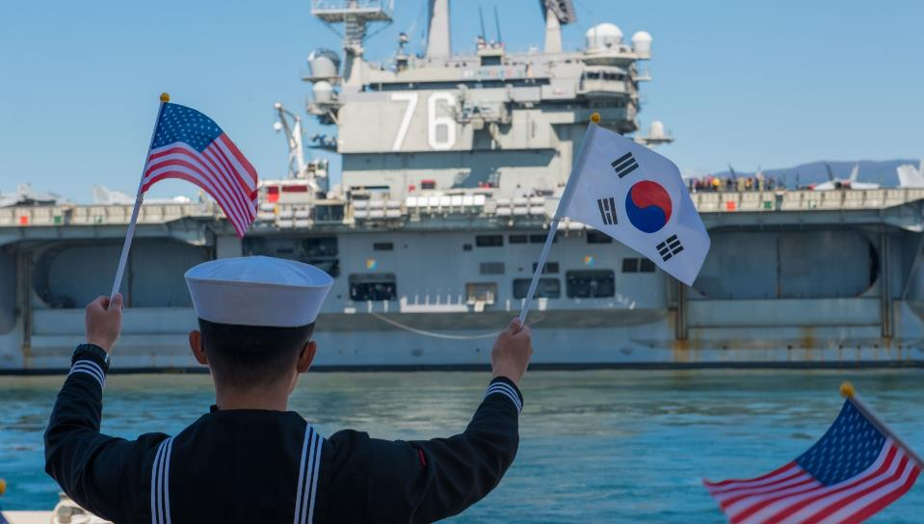
OUR MISSION TODAY:
Protect and Preserve
Notes:
America’s Navy protects our nation from attack in many ways. Our ships, submarines and aircraft possess the necessary combat power to counter threats from the air and sea, making potential adversaries think twice about threatening our shores.
The Navy also preserves America’s strategic influence in key regions of the world by protecting U.S. citizens and American interests abroad, in times of peace and war. By doing this, the Navy continues to retain its significance as a cornerstone of American security and prosperity.
(DESIRED PHOTO: ILLUSTRATION OF NAVY FORCES DEMONSTRATING STRATEGIC INFLUENCE OVERSEAS)

Slide 29
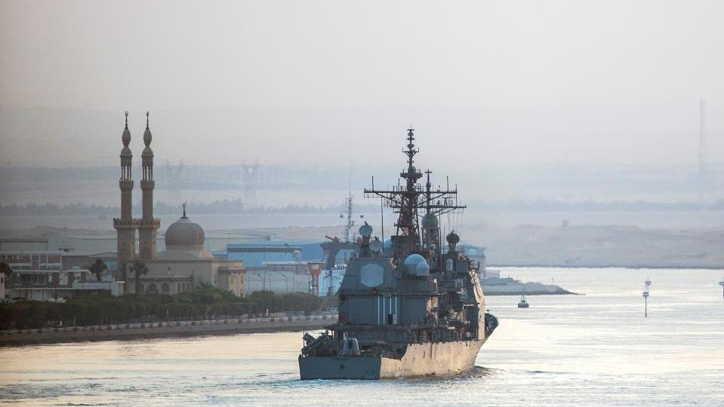
OUR MISSION TODAY:
Prevent and Deter
Notes:
America’s Navy prevents conflict and deters aggression through our worldwide presence. We project power through the deployment of our ships to areas of concern, as well as the basing of ships in overseas locations such as the Middle East and Japan. We also practice strategic deterrence using ballistic missile submarines which patrol the world’s oceans around the clock. Using this presence, America’s Navy deters its adversaries and enables the peaceful resolution of crises worldwide.

Slide 30
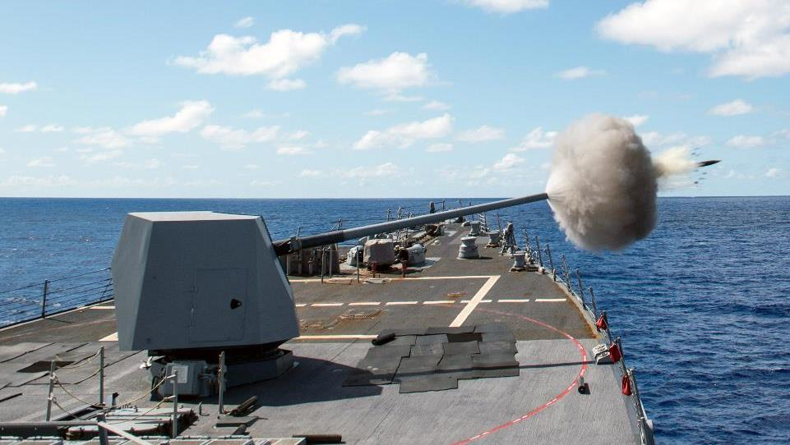
OUR MISSION TODAY:
Be Ready to Fight
Notes:
When combat at sea is necessary, America’s Navy is always ready to fight and win wars. We bring to the fight a wide variety of combat power, from naval guns and missiles on our ships and submarines to strike aircraft and forces ashore.

Slide 31
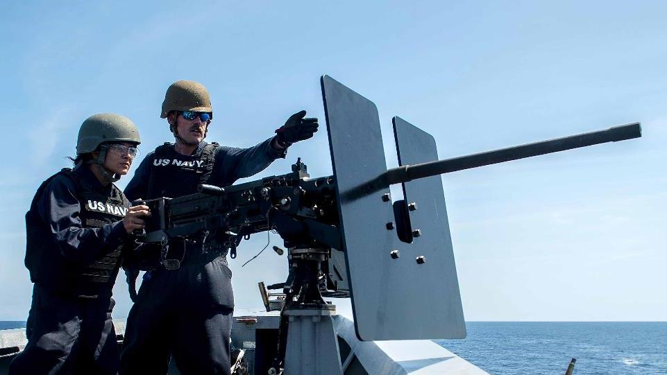
NAVAL POWER…
FROM OUR SAILORS

Slide 32
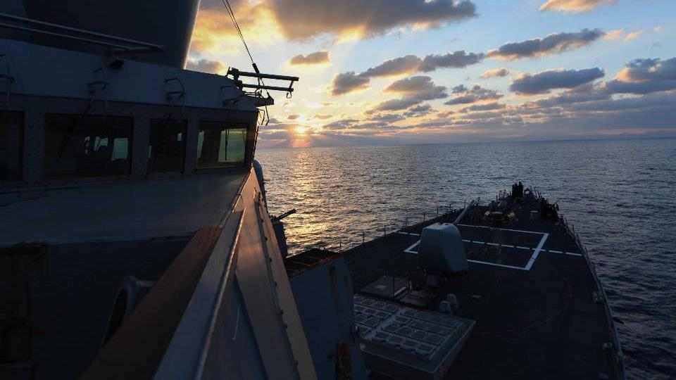
SOUDA BAY, GREECE
OPERATIONAL PATROL
Notes:
Navy ships regularly patrol the U.S. Sixth Fleet area of operations, participating with NATO partners in navigational and ballistic missile defense exercises in the Mediterranean and Black Seas.

Slide 33
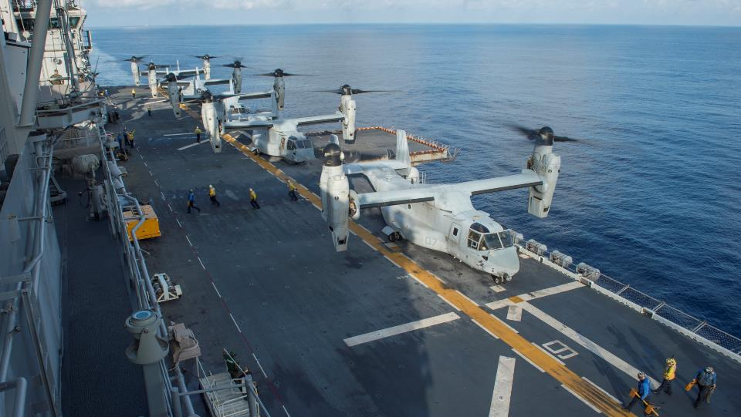
EAST CHINA SEA
MARINE AVIATION ops
Notes:
The Navy has made operations in the Pacific a major point of emphasis in recent years. The USS BONHOMME RICHARD, pictured here, and its Expeditionary Strike Group are forward deployed in Japan, as is the USS RONALD REAGAN Carrier Strike Group. They regularly operate in the Western Pacific, both by themselves and with our allies in the region.

