Slide 1
Team: TouchTouch
The built models should be able to find database images that correspond to a given query image.
Problem Statement :
Example:
Query: Consider you want to search images from your database which contains car .
Solution: You provide an image of car then all images from database have car should be return.

Slide 2
Team: TouchTouch
Solution to problem statement :
Use of Content-Based Image Retrieval
Content-based image retrieval (CBIR) is a system for retrieving relevant images based on a given image.

Slide 3
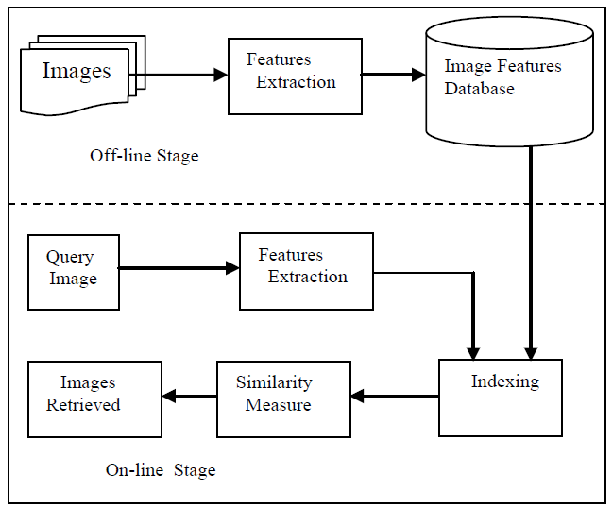
Flow of the CBIR
The process of the system will begin by extracting features on all images, whether it’s the query or the image database by using a feature extraction algorithm.
Then, the system will calculate similarities between the query with all images on the database.
At the end, the system will retrieve all the images that have a great similarity with the query.

Slide 4
Algorithm and Models Used :
Feature Extraction : Convolutional neural network CNN : VGG-16 architecture and pretrained weight from the ImageNet.
Similarity Calculation : Euclidean distance

Slide 5
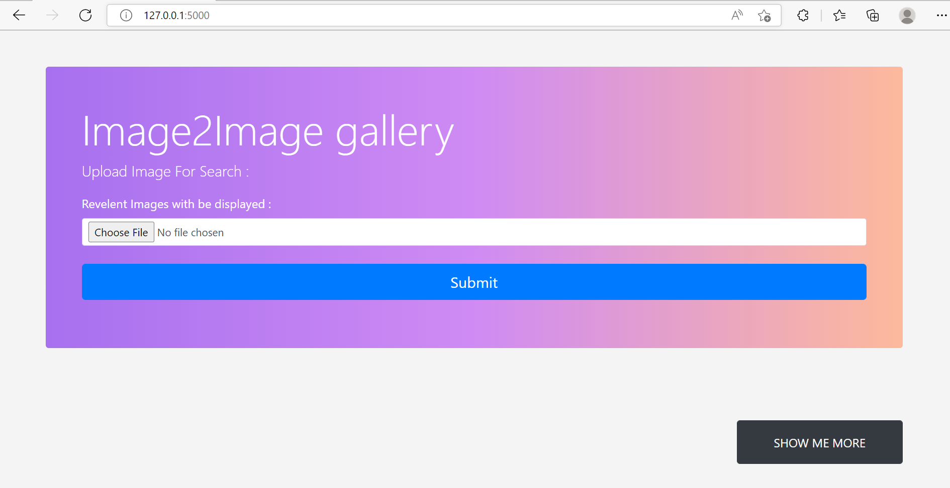
Project Screenshot
Screen 1 : Where user Uploads Image as a search query and hit Submit.

Slide 6
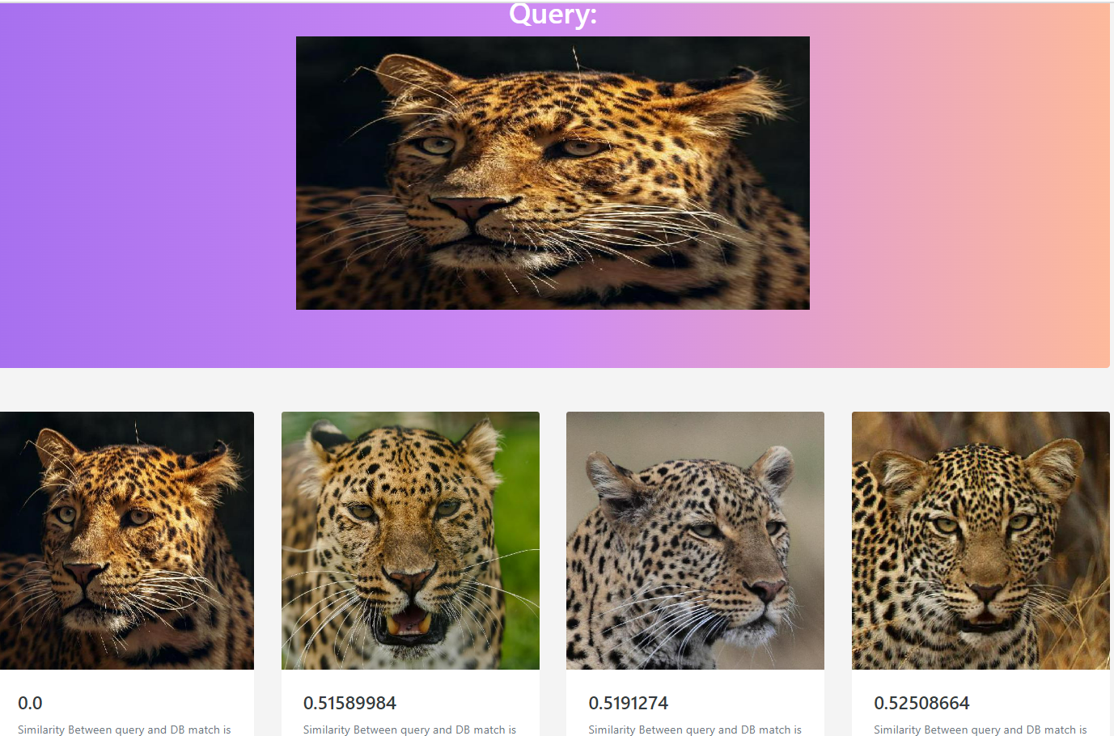
Project Screenshot
Screen 2 : Where response of similar images are presented.

Slide 7
Demo Video Link : https://user-images.githubusercontent.com/94001814/190885304-2b33f910-c5e2-4358-9364-dec2dbeea3d7.mp4

