Slide 1

Riak & jQuery DataTables
Will they blend?
Tutorial Combining Two
Awesome Technologies
2015

Slide 2
Agenda
jQuery DataTables
  Getting Started
  Overview of Features
Riak
  Overview and Demo
Will they blend?
Helpful Resources

Slide 3
What is it?
DataTables is a plug-in for jQuery JavaScript Library
Highly flexible tool to add interactive controls to HTML tables
Open Source – MIT license
Available for free!

Slide 4
Getting Started in 3 Steps
Step 1: Add references to the library
<link rel="stylesheet" type="text/css" href="http://cdn.datatables.net/1.10.5/css/jquery.dataTables.css">
<script type="text/javascript" charset="utf8" src="http://code.jquery.com/jquery-1.11.1.min.js"></script>
<script type="text/javascript" charset="utf8" src="http://cdn.datatables.net/1.10.5/js/jquery.dataTables.min.js"></script>
Step 2: Create a HTML table
<table id="myTable">
<thead>
<tr>
<td>Group</td>
<td>Subject</td>
<td>Last Used</td>
</tr>
</thead>
<tbody>
<tr><td>Event </td><td>I: Thank You </td><td>0000-00-00 00:00:00</td></tr>
<tr><td>Event </td><td>Q: Request for Help </td><td>0000-00-00 00:00:00</td></tr>
<tr><td>Event </td><td>Q: Schedule Follow-up </td><td>0000-00-00 00:00:00</td></tr>
<tr><td>Time </td><td>Q: Vacation Request </td><td>0000-00-00 00:00:00</td></tr>
<tr><td>Time </td><td>I: Vacation Reminder </td><td>0000-00-00 00:00:00</td></tr>
<tr><td>Time </td><td>I: Out Sick </td><td>0000-00-00 00:00:00</td></tr>
</tbody>
</table>

Slide 5
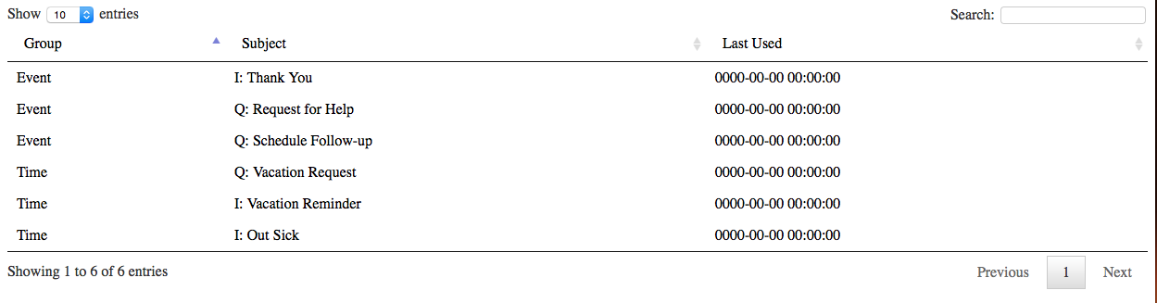
Getting Started in 3 Steps
Step 3: Activate the library for your table
<script>
$(document).ready(function () {
$('#myTable').dataTable();
});
</script>
Now, view the results...

Slide 6
Overview of Features
Quickly leverage built-in support for...
  AJAX requests
  Adding a custom look 'n feel
  Pagination
  Row selection
  Customizing Table Cells
  Item counts, Sorting & Searching

Slide 7
AJAX Requests
Dynamically load data into your HTML table.
<table id="myTable"><thead><tr>
<td>Group</td>
<td>Subject</td>
<td>Last Used</td>
</tr></thead></table>
DataTable will make an AJAX call and populate the table rows using the returned JSON data.
[
{"group":"Time","subject":"Q: Vacation Request","lastUsed":"0000-00-00 00:00:00"},
{"group":"Time","subject":"I: Vacation Reminder","lastUsed":"0000-00-00 00:00:00"},
{"group":"Time","subject":"I: Out Sick","lastUsed":"0000-00-00 00:00:00"},
{"group":"Event","subject":"I: Thank You","lastUsed":"0000-00-00 00:00:00"},
{"group":"Event","subject":"Q: Request for Help","lastUsed":"0000-00-00 00:00:00"},
{"group":"Event","subject":"Q: Schedule Follow-up","lastUsed":"0000-00-00 00:00:00"}
]

Slide 8
AJAX Requests (Continued)
Dynamically load data into your HTML table.
<script>
$(document).ready(function () {
$('#myTable').dataTable({
"ajax": {
"url": "02_ajax.txt",
"dataSrc": "",
},
"columns": [
{
"data": "group"
},
{
"data": "subject"
},
{
"data": "lastUsed"
}]
});
});
</script>

Slide 9
Adding a Customer Look 'n Feel
Using CSS, adjusting the appearance of your tables is within reach.
/* Alternate row colors */
/* Highlight row under cursor */
table.dataTable tr.even {
background-color: #eee;
}
table.dataTable tbody tr:hover {
background-color: #dde;
}
/* Blue & white table header */
/* Update font and border */
table.dataTable thead {
background-color: #07c;
color: #fff;
font-weight: bold;
}
table.dataTable {
border: solid 1px #000;
font-family: sans-serif;
font-size: 10pt; }
table.dataTable tbody tr td {
padding-left: 1.5em; }

Slide 10
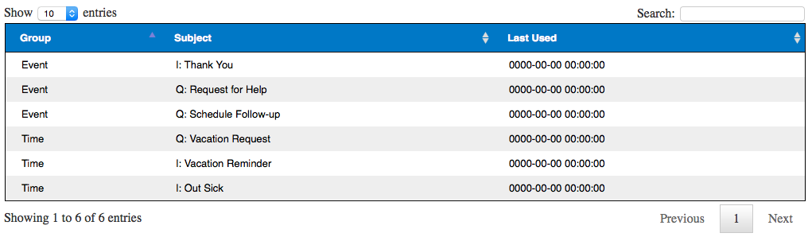
Customer Look 'n Feel (Continue)
Here is what the table looks like after our CSS updates.

Slide 11
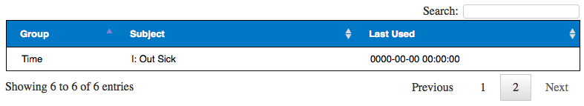
Pagination
With a little configuration, you can adjust how many rows are visible on a page. For example to lock how many our displayed to 5 rows per page, you can use the following.
<script>
$(document).ready(function () {
$('#myTable').dataTable({
pageLength: 5,
lengthChange: false,
});
});
</script>

Slide 12
Pagination (Continued)
You can even get fancy by keeping the height on the last result page the same as the previous pages.
<script>
$(document).ready(function () {
$('#myTable').dataTable({
pageLength: 4,
lengthChange: false,
fnDrawCallback: function (pref) {
var columnCount = $(this).children('thead').children('tr').children('th').length,
missing = pref._iDisplayLength - $(this).children('tbody').children('tr').length,
i;
for (i = 0; i < missing; i++) {
$(this).append('<tr class="space"><td colspan="' + columnCount + '">&nbsp;</td></tr>');
}
}
});
});
</script>

Slide 13
Row Selection
By adding some additional JavaScript, you can enable row selection.
<script>
$(document).ready(function () {
var table = $('#myTable').dataTable();
$('#myTable tbody').on('click', 'tr', function () {
$(this).toggleClass('selected');
table.$('tr.selected').not(this).removeClass('selected');
});
$('#myTable').click(function () {
table.row('.selected').remove().draw(false);
});
});
</script>

Slide 14
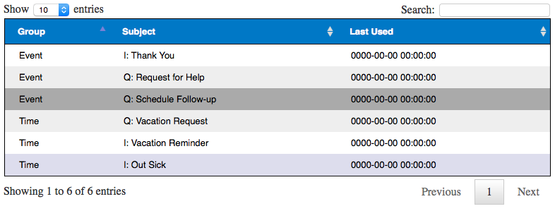
Row Selection (Continued)
Additional CSS can then be added to highlight the row further.
<style>
table.dataTable tbody tr.selected {
background-color: #aaa;
}
</style>

Slide 15
  Customizing Table Cells
If you want to combine data from two columns or want to add in links for each cell in a column, you can specify how it should be rendered.
<script>
$(document).ready(function () {
$('#myTable').dataTable({
"columnDefs": [
{
"render": function (data, type, row) {
return '<a href="mailto:' + row[0] + '">' + data + '</a>';
},
"targets": 1
},
{ "visible": false, "targets": [ 0 ] }
]
});
});
</script>

Slide 16
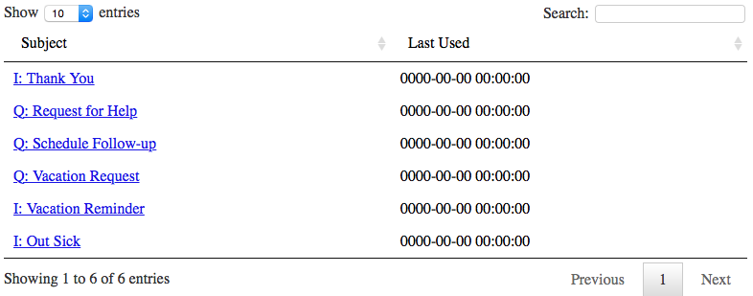
  Customizing Table Cells (Continued)
The subject now contains a mailto: link with the value of data showing earlier in the group column.

Slide 17
  Customizing Table Cells (Continued)
Additionally, you can specify widths of columns using different units such as em, px, pt, etc.
$(document).ready(function () {
$('#myTable').dataTable({
"columnDefs": [
{
"render": function (data, type, row) {
return '<a href="mailto:' + row[0] + '">' + data + '</a>';
},
"targets": 1
},
{
"visible": false,
"targets": [0]
},
{
"width": "25%",
"targets": 2
}
]
});
});
</script>

Slide 18
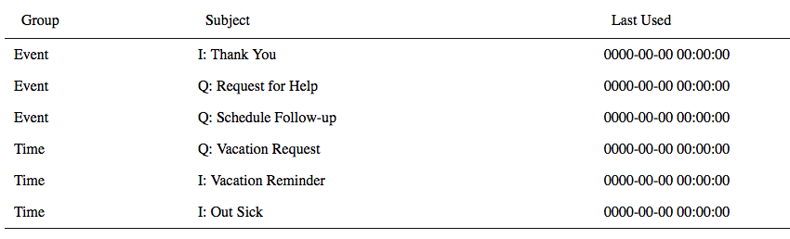
  Item counts, Sorting & Searching
These are on by default, but can be turned off.
<script>
$(document).ready(function () {
$('#myTable').dataTable({
bFilter: false, // Turns off search box
bPaginate: false, // Turns off pagination
bInfo: false, // Turn off number of entries count
bSort: false // Turn off sorting
});
</script>

Slide 19
Helpful Resources
https://www.datatables.net
http://www.codepug.com/wiki/riak-and-datatables

