Slide 1

Riak & jQuery DataTables Will they blend?
Tutorial Combining Two
Awesome Technologies
2015

Slide 2
Agenda
jQuery DataTables
Getting Started
Overview of Features
Demo
Riak
Overview and Demo
Will they blend?
Helpful Resources

Slide 3
What is it?
DataTables is a plug-in for jQuery JavaScript Library
Highly flexible tool to add interactive controls to HTML tables
Open Source – MIT license
Available for free!

Slide 4
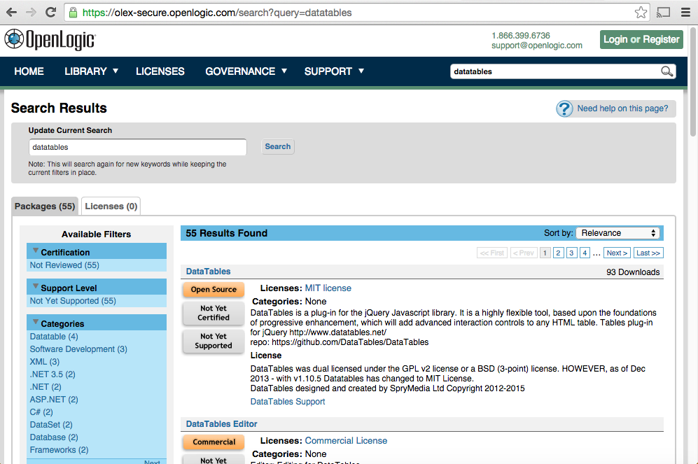
Getting Started with DataTables
Fetch the latest from OLEX (http://s.f/olex)

Slide 5
Overview of Features
jQuery DataTables
Getting Started
Overview of Features
Demo
Riak
Overview
Will they blend?

Slide 6
DataTables Demo

Slide 7
Helpful Resources
https://www.datatables.net
https://olex-secure.openlogic.com/packages/databales

