Slide 1
Detection and Robotic Manipulation of Partially Occluded Object(s)
Detecting partially occluded cylindrical objects for robotic manipulation: a multi-method comparison in 3D point clouds
Master's thesis · evaluation review
[FILL: presenter] · supervisor: [FILL: supervisor] · [FILL: date]

Slide 2
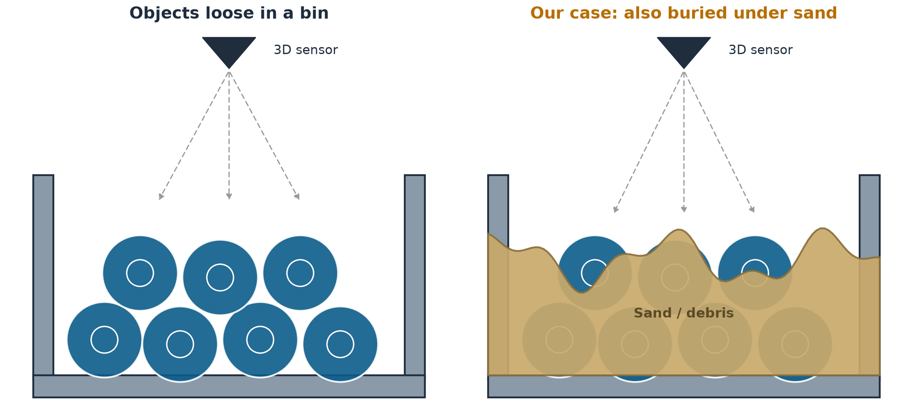
The bin-picking problem
Before the robot can grasp anything, it must know exactly where each object is and how it lies.
Detection and Robotic Manipulation of Partially Occluded Object(s)
1

Slide 3
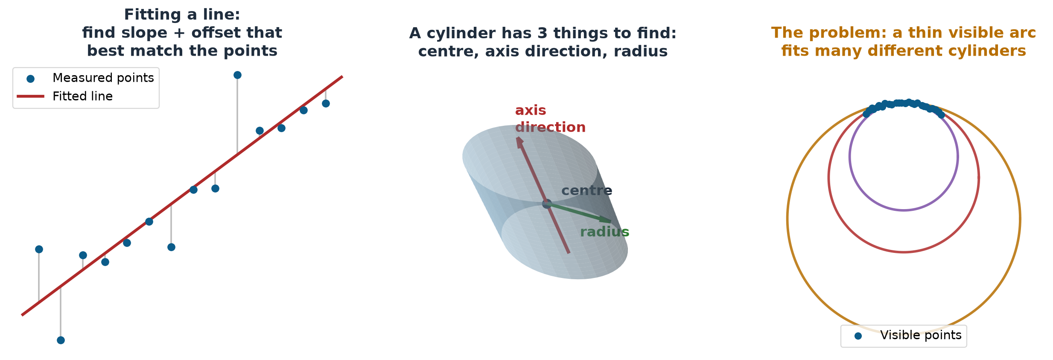
Our task: fit a cylinder to the visible points
“Fitting” = choosing model parameters so the model matches the measured points as well as possible
With a full view, fitting is easy — the difficulty starts when most of the object is hidden.
Detection and Robotic Manipulation of Partially Occluded Object(s)
2

Slide 4
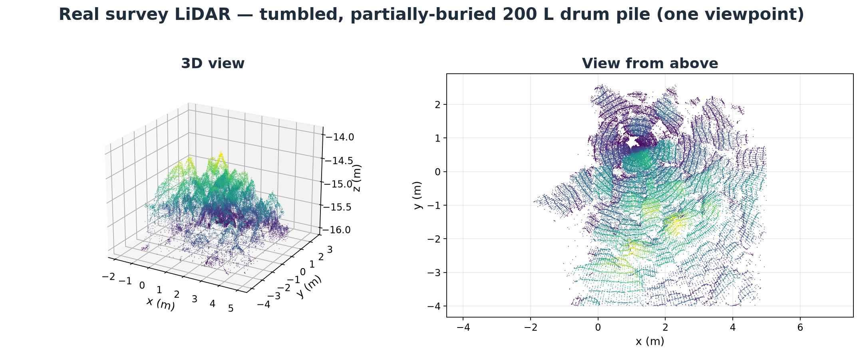
Our case is harder: the drums are covered
Real scan: 200-litre steel drums, tumbled and partially buried
• Drums lie in arbitrary directions.
• Sand and other drums hide most of each drum.
• The sensor sees the pile from one side only.
Each drum shows only a small patch — and a small patch fits many different cylinders.
Detection and Robotic Manipulation of Partially Occluded Object(s)
3

Slide 5
Existing solutions — three families of methods
From an 18-method literature survey; judged by how they cope with hidden objects
Geometry-based
Learning-based
Camera + LiDAR
Search the 3D points directly for cylinder shapes.
+ Works out of the box — no training data needed.
− Needs enough visible points; touching drums get merged.
A neural network learns what partial barrels look like from many examples.
+ Can recognise a barrel from a small fragment.
− Needs lots of labelled training examples first.
Combine colour images with the 3D points.
+ If one sensor is blocked, the other still sees the object.
− Both sensors must be aligned precisely — errors break the pairing.
We compare all three families on the same data — geometry first, since it needs no training data.
Detection and Robotic Manipulation of Partially Occluded Object(s)
4

Slide 6
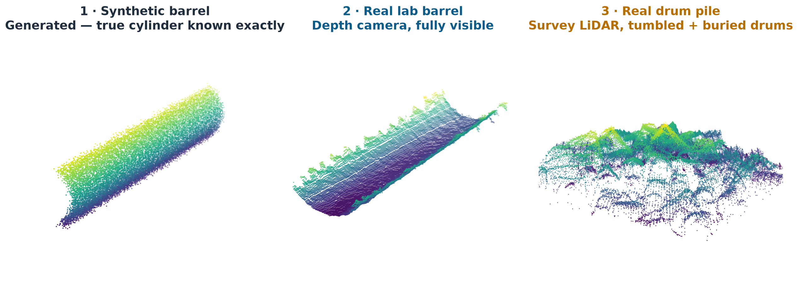
The data we test every method on
Three data sets — difficulty increases left to right
Synthetic clouds tell us the best case; the real pile tells us the truth.
Detection and Robotic Manipulation of Partially Occluded Object(s)
5

Slide 7
Four geometry-based methods implemented
• 3DTK Hough (baseline) — every point votes for the cylinders it could lie on; the strongest vote wins.
• RANSAC fit — try many random small point samples, keep the cylinder most points agree with.
• Least-squares fit — start from a rough guess, then adjust the cylinder until it matches the points best.
• Efficient RANSAC — a faster RANSAC variant that searches the whole scene for shapes in one pass.
All four: LiDAR points only · no training data · identical input and output — directly comparable.
Detection and Robotic Manipulation of Partially Occluded Object(s)
6

Slide 8
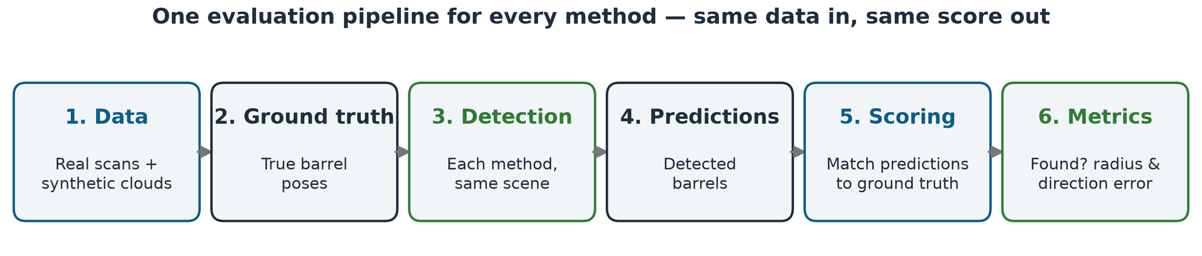
How we evaluate — one pipeline for every method
A prediction counts as correct if direction is within 30° and the centre within 10 cm of the true drum.
Detection and Robotic Manipulation of Partially Occluded Object(s)
7

Slide 9
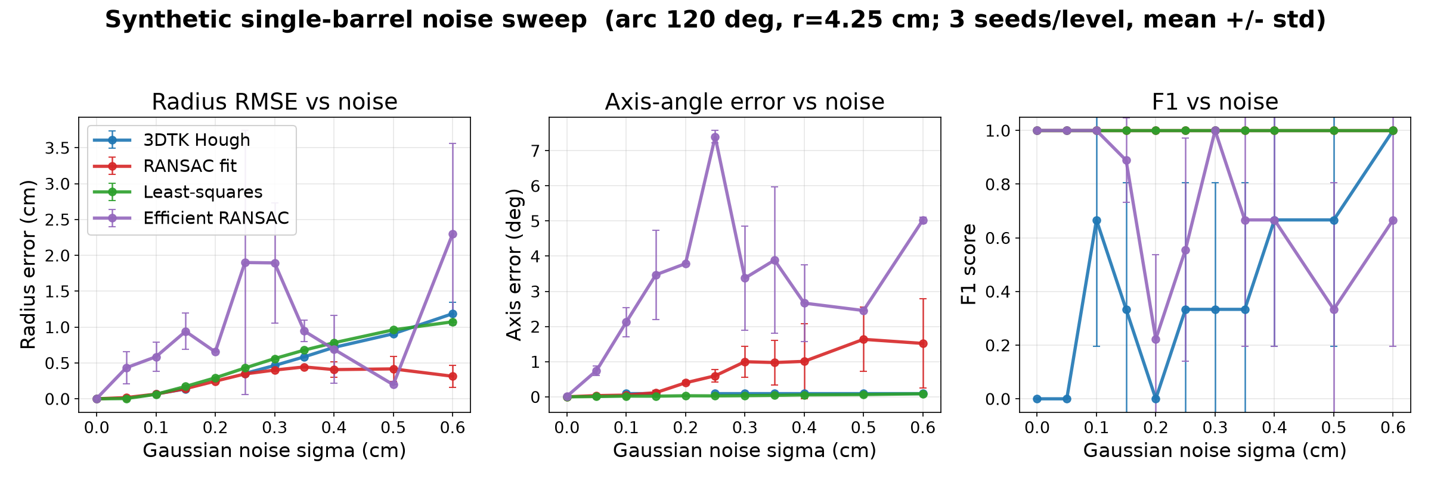
Experiment 1 — how much noise can each method take?
The synthetic barrel (120° visible) at 11 noise levels × 3 repeats = 33 test clouds
• RANSAC and least-squares find the barrel at every noise level (F1 = 1.00 / 1.00).
• Efficient RANSAC degrades first; the Hough baseline is erratic — it even misses some clean scenes.
• Least-squares is the most precise but ~5–10× slower than the others (~17 s per scene).
Detection and Robotic Manipulation of Partially Occluded Object(s)
8

Slide 10
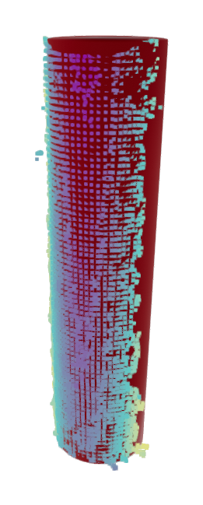
Experiment 2 — the real lab barrel, no occlusion
Depth-camera scan; true radius 4.25 cm
Method | Barrel found? | Radius error | Direction error
RANSAC fit | yes | 0.38 cm | 1.9°
Least-squares | yes | 0.47 cm | 1.6°
Efficient RANSAC | yes | 0.94 cm | 0.1°
3DTK Hough | yes + 1 false alarm | 0.09 cm | 1.5°
• All four methods find the barrel.
• Errors are ~6–8× larger than on synthetic data — real sensor noise is not the clean noise we simulate.
Camera points (coloured) with the fitted cylinder (red)
Detection and Robotic Manipulation of Partially Occluded Object(s)
9

Slide 11
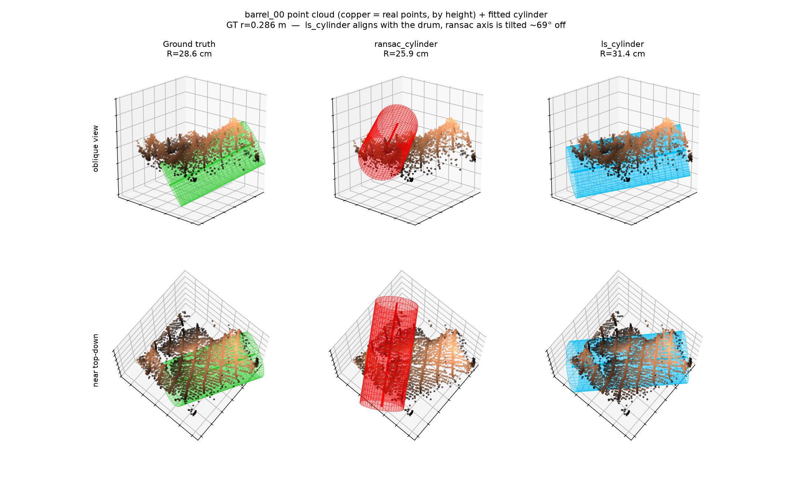
Experiment 3 — a real occluded drum from the pile
One tilted, half-buried 200 L drum cut out of the survey scan
• All four methods fail the accuracy gate here.
• Best attempt (least-squares): direction good (17°), centre off by 11.1 cm — misses the 10 cm gate by 1.1 cm.
• The others: direction far off, or no detection at all.
True drum (green) vs fitted cylinders on the real points
Occlusion is exactly where the classical methods break — motivating a learned method.
Detection and Robotic Manipulation of Partially Occluded Object(s)
10

Slide 12
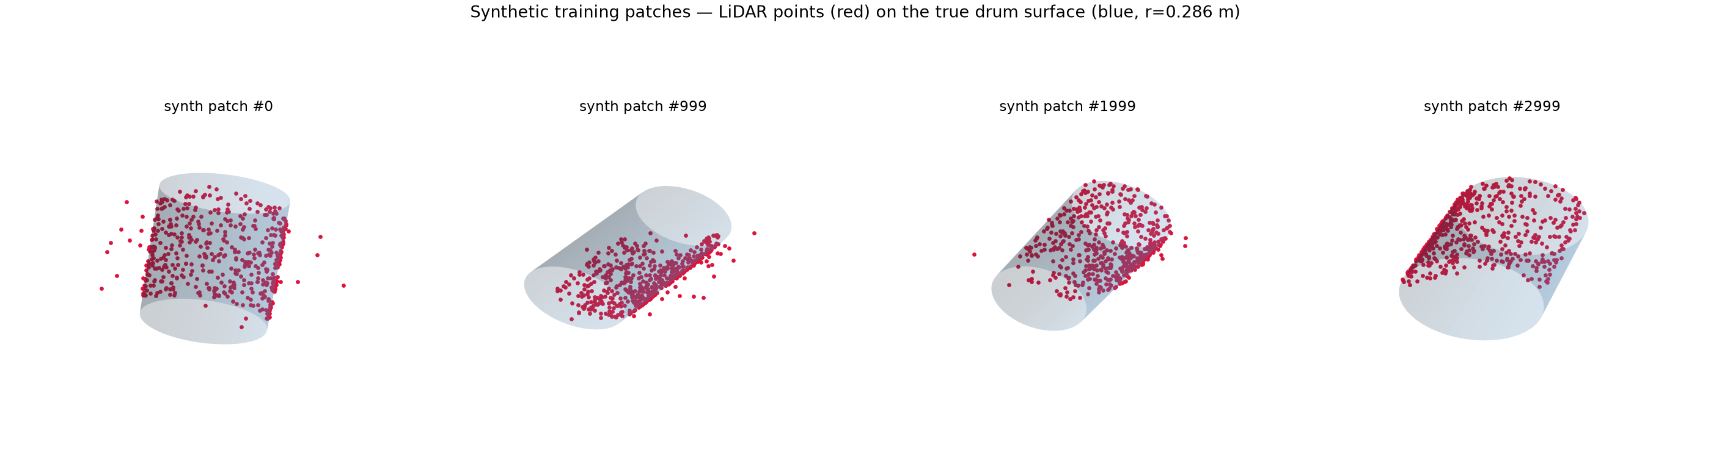
New: BarrelNet — our first learning-based method
A neural network that gets the points of ONE drum and outputs its pose (centre + direction)
Examples of the synthetic training patches: simulated LiDAR points (red) on the drum surface (blue)
• Trained on 12,000 such patches — buried, tilted, noisy, incomplete.
No real data in training: the 21 hand-verified real drums are kept aside as an honest test.
Detection and Robotic Manipulation of Partially Occluded Object(s)
11

Slide 13
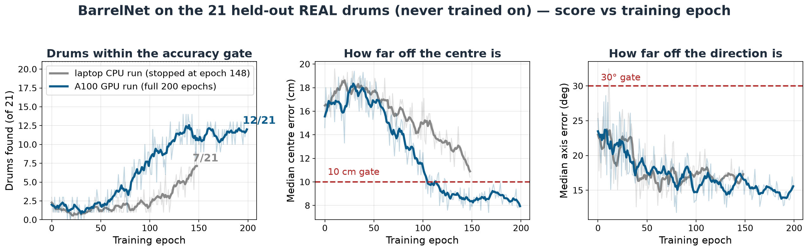
BarrelNet — how the score develops during training
Same network trained twice: laptop CPU (stopped early) vs GPU server (full schedule)
• Finishing the full training schedule nearly doubled the score: 7 → 12 of 21 real drums.
• The direction is learned early; the centre position improves late — it crosses the 10 cm gate only near the end.
Detection and Robotic Manipulation of Partially Occluded Object(s)
12

Slide 14
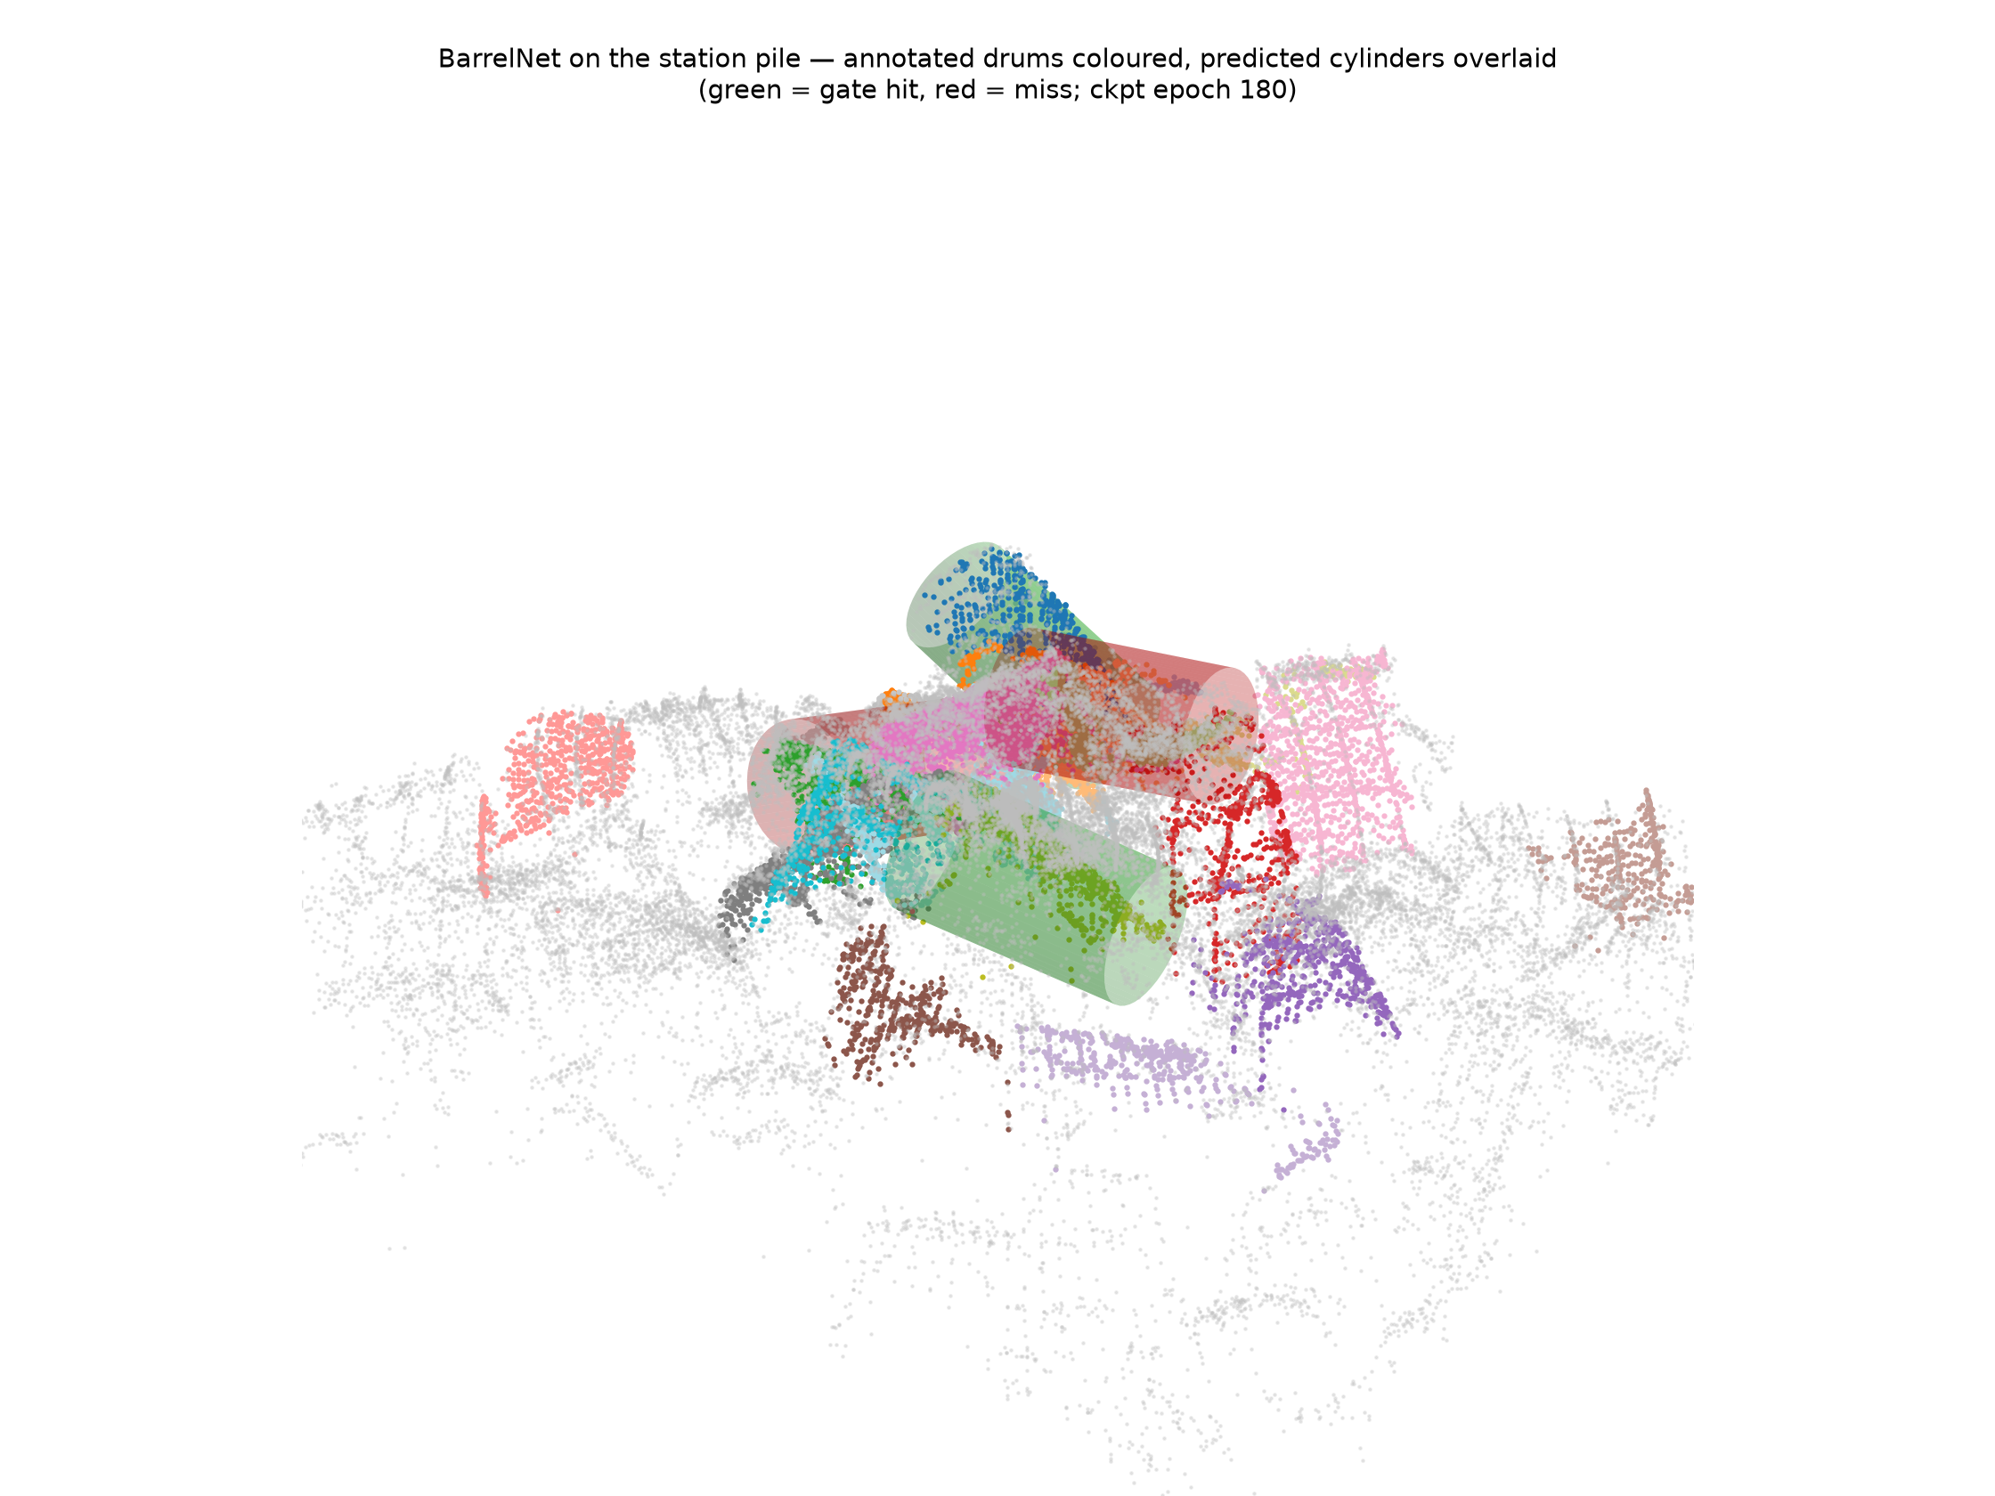
BarrelNet on the real drum pile
Trained purely on synthetic drums, tested on the 21 real ones
• 12 of 21 real drums located within the accuracy gate.
• Direction right on 16 of 21 drums.
• The geometric methods scored 0 on this kind of drum.
• Open point: BarrelNet estimates the pose of a drum it is given — finding the drums in the pile still needs a separate first step.
Annotated drums coloured; predicted cylinders: green = within gate, red = miss
Detection and Robotic Manipulation of Partially Occluded Object(s)
13

Slide 15
What limits the evaluation today
• Our synthetic scenes still cannot imitate a truly buried, cluttered pile.
• Real sensor noise is harder than anything we simulate — Experiment 2 showed 6–8× larger errors.
• Only 21 real drums are labelled (~30% of the pile) — too few for strong statistics.
• Some labels are imperfect: two drums lying end-to-end were annotated as one.
The evaluation machinery works — what is missing is more and better ground-truth data.
Detection and Robotic Manipulation of Partially Occluded Object(s)
14

Slide 16
Open risks — and how we deal with them
Risk | How we deal with it
Accuracy collapses under occlusion | Measure it per method — that comparison IS the thesis.
One sensor alone may not be enough | Add camera + LiDAR fusion — it degrades far more gracefully.
Sim-trained models may not transfer | Measured: 12 of 21 real drums; next, fine-tune on a few real ones.
Manipulation not started yet | Detection delivers exactly the pose a grasp planner needs.
Occlusion numbers: [Shi'19] arXiv:1812.04244 · [Kumar'25] arXiv:2511.04347 · [Wang'25] Sensors 25(9):2794
Detection and Robotic Manipulation of Partially Occluded Object(s)
15

Slide 17
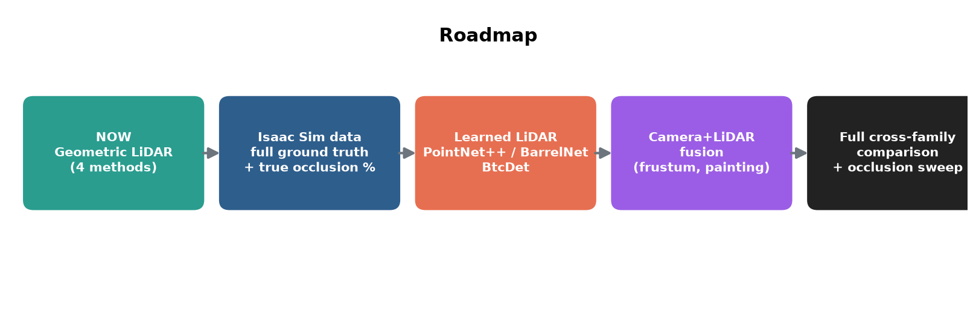
Next step: simulation closes the data gap
NVIDIA Isaac Sim gives unlimited scenes with perfect ground truth
• Every simulated drum comes with its exact pose and its exact degree of burial — labels for free.
• That enables the headline experiment: detection quality as a function of how much of the drum is hidden.
• And it unlocks the remaining families: more learned methods and camera + LiDAR fusion.
Detection and Robotic Manipulation of Partially Occluded Object(s)
16

Slide 18
Summary
• One fair evaluation pipeline — every method, same data, same score.
• Four geometry-based methods work well on visible barrels — and all fail on a truly occluded one.
• BarrelNet, trained only on synthetic drums, already finds 12 of 21 real occluded drums.
• Next: simulation-generated data for the occlusion sweep, fine-tuning, and sensor fusion.
Learned + simulated is the promising path for occluded drums — and we can now measure exactly how promising.
Detection and Robotic Manipulation of Partially Occluded Object(s)
17

Slide 19
Thank you!
Questions?

