Slide 1
Detection of Semi-Occluded Objects
Barrel / cylinder detection in 3D point clouds — a systematic comparison of methods
Master's thesis — progress review
[FILL: student name] · [FILL: supervisor] · [FILL: date]
Notes:
One sentence: detecting barrels in 3D point clouds and fairly comparing the methods that can do it, with a focus on occlusion.

Slide 2
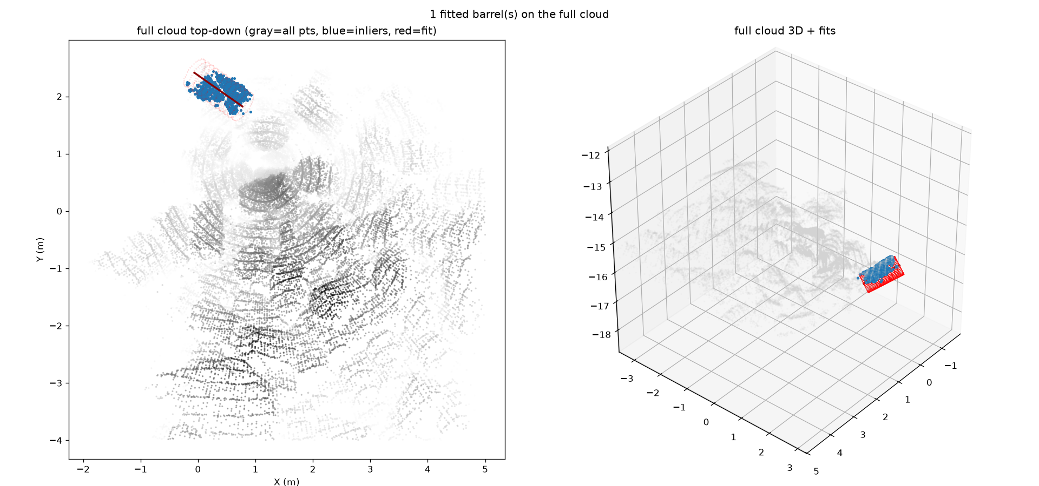
The Problem & Why It Matters
• Goal: find barrels (cylinders) in 3D point clouds and recover pose — center, axis, radius
• Real setting: drums partially buried in sand and mutually occluding in a pile
• Application: industrial / environmental survey of drum sites
• Hard part: one viewpoint often shows only a thin arc of each barrel, not the full surface
Notes:
Motivate with the buried/occluded drum pile — the scenario that makes naive cylinder fitting fail.

Slide 3
Background: Point Clouds & the Occlusion Challenge
• Point cloud = unordered 3D points; no connectivity, variable density
• Single-viewpoint scans give partial coverage: top caps, short walls, scan-shadows
• Occlusion -> each barrel may show only ~120-200° of arc -> ambiguous radius/axis
• Burial removes the bottom of the cylinder; clutter & ground hurt segmentation
• This is exactly where methods diverge — the right axis to benchmark on
Notes:
Occlusion is not an edge case here — it is the central difficulty and the variable I measure against.

Slide 4
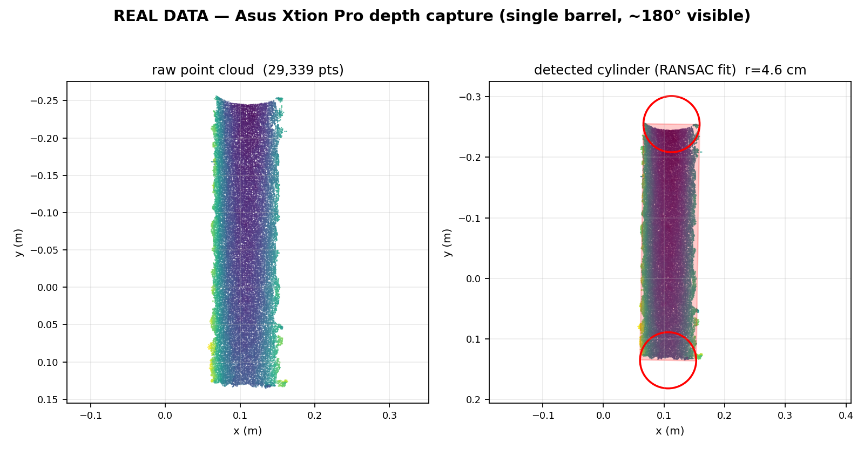
Sensors & Data Sources
• Asus Xtion Pro depth camera — lab captures (0.5-3.5 m); small ~8.5 cm test barrel
• Terrestrial / HV survey LiDAR — real occluded pile of 200 L drums (r=0.286 m), ~1.23 M pts
• Synthetic cylinders — analytic arcs + noise sweep for controlled tests
• Future: NVIDIA Isaac Sim — RTX LiDAR + co-registered camera, full ground truth (planned)
Notes:
Three real/synthetic sources today; simulation is the planned fourth that unlocks perfect ground truth.

Slide 5
Research Aim & Questions
• An empirical, systematic comparison — NOT defending one predetermined hypothesis
• RQ1: Which method detects barrels best, especially under occlusion / partial burial?
• RQ2: How do precision/recall & pose error move as occlusion increases, per method?
• RQ3: When does camera+LiDAR fusion beat LiDAR-only? Geometric vs learned once annotation cost counts?
• Trade-offs are findings to MEASURE, not assume
Notes:
Stress the framing: the deliverable is the comparison itself; every 'X beats Y' claim is a measurement.

Slide 6
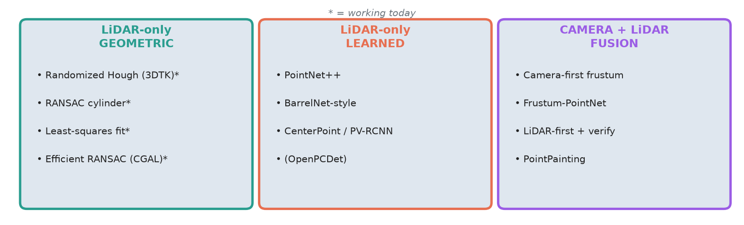
Methods Being Compared — Three Families
• Closest prior work: BarrelNet (Yan et al., OCEANS 2024) — PointNet on synthetic occluded/buried cylinders (no public code)
• Backed by a 9-page literature survey: 18-method comparison table + occlusion-suitability rubric
Notes:
Point to the survey PDF; note the families and that BarrelNet is the nearest neighbour to my problem.

Slide 7
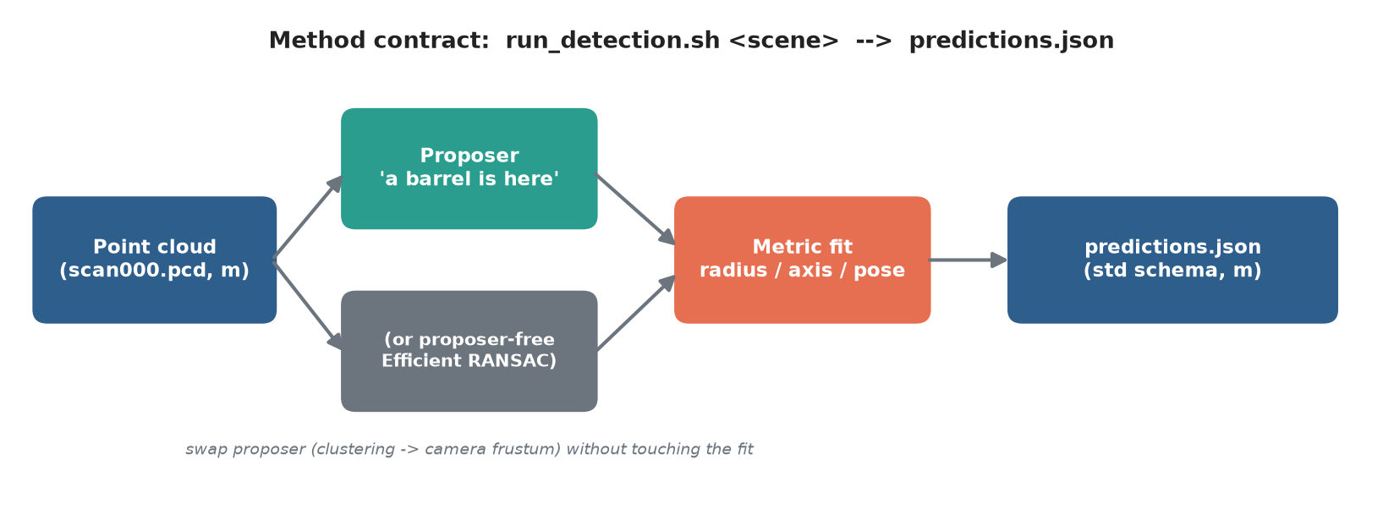
Architecture & Method Contract
• Key split: proposer ('a barrel is here') separated from the metric fit (radius/axis/pose)
• Uniform contract -> same data in, same predictions.json schema out -> method-agnostic, fair comparison
Notes:
This engineering backbone is what makes a fair comparison possible — every method plugs into the same harness.

Slide 8
Evaluation Pipeline
• Shared schema: gt.json (truth) vs predictions.json (per method), both in meters
• eval/evaluate.py matches predictions to GT and reports:
– Detection: Precision / Recall / F1 (AP@IoU planned)
– Pose: radius RMSE, axis-angle error (deg), center error
– Runtime per scan; annotation/training cost as a column (geometric vs learned fairness)
• Recall-vs-occlusion% curve is the headline metric once the sweep exists
Notes:
Highlight that I explicitly track annotation/training cost — otherwise learned methods look 'free'.

Slide 9
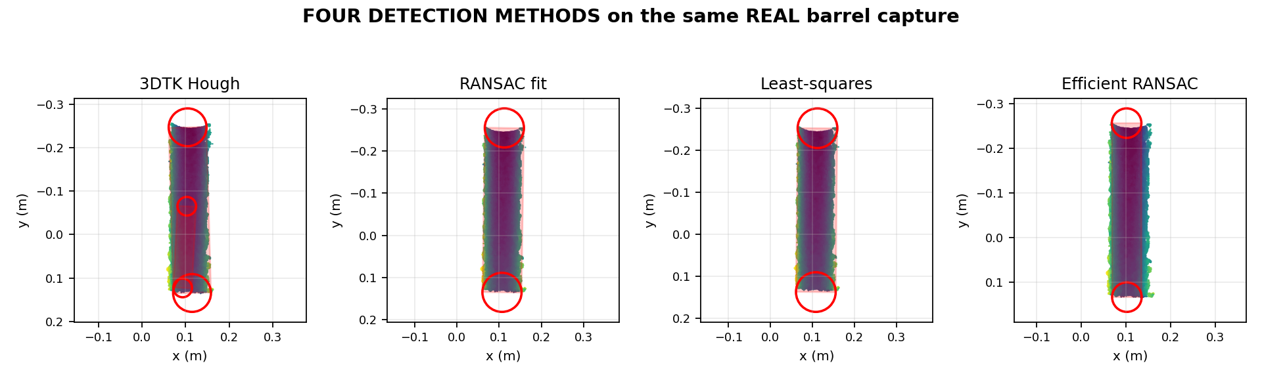
What Works Today: Four Geometric Detectors
• 3dtk_hough — baseline; 3DTK randomized 2-step Hough
• ransac_cylinder — shared proposer + normals2step fit (normal-covariance axis + 2D circle-RANSAC)
• ls_cylinder — shared proposer + nonlinear least-squares cylinder fit
• efficient_ransac — self-contained Schnabel/CGAL, NO proposer (removes proposer confound)
• All LiDAR-only geometric, no training data; reuse off-the-shelf code
Notes:
Four working methods cover the geometric family; methods 2&3 share a proposer (clean fit comparison), method 4 removes that confound.

Slide 10
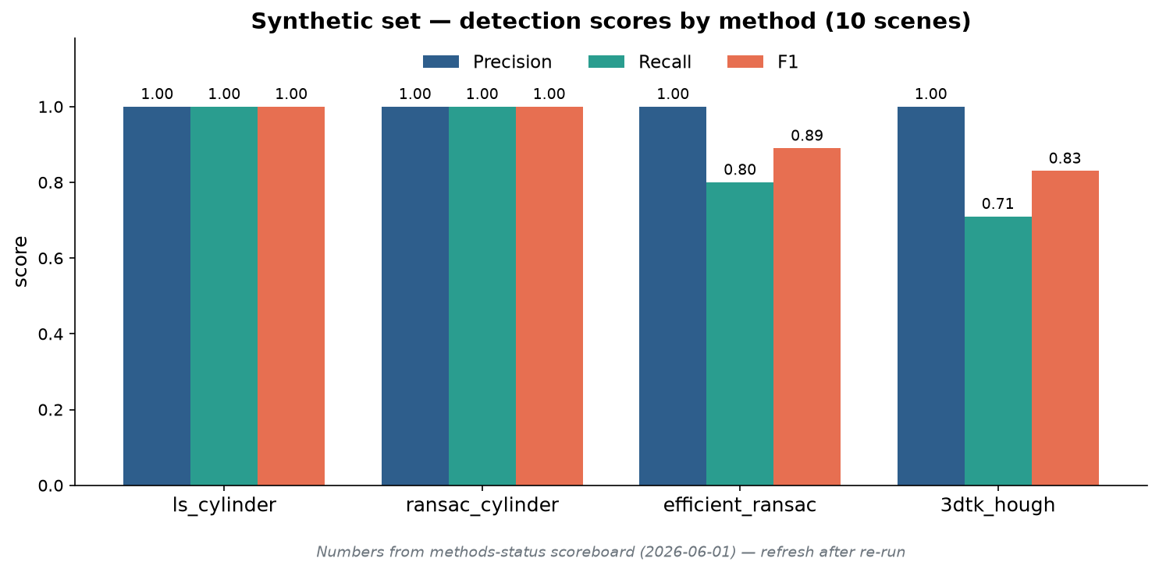
Preliminary Results [refresh after re-run]
• Synthetic: LS & RANSAC perfect P/R/F1; radius RMSE 0.06-0.40 cm; axis <0.5°
• Efficient RANSAC fastest (~0.05 s) but noise-sensitive (R 0.80)
• First real (Xtion): all 4 detect (recall 1.0); radius err ~6-8x synth
– 3dtk_hough: phantom 2nd cylinder (P=0.50), non-deterministic
• Caveat: synth set ~one occlusion level — does NOT yet test occlusion
• [FILL] drop in refreshed numbers from eval/*.csv after the re-run
Notes:
Be honest: perfect synthetic recall is one easy pose; the real and occlusion stress-tests are the point and aren't done. Bar chart uses scoreboard numbers (2026-06-01) — a methods agent is re-running now.

Slide 11
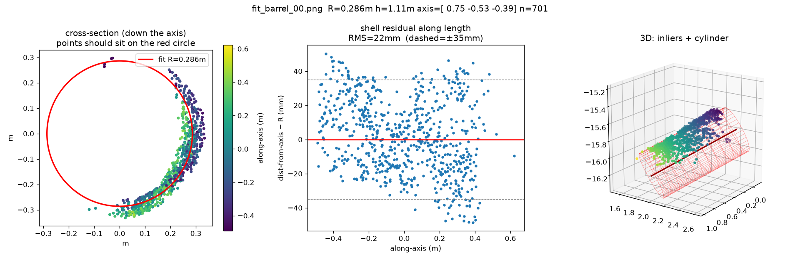
Data & Annotation Work
• Synthetic generator: analytic arcs (--arc-deg), radial normals, noise variants
• Real Xtion captures via ROS 2; crop pipeline (voxel -> RANSAC planes -> DBSCAN -> priors)
• Real occluded survey scene cropped from the 1.23 M-pt scan
• GT pipeline (works): CloudCompare crop one drum -> fit_from_segments.py -> gt.json
– 'Human marks the region, code fits the cylinder'
• First real GT: tilted barrel, R 0.286 m, fit RMS 22 mm
Notes:
'Human marks the region, code fits the cylinder' is how I get ground truth on arbitrarily-oriented real drums.

Slide 12
Challenges Encountered
• No-GUI host: Wayland laptop can't run 3DTK show / CloudCompare -> Docker + VNC/EGL headless
• Units: 3DTK cm vs Open3D/PCD m vs schema m — a recurring source of bugs
• Occlusion/viewpoint: single overhead view = caps + short walls -> RANSAC over-segments
• Annotation cost: no mouse/right-click -> cross-section box; coaxial drums can't be split
• Environment: system Python 3.14 has no deps -> project runs in a uv venv (3.12)
Notes:
Frame the survey-scan over-segmentation as a finding (hard-occlusion case study), not just a bug — it motivates the simulated multi-position data.

Slide 13
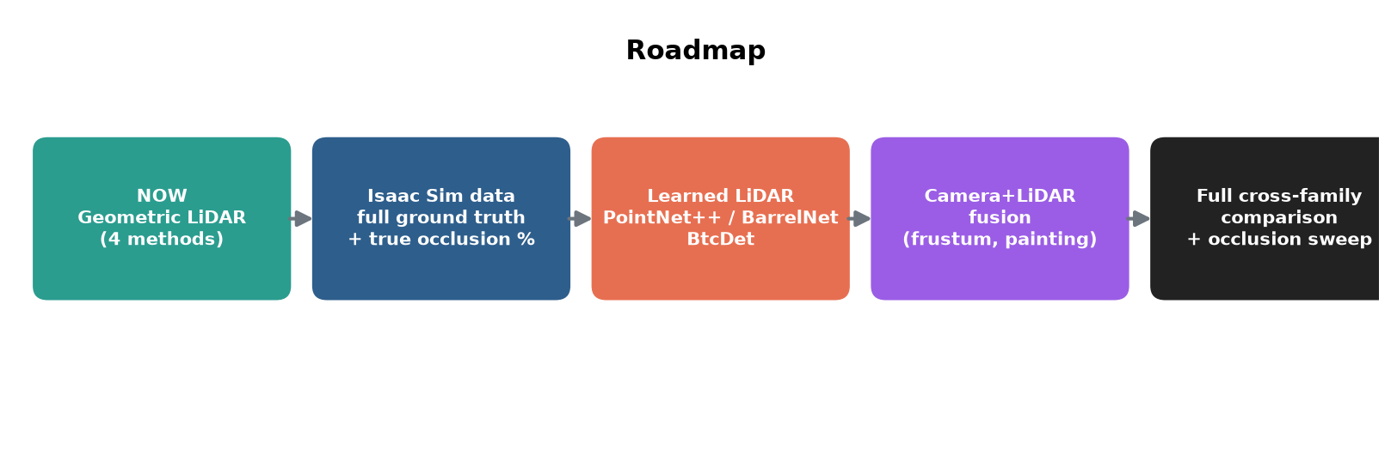
Future Plan / Roadmap
• Isaac Sim dataset: per-barrel GT, masks, true occlusion %; sweep count/spacing/burial/occlusion
• Occlusion sweep: recall + pose error vs true occlusion %, per method (headline result)
• Learned LiDAR (PointNet++/BarrelNet, BtcDet) + camera+LiDAR fusion; calibration-noise experiment
Notes:
Isaac Sim is the unlock — free perfect ground truth that the learned methods and the occlusion sweep both need.

Slide 14
Timeline, Next Steps & Summary
• Done: comparison harness + schema; 4 geometric LiDAR methods; synth + first real scoring; GT pipeline; survey
• Next (near-term): run all 4 on the real survey drum segment untuned; occlusion sweep on synth data
– [FILL: dated month-by-month timeline]
• Then: Isaac Sim data -> learned methods -> fusion -> full cross-family comparison
• Summary: contribution is a fair, method-agnostic comparison of barrel detectors under occlusion
Notes:
Close on the contribution: not one detector, but a grounded comparison. Add a concrete timeline before presenting.

