Slide 1
Detection and Manipulation of Semi-Occluded Objects
Barrel detection in 3D point clouds — benchmarking LiDAR-only and camera–LiDAR fusion methods
Master's thesis · Bharath · June 2026

Slide 2
Approach: a method-agnostic benchmark, scaled to simulation
• Standardised I/O contract: every detector consumes the same point cloud and emits a parametric cylinder (radius, axis, axis-point, extent) — evaluation is therefore method-agnostic and identical across methods.
• Stage 1 — establish and validate the metric fit on controlled input:
– synthetic clouds with analytic ground truth, plus real depth captures for sim-to-real transfer.
• Stage 2 — scale ground-truthed data generation with NVIDIA Isaac Sim:
– per-barrel pose/size/count, instance & semantic segmentation, RTX LiDAR matched to the real sensor with a co-registered camera; scripted occlusion, burial depth and inter-barrel spacing.
• Stage 3 — extend the benchmark from LiDAR-only geometric to learned detectors and camera–LiDAR fusion, scored on the same metrics.
• Metrics: precision / recall / F1, radius RMSE, axis-angle error, recall vs. occlusion fraction, runtime; annotation/training cost tracked so geometric and learned methods compare fairly.
Detection and Manipulation of Semi-Occluded Objects
2

Slide 3
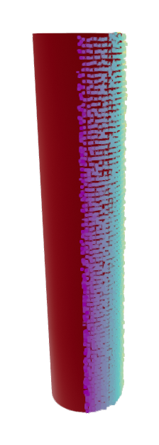
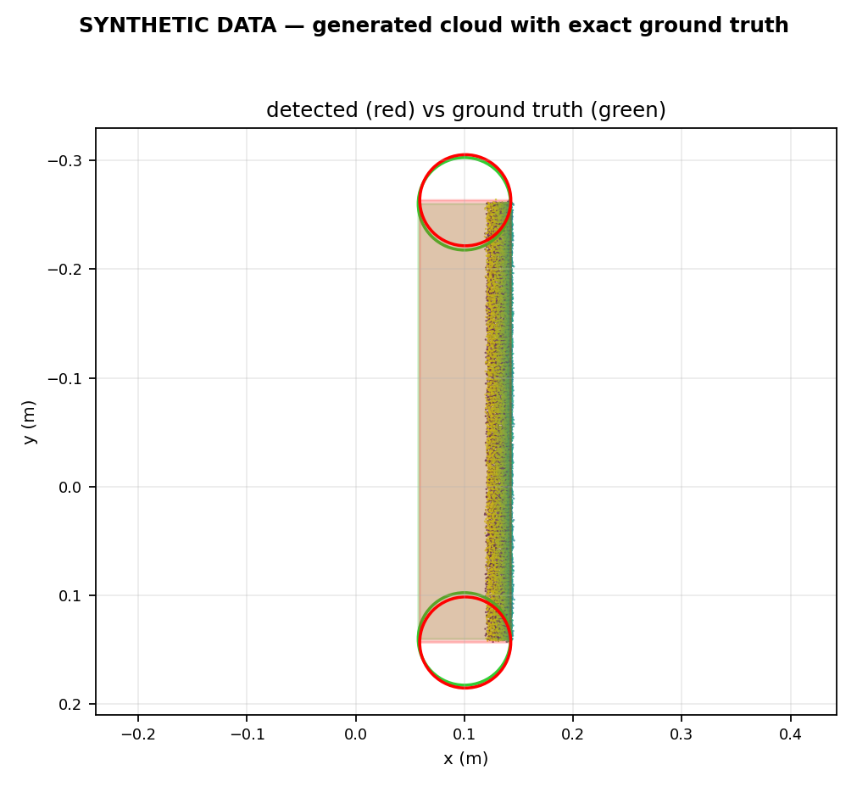
Validation on synthetic clouds with analytic ground truth
Generated cylinders with analytic radial normals — exact (radius, axis, centre) known
• Red = detected cylinder, green = ground truth — near-exact overlap.
• Set spans a one-sided ~120° arc (Xtion-like partial view) and an additive Gaussian-noise sweep (σ = n0.1–0.3).
• Top methods: P = R = F1 = 1.00; radius RMSE < 0.5 cm; axis-angle error < 0.5°.
• Upper bound on fit accuracy where truth is exact, before real-sensor noise.
SYNTHETIC DATA
3D: fitted barrel + synthetic points
2D overlay: detected (red) vs ground truth (green)
Detection and Manipulation of Semi-Occluded Objects
3

Slide 4
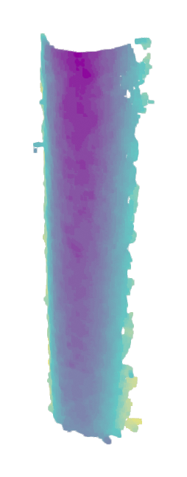
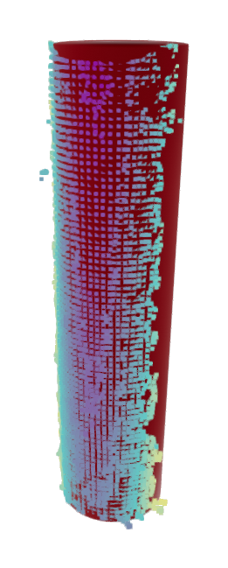
Transfer to real depth captures
Asus Xtion Pro, single barrel, ~180° of the surface visible (one-sided view)
• Pipeline: depth → surface-normal estimation (Open3D) → cylinder fit.
• RANSAC fit: radius 4.63 cm vs. 4.25 cm physical (error 0.38 cm).
• Axis-angle error 1.85° against the vertical reference.
• Real-sensor radius error ~6–8× the synthetic figure — quantifies the sim-to-real gap.
REAL DATA
raw depth cloud
fitted barrel (red) + measured points
Detection and Manipulation of Semi-Occluded Objects
4

Slide 5
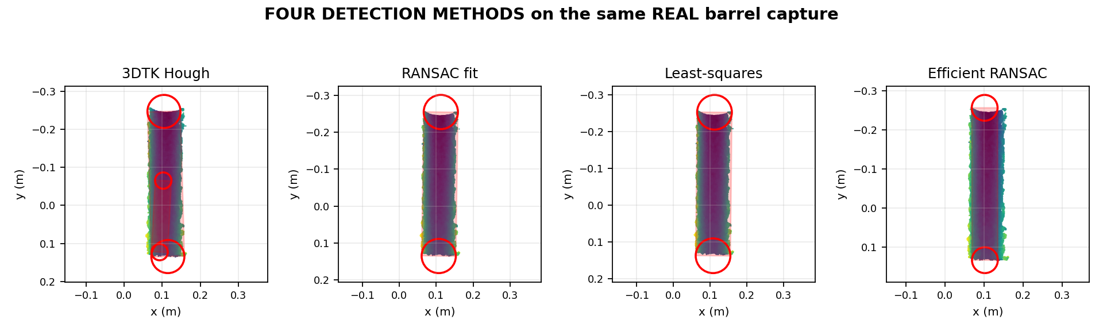
Four LiDAR-only geometric detectors on identical input
Same real barrel cloud — four independent algorithms
• 3DTK randomized 2-step Hough (baseline) · RANSAC primitive fit · nonlinear least-squares cylinder fit · Schnabel Efficient RANSAC (CGAL).
• Architecture: a clustering proposer feeds a reusable metric fit; Efficient RANSAC is self-contained (no proposer) — isolating the proposer as a confound.
• The baseline emits a phantom secondary cylinder (panel 1 centre) and is non-deterministic; the seeded fitting methods stay clean.
Detection and Manipulation of Semi-Occluded Objects
5

Slide 6
Quantitative accuracy on the real capture
Identical metric applied to every method (axis-angle, radius error vs. known drum)
Method | Radius error | Axis-angle error | Runtime
RANSAC primitive fit | 0.38 cm | 1.85° | ~0.7 s
Nonlinear least-squares | 0.47 cm | 1.64° | ~9 s
Efficient RANSAC (Schnabel) | 0.94 cm | 0.10° | ~0.05 s
3DTK Hough (baseline) | 0.09 cm | 1.53° | —
• All methods recover radius to ~1 cm and axis to ~2°; operating points differ — Efficient RANSAC fastest, fitting methods most robust, the baseline over-reports (a phantom second cylinder).
• Single-barrel, low-clutter scene at ~180° visibility — the discriminating regime (occlusion, burial, clutter, multiple instances) is the next experiment.
Detection and Manipulation of Semi-Occluded Objects
6

Slide 7
Status: implemented vs. pending
Implemented
• Method-agnostic capture → detect → evaluate pipeline with a shared schema
• 4 LiDAR-only geometric detectors (Hough, RANSAC, LS, Efficient RANSAC)
• Validated on synthetic ground truth + first real captures
• Literature survey of ~18 methods across the three families
Pending
• Occlusion sweep: recall and pose error vs. occlusion fraction (the headline experiment)
• Learned detectors (PointNet++ / BarrelNet-style, occlusion-aware BtcDet) — require labelled training data
• Multi-instance and cluttered real scenes (exercises the proposer)
• Camera–LiDAR fusion pipeline (camera-first and LiDAR-first)
• Validation on a real industrial test-site dataset
Detection and Manipulation of Semi-Occluded Objects
7

Slide 8
Simulation pipeline & fusion strategy
NVIDIA Isaac Sim — ground-truthed data engine
• Replicator yields per-barrel pose/size/count, 3D boxes and instance/semantic masks for free.
• RTX LiDAR matched to the real sensor; perfectly co-registered camera (known extrinsics).
• Scripted scenes sweep barrel count, spacing, burial depth and mutual occlusion.
• True occlusion fraction (visible/total surface points) gives a grounded x-axis for the occlusion sweep.
• Supplies the labelled training set the learned detectors require.
Camera–LiDAR fusion
• Camera-first: image detection → frustum → constrained 3D fit (e.g. Frustum-PointNet).
• LiDAR-first: 3D proposals → image verification / point painting.
• Hypothesis to test, not assume: fusion's recall advantage under occlusion vs. LiDAR-only.
• Calibration-noise injection: perturb the (sim-perfect) camera–LiDAR extrinsics to find where any fusion advantage degrades — a key real-world failure mode.
Detection and Manipulation of Semi-Occluded Objects
8

Slide 9
Requirement specifications & dataset request
Inputs needed to parameterise the simulation and validate on real operating conditions
Target specification
• What is the barrel size? (nominal dimensions / drum standard, e.g. 200 L)
• Are the barrels damaged or discoloured? (dents, rust, crushing; surface colour & finish)
• How much of each barrel is occluded? (burial, stacking, clutter — i.e. typical visible fraction)
Scene specification
• How many barrels per scene, and their arrangement?
• Operating environment: indoor/outdoor, substrate, illumination, airborne dust.
Sensor & data specification
• Test-site recordings: LiDAR + camera — time-synced only if available; extrinsic calibration where available.
• Sensor suite: LiDAR model (channels / FoV / range), camera resolution; platform & mounting (robot / drone / fixed), motion.
• Any annotations: barrel positions, counts, sizes (even approximate).
Operational requirements
• Required positional & radial accuracy, effective range, latency (online vs. offline), acceptable FP/FN trade-off.
Detection and Manipulation of Semi-Occluded Objects
9

Slide 10
Summary & next step
A method-agnostic benchmark with four LiDAR-only geometric detectors is operational and quantified on synthetic and real data (radius ~1 cm, axis ~2°).
• Next: occlusion/burial sweep via Isaac Sim, learned detectors, and camera–LiDAR fusion — all on the same metrics.
• A calibrated test-site dataset would parameterise the simulation and validate under real operating conditions.

