Slide 1
Discrete Mathematics
Preliminary Mathematics

Slide 2
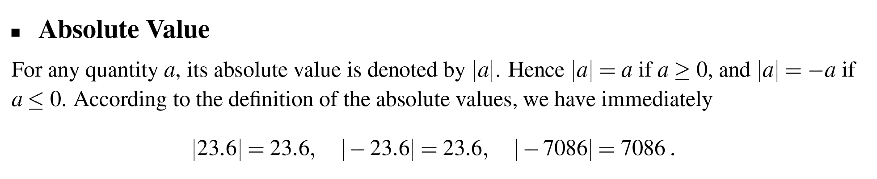
Absolute Value

Slide 3
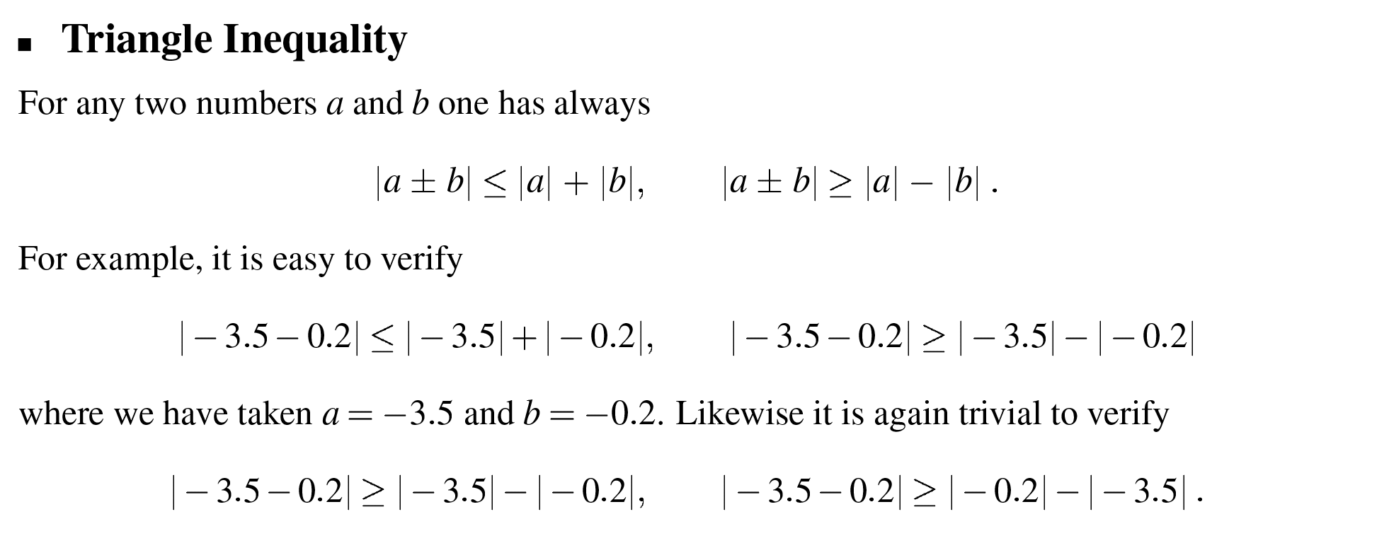
Triangle Inequality

Slide 4
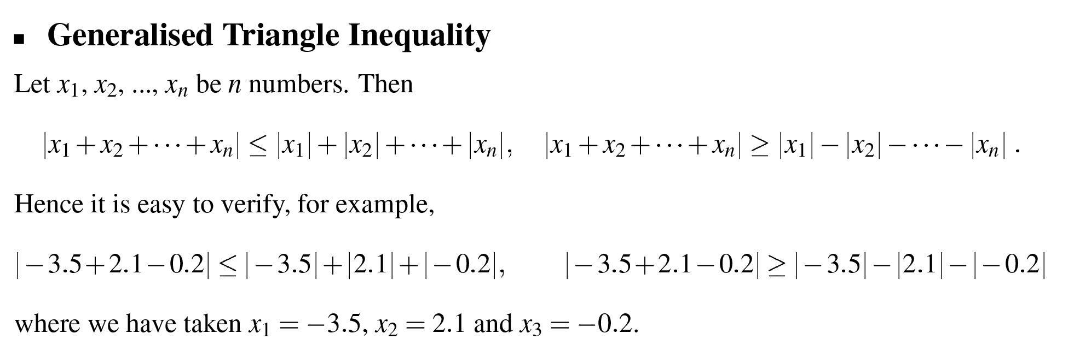
Generalised Triangle Inequality

Slide 5
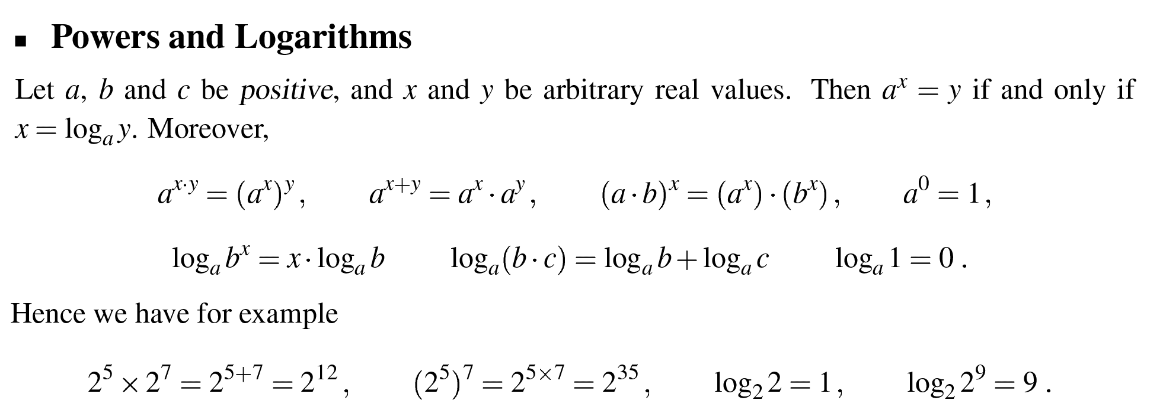
Powers and Logarithms

Slide 6
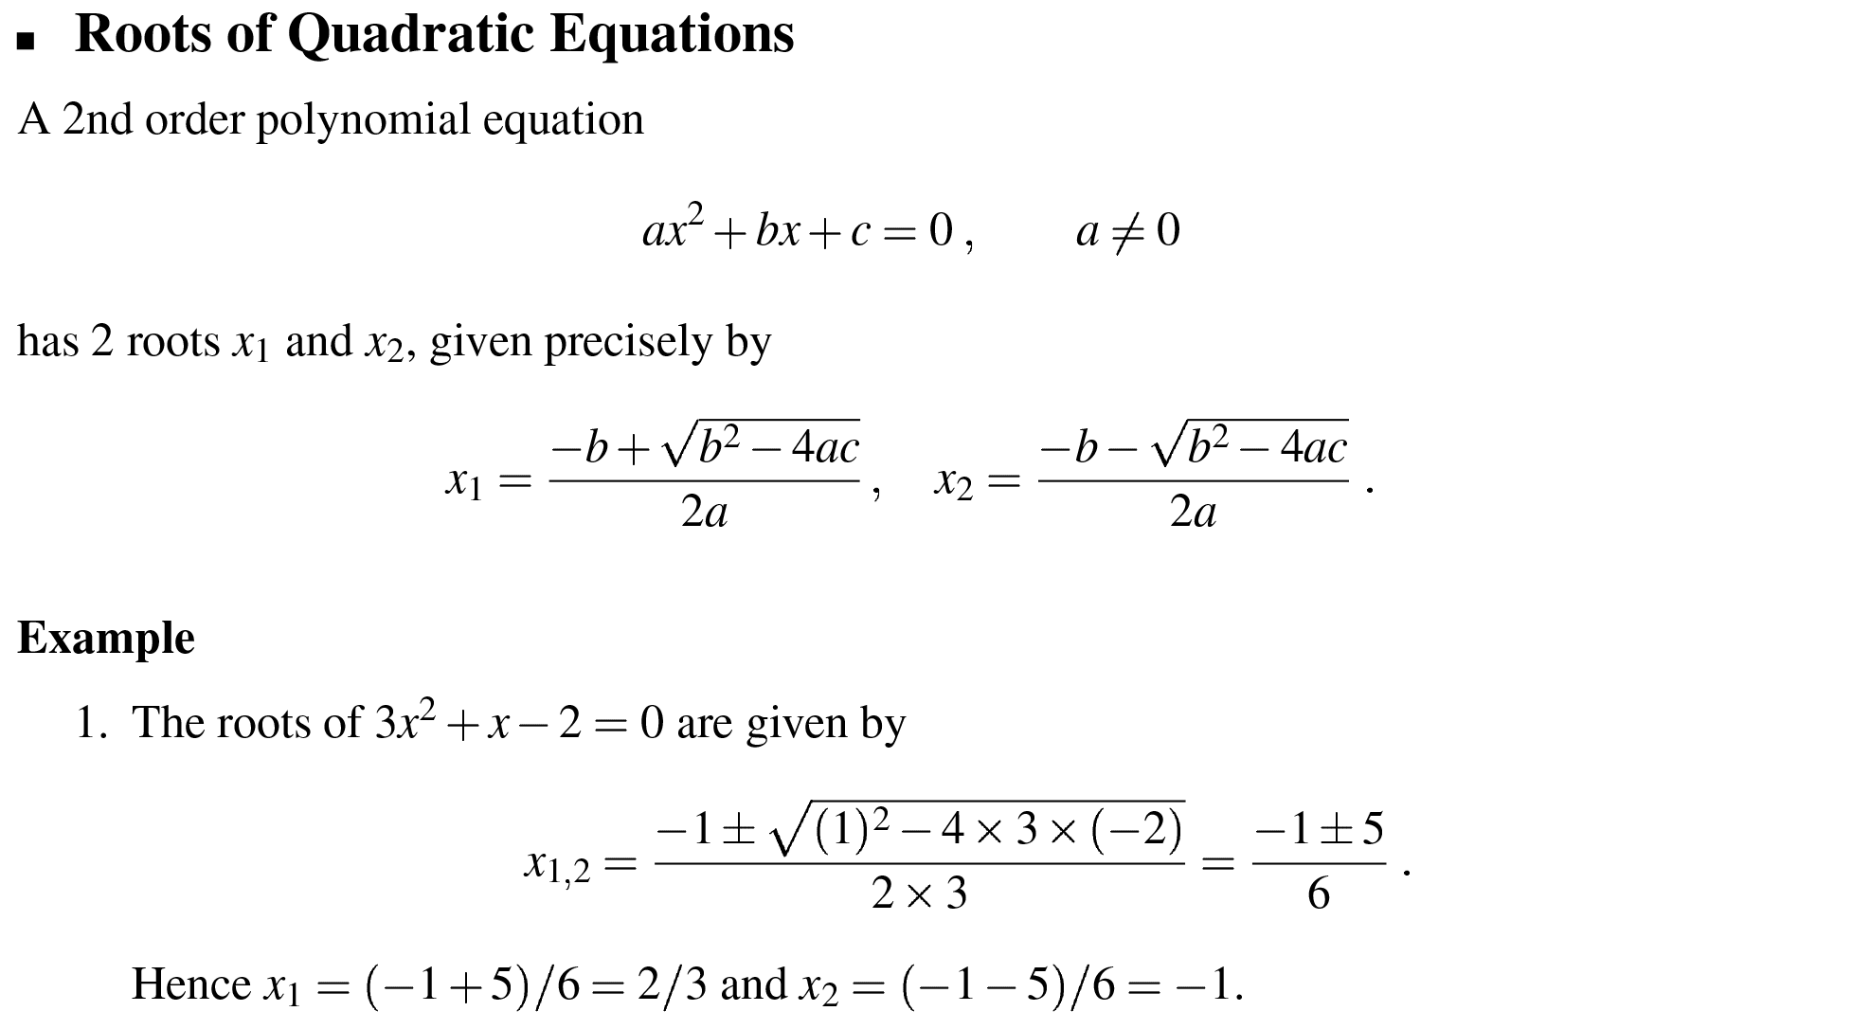
Root of Quadratic Equations

Slide 7
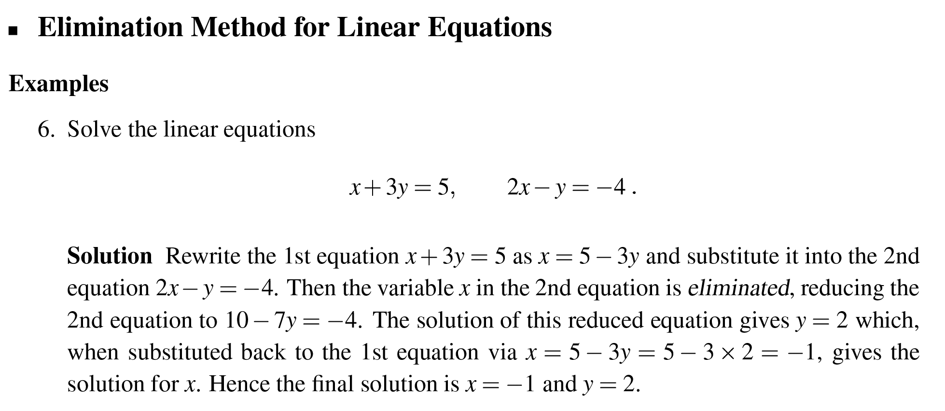
Elimination Method for Linear Equations

Slide 8
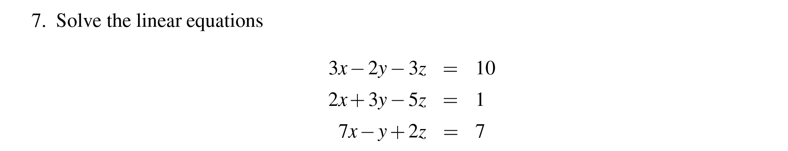
Elimination Method for Linear Equations

Slide 9
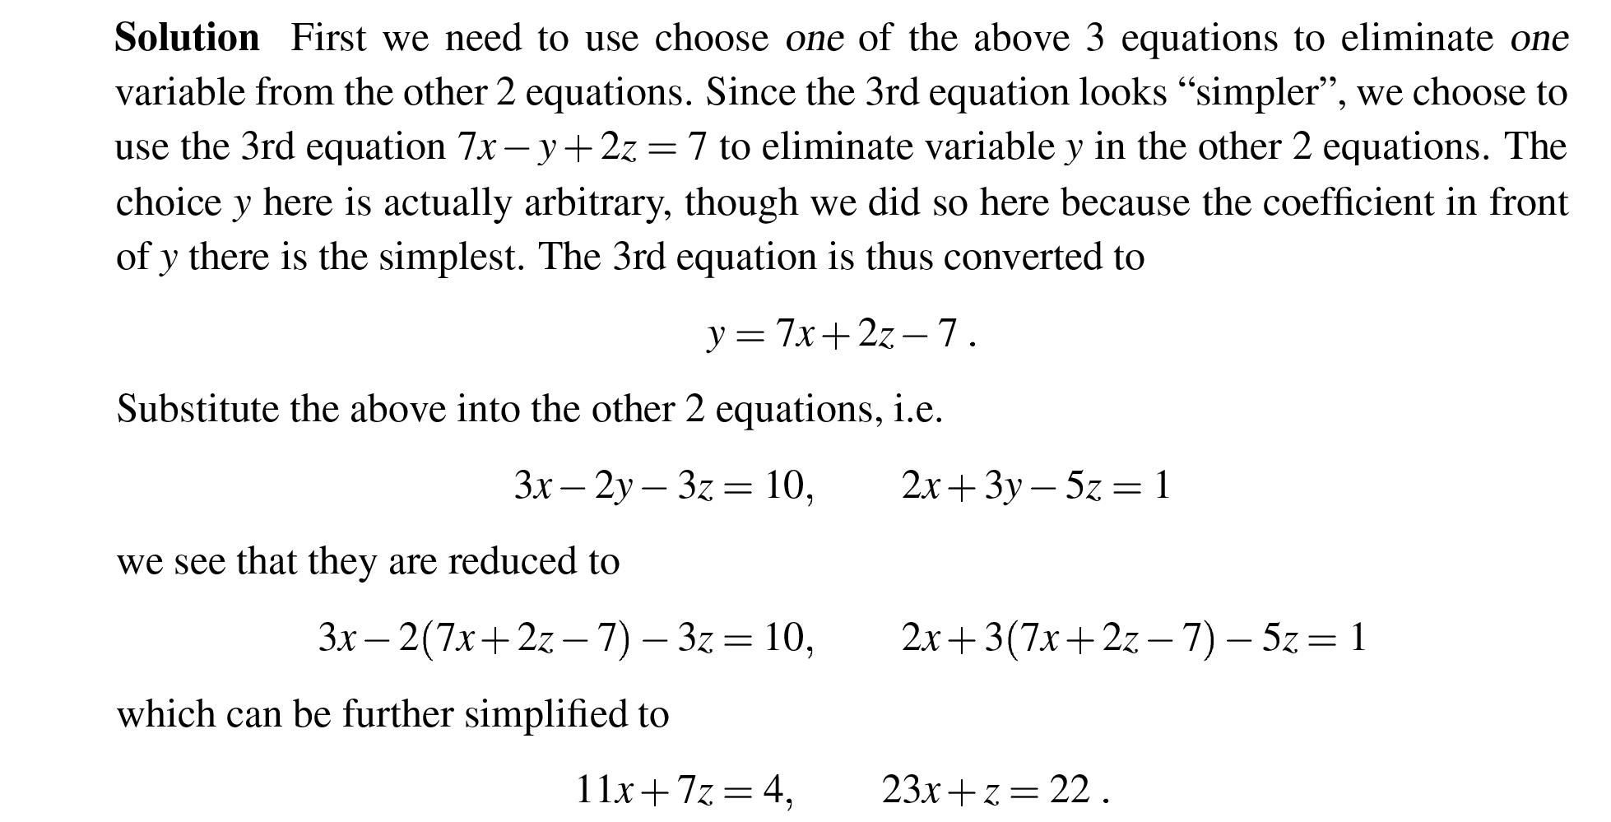
Elimination Method for Linear Equations

Slide 10
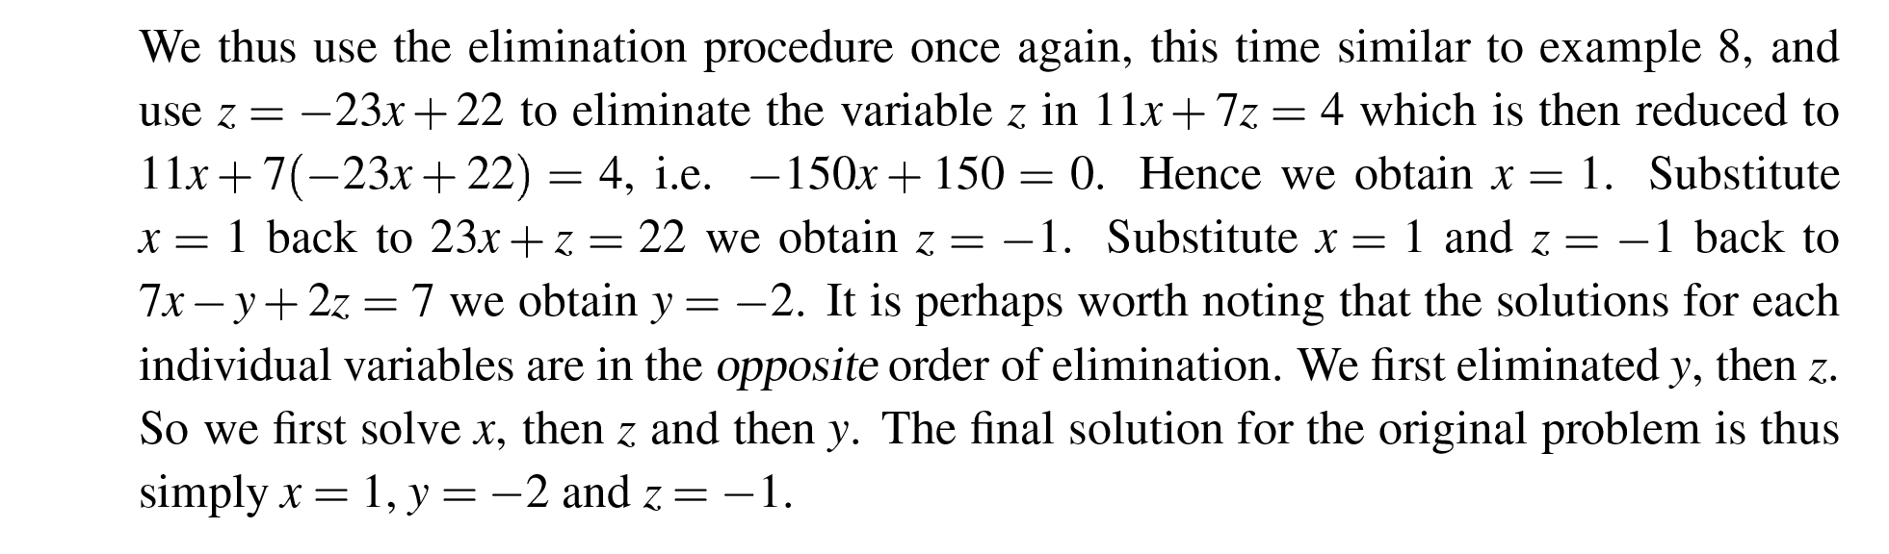
Elimination Method for Linear Equations

Slide 11
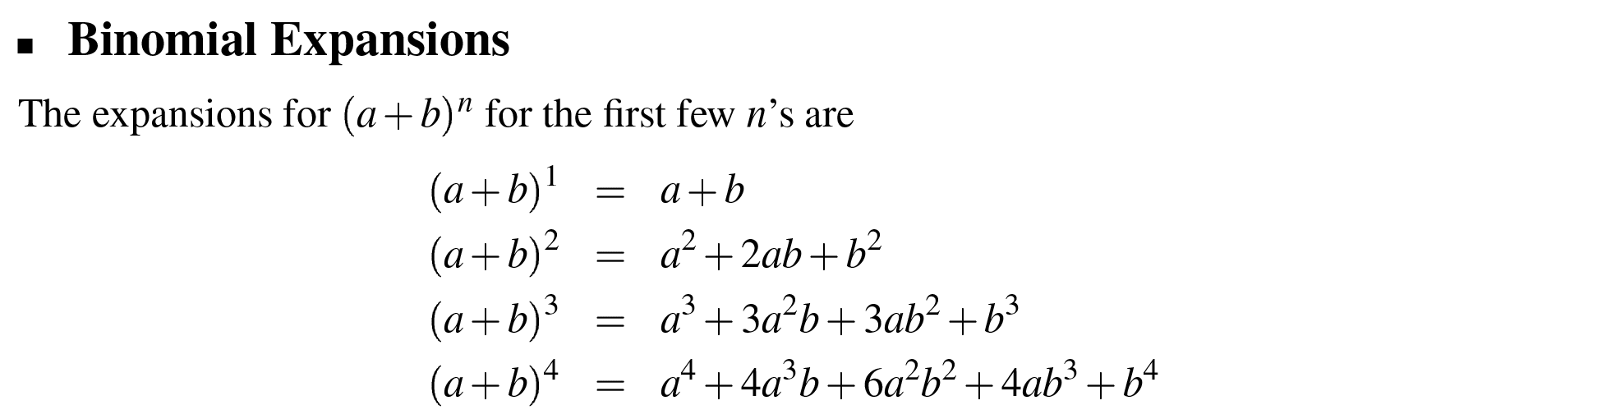
Binomial Expansions

Slide 12
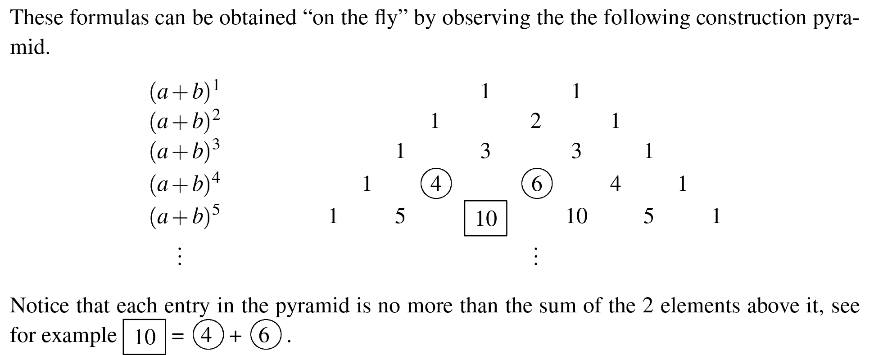
Binomial Expansions

