Slide 1
Project #2
Ruby on Rails
Sheena Takkenberg

Slide 2
DESIGN WALKTHROUGH

Slide 3
Design Walkthrough
What exactly is my project?
What’s the problem? THIS
Trello
Balsamiq

Slide 4
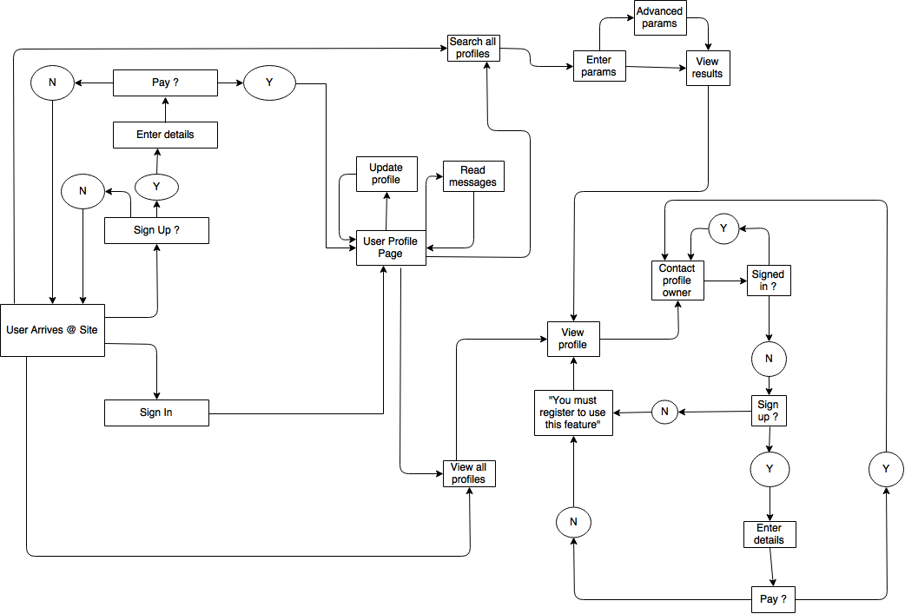
U
S
E
R
J
O
U
R
N
E
Y

Slide 5
Review of build process

Slide 6
Rails review
Coding challenges – Devise & Country Select
Favourite parts – Designing it & Truncate

Slide 7
App Walkthrough

Slide 8
Questions

