Slide 1
Blockchain(Creating a Cryptocurrency)

Slide 2
What is Blockchain?
A blockchain, originally block chain, is a growing list of records, called blocks, that are linked using cryptography. Each block contains a cryptographic hash of the previous block, a timestamp, and transaction data.

Slide 3
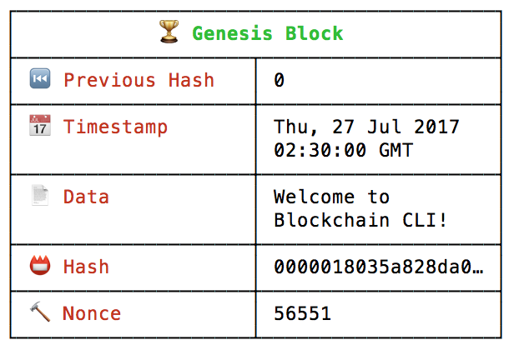
Genesis Block of a Blockchain

Slide 4
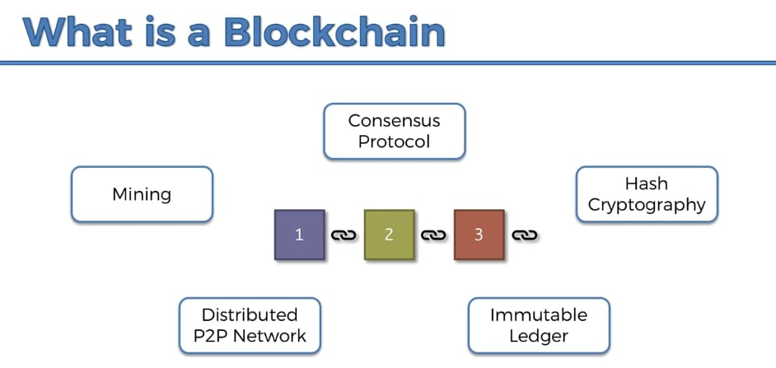

Slide 5
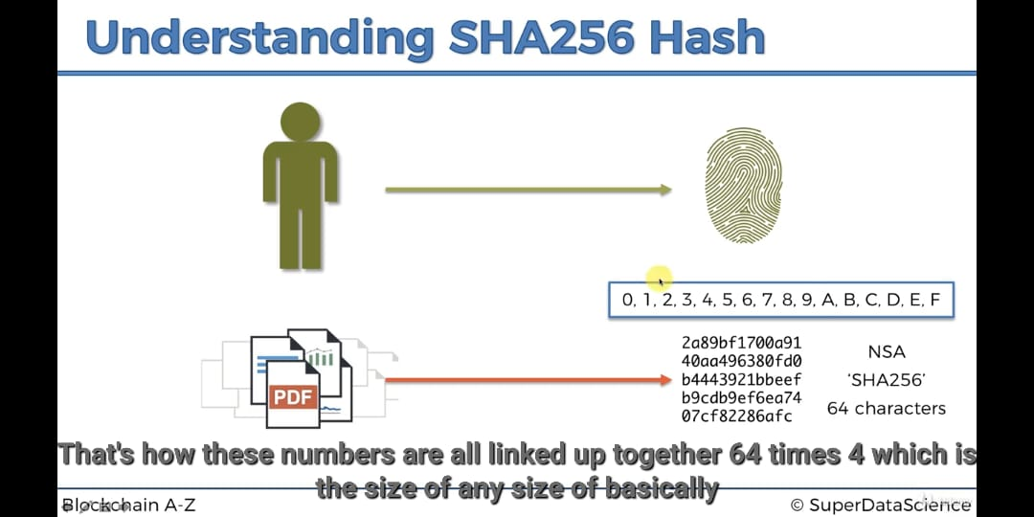

Slide 6
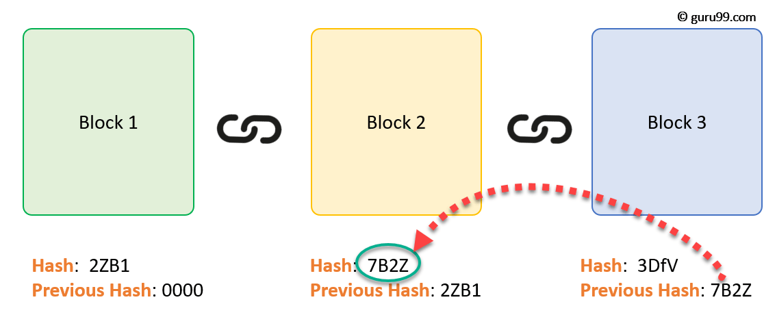
Immutable ledger

Slide 7
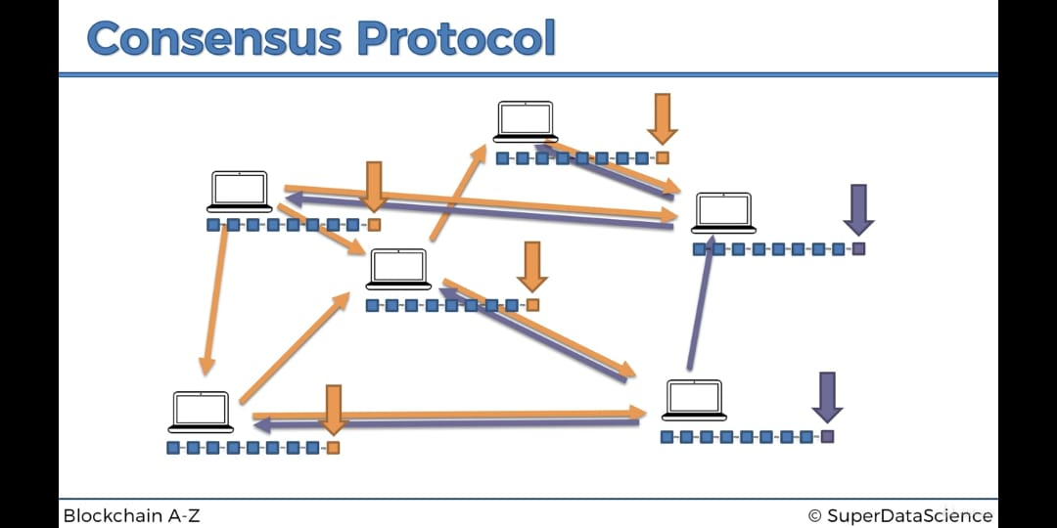

Slide 8
