Slide 1
AMBA Advanced Peripheral Bus (APB) Protocol
Presented by:
Shubham Singh | Aditi Nishad | Mukesh Kumar
Deepika Dasa | Akhila Sunkireddy | Chanakya

Slide 2
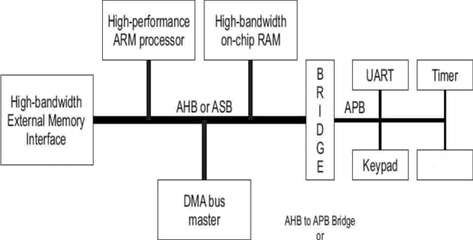
AMBA System-Level View
The AMBA 5.0 protocol defines six buses/interfaces as follows:
1. CHI (Coherent Hub Interface)
Targeted at the interface to the coherent hub found in many of today's SoCs (System on Chips).
2. ACE (AXI Coherency Extensions)
Targeted at high bandwidth, high clock frequency system designs.
3. AXI (Advanced Extensible Interface)
A high performance, flexible protocol.
4. AHB (Advanced High-performance Bus)
Retained for compatibility and to ease the transition.
5. ASB (Advanced System Bus)
No longer actively supported.
6. APB (Advanced Peripheral Bus)
Retained for support of simple, low bandwidth peripherals.

Slide 3
APB Features
3
Low cost interface
Minimal power consumption
Reduce interface complexity
Non pipelined
Ideal for Low Bandwidth peripherals
Every Transfer takes at least two clock cycles
Only one master is allowed

Slide 4
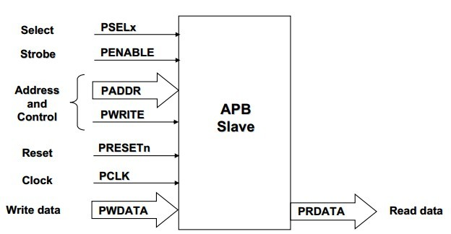
APB Signal Definitions
4
υ
υ
PCLK PRESETn
low)
PADDR PSELx
: the bus clock source (rising-edge triggered)
: the bus (and typically system) reset signal (active
υ
υ
υ
: the APB address bus (can be up to 32-bits wide)
: the select line for each slave device
PENABLE : indicates the 2nd and subsequent cycles of an APB transfer
PWRITE : indicates transfer direction (Write=H, Read=L)
PWDATA : the write data bus (can be up to 32-bits wide)
υ
υ
υ
υ
υ
υ
PREADY : used to extend a transfer
PRDATA : the read data bus (can be up to 32-bits wide)
PSLVERR PPROT
PSLVERR : indicates a transfer error (OKAY=L, ERROR=H) PPROT : indicates the normal, privileged, or secure protection level of the transaction and whether the transaction is a data access or an instruction access.

Slide 5
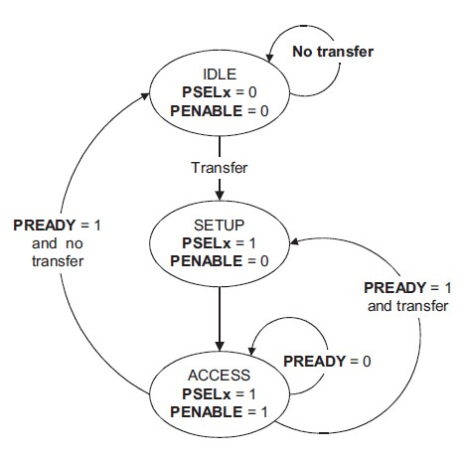
APB State Machine
5
IDLE
Default APB state
SETUP
When transfer required
PSELx is asserted
Only one cycle
ACCESS
PENABLE is asserted
Addr, write, select, and write data remain stable
Stay if PREADY = L
Goto IDLE if PREADY = H and no more data
Goto SETUP is PREADY = H and more data pending
υ
υ
υ

Slide 6
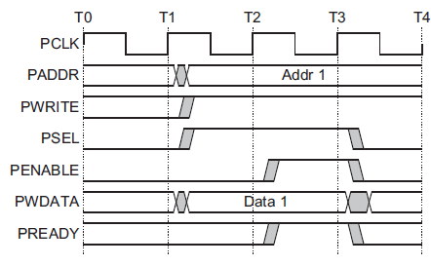

1Write Transfer with no Wait States
SETUP PHASE of the write transfer occurs at T1
PSEL is asserted by Master.
PADDR, PWRITE and PWDATA must be valid.
ACCESS PHASE of the write transfer is at T2
PENABLE is asserted by Master.
PREADY is asserted by the Slave at the rising edge of PCLK to indicate that the write data will be accepted at T3.
PADDR, PWDATA, and any other control signals, must be stable until the transfer completes.
At the end of the transfer,
PENABLE is deaserted.
PSEL is also deaserted, unless there is another transfer to the same peripheral.
6
Setup phase begins with this rising edge
Setup Phase
Access Phase

Slide 7

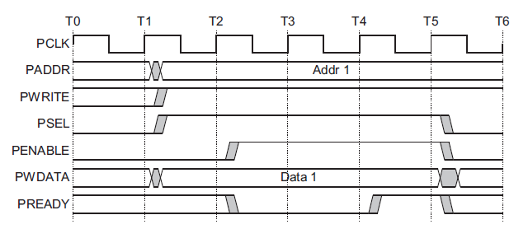
2 Write Transfer with Wait States
SETUP PHASE of the write transfer occurs at T1
PSEL is asserted by Master.
PADDR, PWRITE, and PWDATA must be valid.
ACCESS PHASE of the write transfer is at T2
When PENABLE is HIGH, the Slave extends the transfer by driving PREADY LOW.
The following signals remain unchanged while PREADY remains LOW:
PADDR, PWRITE, PSELx, PENABLE, PWDATA
Write strobe signal, PSTRB
Protection type signal, PPROT
User request attribute, PAUSER
User write data attribute, PWUSER
PREADY can take any value when PENABLE is LOW. This ensures that peripherals that have a fixed two-cycle access can tie PREADY HIGH.
7
Setup phase begins with this rising edge
Setup Phase
Wait State
Wait State
Access Phase

Slide 8

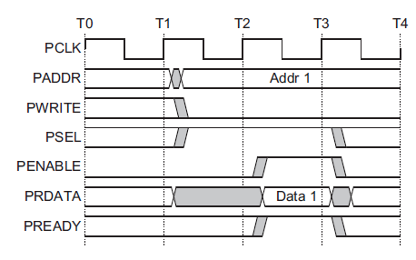
3 Read Transfer with no Wait States
8
Setup Phase of the Write Transfer Occurs at T1
PSEL is asserted by the Master.
PADDR, PWRITE, and PWDATA must be valid.
-----------------------------------------------------------------------
Access Phase of the Read Transfer Occurs at T2.
PENABLE is asserted by the Master.
PREADY is asserted by the Slave at the rising edge of PCLK to indicate that the read data will be provided at T2 and captured by the Master at T3.
PADDR, PWDATA, and any other control signals
must be stable until the transfer completes.
------------------------------------------------------------------------------
The timing of the PADDR, PWRITE, PSEL, and PENABLE signals are the same as described in Write transfers.
The Slave must provide the data before the end of the read transfer.
Setup phase begins with this rising edge
Setup Phase
Access Phase

Slide 9

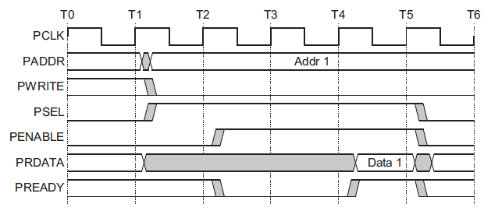
4 Read Transfer with Wait States
9
SETUP PHASE of the Read transfer occurs at T1
PSEL is asserted by Master.- PADDR, PWRITE, and PWDATA must be valid.
ACCESS PHASE of the Read transfer is at T2
The transfer is extended if PREADY is driven LOW during an Access phase.
The following signals remain unchanged while PREADY remains LOW
PADDR, PWRITE, PSEL, PENABLE
Protection signal, PPROT
User signal, PAUSER
Two cycles are added using PREADY.
However, any number of additional cycles can be added.
Setup phase begins with this rising edge
Wait State
Access Phase
Setup Phase
Wait State

Slide 10
Protection unit support
10
To provide protection against illegal transactions. protection is provided by the PPROT[2:0] signals.
Normal or Privileged, PPROT[0]
LOW indicates a normal access, HIGH indicates a privileged access.
Secure or Non-Secure, PPROT[1]
LOW indicates a secure access, HIGH indicates a non-secure access
Data or Instruction, PPROT[2]
LOW indicates a data access, HIGH indicates an instruction access.

Slide 11
Thank you

