Slide 1
Design and implementation of axi-4 memory
Project by Utkarsh kushwaha
Suprith goud
lalith phani kumar p

Slide 2
Introduction
The AXI4 (Advanced eXtensible Interface 4) protocol is part of the ARM AMBA (Advanced Microcontroller Bus Architecture) 4.0 specification. AXI4 is widely used in SoC (System on Chip) design for high-performance, high-frequency system interconnects.
In this project, we will design AXI4 using SystemVerilog and verify its design using UVM(Universal Verification Methodology).

Slide 3
Key Features of AXI4
High Performance: Supports multiple outstanding transactions and out-of-order transaction completion.
High Throughput: Designed for high-frequency operation with minimal pipeline stages.
Low Latency: Efficient transfer of data with minimal delay.
Flexibility: Supports various data widths and burst lengths.
Multiple Transaction Types: Read, write, and various burst types are supported.
Separation of Control and Data: Control and data signals are separated, allowing for efficient data transfer management.

Slide 4
Detailed designed specifications
Data width and Address Space: defines the supported data width and address space for the AXI memory interface,ensuring compatibility and efficiency
Burst Types:
Fixed: The address remains constant for every beat in the burst.
Incremental: The address increments for each beat in the burst.
Wrapped: The address wraps around a specified boundary.
Burst Sizes:
AXI4 supports burst sizes of 1 to 256 beats per burst.

Slide 5
AXI4 Protocol Components
1.Channels: AXI4 uses five channels for communication between the master and the slave:
Read Address Channel: Carries read address information from the master to the slave.
Read Data Channel: Carries read data and response information from the slave to the master.
Write Address Channel: Carries write address information from the master to the slave.
Write Data Channel: Carries write data from the master to the slave.
Write Response Channel: Carries write response information from the slave to the master.

Slide 6
Write address channel
Write Address Overview : Manages the Address phase for write transactions, ensuring the correct address is sent to the memory.
FSM for Write Address Handling: Finite state machine (FSM) controls the sequence of operations ,transaction from idle to address ready states
Address decoding and storage: decodes the address and stores it for subsequent data phases, ensuring accurate data transactions
PINS: awvalid,awready,awid,awlen,awsize ,awaddr,awburst

Slide 7
write data channel
Write Address Overview : Manages the Address phase for write transactions, ensuring the correct address is sent to the memory.
FSM for Write Data Handling: controls the sequence of operations for writing data ,coordinating with write address
Burst Processing: Supports different burst types(fixed,INCR,WRAP) to optimize data transfer efficiency ,particularly in high throughput sytems
PINS: wvalid,wready,wid,wdata,wstrb,wlast

Slide 8
Write response channel
Write Response Overview : Provides feedback to the master after data is written , ensuring correctness and status reporting
FSM for Write response: Manage the sequence of operations in generating and sending write responses , including handling errors
Error detection: Identifies and reports errors in write responses , ensuring reliable communication and data integration
PINS: bready , bvalid, bid, bresp

Slide 9
read address channel
Read Address Overview : handles the address phase for read trasactions ,preparing the memory to send to the master.
FSM for Read Address Handling: Finite state machine (FSM) controls the sequence of operations ,transitioning through states to prepare for data transfer in read transactions
Address decoding: decodes the read address and prepares thee data path for subsequent data phases, ensuring accurate data retrieval
PINS: arready, arid, araddr, arlen, arsize, arburst , arvalid

Slide 10
Read data channel
Data path Overview : Handles the data phase in read transactions, ensuring the correct data is sent to the memory.
FSM for Read Data Handling: controls the sequence of operations for reading data ,coordinating with Read address channel
Burst Processing and Ooptimization: Supports different burst types(fixed,INCR,WRAP) to optimize data retrieval efficiency ,particularly in high throughput sytems
PINS: rid,rdata,rresp,rlast,rvalid,rready

Slide 11
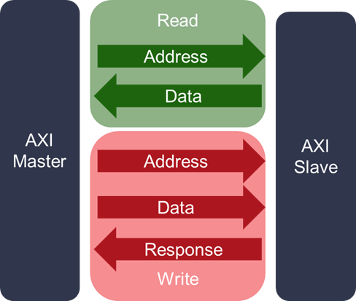

Slide 12
AXI4 Protocol Components
2. Signals: Each channel consists of a set of signals for communication:
Address Signals: Carry the address of the transaction.
Control Signals: Carry control information like burst type, transaction size, and length.
Data Signals: Carry the actual data being transferred.
Handshake Signals: Ensure proper synchronization between the master and the slave using valid and ready signals.

Slide 13
AXI4 Transaction Types
Read Transactions: Initiated by the master to read data from the slave.
The master sends a read address and control information via the read address channel.
The slave responds with the data via the read data channel.
Write Transactions: Initiated by the master to write data to the slave.
The master sends a write address and control information via the write address channel.
The master sends the write data via the write data channel.
The slave sends a write response via the write response channel.

Slide 14
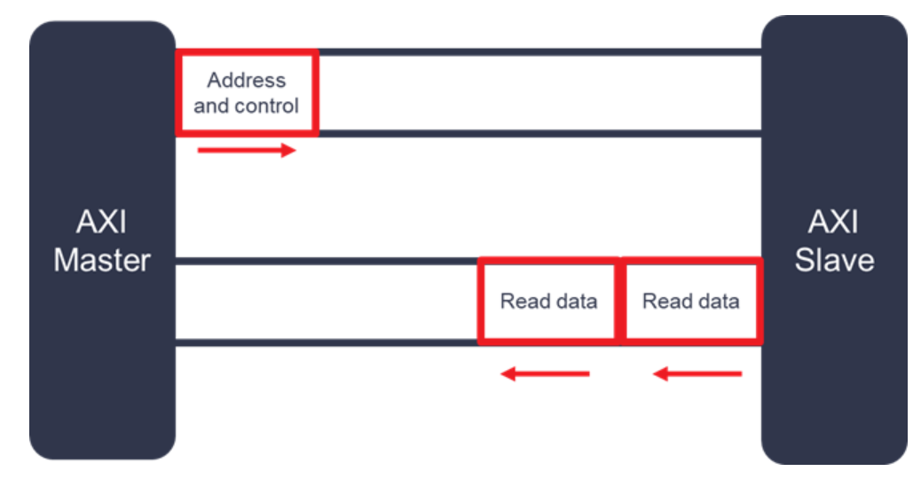
Read transaction

Slide 15
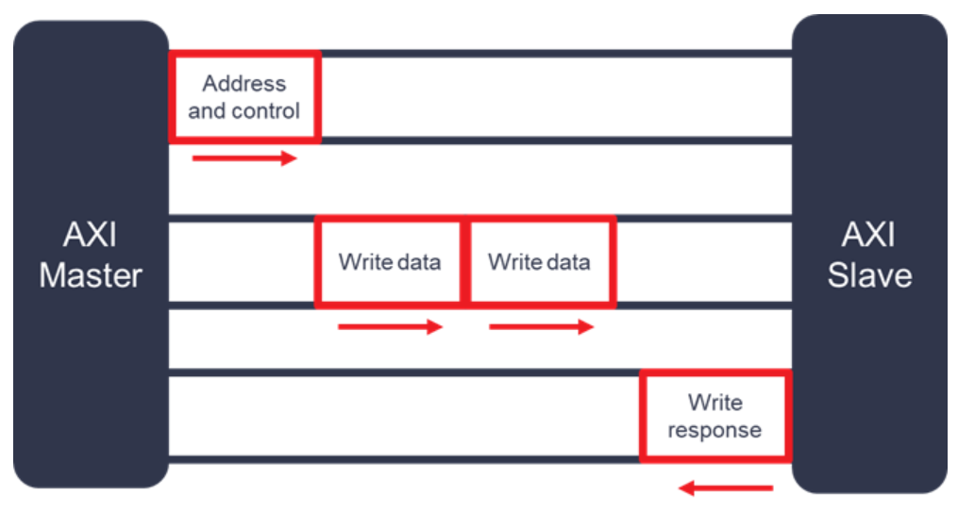
Write Transaction

Slide 16
Burst Types and Sizes
Burst Types:
Fixed: The address remains constant for every beat in the burst.
Incremental: The address increments for each beat in the burst.
Wrapped: The address wraps around a specified boundary.
Burst Sizes:
AXI4 supports burst sizes of 1 to 256 beats per burst.

Slide 17
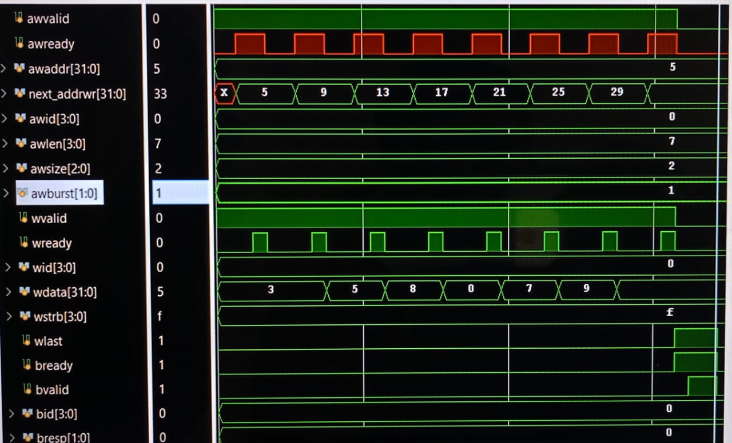
Write transaction

Slide 18
Summary
This waveform outline provides a high-level view of how AXI4 transactions proceed through their respective phases. Understanding these signal interactions is crucial for designing and verifying AXI4-based systems. The precise timing and handshaking ensure reliable communication between master and slave devices in high-performance SoCs.

