Slide 1
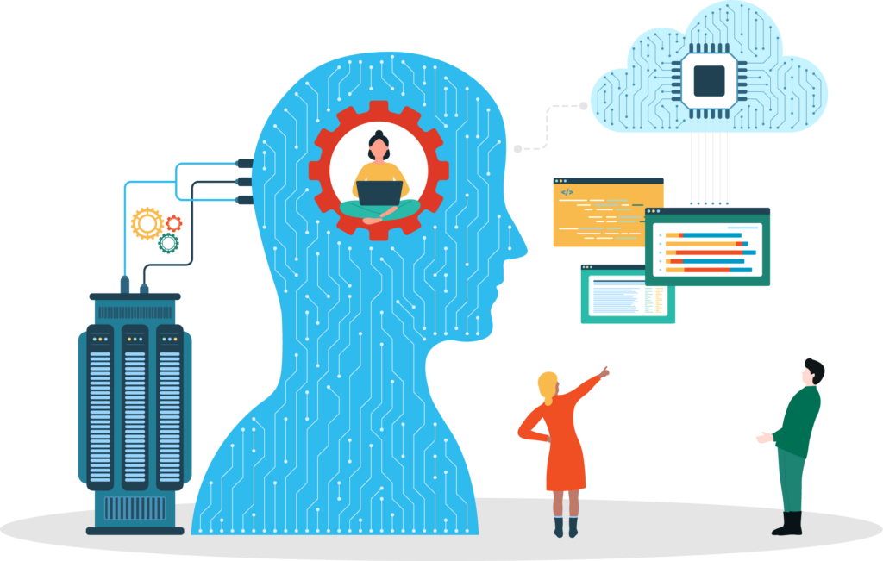
Agenda
Generative AI Core Concepts
LLM Building Blocks
Transformers
RAG
Vector Databases
LangChain
Workshop Overview
Let us build something live!
Follow ups

Slide 2
Generative AI - Core Concepts
LLM Building Blocks
Transformers
Vector Databases
RAG
LangChain

Slide 3
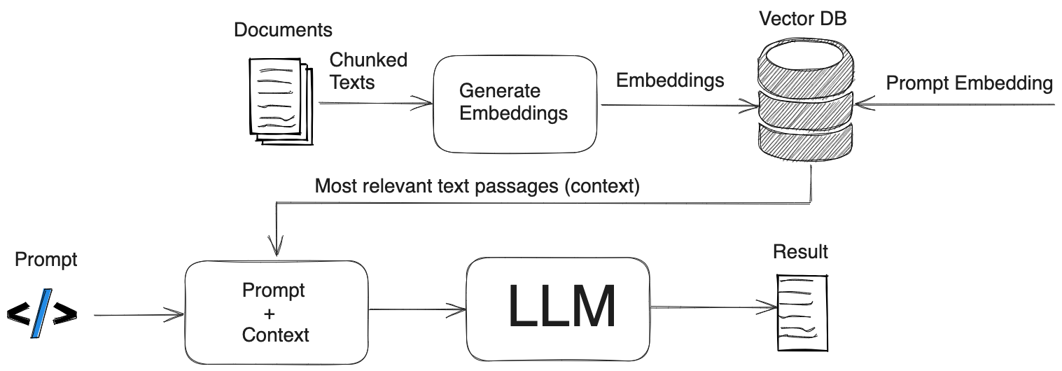
LLM Building Blocks
Tokens
Vectors
Embeddings

Slide 4
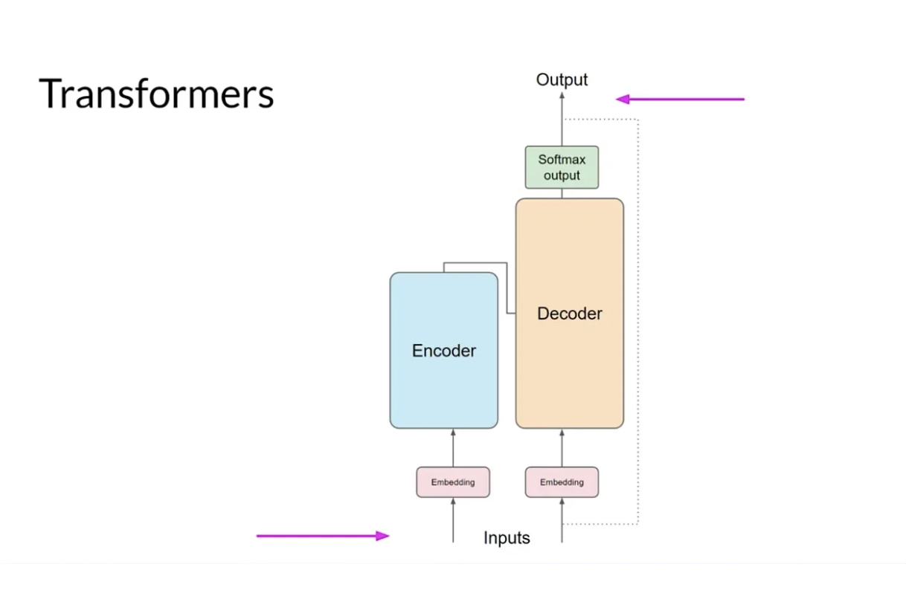
Transformers
Positional Encodings
Attention
Self-Attention
* Image fromhttps://python.plainenglish.io/a-basic-high-level-view-of-transformer-architecture-llms-from-35000-feet-c036dd2f7c25

Slide 5
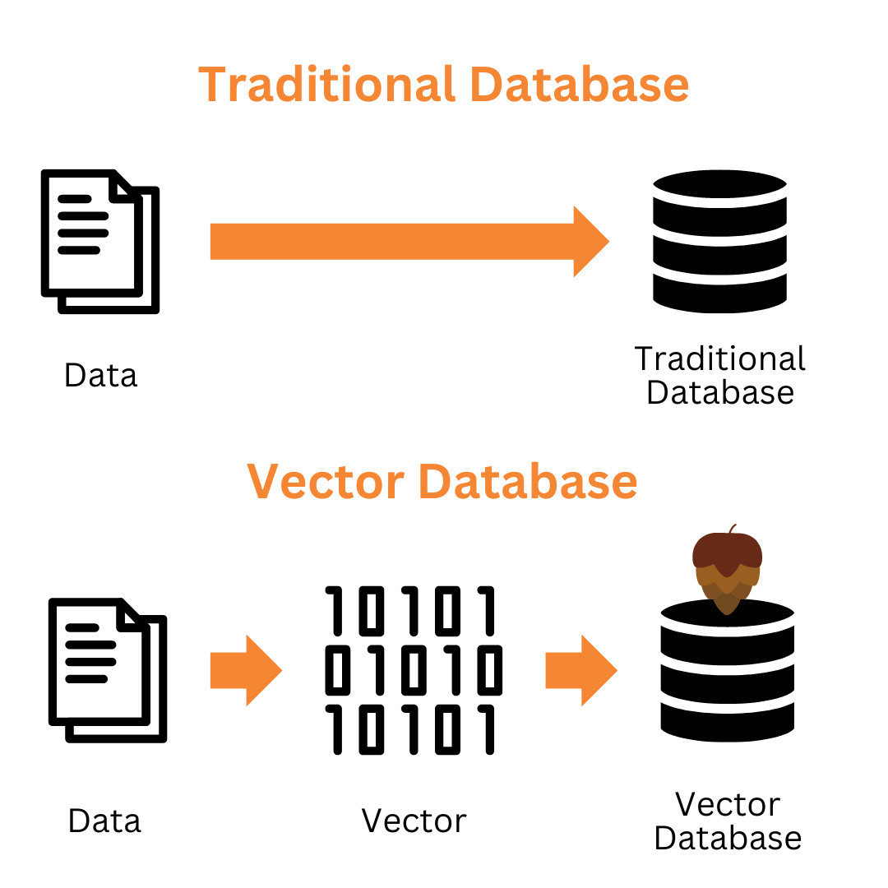
Vector Database
What are Embeddings
How to store
Why use Embeddings?

Slide 6
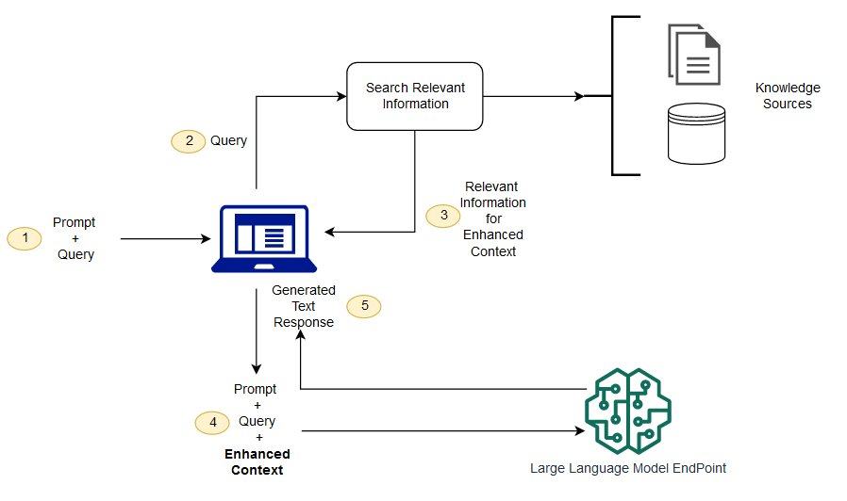
Retrieval Augmented Generation AKA RAG
Custom Knowledge Base
Vector Databases
Retrieval Component
Generation Component
RAG-LLM Combination
RAG-LLM Benefits
* Image from https://docs.aws.amazon.com/sagemaker/latest/dg/jumpstart-foundation-models-customize-rag.html

Slide 7
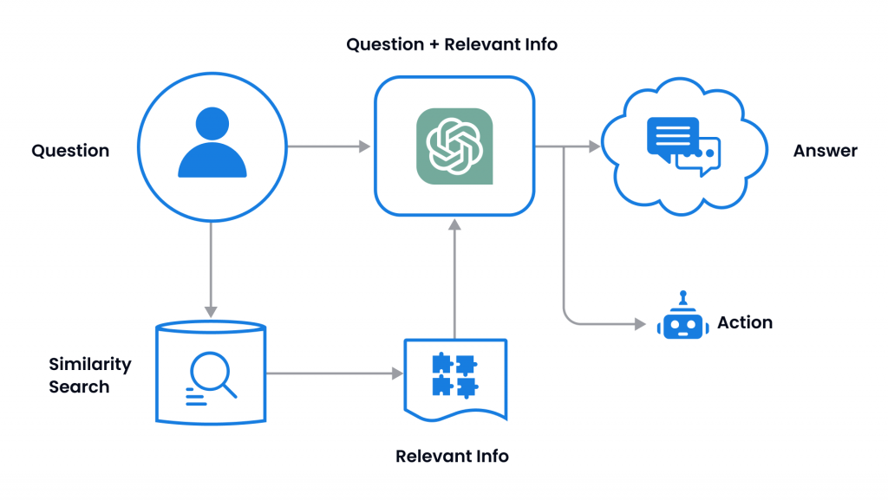
LangChain
Templates
Agents
The Chains

Slide 8
Workshop Overview
Overview: We will build a Q and A application using LLM, RAG and Langchain
Git Repo : https://github.com/coder-lgtm/langchain-demo OR git@github.com:coder-lgtm/langchain-demo.git
Software and tools used:
- Python - Python 3.8
- Open AI API - https://openai.com/api
- Streamlit Python Library - https://streamlit.io/
- LangChain Python Library - https://python.langchain.com/docs/get_started/introduction/
What do you need?
If you want to build this app live then a Laptop with internet connection. This is optional. You can always try this at a later time per your convenience.
Please follow Setup Instructions here https://github.com/coder-lgtm/langchain-demo beforehand.

Slide 9

Let’s Build Something LIVE!!

Slide 10

THANK YOU!
Questions??

