Slide 1

Agenda
AI Core Concepts
Generative AI
LLMs
Prompt Design
Workshop Logistics
Workshop Overview
Let us build something live!
Follow ups

Slide 2
AI - Core Concepts
AI
Machine Learning
Deep Learning
Generative AI
Large Language Models

Slide 3
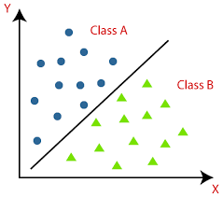
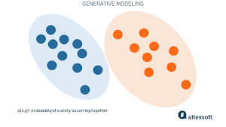
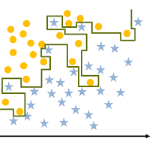
Generative AI
Use of artificial neural networks
Semi Supervised learning
Subset of Deep Learning
Discriminative Models
Generative Models
Generates Natural Language, Image, Videos etc.

Slide 4


Large Language Models
Foundation Models
Trained on massive datasets:
Large Data + Large number of parameters
Pre-trained for general purposes
Fine tuned for specific use-cases
Generates Natural Language, Image, Videos etc.
Draw me a cat dancing on Mars

Slide 5
Prompt Design
Fine tuning
Zero Shot prompts
Few Shot prompts
Prompt Engineering
Prompt tuning

Slide 6

Workshop Logistics
GitHub Repo : git@github.com:coder-lgtm/llm-demo.git
Prerequisites : Follow README.md for the pre-setup
Software and tools used:
- Streamlit Python Library - https://streamlit.io/
- Replicate - https://replicate.com/explore
- Llama2 by Meta -
https://about.fb.com/news/2023/07/llama-2/

Slide 7
Workshop Overview
Build Streamlit based AI powered chat bot
Accept User Input
Integrate with Llama2 Model hosted in Replicate
Explore fine-tuning of a model
Build a new application using the fine-tuned model
Evaluate the performance
Understand the end-to-end workings of the application

Slide 8

Lets Build!

Slide 9
Follow ups
Performance improvements
Use Cases
What’s next?
Q & A

