Slide 1
Computer Vision
An exploration of images, processing techniques, and applications in modern technology.

Slide 2
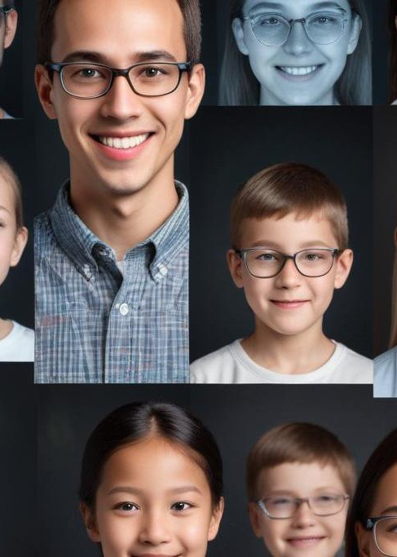
This presentation delves into the fundamentals of computer vision, covering key concepts from image formation to advanced processing techniques. Expect to learn about pixels, brightness, the significance of computer vision, as well as various methodologies utilized in image processing and analysis.

Slide 3
01
Images & Pixels
What are images? How do we represent it?

Slide 4
Definition of Images
Images are visual representations of the world created using light or electronic means. They can be static or dynamic, captured through cameras or generated digitally.

Slide 5
Understanding Pixels
Pixels, or picture elements, are the smallest units of a digital image. Each pixel represents a color in the image. Images are composed of a grid of pixels, and their resolution (width x height) defines the overall image quality. High pixel density results in sharper images.

Slide 6

Brightness and Color
Brightness refers to the luminance of a pixel, influencing how light or dark an image appears. Color in images is typically represented in RGB format, where different intensities of red, green, and blue produce a spectrum of colors. Understanding these concepts is vital for image editing and analysis.
1 RGB
2 HSV represents colors using three components: hue (the type of color), saturation (the intensity or purity of the color), and value (the brightness of the color). This model is often preferred in situations where color perception by humans is considered, such as in image editing software.

Slide 7
02
Computer Vision Applications
Widely used none industry is left untouched

Slide 8
Computer Vision enables machines to interpret and make decisions based on visual data.
It is widely used in various fields, including:
Medical Imaging – Helps in disease detection, X-ray analysis, and MRI scans.
Automated Transport – Used in self-driving cars, drones, and traffic monitoring.
Surveillance & Security – Facial recognition, anomaly detection, and crowd monitoring.
Retail & E-commerce – Virtual try-ons, automated checkouts, and product recognition.
Manufacturing & Quality Control – Detects defects, automates assembly lines.
Agriculture – Monitors crop health, detects diseases, and automates harvesting.
Augmented Reality (AR) & Virtual Reality (VR) – Enhances gaming, training simulations, and interactive applications.
Robotics & Automation – Enables robots to navigate, recognize objects, and interact with the environment.
Allows for real-time analysis and interaction in automated systems and applications.
Continues to evolve with AI & Deep Learning, improving accuracy and efficiency.

Slide 9
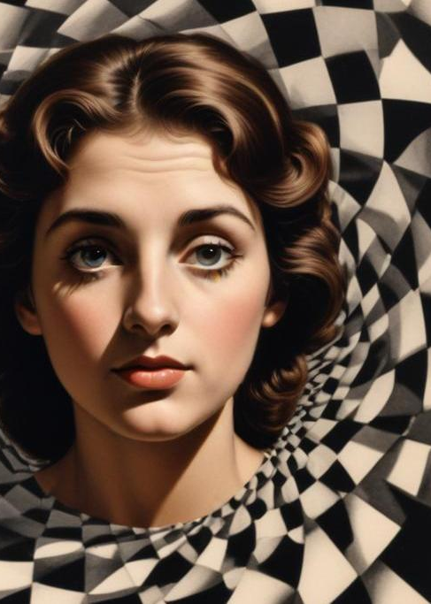
Examples of Optical Illusions
Optical illusions challenge our perception, demonstrating how our brains interpret visual information. Notable examples include Fraser's spiral, the checker’s shadow illusion, and the Donguri waves, each revealing the complexities of visual processing and perception.

Slide 10
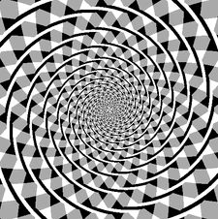
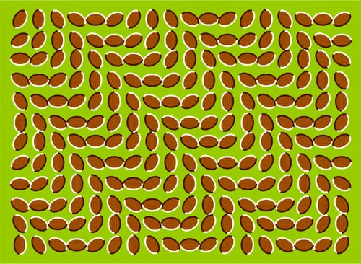

Slide 11
Image Formation Techniques
Image formation can be achieved through various methods such as pinhole cameras, which produce images based on light projection through a small aperture, and lens cameras that utilize lenses to focus light. Understanding perspective projection is also fundamental for grasping how images result from real-world scenes.

Slide 12
03
Image Processing Techniques
There are lot to deal with

Slide 13

Introduction to Noise
Noise refers to unwanted random variations in brightness or color in images that can obscure useful information. Common types of noise include Gaussian, salt-and-pepper, and speckle noise. Understanding noise is critical for improving image quality and accuracy in computer vision applications.

Slide 14
Camera Response Functions
Camera response functions describe how a camera sensor responds to light intensity. These functions can vary by sensor and affect image capture. A linear response produces accurate brightness representation, while nonlinear responses may lead to artifacts or loss of detail in highlights and shadows.

Slide 15
High Dynamic Range
High Dynamic Range (HDR) imaging combines multiple exposures of a scene to capture greater detail in both highlights and shadows. This technique utilizes algorithms to merge images, create a wider tonal range, and enhance overall image quality, making it invaluable in photography and computer vision.

Slide 16
04
Filtering & Detection

Slide 17
Linear Filters Overview
Linear filters, including box and Gaussian filters, manipulate pixel values based on neighboring pixels to reduce noise or achieve smoothing effects. They maintain linearity, meaning that combining inputs yields predictable output. These filters are fundamental in image processing for noise reduction and edge detection.

Slide 18
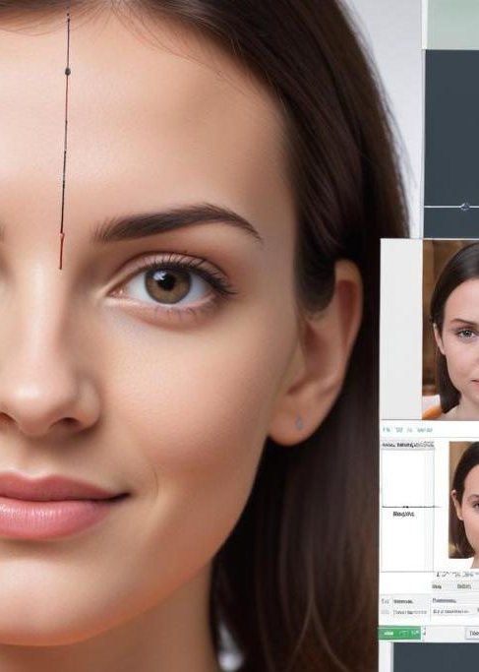
Template Matching Techniques
Template matching is a method used to detect and find the position of a template image within a larger image. This technique utilizes convolution operations, comparing image patches to the template to identify similarities. It's widely used in object recognition and surveillance applications.

Slide 19
Edge Detection Methods
Edge detection methods identify points in an image where brightness changes sharply. Techniques such as Sobel filters and Canny edge detection are focal here. The Sobel operator emphasizes edge features while the Canny method uses a multi-stage process to select strong edges, essential for object detection.

Slide 20
05
Advanced Techniques

Slide 21
Image Stitching Methods
Image stitching involves combining multiple photographs into a single panoramic image. Techniques utilize feature extraction, alignment, and blending to create seamless transitions between images. This is useful in applications like virtual reality, geographic mapping, and digital photography.

Slide 22
RANSAC & Homography
RANSAC (Random Sample Consensus) is an iterative method used to estimate parameters of a mathematical model from observed data that contains outliers. Homography describes the transformation between two images of the same scene. Combining RANSAC with homography facilitates accurate alignment in image stitching and 3D reconstruction.

Slide 23
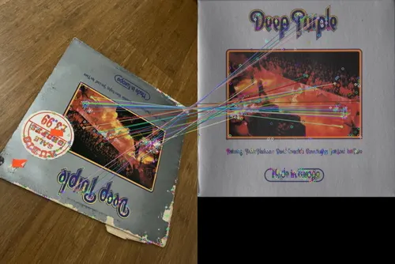
SIFT Detection Applications
SIFT (Scale-Invariant Feature Transform) is a robust algorithm used to detect and describe local features in images. It is effective for object recognition, image stitching, and 3D modeling due to its ability to maintain accuracy under scaling and rotation. SIFT is widely applied in computer vision tasks for feature matching.

Slide 24
Conclusions
In summary, computer vision encompasses various techniques, from noise reduction to advanced feature detection methods like SIFT. These technologies are integral to interpreting and analyzing visual data, enabling advancements in numerous fields such as healthcare, robotics, and augmented reality.

Slide 25
Thank you!
Do you have any questions?
If you have any question or any bt to share you can stay here else go
Thank you!

