Slide 1

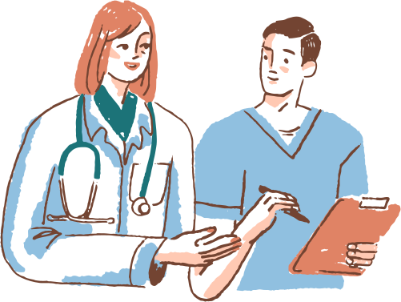

CANCER BIOMARKER DISCOVERY
USING IMAGE PROCESSING
HACKMASTER HACKATHON’23
Group No.20 :
Sampada Khopade
Ram Deshpande
Gauri Dighe
Domain :Healthcare:

Slide 2

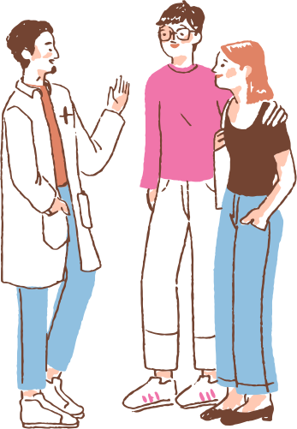

TEAMMATES INFORMATION & INTERCONTRIBUTION
Gauri Dighe :
Created the UI and UX.
Ram Deshpande :
connected the UI to the main code for image processing.
Sampada Khopade :
Developed the code for image Processing.

Slide 3
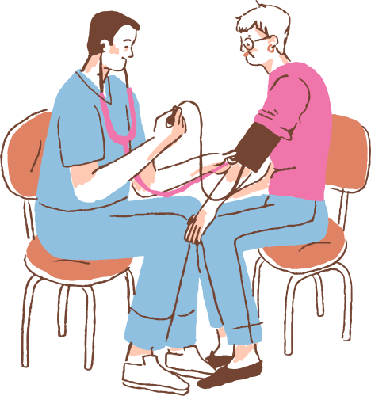
PROBLEM STATEMENT
Developing an image processing-based approach for the discovery of reliable cancer biomarkers from medical images to aid in early and accurate cancer diagnosis.

Slide 4

OBJECTIVES :
Cancer detection and segmentation is one of the most challenging and time-consuming tasks in medical image processing.
MRI (Magnetic Resonance Imaging) is a medical technique, mainly used by radiologists for visualization of the internal structure of the human body without any surgery.
MRI provides plentiful information about human soft tissue, which helps in the diagnosis of cancer.
Accurate segmentation of MRI images is important for the diagnosis of cancer by a computer-aided clinical tool.
Cancer detection helps in finding the exact size and location of cancer.
Firstly, the quality of the scanned image is enhanced, and then morphological operators are applied to detect cancer in the scanned image.

Slide 5

TECHNOLOGIES USED
Python
Jupyter Notebook
OpenCV
scikit-image
Matplotlib
ipywidgets

Slide 6
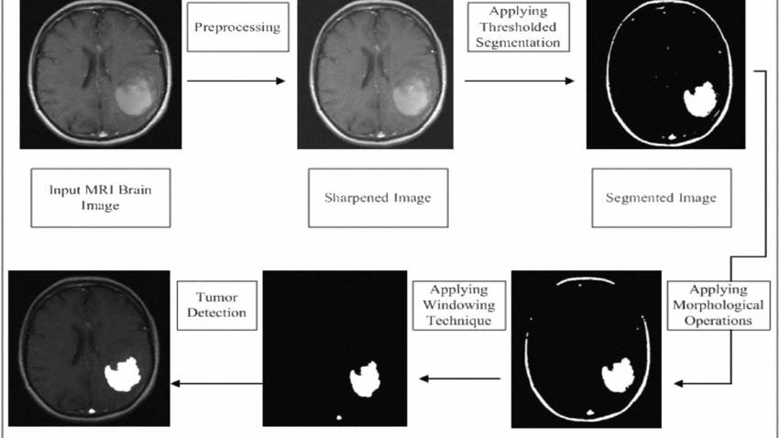

FLOW - CHART :

Slide 7
BRIEF OVERVIEW OF ALGORITHM STEPS
Consistent Image Size:
The algorithm ensures that the image is of a consistent size (256x256 pixels in this case) for uniform processing.
Grayscale Conversion:
The RGB image is converted into a grayscale image, simplifying subsequent processing steps.
Smoothing (Gaussian Blur):
A Gaussian blur is applied to the grayscale image to reduce noise and make the image smoother.
Image Acquisition:
The algorithm starts by acquiring a medical image, which may contain brain scans with potential tumor regions.
Preprocessing:
Unwanted text or noise may be removed from the acquired image.
Image Conversion:
The image is converted into a NumPy array in RGB format to work with it in Python.

Slide 8

Contrast Stretching:
Contrast stretching is performed to enhance the contrast in the image, making features more distinguishable.
Median Filtering for Noise Reduction:
Median filtering is used to reduce noise in the image, particularly in medical images where noise can interfere with analysis.
Segmentation (Simple Thresholding):
The image is segmented using a simple thresholding technique, where pixel values above a certain threshold are
considered part of the region of interest (ROI).
Erosion (Morphological Operation):
Morphological erosion is applied to the segmented image to refine the shape of the detected region and remove any remaining noise.
Tumor Detection (Contour Detection):
Contours of the potential tumor regions are detected in the eroded image using OpenCV's contour detection functions.

Slide 9
Tumor Highlighting on Original Image:
The algorithm highlights the detected tumor contours on the original RGB image, emphasizing the regions of interest.
Display and Results:
The algorithm displays various processed images at different stages, such as grayscale, smoothed, contrast-stretched, median-filtered, segmented, and eroded images.

Slide 10
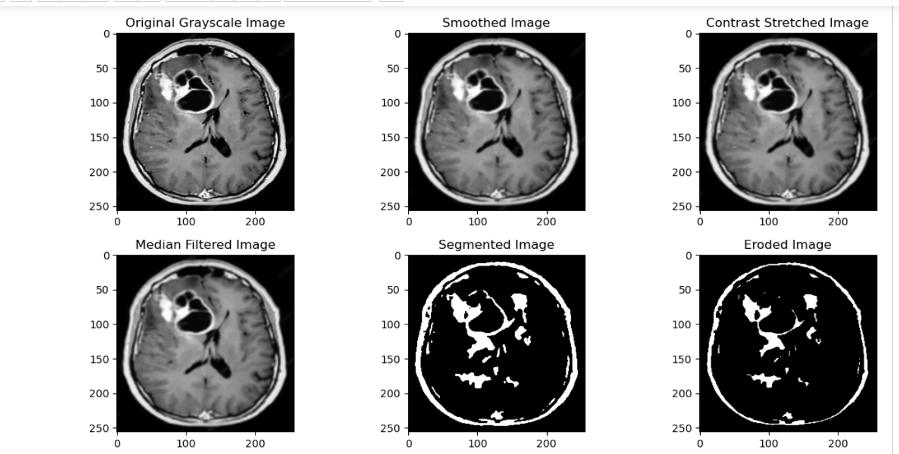
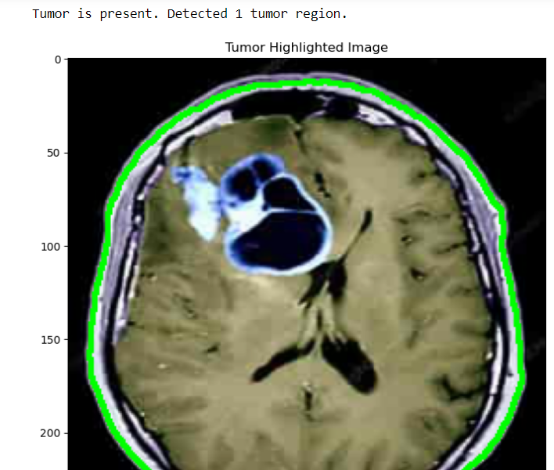

FINAL OUTPUT :

Slide 11
END USERS :
User-Friendly Interface:
The system is designed with a user-friendly interface for ease of use.
Simple Image Upload:
Uploading your medical images is straightforward. Just click the "Upload Image" button and follow the prompts.
Automated Analysis:
The system automates the complex process of cancer detection and segmentation from MRI images.
Quick Results:
You'll receive results quickly, reducing waiting times for diagnosis.

Slide 12
CONCLUSION :
This research was conducted to detect cancer using medical imaging techniques.
The main technique used was segmentation, which is done using a method based on threshold segmentation and morphological operators.
The proposed segmentation method was experimented with MRI scanned images of human bodies: thus locating cancer in the images.
Samples of human bodies were taken, scanned using MRI process, and then were processed through segmentation methods, thus giving efficient end results. This technique gives efficient and reliable results.

Slide 13
FUTURE SCOPE :
The future of using computers to find cancer in medical images has the potential to help doctors find cancer earlier, plan treatments better, and improve how patients do. To make this happen, we need experts from different fields to work together, come up with new ideas, and make sure we use this technology in a fair and responsible way in the fight against cancer.

